Slide 1

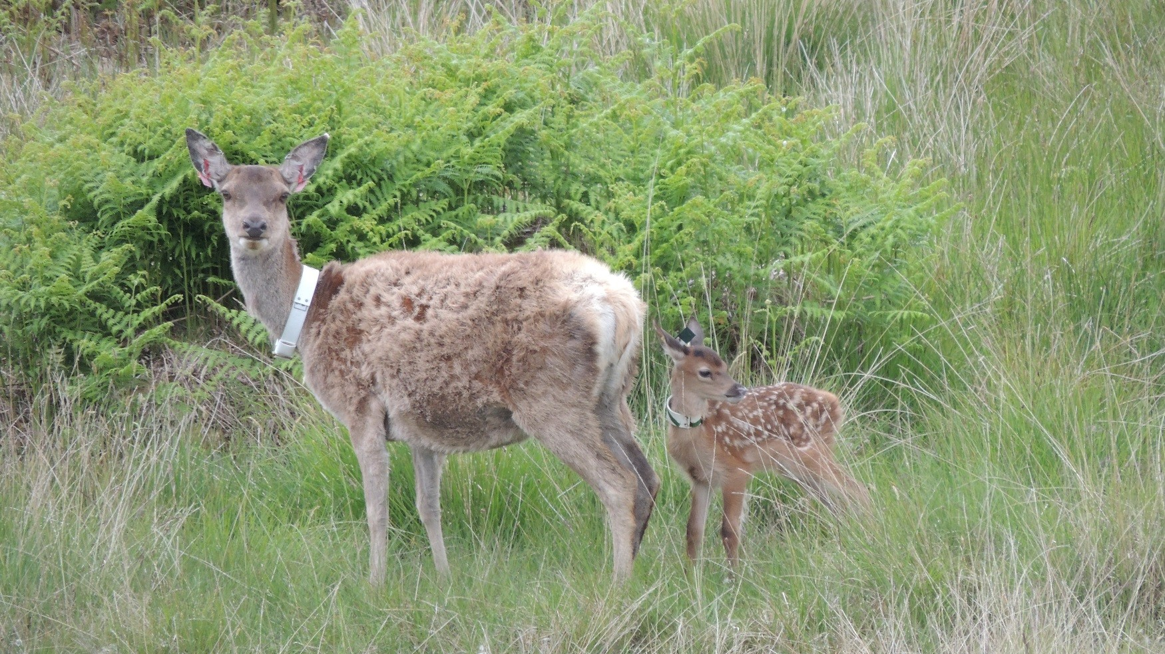
Revisiting Density-Dependent Traits in Red Deer on the Isle of Rum with Extended Data and Enhanced Models
Hayward Wong B141395
Supervised by: Josephine Pemberton, Craig Walling

Slide 2

Background
Notes:
Ecological data is inherently noisy, and models often explain little variance.
There is always a quest to try and explain more variance by improving the precision of predictors.
Despite the difficulties this is necessary to better understand population dynamics

Slide 3
Density dependence
Important part of population dynamics
Regulating population size and growth
Essential for population management
Predict how populations will respond to changes in density

Slide 4
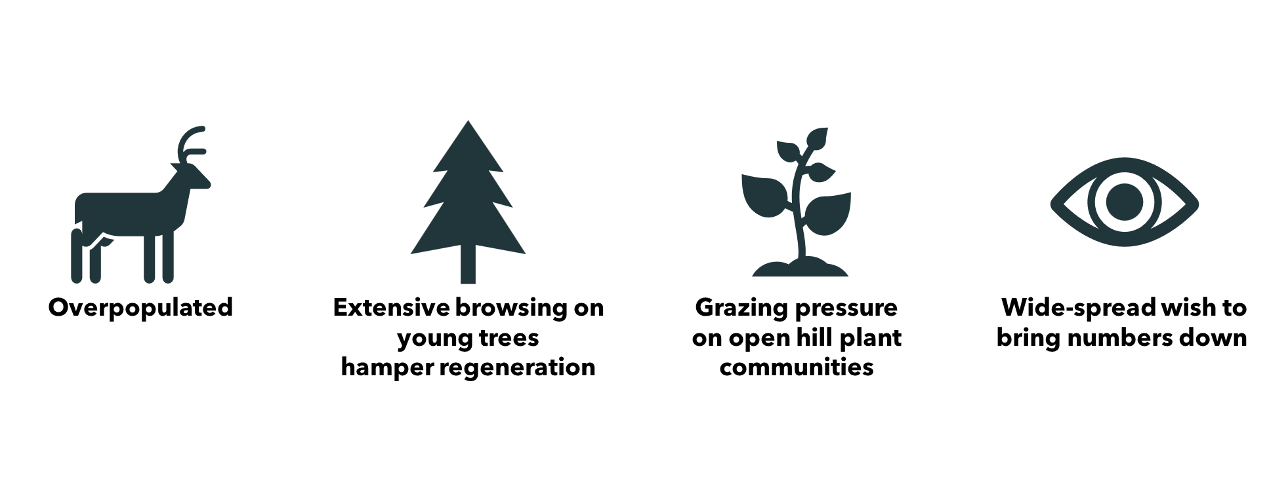
Red Deer in Scotland
Notes:
In Scotland, the overpopulation of red deer presents a significant ecological challenge.
The extinction of wolves in the UK has left red deer without natural predators, allowing their populations to grow substantially if not controlled.
This unchecked growth leads to extensive browsing on young trees, severely hampering forest regeneration.
The heavy grazing pressure exerted by red deer has damaged open hill plant communities, resulting in soil erosion and the loss of native vegetation.
As a result, there is a widespread wish to reduce red deer numbers to restore ecological balance.

Slide 5
Density dependence in Red Deer
Typically investigated by comparing areas of high and low density (Rodriguez-Hidalgo et al. 2010)
Or using estimated density data (Flajšman et al. 2018)
Important to investigate density dependence using populations with high-quality data
Notes:
can be confounded by various factors things that are not independent to density such as differences in habitat quality, climate, food availability, and human disturbance
lack precision due to the reliance on indirect measures, assumptions, and limited sampling.

Slide 6

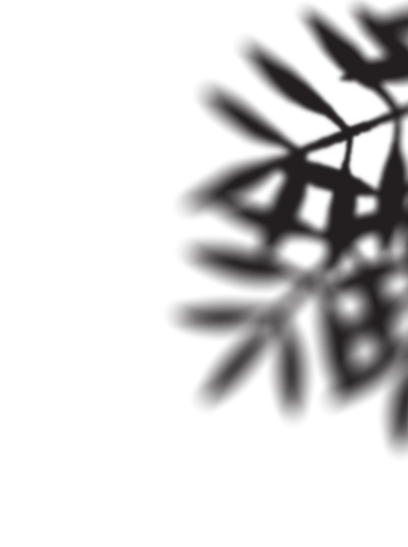
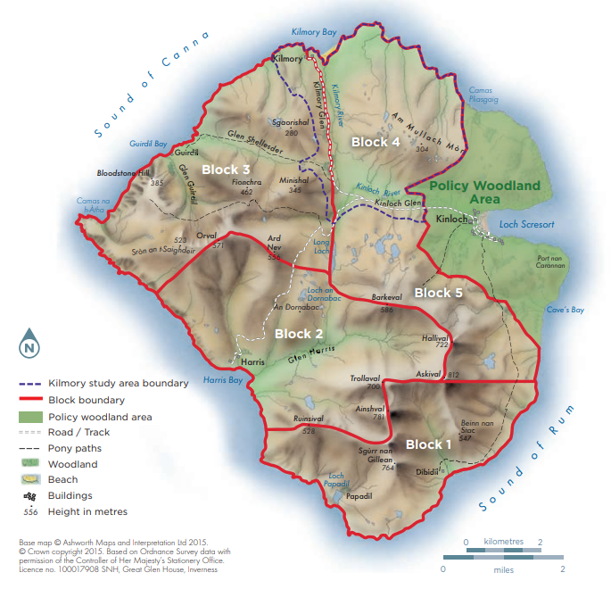
Isle of Rum Red Deer Project
Started in 1972 to present
In the North Block of Isle of Rum, Scotland
All deer identified by Natural markings and artificial tags (n=4300+)
Condition , behaviour, reproduction etc. monitored
Notes:
one of the longest running studies of a large herbivore population
monitor the behaviour, movement, and reproduction of individual deer from birth to death
The geographical isolation of Rum and the cessation of culling since 1973 create a closed system, ideal for studying population dynamics without external influences.

Slide 7
Density dependence on Rum
Earlier work on Rum have documented:
Decrease in many aspects of red deer life history as population density increases
Survival (Clutton-Brock et al. 1987; Coulson et al. 1997)
Reproduction (Albon et al. 1983; Coulson et al. 2000; McLoughlin et al. 2006)
Various growths (Clutton-Brock 1982; Schmidti 2001)
Historically used the number of hinds for density
Stems from early works by Tim Clutton-Brock
Later studies seldom justify this selection

Slide 8
Justification of using hind density
Segregation of sexes in deer (Clutton-Brock et al. 1987)
Hinds and their offspring are more likely to be affected by competition with other hinds and juveniles instead
Therefore, used hind density alone and not a combined (hinds + stags) density for hind or calf traits

Slide 9
Justification of using hind density​
Clutton-Brock tested both hind and combined density as predictors for stag growth and survival​
Found hind density to be a better predictor for stag performance
You might have noticed some issues with that decision already...

Slide 10
Problem of using hind density
Clutton-Brock did not apply the same reasoning for stag traits
If Hinds only competes with hinds, then stags should compete with stags
He only tested hind and combined density for stags, not stag alone
In reality, the two sexes are not fully segregated
Overlooks a substantial part of the population (stags and calves)
who also compete for the same forage supply
struggle to capture the full spectrum of ecological impacts
Notes:
In reality, stags and hinds both use all parts of the study area to varying extents, and both sexes can influence each other's access to resources
struggle to capture the full spectrum of ecological impacts, such as total resource competition

Slide 11
Correlation between different measures of population sizes
Number of resident hinds is not strongly correlated with the number of resident stags or calves
 | Hinds | Stags | Calves | Combined
Hinds | 1.00 | -0.433 | 0.586 | 0.331
Stags | -0.433 | 1.00 | -0.328 | 0.707
Calves | 0.586 | -0.328 | 1.00 | 0.117
Adults | 0.331 | 0.707 | 0.117 | 1.00
Notes:
Number of hinds is not strongly correlated with the rest of the population
In fact their trajectory are quite different over the years

Slide 12
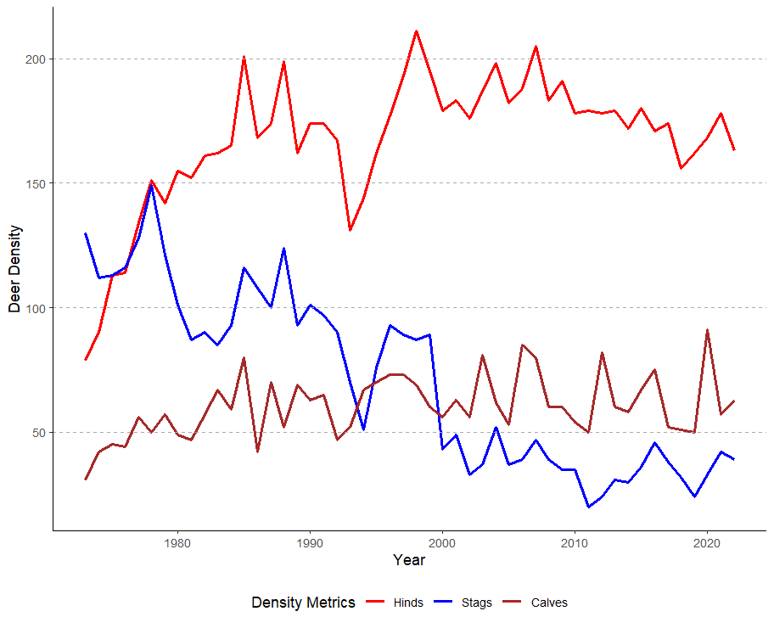
Deer Density
Surge in hind population size after cessation of culling
Reached and fluctuated around carrying capacity for the past 40 years
Stag population continued to decline, possibly due to resource competition
Notes:
Although Previous studies that started in the early 1970s had provided valuable insights on density dependence effects
Based on a relatively short time frame of 13 to 16 years
Characterised by a pronounced surge in hind population size in first decade

Slide 13
Historical Context
Culling in the study area also persisted until 1973
Regular supplementary feeding in the study area from 1968 to 1972
Rarely mentioned in studies on Rum
These management practices might have lingered effect
Coincided with initial years of early work on Rum
Notes:
The earlier work on rum must be contextualised within the broader framework of ecological change and management history.

Slide 14
Temporal Trends(Vickery and Nudds 1984; Woiwod and Hanski 1992; Lande et al. 2006)
Climate variability, changes in resource availability, and management interventions, can introduce trends independent to density
Obscuring the detection of density dependence
Density dependence was detected in 87-91% of aphid series without trends but only in 35-50% with trends (Woiwod and Hanski 1992)
Detected in 67-88% of moths series without trends but only in 43-72% with trends (Woiwod and Hanski 1992)
Notes:
Studies on aphids and moths both detected less density dependence when they account for trends.

Slide 15
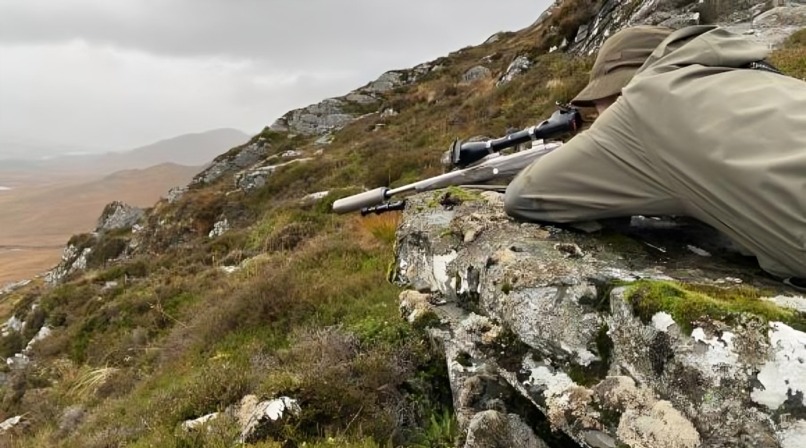
Aims
Notes:
With now a total of 50 years of data, revisiting and reassessing the density-dependent effects on the red deer population on Rum is essential.
The extended dataset provides a more comprehensive understanding of long-term population dynamics, and a chance to enhance predictability of existing models.
in an environment free from the immediate effects of past interventions. I will be using data after 1973 to 2022, so 50 years of data after all management ceased.

Slide 16
Research Questions
What density measure is the most predictive?
Does it make a difference to fit year as a fixed effect?
were there temporal trends existing independent of density?
Notes:
The overarching aim of this study is to enhance predictors for deer life-history traits.
Therefore, the goal is solely to detrend any potential temporal changes,
not to investigate the underlying causes of these trends, whether they be climate-related or other causes.
Determining the causes of temporal trends requires further studies and additional time
which is beyond the scope of this project.

Slide 17

Methods

Slide 18
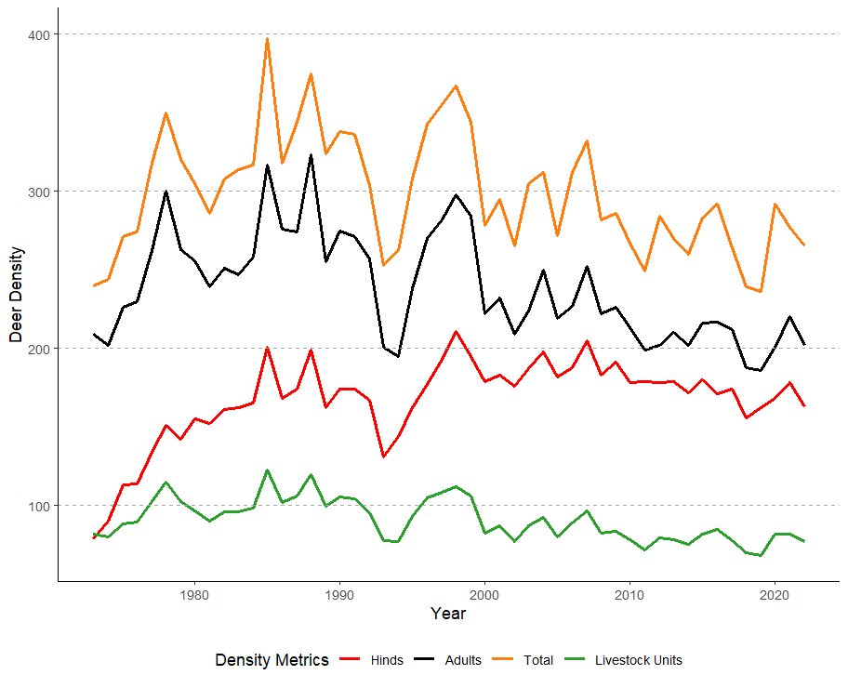
Density Measures Tested
Hinds
Adults
(Hinds + Stags)
Total
(Hinds + Stags + Calves)
Total Livestock Units
Hinds (0.3)
+ Stags (0.4)
+ Calves (0.2)
Notes:
Livestock units is the proportional food consumption of all residents
standardised to 1 unit equaling the food intake of one cattle

Slide 19
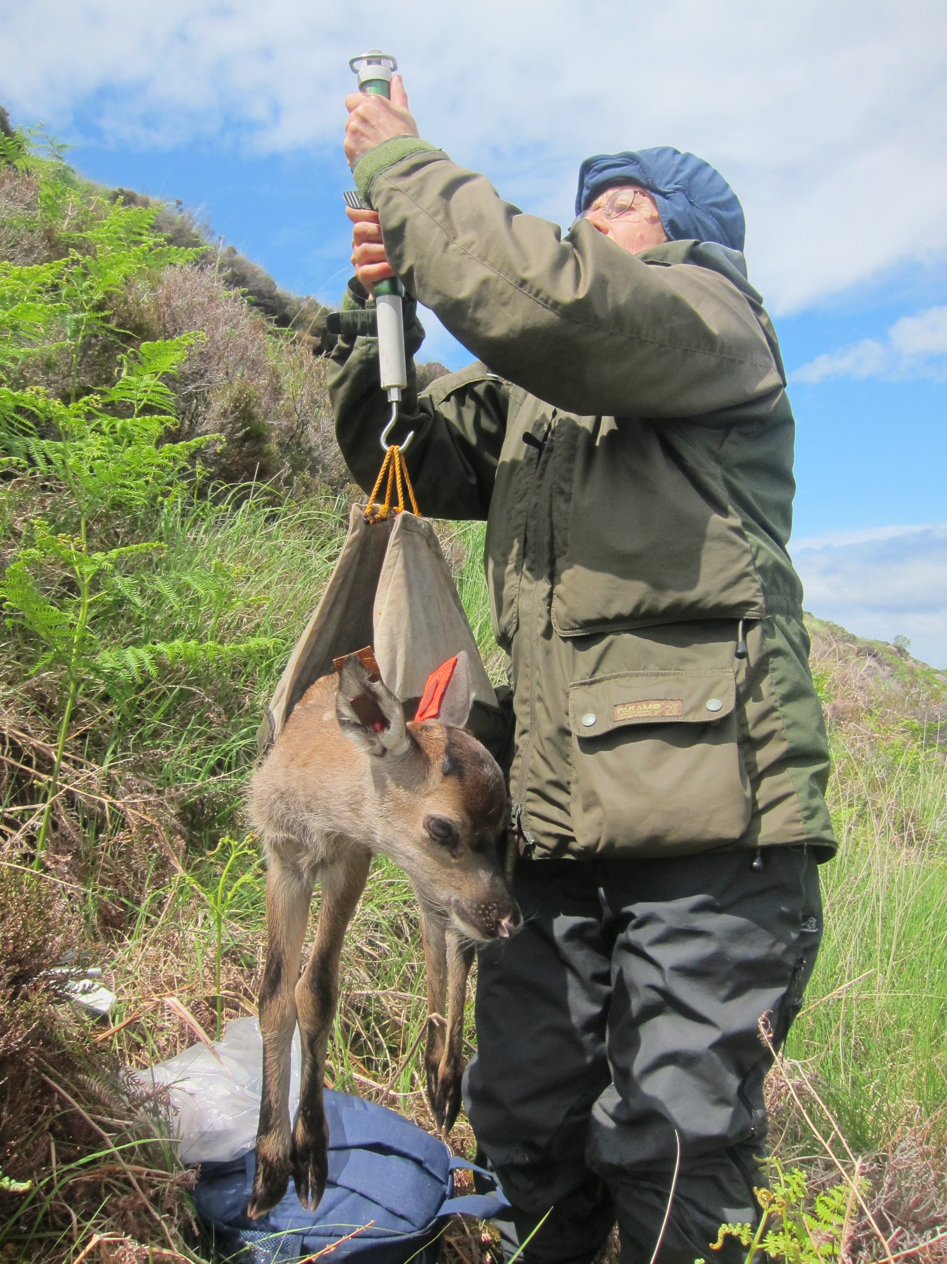
Life-History Traits Investigated
Fecundity (Hinds)
Birth Weight (Calves)
First Winter Survival (Calves)
Yearling Spike Length (Male Calves)
Notes:
The traits I used follow the life-history of a deer
Going from birth weight, a trait that never found related to density
To traits that people had found density effect
Covering both male and female, juveniles and adults
Moreover, they're on animals that almost never leave the study area
So we can be sure they're affected only by resource competition within the study area

Slide 20
Temporal Detrending
With or Without Year as a fixed effect
captures systematic trends over time
Year as a random effect
captures random variability around these fixed trends
acknowledging unique yearly factors
Notes:
Use Year as a fixed effect captures systematic trends over time,
such as gradual environmental changes or long-term shifts in population dynamics.
Year as a random effect captures random variability around these fixed trends,
acknowledging unique yearly factors like specific management interventions, or impacts of climate change.

Slide 21
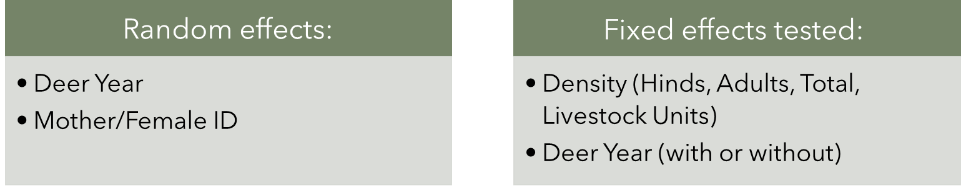
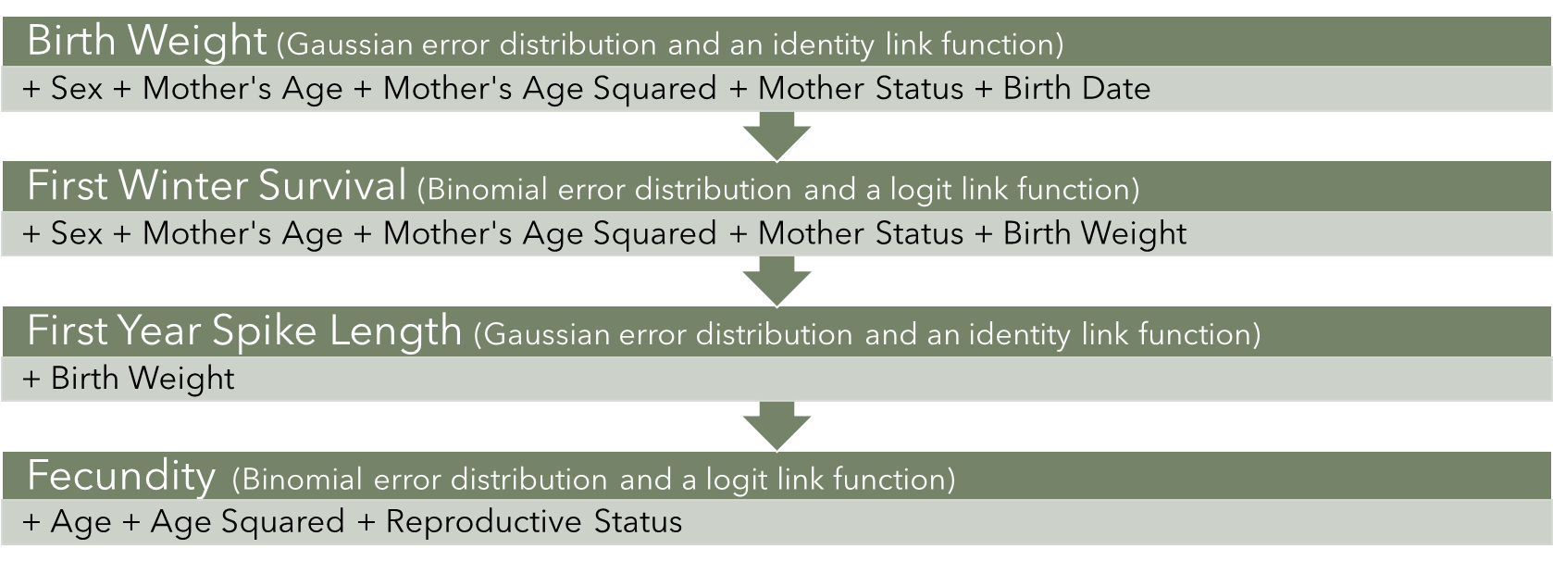
Generalised Linear Mixed Models using glmmTMB()
Notes:
These are the terms I have used for each of the traits
They were previously found significant to the particular trait

Slide 22
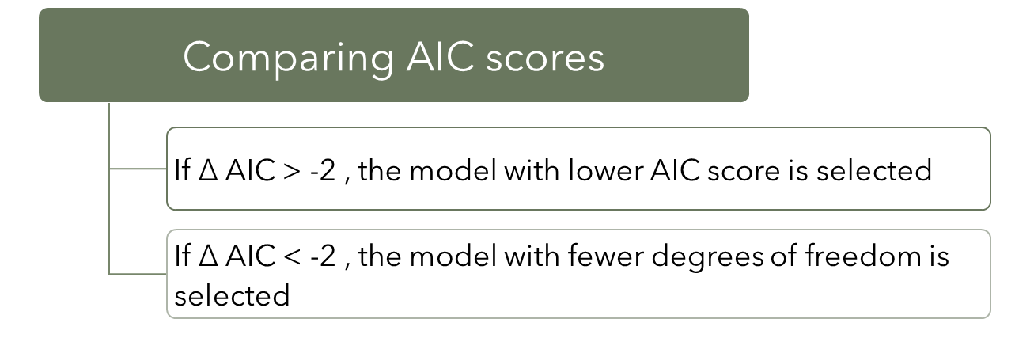
Model Selection Criteria
To avoid overfitting and to maintain model simplicity

Slide 23
Results

Slide 24
Birth Weight
glmmTMB(BirthWt~Adults +Sex +DaysFrom1May +MumAge +MumAgeSquared +MotherStatus +(1|DeerYear) +(1|MumCode), family = gaussian())
Models | AIC
No Deer Year No Density 0 d.f. | 9245.0
Deer Year (No Density) 1 d.f. | +1.9
Hinds (No Deer Year) 1 d.f. | -337.2
Hinds + Deer Year 2 d.f. | -335.8
Adults (No Deer Year) 1 d.f. | -337.3 ***
Adults + Deer Year 2 d.f. | -335.3
Total (No Deer Year) 1 d.f. | -337.1
Total + Deer Year 2 d.f. | -335.2
Livestock Units (No Deer Year) 1 d.f. | -337.2
Livestock Units + Deer Year 2 d.f. | -335.2
(n=3,082)
Best Model:
Adult Density
Without Deer Year
AIC: 8907.7
Density Effect Size:
-0.000823 (p = 0.544)

Slide 25
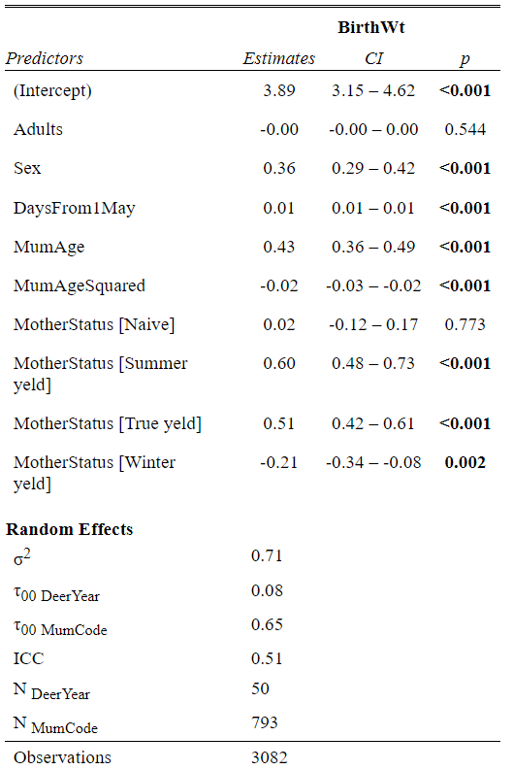
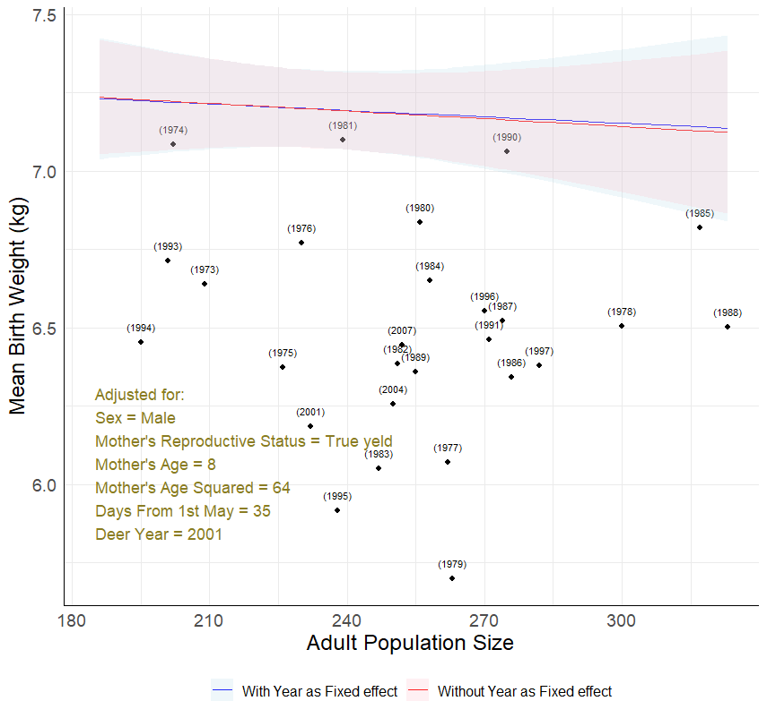

Slide 26
First Winter Survival
glmmTMB(FWSurvival~Adults+Sex+MotherStatus+MumAge+MumAgeSquared+BirthWt+(1|DeerYear)+(1|MumCode),family = binomial)
Models | AIC
No Deer Year No Density 0 d.f. | 2372.6
Deer Year (No Density) 1 d.f. | +0
Hinds (No Deer Year) 1 d.f. | -2.7 ***
Hinds + Deer Year 2 d.f. | -0.8
Adults (No Deer Year) 1 d.f. | +1.4
Adults + Deer Year 2 d.f. | -1.4
Total (No Deer Year) 1 d.f. | +1.8
Total + Deer Year 2 d.f. | +0.9
Livestock Units (No Deer Year) 1 d.f. | +2.0
Livestock Units + Deer Year 2 d.f. | +0.2
(n=2,241)
Best Model:
Hind Density
Without Deer Year
AIC: 2369.9
Density Effect Size:
-0.0159 (p = 0.0288)

Slide 27
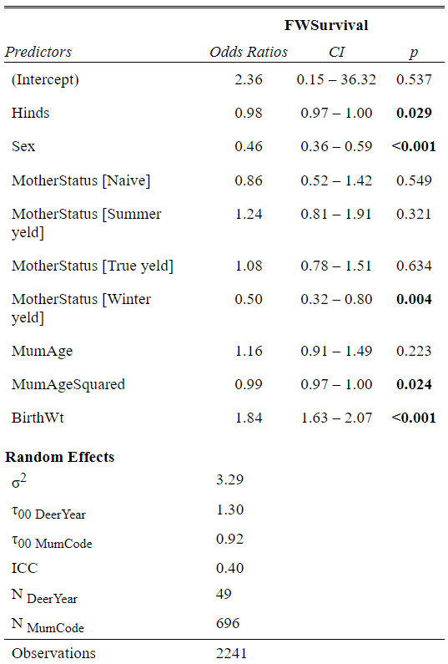
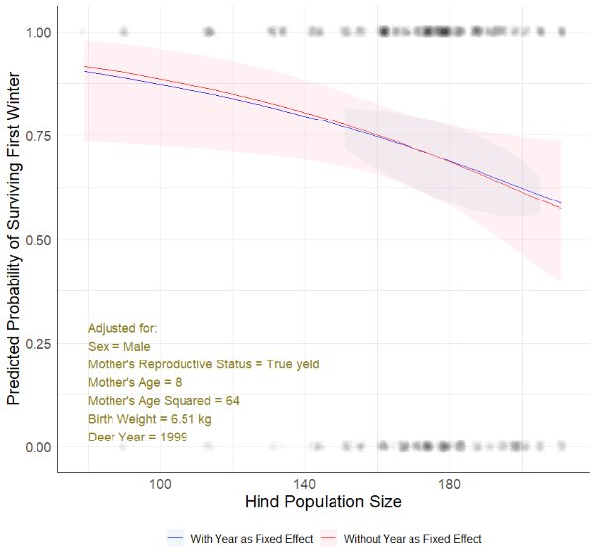
Notes:
FWS with year as fixed effect failed to converge

Slide 28
Yearling Spike Length
glmmTMB(AvgSpike~BirthWt+DeerYear+(1|DeerYear)+(1|MumCode), family = gaussian())
Models | AIC
No Deer Year No Density 0 d.f. | 2688.0
Deer Year (No Density) 1 d.f. | -14.6 ***
Hinds (No Deer Year) 1 d.f. | -6.3
Hinds + Deer Year 2 d.f. | -13.5
Adults (No Deer Year) 1 d.f. | +1.5
Adults + Deer Year 2 d.f. | -14.8
Total (No Deer Year) 1 d.f. | +2.0
Total + Deer Year 2 d.f. | -13.9
Livestock Units (No Deer Year) 1 d.f. | +0.9
Livestock Units + Deer Year 2 d.f. | -14.4
(n=607)
Best Model:
Without Density
With Deer Year
AIC: 2673.4
Deer Year Effect Size:
+0.345 (p = 6.15e-06)
Models with Deer Year performs better in general

Slide 29
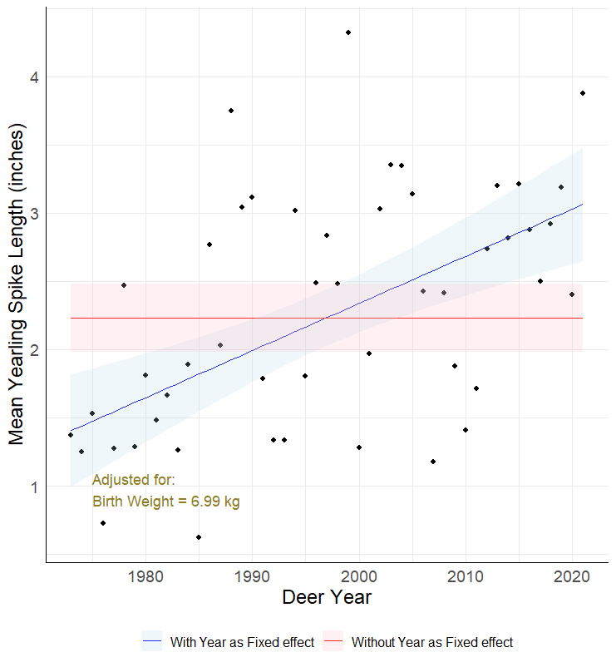
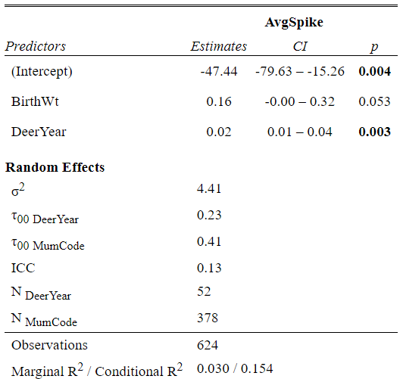

Slide 30
Fecundity
glmmTMB(Fecundity~Hinds+Age+AgeSquared+ReprodStatus+(1|DeerYear)+(1|Female),family = binomial(link = "logit"))
Models | AIC
No Deer Year No Density 0 d.f. | 6447.0
Deer Year (No Density) 1 d.f. | -3.7
Hinds (No Deer Year) 1 d.f. | -91.2 ***
Hinds + Deer Year 2 d.f. | -90
Adults (No Deer Year) 1 d.f. | -72.2
Adults + Deer Year 2 d.f. | -82
Total (No Deer Year) 1 d.f. | -72.5
Total + Deer Year 2 d.f. | -77.9
Livestock Units (No Deer Year) 1 d.f. | -69.8
Livestock Units + Deer Year 2 d.f. | -77.6
Yearly Fecundity (n=6,053) of Hinds (n=917)
Best Model:
Hind Density
Without Deer Year
AIC: 6355.8
Density Effect Size:
-0.0183 (p = 2.26e-07)

Slide 31
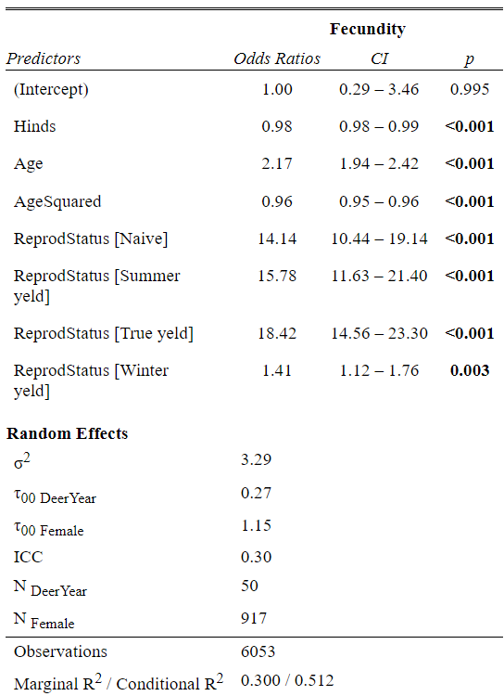
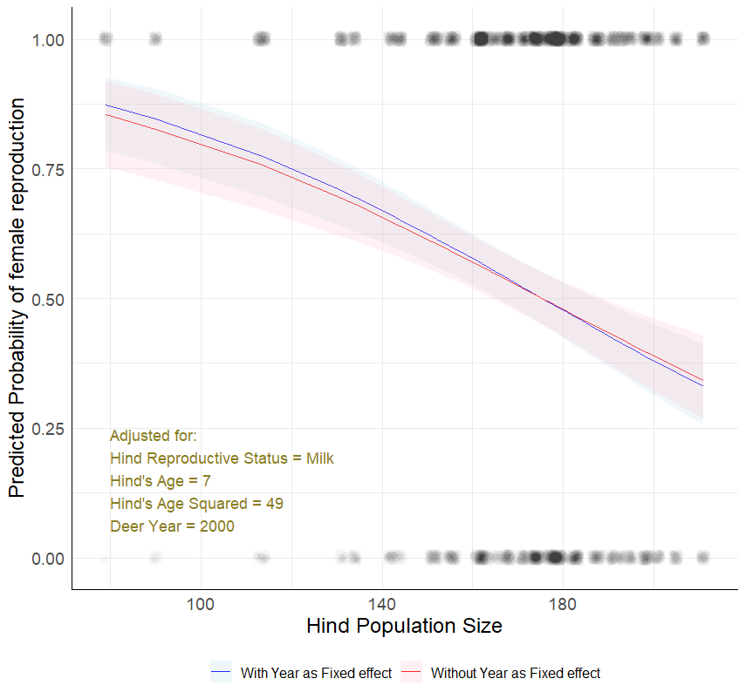
Notes:
Different reproductive status have varying effects and when plot as an interaction provided even lower AIC vaues.
Work is still on going but it will be in my thesis

Slide 32
Discussion & Conclusion

Slide 33
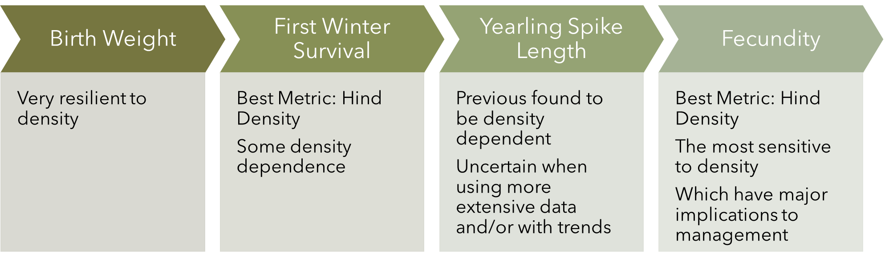
Density dependence
Notes:
Hind density was the best predictor when density dependence are observed
These are traits on Hinds and Calves though,
Clutton-Brock is right when he said females and juveniles are more likely to be affected by competition with other hinds and juveniles
But Hind density is not a great predictor for spike length which is a male trait.
In fact spike is not density dependent

Slide 34
Deer Year as a Fixed Effect
Only improved the model fit for Yearling Spike Length
Not applicable to all traits
For Birth Weight, First Winter Survival, Fecundity
Temporal trends did not have a substantial effect
Density models with year as a random effect are sufficient
Notes:
, and the original models with year as a random effect were sufficient for capturing the relevant variations

Slide 35

Implications to Management
Fecundity is the most sensitive to density
Indiscriminate culling is not the solution
Counterproductive rebound effect
Over-culling can be just as detrimental
Maintain a level where density-dependent fecundity does not lead to a rapid rebound
Notes:
Over-culling can be just as detrimental as under-culling, leading to ecological imbalances and unintended consequences for other species and the habitat

Slide 36
References
Albon, S. D., B. Mitchell, and B. W. Staines. 1983. Fertility And Body Weight In Female Red Deer - A Density-Dependent Relationship. Journal Of Animal Ecology 52:969-980.
Clutton-Brock, T. H., M. Major, S. D. Albon, and F. E. Guinness. 1987. Early Development And Population Dynamics In Red Deer .1. Density-Dependent Effects On Juvenile Survival. Journal Of Animal Ecology
Clutton-Brock, T. H., S. D. Albon, and F. E. Guinness. 1987. Interactions Between Population-Density And Maternal Characteristics Affecting Fecundity And Juvenile Survival In Red Deer. Journal Of Animal Ecology 56:857-871.
Clutton-Brock, T. H., G. R. Iason, and F. E. Guinness. 1987. Sexual Segregation And Density-Related Changes In Habitat Use In Male And Female Red Deer (Cervus-Elaphus). Journal Of Zoology 211:275-289.
Coulson, T., E. J. Milner-Gulland, and T. Clutton-Brock. 2000. The relative roles of density and climatic variation on population dynamics and fecundity rates in three contrasting ungulate species. Proceedings Of The Royal Society Of London Series B-Biological Sciences 267:1771-1779.
Coulson, T., S. Albon, F. Guinness, J. Pemberton, and T. CluttonBrock. 1997. Population substructure, local density, and calf winter survival in red deer (Cervus elaphus). Ecology 78:852-863.
Hanski, I., & Woiwod, I. P. (1993). Spatial synchrony in the dynamics of moth and aphid populations. Journal of Animal Ecology, 656-668.
Lande, R., S. Engen, B. E. Saether, and T. Coulson. 2006. Estimating density dependence from time series of population age structure. American Naturalist 168:76-87.
McLoughlin, P. D., M. S. Boyce, T. Coulson, and T. Clutton-Brock. 2006. Lifetime reproductive success and density-dependent, multi-variable resource selection. Proceedings of the Royal Society B-Biological Sciences 273:1449-1454.
Schmidt, K. T., A. Stien, S. D. Albon, and F. E. Guinness. 2001. Antler length of yearling red deer is determined by population density, weather and early life-history. Oecologia 127:191-197.
Vickery, W. L., & Nudds, T. D. (1984). Detection of density‐dependent effects in annual duck censuses. Ecology, 65(1), 96-104.

Slide 37
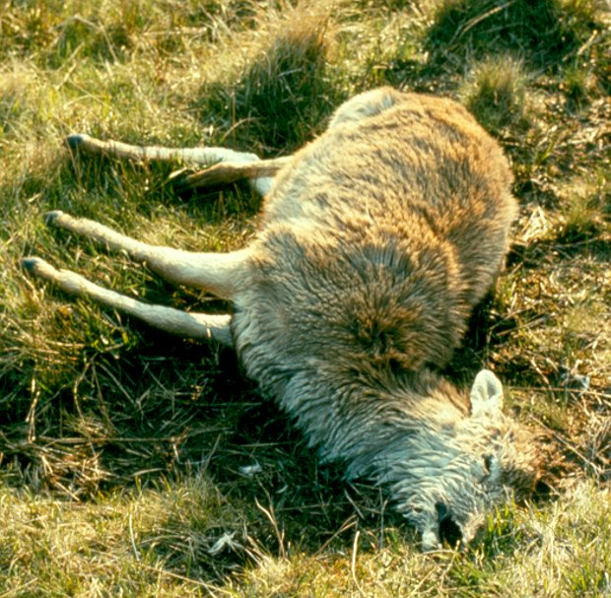
The End
Notes:
Just remember If you are also struggling to finish your thesis, at least you are not a red deer calf facing its first winter

Slide 38

Questions?

