Slide 1
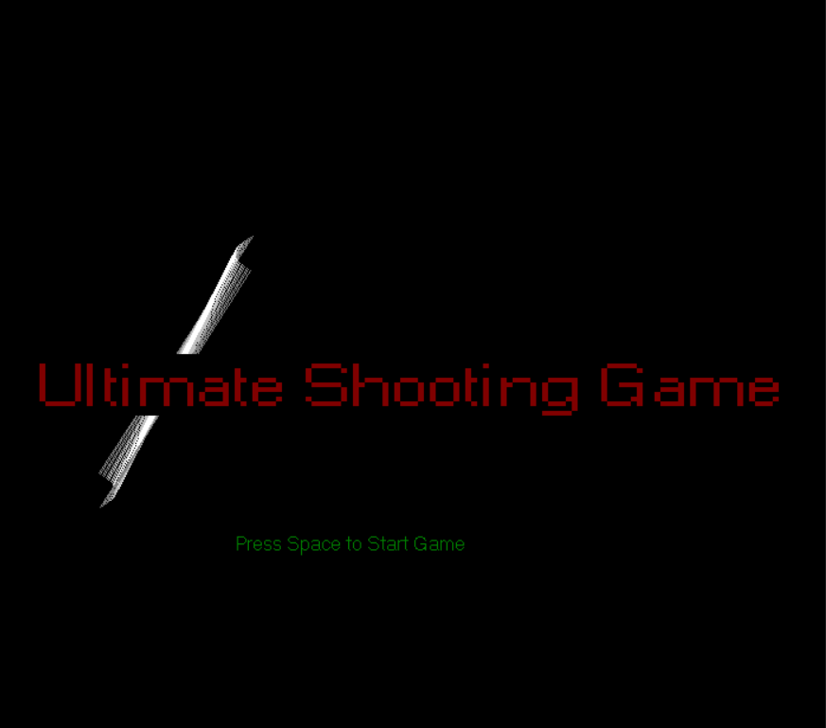

Slide 2
Objects In Game
Falling of Bombs
Target (Circles)
Tank

Slide 3
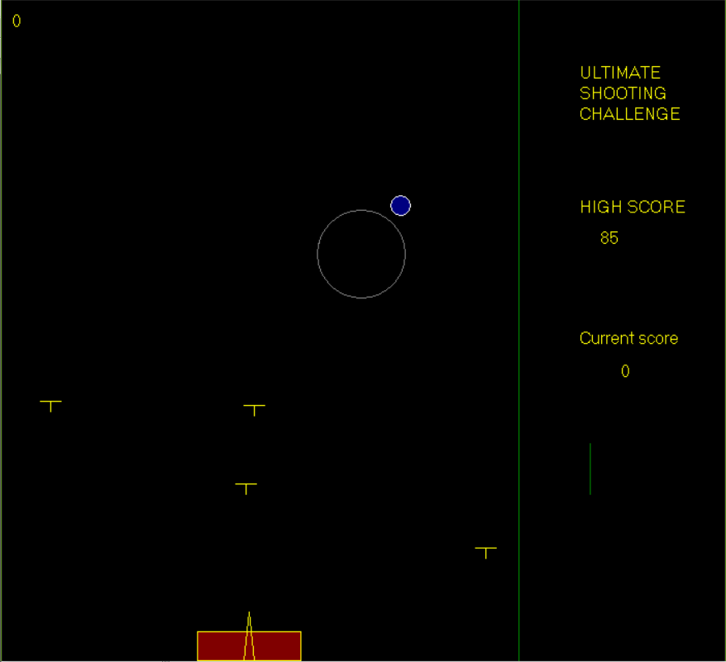
Falling of Bullets
Bullets are the real enemy of the Tank
Bullets are randomly falling from above
The Path followed by bullet is straight from up to down
Tank’s health reduces, when bullet hits the Tank
The speed of the bullets increase if Player became pro

Slide 4
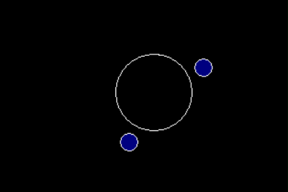
Target (Circle)
Target is generated randomly on screen.
Size of target decrease continuously and disappear.
Tank have to shoot the target.
To protect target, obstacles move around the target.

Slide 5
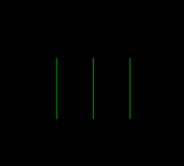
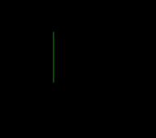
Life can be represented by Vertical Green Lines.
If target disappear, then life decreases.
If 3 targets missed then Game Over.

Slide 6
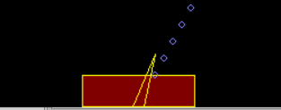
Tank
Tank moves horizontally.
Tank have a shooter, to shoot the bullets in any direction.
Shooter can be rotate in any direction.
Tank shoots bullet to destroyed the target.
Tank’s health is shown by red colour, filled inside the tank.

Slide 7
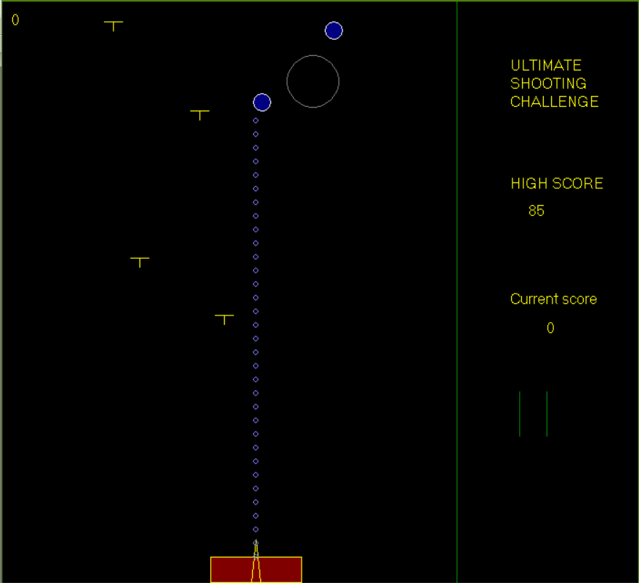
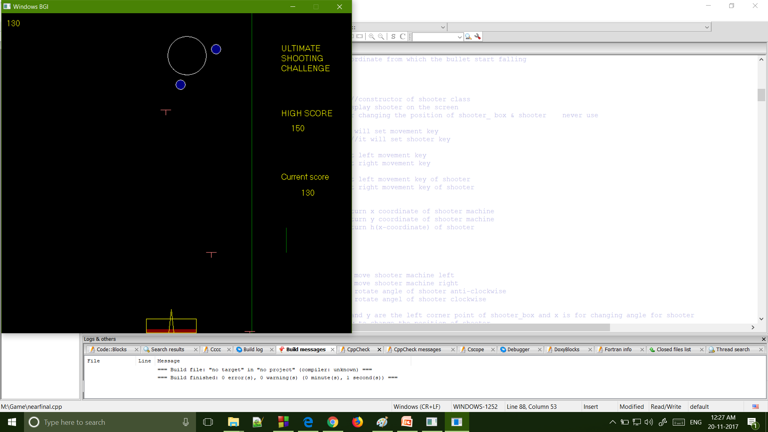
The red colour inside the Tank show its health.
Tank’s health decrease if and only if falling bullets hit Tank.
If bullet hits Tank, one units of health decreases.
For beginner, Tank’s maximum health is Seven units.
For Pro Player, Tank’s maximum health is Fourteen units.

Slide 8
Score

