Slide 1
An Artificiality Intelligent Video Player using Face Detection and Recognition
Abhinav Suthar (B16CS001) Chetan Prakash Meena (B16CS006)
Mentor : Dr. Chiranjoy Chattopadhyay
Department of Computer Science and Engineering
Indian Institute of Technology, Jodhpur

Slide 2
Problem Statement
To make an Artificial Intelligence Video Player which is controlled by facial expressions.
On closing eye video should be stopped and again on opening eye video should be started.
Video should be stopped if no face is detected for a time.
On no face detected program should be stopped after some time.

Slide 3
Challenge
We had no knowledge of Python and machine learning.
We have to learn the basics of face detection
Linking/Making video player for Python was difficult

Slide 4
Algorithms
We are using Viola Jones method for face detection.
The algorithm has four stages:
Haar Feature Selection
Creating an Integral Image
Adaboost Training
Cascading Classifiers
The goal is to distinguish faces from non-faces.
For eye detection we are using same face detection technique but with different classifiers.

Slide 5


Process (1): Preprocessing
Take an RGB image.
Convert it to Grayscale image ( RGB weight: 0.2989, 0.5870, 0.1140).
RGB to Grayscale

Slide 6
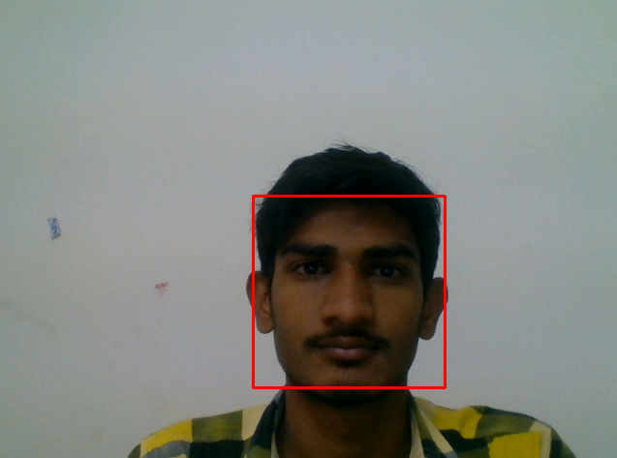
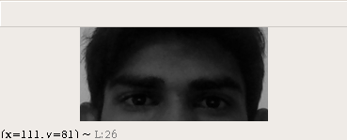
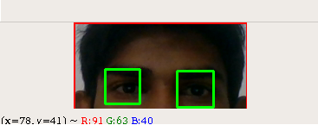
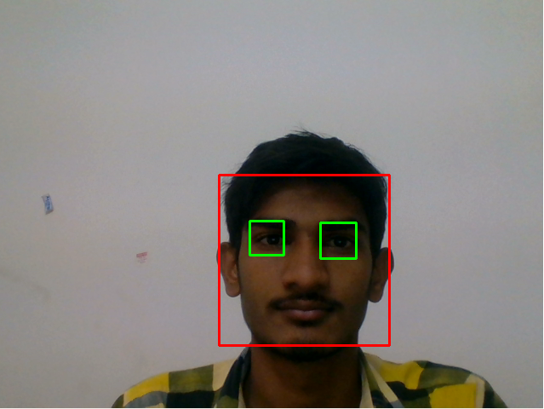
Process (2): Face and eyes detection
Next, detect eyes in given face.
The eye detector also detects eye below the nose.
So we are detecting eye in the upper half of face.
Find face(s) in given grayscale image and draw rectangle around it.
Detected face and eyes in an image

Slide 7


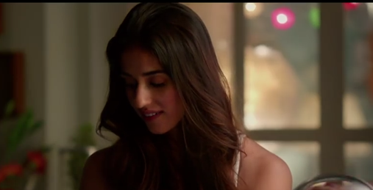

Process (3): Playback control
1. Detect face for every frame of video input by webcam
2. On successful detection of the face and eyes, play the video
3. On closing of eyes, video pauses
4. When no face is detected, video player is closed

Slide 8
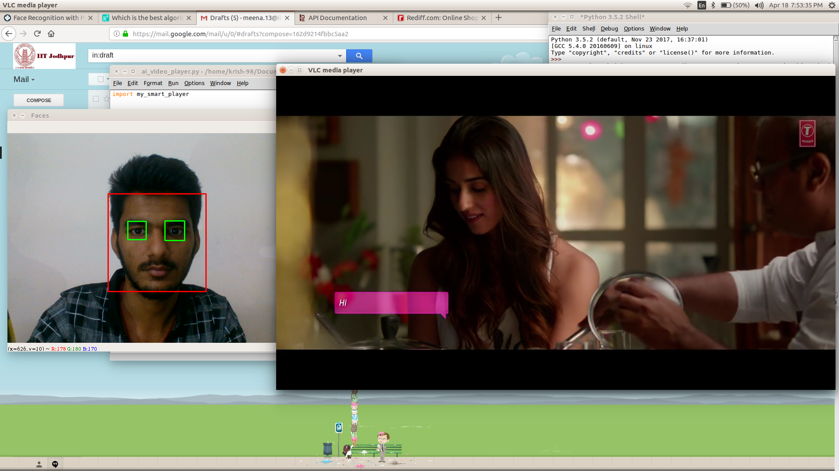
Result

Slide 9
Thank You

