Slide 1
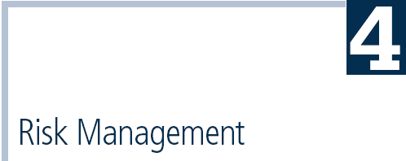
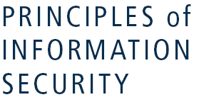

Slide 2
An Overview of Risk Management
Know yourself: identify, examine, and understand the information and systems currently in place
Know the enemy: identify, examine, and understand threats facing the organization

Slide 3
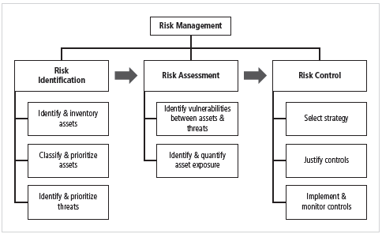

Slide 4
Risk Identification
Assets are targets of various threats and threat agents
Risk management process of identifying and controlling risks facing an organization
Risk identification begins with identifying organization’s assets and assessing their value

Slide 5
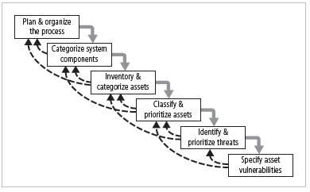
Figure 4-2 Components of Risk Identification

Slide 6
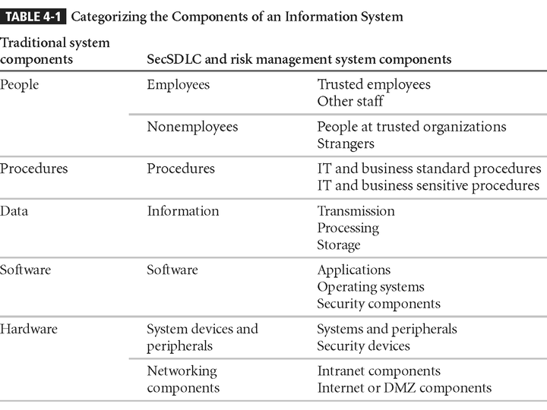
Table 4-1 - Categorizing Components

Slide 7
People, Procedures, and Data Asset Identification
Asset attributes for people: position name/number/ID; supervisor; security clearance level; special skills
Asset attributes for procedures: description; intended purpose; what elements it is tied to; storage location for reference; storage location for update
Asset attributes for data: classification; owner/creator/ manager; data structure size; data structure used; online/offline; location; backup procedures employed

Slide 8
Hardware, Software, and Network Asset Identification
What information attributes to track depends on:
  Needs of organization/risk management efforts
  Management needs of information security/information technology communities
Asset attributes to be considered are: name; IP address; MAC address; element type; serial number; manufacturer name; model/part number; software version; physical or logical location; controlling entity

Slide 9
Data Classification and Management
Information owners responsible for classifying their information assets
Information classifications must be reviewed periodically
Most organizations do not need detailed level of classification used by military or federal agencies;
Instead organizations may use other data classification schemes (e.g., confidential, internal, public data)‏
Categories must be comprehensive and mutually exclusive

Slide 10
Information Asset Valuation
Questions help develop criteria for asset valuation
Which information asset:
  is most critical to organization’s success?
  generates the most revenue/profitability?
  would be most expensive to replace or protect?
  would be the most embarrassing or cause greatest liability if revealed?

Slide 11
Information Asset Prioritization
Create weighting for each category based on the answers to questions
Calculate relative importance of each asset using weighted factor analysis
List the assets in order of importance using a weighted factor analysis worksheet

Slide 12
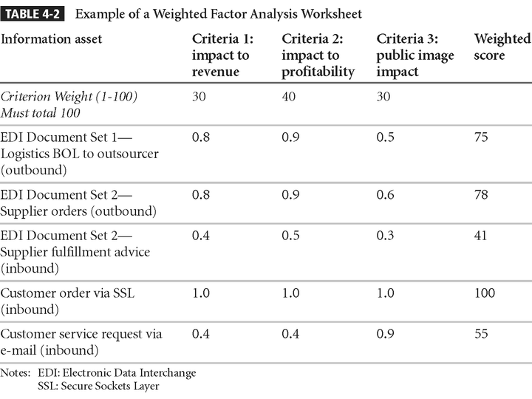
Table 4-2 – Example Weighted Factor Analysis

Slide 13
Threat Identification
Realistic threats need investigation; unimportant threats are set aside
Threat assessment:
  Which threats present danger to assets?
  Which threats represent the most danger to information?
  How much would it cost to recover from attack?
  Which threat requires greatest expenditure to prevent?

Slide 14
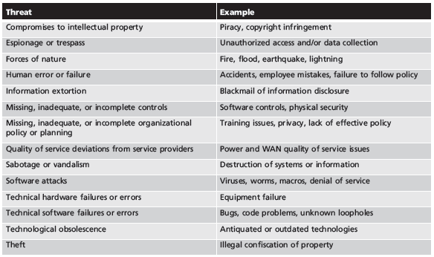
Table 4-3 Threats to Information Security⁵

Slide 15
Vulnerability Identification
Specific avenues threat agents can exploit to attack an information asset are called vulnerabilities
Examine how each threat could be perpetrated and list organization’s assets and vulnerabilities
Process works best when people with diverse backgrounds within organization work iteratively in a series of brainstorming sessions
At end of risk identification process, list of assets and their vulnerabilities is achieved

Slide 16
Risk Assessment
Risk assessment evaluates the relative risk for each vulnerability
Assigns a risk rating or score to each information asset
The goal at this point: create a method for evaluating the relative risk of each listed vulnerability.

Slide 17
Likelihood
The probability that a specific vulnerability will be the object of a successful attack
Assign numeric value: number between 0.1 (low) and 1.0 (high), or a number between 1 and 100
Zero not used since vulnerabilities with zero likelihood removed from asset/vulnerability list
Use selected rating model consistently
Use external references for values that have been reviewed/adjusted for your circumstances

Slide 18
Risk Determination
For the purpose of relative risk assessment, risk equals:
  Likelihood of vulnerability occurrence TIMES value (or impact)‏
  MINUS percentage risk already controlled
  PLUS an element of uncertainty

Slide 19
Identify Possible Controls
For each threat and associated vulnerabilities that have residual risk, create preliminary list of control ideas
Residual risk is risk that remains to information asset even after existing control has been applied
There are three general categories of controls:
  Policies
  Programs
  Technologies

Slide 20
Documenting the Results of Risk Assessment
Ranked vulnerability risk worksheet
Worksheet details asset, asset impact, vulnerability, vulnerability likelihood, and risk-rating factor
Ranked vulnerability risk worksheet is initial working document for next step in risk management process: assessing and controlling risk

Slide 21
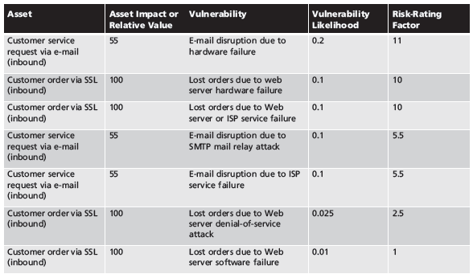
Table 4-9 Ranked Vulnerability Risk Worksheet

Slide 22
Deliverable | Purpose
Information asset classification worksheet | Assembles information about information assets and their impact
Weighted criteria analysis worksheet | Assigns ranked value or impact weight to each information asset
Ranked vulnerability risk worksheet | Assigns ranked value of risk rating for each uncontrolled asset-vulnerability pair
Table 4-10 Risk Identification and Assessment Deliverables

Slide 23
Risk Control
Once ranked vulnerability risk worksheet complete, must choose one of five strategies to control each risk:
  Apply safeguards (defend)
  Transfer the risk (transfer)‏
  Reduce impact (mitigate)‏
  Understand consequences and accept risk (acceptance)‏
  Avoid activities that are too risky (terminate)

Slide 24
Defend
Attempts to prevent exploitation of the vulnerability
Preferred approach; accomplished through countering threats, removing asset vulnerabilities, limiting asset access, and adding protective safeguards
Three common methods of risk avoidance:
  Application of policy
  Training and education
  Applying technology

Slide 25
Transfer
Control approach that attempts to shift risk to other assets, processes, or organizations
If lacking, organization should hire individuals/firms that provide security management and administration expertise
Organization may then transfer risk associated with management of complex systems to another organization experienced in dealing with those risks

Slide 26
Mitigate
Attempts to reduce impact of vulnerability exploitation through planning and preparation
Approach includes three types of plans:
  Incident response plan (IRP)
  Disaster recovery plan (DRP)‏
  Business continuity plan (BCP)‏

Slide 27
Accept
Doing nothing to protect a vulnerability and accepting the outcome of its exploitation
Valid only when the particular function, service, information, or asset does not justify cost of protection
Risk appetite describes the degree to which organization is willing to accept risk as trade-off to the expense of applying controls

Slide 28
Terminate
Directs the organization to avoid those business activities that introduce uncontrollable risks
May seek an alternate mechanism to meet customer needs.

Slide 29
Selecting a Risk Control Strategy
Level of threat and value of asset play major role in selection of strategy
Rules of thumb on strategy selection can be applied:
  When a vulnerability exists
  When a vulnerability can be exploited
  When attacker’s cost is less than potential gain
  When potential loss is substantial

Slide 30
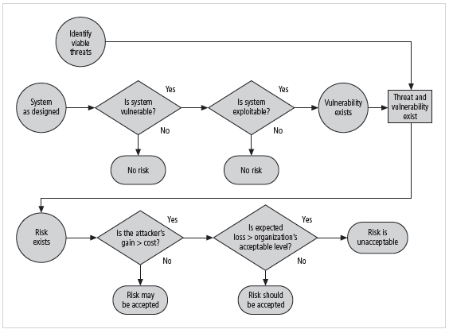
Figure 4-8 Risk Handling Decision Points

Slide 31
Feasibility Studies
Before deciding on strategy, all information about economic/noneconomic consequences of vulnerability of information asset must be explored
A number of ways exist to determine advantage of a specific control

Slide 32
Cost Benefit Analysis (CBA)‏
Most common approach for deciding on information security controls is economic feasibility of implementation
CBA is begun by evaluating worth of assets to be protected and the loss in value if those assets are compromised
The formal process to document this is called cost benefit analysis or economic feasibility study

Slide 33
Cost Benefit Analysis (CBA) (continued)‏
Once value of assets is estimated, potential loss from exploitation of vulnerability is studied
Process result is estimate of potential loss per risk
Expected loss per risk stated in the following equation:
  Annualized loss expectancy (ALE) equals
  Single loss expectancy (SLE) TIMES
  Annualized rate of occurrence (ARO)‏
SLE is equal to asset value times exposure factor (EF)‏

Slide 34
The Cost Benefit Analysis (CBA) Formula
CBA determines if alternative being evaluated is worth cost incurred to control vulnerability
CBA is most easily calculated using ALE from earlier assessments, before implementation of proposed control:
CBA = ALE(prior) – ALE(post) – ACS
ALE(prior) is annualized loss expectancy of risk before implementation of control
ALE(post) is estimated ALE based on control being in place for a period of time
ACS is the annualized cost of the safeguard

Slide 35
Evaluation, Assessment, and Maintenance of Risk Controls
Selection and implementation of control strategy is not end of process
Strategy and accompanying controls must be monitored/reevaluated on ongoing basis to determine effectiveness and to calculate more accurately the estimated residual risk
Process continues as long as organization continues to function

Slide 36
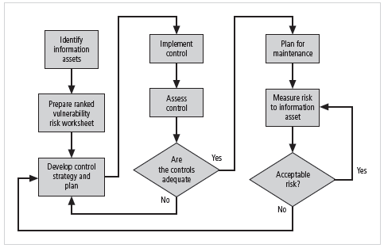
Figure 4-9 Risk Control Cycle

Slide 37
Quantitative versus Qualitative Risk Control Practices
Performing the previous steps using actual values or estimates is known as quantitative assessment
Possible to complete steps using evaluation process based on characteristics using nonnumerical measures; called qualitative assessment
Utilizing scales rather than specific estimates relieves organization from difficulty of determining exact values

Slide 38
Benchmarking and Best Practices
An alternative approach to risk management
Benchmarking is process of seeking out and studying practices in other organizations that one’s own organization desires to duplicate
One of two measures typically used to compare practices:
  Metrics-based measures
  Process-based measures

Slide 39
Benchmarking and Best Practices (continued)‏
Standard of due care: when adopting levels of security for a legal defense, organization shows it has done what any prudent organization would do in similar circumstances
Due diligence: demonstration that organization is diligent in ensuring that implemented standards continue to provide required level of protection
Failure to support standard of due care or due diligence can leave organization open to legal liability

Slide 40
Benchmarking and Best Practices (continued)‏
Best business practices: security efforts that provide a superior level of information protection
When considering best practices for adoption in an organization, consider:
  Does organization resemble identified target with best practice?
  Are resources at hand similar?
  Is organization in a similar threat environment?

Slide 41
Problems with the Application of Benchmarking and Best Practices
Organizations don’t talk to each other (biggest problem)‏
No two organizations are identical
Best practices are a moving target
Knowing what was going on in information security industry in recent years through benchmarking doesn’t necessarily prepare for what’s next

Slide 42
Baselining
Analysis of measures against established standards
In information security, baselining is comparison of security activities and events against an organization’s future performance
Useful during baselining to have a guide to the overall process

