Slide 1

Principals of Information Security,
Fourth Edition
Chapter 7
Security Technology: Intrusion
Detection and Prevention Systems,
and Other Security Tools, Cryptography
Do not wait; the time will never be just right. Start where you stand and work with whatever tools you may have at your command, and better tools will be found as you go along.
NAPOLEON HILL (1883–1970) FOUNDER OF THE SCIENCE of SUCCESS

Slide 2
Learning Objectives
Upon completion of this material, you should be able to:
  Identify and describe the categories of intrusion detection and prevention systems, honeypots, honeynets, padded cel, the use of biometric access mechanisms and the basic principles of cryptography
  Describe the operating principles of the most popular cryptographic tools
  List and explicate the major protocols used for secure communications
  Discuss the nature of the dominant methods of attack used against cryptosystems
Principals of Information Security, Fourth Edition
Notes:
Upon completion of this material, you should be able to:
Identify and describe the categories and operating models of intrusion detection and prevention systems
Define and describe honeypots, honeynets, and padded cell systems
List and define the major categories of scanning and analysis tools, and describe the specific tools used within each of these categories
Explain the various methods of access control, including the use of biometric access mechanisms

Slide 3
Intrusion Detection and Prevention Systems入侵检测与防御系统
Intrusion: occurs when an attacker attempts to gain entry into or disrupt the normal operations of an information system, almost always with the intent to do harm
Intrusion prevention: consists of activities that seek to deter an intrusion from occurring
Principals of Information Security, Fourth Edition
Notes:
Introduction
An intrusion is a type of attack on information assets in which the instigator attempts to gain entry into a system or disrupt the normal operations of a system with, almost always, the intent to do malicious harm.
Incident response is the identification of, classification of, response to, and recovery from an incident, and is frequently discussed in terms of prevention, detection, reaction, and correction.
Intrusion prevention consists of activities that seek to deter an intrusion from occurring.
Intrusion detection consists of procedures and systems that are created and operated to detect system intrusions.
Intrusion reaction encompasses the actions an organization undertakes when an intrusion event is detected.
Intrusion correction activities finalize the restoration of operations to a normal state, and by seeking to identify the source and method of the intrusion in order to ensure that the same type of attack cannot occur again, they return to intrusion prevention—thus closing the incident response loop.

Slide 4
Intrusion Detection and Prevention Systems (cont’d.)
Intrusion detection: consists of procedures and systems created and operated to detect system intrusions
Intrusion reaction: encompasses actions an organization undertakes when intrusion event is detected
Intrusion correction activities: finalize restoration of operations to a normal state
Principals of Information Security, Fourth Edition

Slide 5
Why Use an IDPS?
Prevent problem behaviors by increasing the perceived risk of discovery and punishment
Detect attacks and other security violations
Detect and deal with preambles to attacks
Document existing threat to an organization
Act as quality control for security design and administration, especially of large and complex enterprises
Provide useful information about intrusions that take place
Principals of Information Security, Fourth Edition
Notes:
Why Use an IDS?
To prevent problem behaviors by increasing the perceived risk of discovery and punishment for those who would attack or otherwise abuse the system
To detect attacks and other security violations that are not prevented by other security measures
To detect and deal with the preambles to attacks
To document the existing threat to an organization
To act as quality control for security design and administration, especially of large and complex enterprises
To provide useful information about intrusions that do take place, allowing improved diagnosis, recovery, and correction of causative factors

Slide 6
Types of IDPS
IDSs operate as network-based, host-based, or application based systems
Network-based IDPS is focused on protecting network information assets
  Wireless IDPS: focuses on wireless networks
  Network behavior analysis IDPS: examines traffic flow on a network in an attempt to recognize abnormal patterns
Principals of Information Security, Fourth Edition
Notes:
Types of IDSs and Detection Methods
IDSs operate as network-based, host-based, or application-based systems.
A network-based IDS is focused on protecting network information assets.
A host-based version is focused on protecting the server or host’s information assets.
The application-based model works on one or more host systems that support a single application and is oriented to defend that specific application from special forms of attack.

Slide 7
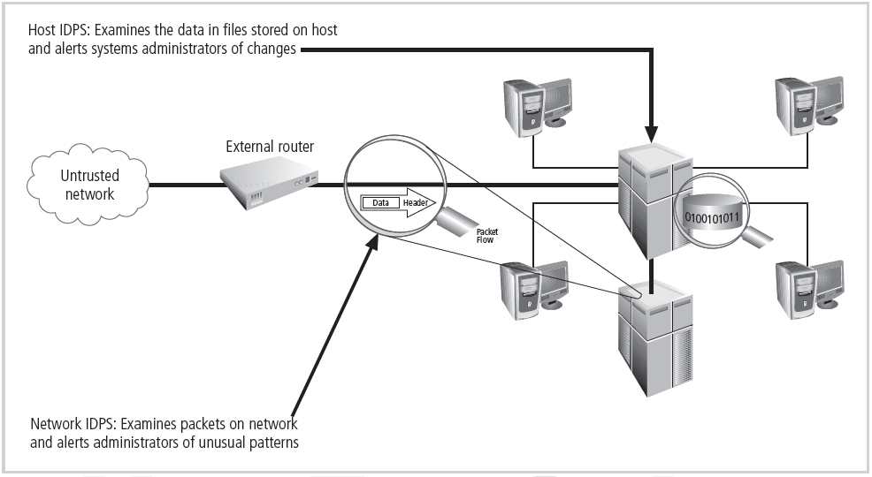
Figure 7-1 Intrusion Detection and Prevention Systems
Principals of Information Security, Fourth Edition

Slide 8
Types of IDPS (cont’d.)
Network-based IDPS
  Resides on computer or appliance connected to segment of an organization’s network; looks for signs of attacks
  When examining packets, a NIDPS looks for attack patterns
  Installed at specific place in the network where it can watch traffic going into and out of particular特定network segment网段
Principals of Information Security, Fourth Edition
Notes:
Network-Based IDS
A network-based IDS resides on a computer or appliance connected to a segment of an organization’s network and monitors network traffic on that network segment, looking for indications of ongoing or successful attacks.
When a situation occurs that the network-based IDS is programmed to recognize as an attack, it responds by sending notifications to administrators.
When examining the packets transmitted through an organization’s networks, a NIDS looks for attack patterns within network traffic such as large collections of related items that are of a certain type, which could indicate that a denial-of-service attack is underway, or the exchange of a series of related packets in a certain pattern, which could indicate that a port scan is in progress.
NIDSs are installed at a specific place in the network (such as on the inside of an edge router) from where it is possible to watch the traffic going into and out of a particular network segment.
The NIDS can be deployed to watch a specific grouping of host computers on a specific network segment, or it may be installed to monitor all traffic between the systems that make up an entire network.

Slide 9
Types of IDPS (cont’d.)
Advantages of NIDPSs
  Can enable organization to use a few devices to monitor large network
  NIDPSs not usually susceptible to direct attack and may not be detectable by attackers
Disadvantages of NIDPSs
  Can become overwhelmed by network volume and fail to recognize attacks
  Require access to all traffic to be monitored
  Cannot analyze encrypted packets
  Cannot reliably ascertain if attack was successful or not
Principals of Information Security, Fourth Edition
Notes:
Advantages of NIDSs
Good network design and placement of NIDS devices can enable an organization to use a few devices to monitor a large network.
NIDSs are usually passive devices and can be deployed into existing networks with little or no disruption to normal network operations.
NIDSs are not usually susceptible to direct attack and, in fact, may not be detectable by attackers.

Slide 10
Types of IDPS (cont’d.)
Wireless NIDPS
  Monitors and analyzes wireless network traffic
  Issues associated with it include physical security, sensor range, access point and wireless switch locations, wired network connections, cost
Network behavior analysis systems
  Examine network traffic in order to identify problems related to the flow of traffic检查网络流量，以确定与流量相关的问题
  Types of events commonly detected include DoS attacks, scanning, worms, unexpected application services, policy violations

Slide 11
Types of IDPS (cont’d.)
Host-based IDPS
  Resides on a particular computer or server and monitors activity only on that system
  Advantage over NIDPS: can usually be installed so that it can access information encrypted when traveling over network
Principals of Information Security, Fourth Edition
Notes:
Host-Based IDS
A host-based IDS resides on a particular computer or server, known as the host, and monitors activity only on that system.
HIDSs are also known as system integrity verifiers, as they benchmark and monitor the status of key system files and detect when an intruder creates, modifies, or deletes monitored files.
Most HIDSs work on the principle of configuration or change management, which means they record the sizes, locations, and other attributes of system files.
The HIDS then triggers an alert when one of the following changes occurs: file attributes change, new files are created, or existing files are deleted.
A HIDS has an advantage over NIDS in that it can usually be installed in such a way that it can access information that is encrypted when traveling over the network.
A HIDS relies on the classification of files into various categories and then applies various notification actions, depending on the rules in the HIDS configuration.
Managed HIDSs can monitor multiple computers simultaneously by creating a configuration file on each monitored host and by making each HIDS report back to a master console system, which is usually located on the system administrator’s computer.

Slide 12
Types of IDPS (cont’d.)
Advantages of HIDPSs
  Can detect local events on host systems and detect attacks that may elude a network-based IDPS
  Functions where encrypted traffic will have been decrypted and is available for processing
  Not affected by use of switched network protocols
  Can detect inconsistencies in how applications and systems programs were used by examining records stored in audit logs
Principals of Information Security, Fourth Edition
Notes:
Advantages of HIDSs
A HIDS can detect local events on host systems and also detect attacks that may elude a network-based IDS.
A HIDS functions on the host system, where encrypted traffic will have been decrypted and is available for processing.
The use of switched network protocols does not affect a HIDS.
A HIDS can detect inconsistencies in how applications and systems programs were used by examining the records stored in audit logs.

Slide 13
Types of IDPS (cont’d.)
Disadvantages of HIDPSs
  Pose more management issues
  Vulnerable both to direct attacks and attacks against host operating system
  Does not detect multi-host scanning, nor scanning of non-host network devices
  Susceptible to some denial-of-service attacks
  Can use large amounts of disk space
  Can inflict a performance overhead on its host systems
Principals of Information Security, Fourth Edition
Notes:
Disadvantages of HIDS
HIDSs pose more management issues since they are configured and managed on each monitored host.
A HIDS is vulnerable both to direct attacks and to attacks against the host operating system.
A HIDS is not optimized to detect multi-host scanning, nor is it able to detect the scanning of non-host network devices, such as routers or switches.
A HIDS is susceptible to some denial-of-service attacks.
A HIDS can use large amounts of disk space to retain the host OS audit logs; to function properly, it may require disk capacity to be added to the system.
A HIDS can inflict a performance overhead on its host systems, and in some cases may reduce system performance below acceptable levels.

Slide 14
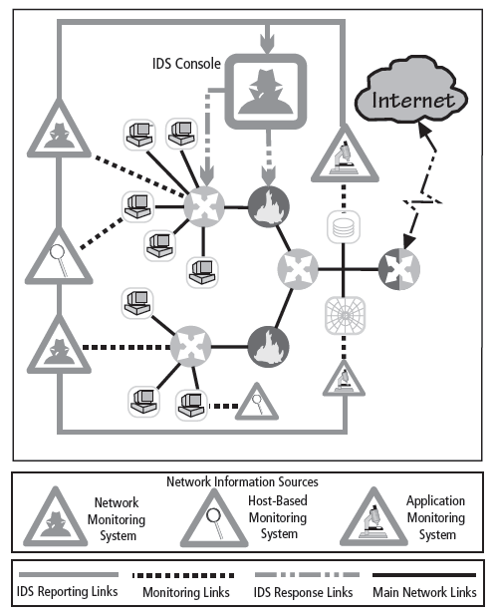
Figure 7-4 Centralized IDPS Control¹³
Principals of Information Security, Fourth Edition

Slide 15
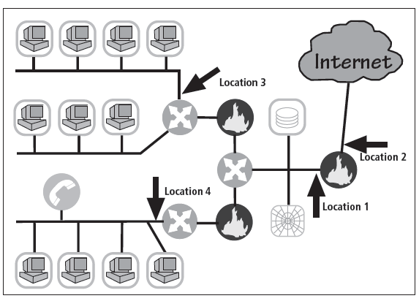
Figure 7-7 Network IDPS Sensor Locations¹⁷
Principals of Information Security, Fourth Edition

Slide 16
Honeypots, Honeynets, and Padded Cell Systems
Honeypots: decoy systems designed to lure potential attackers away from critical systems and encourage attacks against the themselves
Honeynets: collection of honeypots connecting several honey pot systems on a subnet
Honeypots designed to:
  Divert attacker from accessing critical systems
  Collect information about attacker’s activity
  Encourage attacker to stay on system long enough for administrators to document event and, perhaps, respond
Principals of Information Security, Fourth Edition
Notes:
Honey Pots & Honey Nets
Honey pots are decoy systems designed to lure potential attackers away from critical systems and encourage attacks against themselves.
Honey nets are a collection of honey pots connecting several honey pot systems on a subnet.
Honey pots are designed to:
Divert an attacker from accessing critical systems
Collect information about the attacker’s activity
Encourage the attacker to stay on the system long enough for administrators to document the event and, perhaps, respond

Slide 17
Honeypots, Honeynets, and Padded Cell Systems (cont’d.)
Padded cell: honeypot that has been protected so it cannot be easily compromised
In addition to attracting attackers with tempting data, a padded cell operates in tandem with a traditional IDS
When the IDS detects attackers, it seamlessly transfers them to a special simulated environment where they can cause no harm—the nature of this host environment is what gives approach the name padded cell
Principals of Information Security, Fourth Edition
Notes:
Padded Cell Systems
A padded cell is a honey pot that has been protected so that that it cannot be easily compromised.
In addition to attracting attackers with tempting data, a padded cell operates in tandem with a traditional IDS.
When the IDS detects attackers, it seamlessly transfers them to a special simulated environment where they can cause no harm—the nature of this host environment is what gives the approach its name, padded cell.

Slide 18
Honeypots, Honeynets, and Padded Cell Systems (cont’d.)
Advantages
  Attackers can be diverted to targets they cannot damage
  Administrators have time to decide how to respond to attacker
  Attackers’ actions can be easily and more extensively monitored, and records can be used to refine threat models and improve system protections
  Honey pots may be effective at catching insiders who are snooping around a network
Principals of Information Security, Fourth Edition
Notes:
Honey Pots, Honey Nets, and Padded Cell Systems
Advantages:
Attackers can be diverted to targets that they cannot damage.
Administrators have time to decide how to respond to an attacker.
Attackers’ actions can be easily and more extensively monitored, and the records can be used to refine threat models and improve system protections.
Honey pots may be effective at catching insiders who are snooping around a network.
Disadvantages:
The legal implications of using such devices are not well defined.
Honey pots and padded cells have not yet been shown to be generally useful security technologies.
An expert attacker, once diverted into a decoy system, may become angry and launch a more hostile attack against an organization’s systems.
Administrators and security managers will need a high level of expertise to use these systems.

Slide 19
Honeypots, Honeynets, and Padded Cell Systems (cont’d.)
Disadvantages
  Legal implications of using such devices are not well defined
  Honeypots and padded cells have not yet been shown to be generally useful security technologies
  Expert attacker, once diverted into a decoy system, may become angry and launch a more hostile attack against an organization’s systems
  Administrators and security managers will need a high level of expertise to use these systems
Principals of Information Security, Fourth Edition
Notes:
Honey Pots, Honey Nets, and Padded Cell Systems (continued)
Advantages:
Attackers can be diverted to targets that they cannot damage.
Administrators have time to decide how to respond to an attacker.
Attackers’ actions can be easily and more extensively monitored, and the records can be used to refine threat models and improve system protections.
Honey pots may be effective at catching insiders who are snooping around a network.
Disadvantages:
The legal implications of using such devices are not well defined.
Honey pots and padded cells have not yet been shown to be generally useful security technologies.
An expert attacker, once diverted into a decoy system, may become angry and launch a more hostile attack against an organization’s systems.
Administrators and security managers will need a high level of expertise to use these systems.

Slide 20
Biometric Access Control
Based on the use of some measurable human characteristic or trait to authenticate the identity of a proposed systems user (a supplicant)
Relies upon recognition
Includes fingerprint comparison, palm print comparison, hand geometry, facial recognition using a photographic id card or digital camera, retinal print, iris pattern
Characteristics considered truly unique: fingerprints, retina of the eye, iris of the eye
Principals of Information Security, Fourth Edition

Slide 21

Figure 7-20 Biometric Recognition Characteristics
Principals of Information Security, Fourth Edition

Slide 22
Effectiveness of Biometrics
Biometric technologies evaluated on three basic criteria:
  False reject rate: the rejection of legitimate users
  False accept rate: the acceptance of unknown users
  Crossover error rate (CER): the point where false reject and false accept rates cross when graphed
Principals of Information Security, Fourth Edition
Notes:
Effectiveness of Biometrics
Biometric technologies are evaluated on three basic criteria:
The false reject rate: The rate at which supplicants who are authentic users are denied or prevented access to authorized areas as a result of a failure in the biometric device (Type I error).
The false accept rate: The rate at which supplicants who are not legitimate users are allowed access to systems or areas as a result of a failure in the biometric device (Type II error).
The crossover error rate (CER): The level at which the number of false rejections equals the false acceptances (Equal error rate). This is the most common and important overall measure of the accuracy of a biometric system.

Slide 23
Acceptability of Biometrics
Balance must be struck between how acceptable security system is to users and its effectiveness in maintaining security
Many biometric systems that are highly reliable and effective are considered intrusive
As a result, many information security professionals, in an effort to avoid confrontation and possible user boycott of biometric controls, don’t implement them
Principals of Information Security, Fourth Edition
Notes:
Acceptability of Biometrics
A balance must be struck between how acceptable a security system is to its users and how effective it is in maintaining security.
Many of the biometric systems that are highly reliable and effective are considered somewhat intrusive to users.
As a result, many information security professionals, in an effort to avoid confrontation and possible user boycott of the biometric controls, don’t implement them.

Slide 24
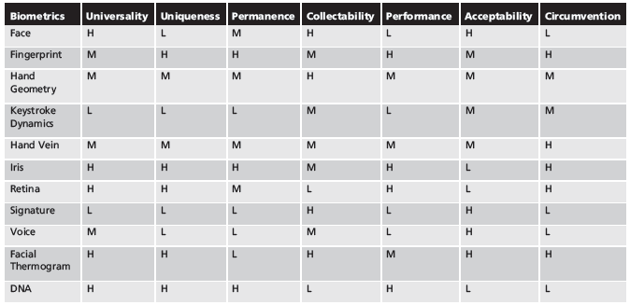
Table 7-3 Ranking of Biometric Effectiveness and Acceptance
H=High, M=Medium, L=Low
Reproduced from The ‘123’ of Biometric Technology, 2003, by Yun, Yau Wei²²
Principals of Information Security, Fourth Edition

Slide 25
Cryptography
Cryptology: science of encryption; combines cryptography and cryptanalysis
Cryptography: process of making and using codes to secure transmission of information
Cryptanalysis: process of obtaining original message from encrypted message without knowing algorithms
Encryption: converting original message into a form unreadable by unauthorized individuals
Decryption: the process of converting the ciphertext message back into plaintext(original message)
Principals of Information Security, Fourth Edition
Notes:
Cryptography and Encryption-Based Solutions
Although not a specific application or security tool, encryption represents a sophisticated approach to security that is implemented in many security systems.
In fact, many security-related tools use embedded encryption technologies to protect sensitive information handled by the application.
Encryption is the process of converting an original message into a form that is unreadable by unauthorized individuals, that is, anyone without the tools to convert the encrypted message back to its original format.
The science of encryption, known as cryptology, encompasses cryptography, from the Greek words kryptos, meaning hidden; graphein, meaning to write; and cryptanalysis, the process of obtaining the original message (or plaintext) from an encrypted message (or ciphertext), without the knowledge of the algorithms and keys used to perform the encryption.

Slide 26
Cipher Methods
Substitution Cipher
Transposition Cipher
Book or Running Key Cipher
Hash Functions
Principals of Information Security, Fourth Edition
Notes:
Cryptography and Encryption-Based Solutions
The notation used to describe the encryption process differs depending on the source.
The first uses the letters M to represent the original message, C to represent the ending ciphertext, and E to represent the encryption process: E(M) = C.
This formula represents the application of encryption to a message to create ciphertext. D represents the decryption or deciphering process, thus D[E(M)]=M.
K is used to represent the key, thus E(M, K) = C, or encrypting the message with the key results in the ciphertext.
Now look at a simple form of encryption based on two concepts: the block cipher and the exclusive OR operation.
With the block cipher method, the message is divided into blocks, i.e., 8- or 16-bit blocks, and then each block is transformed using the algorithm and key.
The exclusive OR operation (XOR) is a function of Boolean algebra whereby two bits are compared, and if the two bits are identical, the result is a binary 0. If the two bits are NOT the same, the result is a binary 1.

Slide 27
Cryptographic Algorithms
Often grouped into two broad categories, symmetric and asymmetric
  Today’s popular cryptosystems use hybrid combination of symmetric and asymmetric algorithms
Symmetric and asymmetric algorithms distinguished by types of keys used for encryption and decryption operations
Principals of Information Security, Fourth Edition
Notes:
Cryptographic Algorithms
In general, cryptographic algorithms are often grouped into two broad categories—symmetric and asymmetric—but in practice, today’s popular cryptosystems use a hybrid combination of symmetric and asymmetric algorithms.
Symmetric and asymmetric algorithms can be distinguished by the types of keys they use for encryption and decryption operations.

Slide 28
Symmetric Encryption
Uses same “secret key” to encipher and decipher message
  Encryption methods can be extremely efficient, requiring minimal processing
  Both sender and receiver must possess encryption key
  If either copy of key is compromised, an intermediate can decrypt and read messages
  Data Encryption Standard (DES), Triple DES (3DES), Advanced Encryption Standard (AES)
Principals of Information Security, Fourth Edition
Notes:
Symmetric Encryption
Symmetric encryption indicates that the same key, also known as a secret key, is used to conduct both the encryption and decryption of the message.
Symmetric encryption methods can be extremely efficient, requiring minimal processing to either encrypt or decrypt the message.
The problem is that both the sender and the receiver must own the encryption key.
If either copy of the key is compromised, an intermediate can decrypt and read the messages.
One of the challenges of symmetric key encryption is getting a copy of the key to the receiver, a process that must be conducted out-of-band to avoid interception.

Slide 29
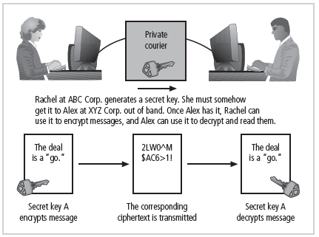
Figure 8-5 Example of Symmetric Encryption
Principals of Information Security, Fourth Edition

Slide 30
Asymmetric Encryption
Also known as public-key encryption
Uses two different but related keys
  Either key can encrypt or decrypt message
  If Key A encrypts message, only Key B can decrypt
  Highest value when one key serves as private key and the other serves as public key
RSA algorithm
Principals of Information Security, Fourth Edition
Notes:
Asymmetric Encryption
Another category of encryption techniques is asymmetric encryption, also known as public-key encryption.
Whereas the symmetric encryption systems are based on a single key to both encrypt and decrypt a message, asymmetric encryption uses two different keys.
Either key can be used to encrypt or decrypt the message. However, if Key A is used to encrypt the message, only Key B can decrypt, and if Key B is used to encrypt a message, only Key A can decrypt it.
The public key is stored in a public location, where anyone can use it.
The private key, as its name suggests, is a secret known only to the owner of the key pair.
The problem with asymmetric encryption is that it requires four keys to hold a single conversation between two parties.
Asymmetric encryption is not as efficient as symmetric encryptions in terms of CPU computations.
As a result, the hybrid system described in the section on Public Key Infrastructure is more commonly used, instead of a pure asymmetric system.

Slide 31
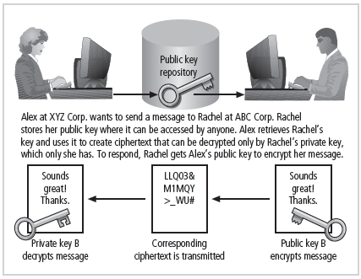
Figure 8-6 Example of Asymmetric Encryption
Principals of Information Security, Fourth Edition

Slide 32
Encryption Key Size
When using ciphers, size of cryptovariable or key is very important
Strength of many encryption applications and cryptosystems measured by key size
For cryptosystems, security of encrypted data is not dependent on keeping encrypting algorithm secret
Cryptosystem security depends on keeping some or all of elements of cryptovariable(s) or key(s) secret
Principals of Information Security, Fourth Edition
Notes:
Encryption Key Size
When using ciphers, one of the decisions that has to be made is the size of the cryptovariable or key. The strength of many encryption applications and cryptosystems is measured by key size.
When it comes to cryptosystems, the security of encrypted data is not dependent on keeping the encrypting algorithm secret; in fact, algorithms are often published, so that research to uncover their weaknesses can be done.
The security of any cryptosystem depends on keeping some or all of the elements of the cryptovariable(s) or key(s) secret.

Slide 33
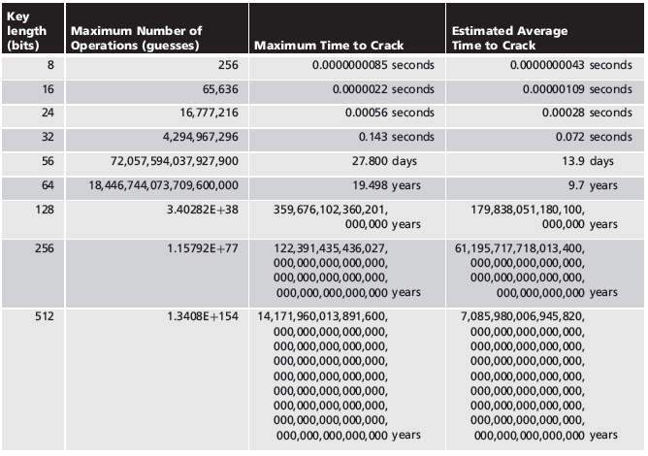
Table 8-7 Encryption Key Power
Principals of Information Security, Fourth Edition

Slide 34
Cryptographic Tools
Potential areas of use include:
  Ability to conceal the contents of sensitive messages
  Verify the contents of messages and the identities of their senders
Tool:
  Public-Key Infrastructure (PKI)
  Digital Signatures
  Digital Certificates
Principals of Information Security, Fourth Edition

Slide 35
Public-Key Infrastructure (PKI)
Integrated system of software, encryption methodologies, protocols, legal agreements, and third-party services enabling users to communicate securely
PKI systems based on public-key cryptosystems
PKI protects information assets in several ways:
  Authentication
  Integrity
  Privacy
  Authorization
  Nonrepudiation
Principals of Information Security, Fourth Edition
Notes:
Cryptography Tools
Public Key Infrastructure (PKI) is an integrated system of software, encryption methodologies, protocols, legal agreements, and third-party services that enables users to communicate securely.
PKI systems are based on public-key cryptosystems and include digital certificates and certificate authorities (CAs).
PKI Protects Information Assets in Several Ways:
Authentication. Digital certificates in a PKI system permit parties to validate the identity of other parties in an Internet transaction.
Integrity. A digital certificate demonstrates that the content signed by the certificate has not been altered while being moved from server to client.
Privacy. Digital certificates keep information from being intercepted during transmission over the Internet.
Authorization. Digital certificates issued in a PKI environment can replace user IDs and passwords, enhance security, and reduce some of the overhead required for authorization processes and controlling access privileges.
Nonrepudiation. Digital certificates can validate actions, making it less likely that customers or partners can later repudiate a digitally signed transaction.

Slide 36
Digital Signatures
Verify information transferred using electronic systems
Asymmetric encryption processes used to create digital signatures
Nonrepudiation: the process that verifies the message was sent by the sender and thus cannot be refuted
Principals of Information Security, Fourth Edition
Notes:
Digital Signatures
An interesting thing happens when the asymmetric process is reversed, that is, the private key is used to encrypt a short message.
The public key can be used to decrypt it, and the fact that the message was sent by the organization that owns the private key cannot be refuted.
This is known as nonrepudiation, which is the foundation of digital signatures.
Digital signatures are encrypted messages that are independently verified by a central facility (registry) as authentic.

Slide 37
Digital Certificates
Electronic document containing key value and identifying information about entity that controls key
Digital signature attached to certificate’s container file to certify file is from entity it claims to be from
Principals of Information Security, Fourth Edition
Notes:
Digital Certificates and Certificate Authorities
As alluded to earlier, a digital certificate is an electronic document, similar to a digital signature, attached to a file certifying that this file is from the organization it claims to be from and has not been modified from the originating format.
A certificate authority is an agency that manages the issuance of certificates and serves as the electronic notary public to verify their worth and integrity.

Slide 38
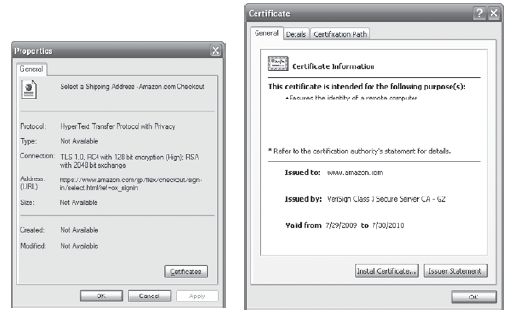
Figure 8-8 Digital Certificate
Principals of Information Security, Fourth Edition

Slide 39
Steganography
Process of hiding information
Has been in use for a long time
Most popular modern version hides information within files appearing to contain digital pictures or other images
Some applications hide messages in .bmp, .wav, .mp3, and .au files, as well as in unused space on CDs and DVDs
Principals of Information Security, Fourth Edition
Notes:
Steganography
Steganography is a process of hiding information and has been in use for a long time.
The word “steganography” is derived from the Greek words steganos meaning “covered” and graphein meaning “to write.”
The most popular modern version of steganography involves hiding information within files that appear to contain digital pictures or other images.
Most computer graphics standards use a combination of three color values (red, blue, and green (RGB)) to represent a picture element, or pixel.
Each of the three color values usually requires an 8-bit code for that color’s intensity (e.g., 00000000 for no red and 11111111 for maximum red).
This inability to perceive difference on the part of humans provides the steganographer with one bit per color (or three bits per pixel) to use for encoding data into an image file.
Some applications are capable of hiding messages in .bmp, .wav, .mp3, and .au files, as well as in unused storage space on CDs and DVDs.

Slide 40
Securing Internet Communication with Protocol S-HTTP and SSL
Secure Socket Layer (SSL) protocol: uses public key encryption to secure channel over public Internet
Secure Hypertext Transfer Protocol (S-HTTP): extended version of Hypertext Transfer Protocol; provides for encryption of individual messages between client and server across Internet
S-HTTP is the application of SSL over HTTP
Principals of Information Security, Fourth Edition
Notes:
Securing the Web
Secure Electronic Transactions (SET) was developed by MasterCard and Visa in 1997 to provide protection from electronic payment fraud.
SET works by encrypting the credit card transfers with DES for encryption and RSA for key exchange, much as other algorithms do.
SET provides the security for both Internet-based credit card transactions and the encryption of swipe systems of those credit cards in retail stores.
Secure Socket Layer was developed by Netscape in 1994 to provide security in online electronic commerce transactions.
It uses a number of algorithms but mainly relies on RSA for key transfer and IDEA, DES, or 3DES for encrypted symmetric key-based data transfer.
Secure Hypertext Transfer Protocol (SHTTP) is an encrypted solution to the unsecured version of HTTP.
It provides an alternative to the aforementioned protocols and can provide secure e-commerce transactions as well as encrypted Web pages for secure data transfer over the Web, using a number of different algorithms.
Secure Shell (SSH) provides security over remote access connections using tunneling. It provides authentication services between a client and server.
IP Security (IPSec) is the cryptographic authentication and encryption product of the IETF’s IP Protocol Security Working Group, defined in RFC 1825, 1826 and 1827.
IP Security (IPSec) is used to create virtual private networks (VPNs) and is an open framework for security development within the TCP/IP family of protocol standards.

Slide 41
Securing e-mail with S/MIME, PEM, and PGP Protocols
Secure Multipurpose Internet Mail Extensions (S/MIME): builds on Multipurpose Internet Mail Extensions (MIME) encoding format by adding encryption and authentication
Privacy Enhanced Mail (PEM): proposed as standard to function with public-key cryptosystems; uses 3DES symmetric key encryption
Pretty Good Privacy (PGP): uses IDEA Cipher for message encoding
Principals of Information Security, Fourth Edition
Notes:
Securing E-mail
A number of encryption cryptosystems have been adapted in an attempt to inject some degree of security into e-mail, a notoriously unsecured medium.
S/MIME builds on the Multipurpose Internet Mail Extensions (MIME) encoding format by adding encryption and authentication through digital signatures based on public key cryptosystems.
Privacy Enhanced Mail (PEM) was proposed by the Internet Engineering Task Force (IETF) as a standard to function with the public-key cryptosystems.
PEM uses 3DES symmetric key encryption and RSA for key exchanges and digital signatures.
Pretty Good Privacy (PGP) was developed by Phil Zimmerman and uses the IDEA Cipher, a 128-bit symmetric key block encryption algorithm with 64-bit blocks for message encoding.
IDEA performs eight rounds on 16-bit sub-blocks using algebraic calculations.
PGP also uses RSA for symmetric key exchange and for digital signatures.

Slide 42
Securing Web transactions with SET, SSL, and S-HTTP
Secure Electronic Transactions (SET): developed by MasterCard and VISA in 1997 to provide protection from electronic payment fraud
Uses DES to encrypt credit card information transfers
Provides security for both Internet-based credit card transactions and credit card swipe systems in retail stores
Principals of Information Security, Fourth Edition
Notes:
Securing Web Transactions with SET, SSL, and S-HTTP
Just as PGP, PEM, and S/MIME work to secure e-mail operations, a number of related protocols work to secure Web browsers, especially at electronic commerce sites.
Among these are Secure Electronic Transactions (SET), Secure Socket Layer (SSL), Secure Hypertext Transfer Protocol (S-HTTP), Secure Shell (SSH-2), and IP Security (IPSec).
Secure Electronic Transactions (SET) was developed by MasterCard and VISA in 1997 to provide protection from electronic payment fraud.
SET uses DES to encrypt credit card information transfers and RSA for key exchange. SET provides the security for both Internet-based credit card transactions and credit card swipe systems in retail stores.

Slide 43
Securing Wireless Networks with WEP and WPA
Wired Equivalent Privacy (WEP): early attempt to provide security with the 8002.11 network protocol
Wi-Fi Protected Access (WPA and WPA2): created to resolve issues with WEP
Next Generation Wireless Protocols: Robust Secure Networks (RSN), AES – Counter Mode Encapsulation, AES – Offset Codebook Encapsulation
Principals of Information Security, Fourth Edition

Slide 44
Protocols for Secure Communications (continued)
Securing TCP/IP with IPSec
  Internet Protocol Security (IPSec): open source protocol to secure communications across any IP-based network
Principals of Information Security, Fourth Edition
Notes:
IPSec
IPSec combines several different cryptosystems including:
Diffie-Hellman key exchange for deriving key material between peers on a public network
Public-key cryptography for signing the Diffie-Hellman exchanges to guarantee the identity of the two parties
Bulk encryption algorithms, such as DES, for encrypting the data
Digital certificates signed by a certificate authority to act as digital ID cards.
IPSec includes:
1) The IP Security Protocol itself, which defines the information to add to an IP packet, as well as how to encrypt packet data
2) The Internet Key Exchange, which uses asymmetric-based key exchange and negotiates the security associations.

Slide 45
Attacks on Cryptosystems
Attempts to gain unauthorized access to secure communications have used brute force attacks (ciphertext attacks)
Attacker may alternatively conduct known-plaintext attack or selected-plaintext attach schemes
Principals of Information Security, Fourth Edition
Notes:
Attacks on Cryptosystems
Historically, attempts to gain unauthorized access to secure communications have used brute force attacks.
Ciphertext attacks involve a hacker searching for a common text structure, wording, or syntax in the encrypted message that can enable him or her to calculate the number of each type of letter used in the message.
Frequency analysis can be used along with published frequency of occurrence patterns of various languages and can allow an experienced attacker to crack almost any code quickly if the individual has a large enough sample of the encoded text.
To protect against this, modern algorithms attempt to remove the repetitive and predictable sequences of characters from the ciphertext.
Occasionally, an attacker may obtain duplicate texts, one in ciphertext and one in plaintext, which enable the individual to reverse-engineer the encryption algorithm in a known-plaintext attack scheme.
Alternatively, an attacker may conduct a selected-plaintext attack by sending the potential victim a specific text that they are sure the victim will forward on to others.

Slide 46
Man-in-the-Middle Attack
Designed to intercept transmission of public key or insert known key structure in place of requested public key
From victim’s perspective, encrypted communication appears to be occurring normally, but in fact, attacker receives each encrypted message, decodes, encrypts, and sends to originally intended recipient
Establishment of public keys with digital signatures can prevent traditional man-in-the-middle attack
Principals of Information Security, Fourth Edition
Notes:
Man-in-the-Middle Attack
A man-in-the-middle attack is designed to intercept the transmission of a public key or even to insert a known key structure in place of the requested public key.
From the perspective of the victims of such attacks, their encrypted communication appears to be occurring normally, but in fact the attacker is receiving each encrypted message and decoding it and then encrypting and sending it to the originally intended recipient.
Establishment of public keys with digital signatures can prevent the traditional man-in-the-middle attack, as the attacker cannot duplicate the signatures.

Slide 47
Correlation Attacks
Collection of brute-force methods that attempt to deduce statistical relationships between structure of unknown key and ciphertext
Differential and linear cryptanalysis have been used to mount successful attacks
Only defense is selection of strong cryptosystems, thorough key management, and strict adherence to best practices of cryptography in frequency of changing keys
Principals of Information Security, Fourth Edition
Notes:
Correlation Attacks
Correlation attacks are a collection of brute-force methods that attempt to deduce statistical relationships between the structure of the unknown key and the ciphertext that is the output of the cryptosystem.
Differential and linear cryptanalysis, both of which are advanced methods of breaking codes, have been used to mount successful attacks on block cipher encryptions such as DES.
The only defense against this kind of attack is the selection of strong cryptosystems that have stood the test of time, thorough key management, and strict adherence to the best practices of cryptography in the frequency of changing keys.

Slide 48
Dictionary Attacks
Attacker encrypts every word in a dictionary using same cryptosystem used by target
Dictionary attacks can be successful when the ciphertext consists of relatively few characters (e.g., usernames, passwords)
Principals of Information Security, Fourth Edition
Notes:
Dictionary Attacks
In a dictionary attack, the attacker encrypts every word in a dictionary using the same cryptosystem as used by the target.
Dictionary attacks can be successful when the ciphertext consists of relatively few characters, as for example files that contain encrypted usernames and passwords.
After a match is located, the attacker has essentially identified a potential valid password for the system under attack.

Slide 49
Timing Attacks
Attacker eavesdrops during victim’s session
  Uses statistical analysis of user’s typing patterns and inter-keystroke timings to discern sensitive session information
Can be used to gain information about encryption key and possibly cryptosystem in use
Once encryption successfully broken, attacker may launch a replay attack (an attempt to resubmit recording of deciphered authentication to gain entry into secure source)
Principals of Information Security, Fourth Edition
Notes:
Timing Attacks
In a timing attack, the attacker eavesdrops during the victim’s session and uses statistical analysis of the user’s typing patterns and inter-keystroke timings to discern sensitive session information.
While timing analysis may not directly result in the decryption of sensitive data, it can be used to gain information about the encryption key and perhaps the cryptosystem in use.
Once the attacker has successfully broken an encryption, he or she may launch a replay attack, which is an attempt to resubmit a recording of the deciphered authentication to gain entry into a secure source.

Slide 50
Defending Against Attacks
No matter how sophisticated encryption and cryptosystems have become, if key is discovered, message can be determined
Key management is not so much management of technology but rather management of people
Principals of Information Security, Fourth Edition
Notes:
Defending From Attacks
No matter how sophisticated encryption and cryptosystems have become, however, they have retained the same flaw that the first systems contained thousands of years ago: if you discover the key, you can determine the message.
Thus, key management is not so much the management of technology but rather the management of people.

