Slide 1
Table 1. The 10 strains choice
Nitrogen fixation | Strains name
yes | Crocosphaera watsonii WH 8501
yes | Nodularia spumigena CCY9414
yes | Nostoc azollae 0708
yes | Rippkaea orientalis PCC 8801
yes | Synechococcus sp. JA-2-3B'a(2-13)
no | Acaryochloris marina MBIC11017
no | Gloeobacter violaceus PCC 7421
no | Microcystis aeruginosa NIES-843
no | Synechococcus sp. CC9902
no | Synechococcus sp. WH 5701

Slide 2
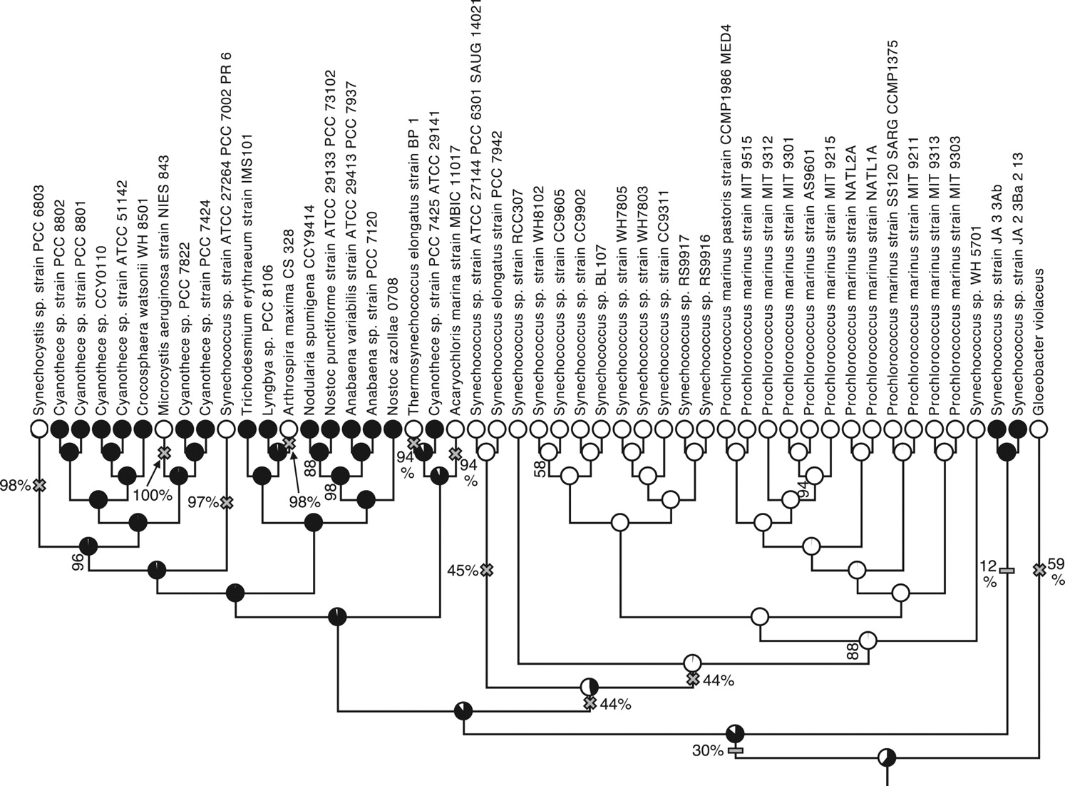
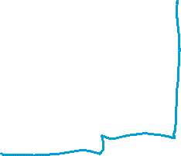

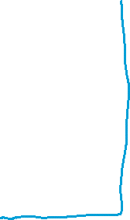
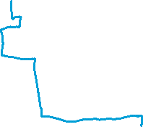

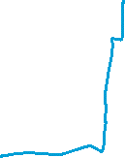




Slide 3
Table 2. Top5 best matching proteins with WP_007305805.1
Sequences producing significant alignments: | Score (Bits) | E Value
WP_007305805.1 | 932 | 0
WP_012595108.1 | 712 | 0
WP_013190623.1 | 530 | 0
WP_006194547.1 | 526 | 0
WP_238376856.1 | 507 | 6.00E-179
WP_011432083.1 | 177 | 7.00E-50
Table 3. Top5 best matching proteins with WP_007305805.1 and their responding
Orthogroup | Protein name
OG0002700 | WP_007305805.1
OG0002700 | WP_012595108.1
OG0002700 | WP_013190623.1
OG0002700 | WP_006194547.1
OG0002700 | WP_238376856.1
OG0002724 | WP_011432083.1

Slide 4
Table 4. Phylogenetic profile of NifN proteins (OG0002700)
Strains | Acaryochloris marina MBIC11017 | Crocosphaera watsonii WH 8501 | Gloeobacter violaceus PCC 7421 | Microcystis aeruginosa NIES-843 | Nodularia spumigena CCY9414
Gene count | 0 | 1 | 0 | 0 | 1
Strains | Nostoc azollae 0708 | Rippkaea orientalis PCC 8801 | Synechococcus sp. CC9902 | Synechococcus sp. JA-2-3B'a(2-13) | Synechococcus sp. WH 5701
Gene count | 1 | 1 | 0 | 1 | 0
: Strains with ability to fix nitrogen

Slide 5
Table 5. Detail of orthogroups having the same phylogenetic profile pattern with OG0002700
Orthogroup | Annotation of proteins in the group
OG0002149 | nitrogenase iron protein
OG0002383 | response regulator transcription factor
OG0002414 | homocitrate synthase
OG0002659 | putative nitrogen fixation protein NifT
OG0002669 | ATP-binding protein
OG0002698 | nitrogenase iron-molybdenum cofactor biosynthesis protein NifE
OG0002700 | nitrogenase iron-molybdenum cofactor biosynthesis protein NifN
OG0002714 | NifX-associated nitrogen fixation protein
OG0002715 | cysteine desulfurase NifS
OG0002720 | nitrogenase cofactor biosynthesis protein NifB
OG0002721 | nitrogenase-stabilizing/protective protein NifW
OG0002722 | nitrogenase molybdenum-iron protein alpha chain
OG0002724 | nitrogenase molybdenum-iron protein subunit beta
OG0002748 | nitrogen fixation protein NifZ
OG0002770 | hypothetical protein

Slide 6
Table 6. Detail of the genes in the orthogroups with the same pattern with OG0002700
 | Phylogenetic profile details
Orthogroup | Crocosphaera watsonii WH 8501 | Nodularia spumigena CCY9414 | Nostoc azollae 0708 | Rippkaea orientalis PCC 8801 | Synechococcus sp. JA-2-3B'a(2-13)
OG0002149 | WP_007305800.1 | WP_006195291.1 | WP_013190628.1 WP_013192322.1 WP_013192381.1 | WP_012595104.1 | WP_011430651.1
OG0002383 | WP_007307614.1 | WP_017804013.1 | WP_041640169.1 WP_041643064.1 | WP_012595622.1 | WP_011433617.1
OG0002414 | WP_007305825.1 | WP_017804298.1 WP_082209982.1 | WP_013190643.1 | WP_012595095.1 | WP_011432084.1
OG0002659 | WP_007305827.1 | WP_006194576.1 | WP_013190641.1 | WP_012595093.1 | WP_011430645.1
OG0002669 | WP_007307666.1 | WP_006197324.1 | WP_013192091.1 | WP_012595391.1 | WP_041437176.1
OG0002698 | WP_007305804.1 | WP_006194548.1 | WP_013190624.1 | WP_012595107.1 | WP_011432073.1
OG0002700 | WP_007305805.1 | WP_006194547.1 | WP_013190623.1 | WP_012595108.1 | WP_238376856.1
OG0002714 | WP_007305807.1 | WP_006194545.1 | WP_013190621.1 | WP_012595110.1 | WP_011432071.1
OG0002715 | WP_007305799.1 | WP_006194563.1 | WP_013190630.1 | WP_012595102.1 | WP_041436140.1
OG0002720 | WP_007305797.1 | WP_173403303.1 | WP_013190632.1 | WP_012595099.1 | WP_011432078.1
OG0002721 | WP_007305809.1 | WP_006194543.1 | WP_013190619.1 | WP_012595112.1 | WP_011432069.1
OG0002722 | WP_007305801.1 | WP_006194555.1 | WP_013190627.1 | WP_012595105.1 | WP_011432082.1
OG0002724 | WP_007305802.1 | WP_006194550.1 | WP_013190626.1 | WP_012595106.1 | WP_011432083.1
OG0002748 | WP_007305826.1 | WP_006194575.1 | WP_013190642.1 | WP_012595094.1 | WP_011430646.1
OG0002770 | WP_007305808.1 | WP_006194544.1 | WP_013190620.1 | WP_012595111.1 | WP_011432070.1

Slide 7
Table 7. Top 5 BLAST result for nifH search
Sequences | Annotation | Score (bits) | E Value
WP_007305800.1 | nitrogenase iron protein [Crocosphaera watsonii] | 268 | 2.00E-89
WP_013190628.1 | nitrogenase iron protein [Trichormus azollae] | 266 | 8.00E-89
WP_013192381.1 | nitrogenase iron protein [Trichormus azollae] | 263 | 3.00E-87
WP_013192322.1 | nitrogenase iron protein [Trichormus azollae] | 259 | 4.00E-86
WP_006195291.1 | MULTISPECIES: nitrogenase iron protein [Nodularia] | 256 | 5.00E-85

Slide 8
Table 8. BLAST result of WP_007305805.1 against OG0002724
Sequences | Score (bits) | E Value
WP_011432083.1 | 177 | 2.00E-53
WP_006194550.1 | 169 | 8.00E-51
WP_013190626.1 | 163 | 1.00E-48
WP_012595106.1 | 163 | 2.00E-48
WP_007305802.1 | 162 | 4.00E-48

Slide 9
Table 9. BLAST result of WP_017804298.1 against OG0002414
Sequences | Score (bits) | E Value
WP_013190643.1 | 653 | 0
WP_082209982.1 | 575 | 0
WP_012595095.1 | 535 | 0
WP_007305825.1 | 525 | 0
WP_011432084.1 | 466 | 2e-168

Slide 10
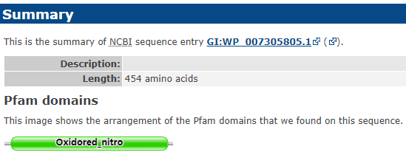
Figure 1. Domain of WP_007305805.1. The domain is Nitrogenase component 1 type Oxidoreductase. ( https://pfam.xfam.org/family/PF00148.22 )

Slide 11
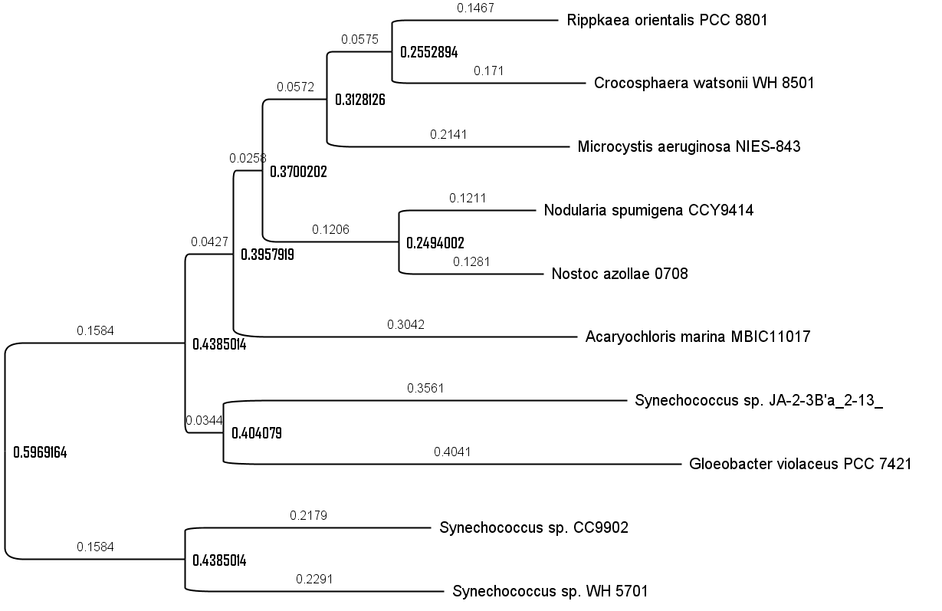
Figure 2. One possible rooted species tree generated by orthfinder

Slide 12
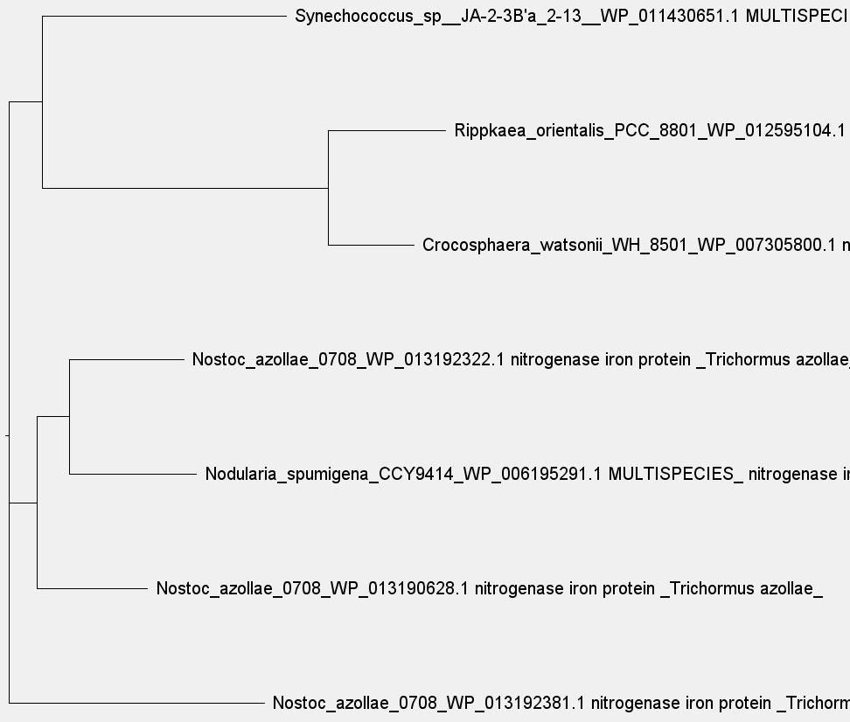
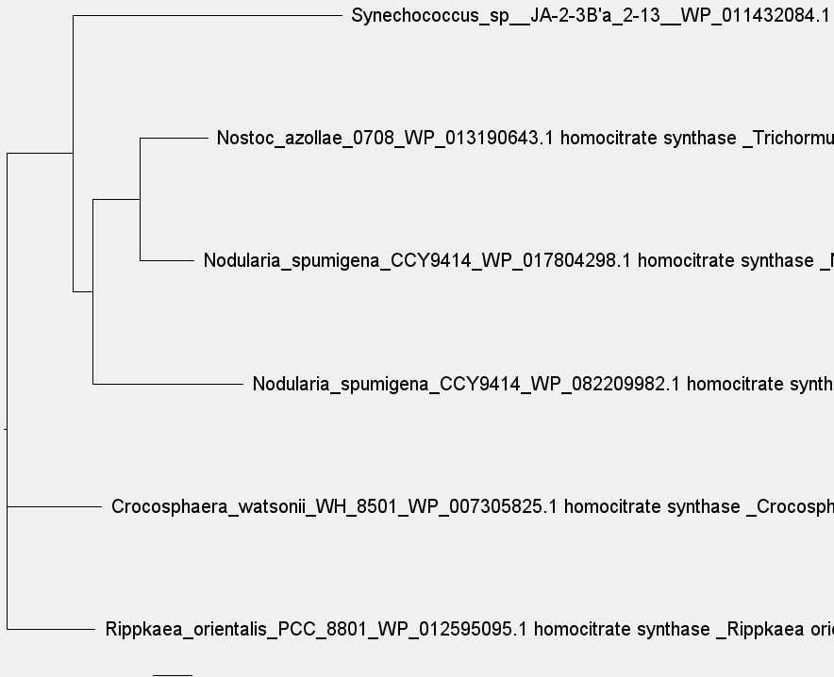
Figure 3. phylogenetic tree (left: OG0002149 Right: OG0002414)

Slide 13

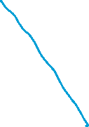
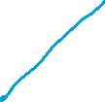

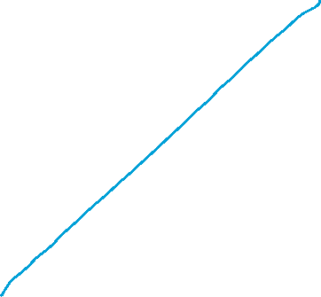
Figure 4. Assumption for phylogenetic tree of OG0002149(figure 3 left)

Slide 14
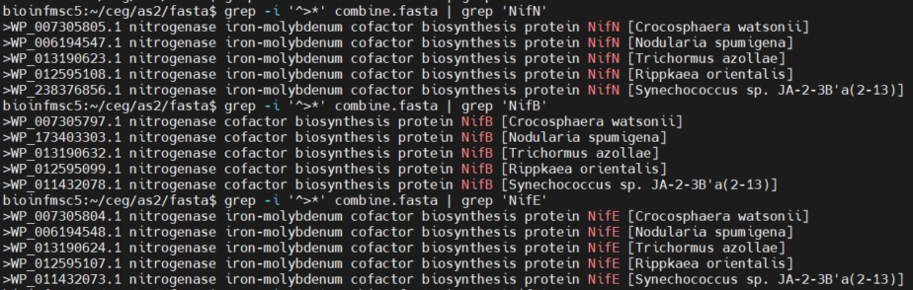
Figure 5. Results of searching “nif” in the combined protein set.

Slide 15
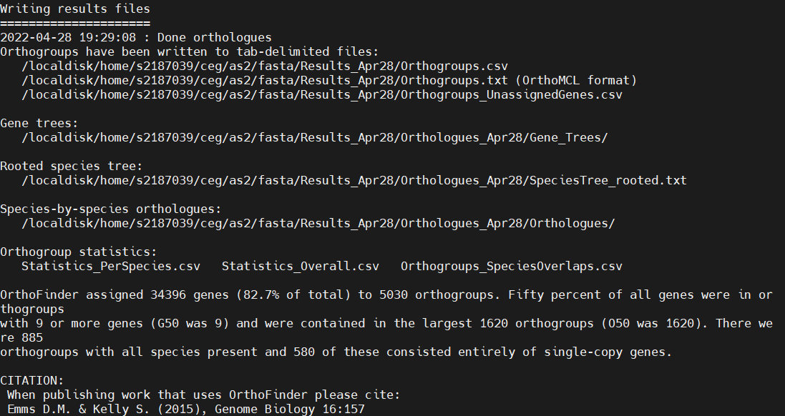
OrthoFinder results:
OrthoFinder assigned 34396 genes (82.7% of total) to 5030 orthogroups. Fifty percent of all genes were in or thogroups
with 9 or more genes (G50 was 9) and were contained in the largest 1620 orthogroups (O50 was 1620). There we re 885
orthogroups with all species present and 580 of these consisted entirely of single-copy genes.

