Slide 1

Exploring Background of different professional in Haiti from LinkedIn

Slide 2
Project Description
Haiti is a country with highly educated youth who lack access to opportunity.
why college graduates can’t find a job or a good job? Obtaining employment after college is often difficult. Some graduates accept the first job they find without realizing the potential impact it may have on their future. The primary reason why graduates find obtaining employment difficult is the sheer amount of competition. Not enough opportunity overall in Haiti.
There are many reasons why graduates struggle in their job searching. Personal reasons aside, there are greater causes that many students and recent graduates face such as:
High competition
Little work experience
Few or no skills at all
Little networking
Lack of communication skills

Slide 3
Project Description
Furthermore, I want to focus farther i.e. the choice of the field of study after high school. In Haiti, we do not offer professional orientation to young people. Before choosing a study field, wouldn't it be important to have a clear idea of the opportunities offered in this field, and the skills to be acquired?
what degree or level of education that offer more opportunities or that is the most in demand, what skills are employers looking for? This lead me to explore the backgrounds, experiences, and skills of different professionals in Haiti.
what degree’s lead to what skills?
For this project I want to study the profile of different professionals, and their evolution.
I want to look at their background, the skills they have acquired, and the opportunities they have had.
Graduated high school students will be able to use this study to obtain information on the most demanded study fields. Undergraduate students to get information such whether or not a graduate degree (master’s degree) to get more opportunities in their field of study.

Slide 4
Data acquisition & Methodology
The Data has been acquired from LinkedIn. LinkedIn is a social network for professionals making it the Facebook for your career. This platform is the best for networking with others within your industry or an industry the user may be trying to enter. Not only is this platform great for social networking but it's also great for job searches! So I decided to do my web-scraping project on LinkedIn. I used selenium and beautiful soup to web-scrape different LinkedIn profiles of people located in Haiti.
I was able to build a datasets from 1,093 profiles.
The data set includes information about:
The experiences and its duration
The degrees, certificates and other formations obtained
The different skills obtained

Slide 5
Methodology
I categorized the different formations in: business administration, social science, technology, engineering, natural sciences, health science, art & other.
I categorized the different skills in: analysis & research, communication, creativity, education & formation, leadership & management, medicine & healthcare, technical & information skills and other.
The goal of the project is to analyze those different features and to use Clustering methods to identify groups of similar profiles the data sets collected. Clustering can be considered the most important unsupervised learning algorithm problem; so, as every other problem of this kind, it deals with finding a structure in a collection of unlabeled data. A loose definition of clustering could be “the process of organizing objects into groups whose members are similar in some way”.

Slide 6
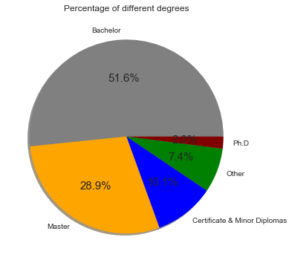
Results
The graph shows us the repartition of the different degrees. Most of the profiles have a Bachelor’s degree, 51.6%, follow with Master 28.9%.

Slide 7
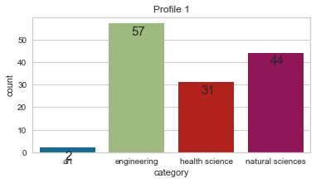
Results
Group Profile 1:
There are 57 profiles for Technology , 44 for natural sciences, 31 for health science.
2 profile are from art.

Slide 8
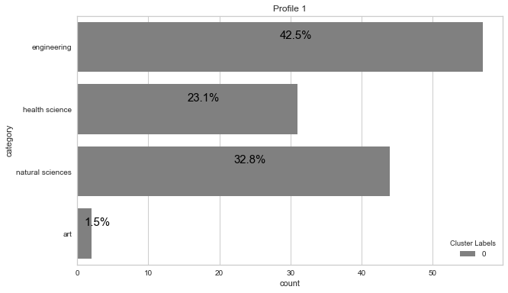
Results
Group Profile 1:
The repartition of the field of study,
42.5% for engineering, 32.8% for natural sciences, 23.1% for health science and 1.5% for art.

Slide 9
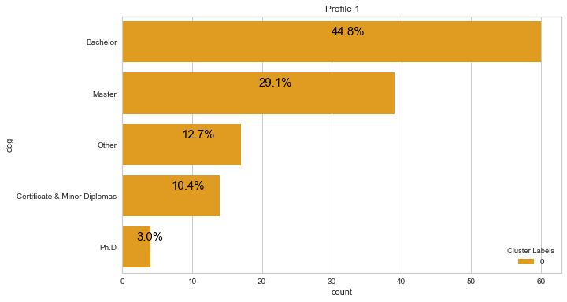
Results
For group profile 1 we can see that 44.8% of degrees are Bachelor, 29.1% master, 10.4% certificate & Minor Diplomas and 3% are Ph.D.

Slide 10
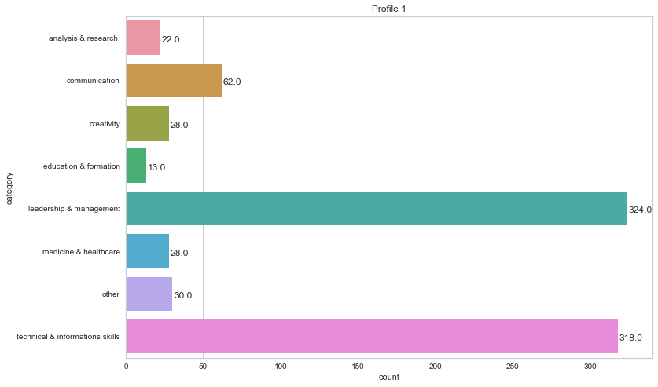
Results
Group Profile 1, we can see that most of the profile have skills related to leadership & management and technical & information skills, respectively 324 and 318.

Slide 11
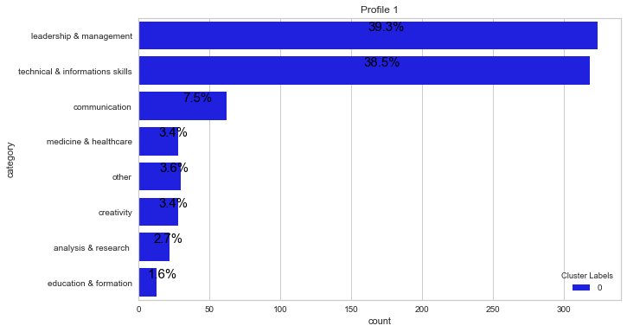
Results
The repartition of category of skills in group profile 1,
Respectively 39.3% and 38.5% for leadership & management and technical & informations skills.

Slide 12
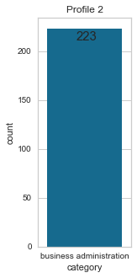
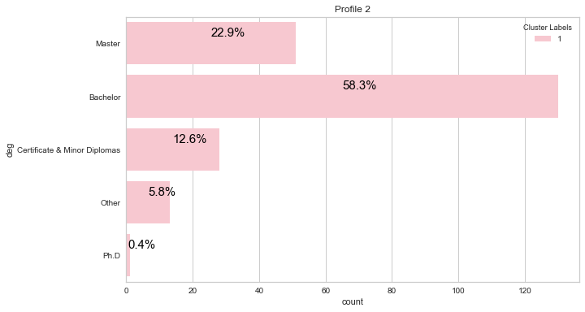
Results
Group profile 2, all those profiles are related to business administration and are more likely to have a Bachelor (58.3%), or a master (22.9%)..

Slide 13
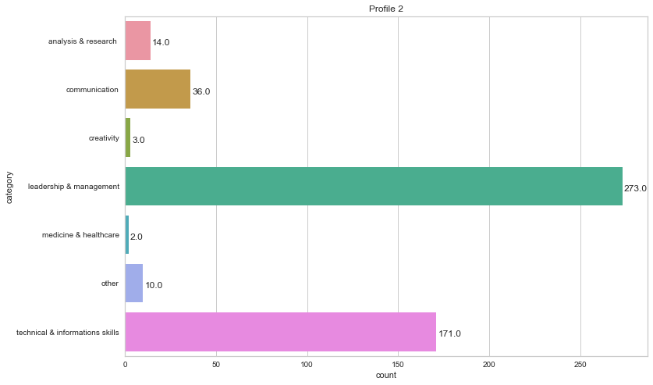
Results
Group profile 2, all those profiles are more likely to have skills related to leadership & management granted 273, or a technical & informations skills granted 171.

Slide 14
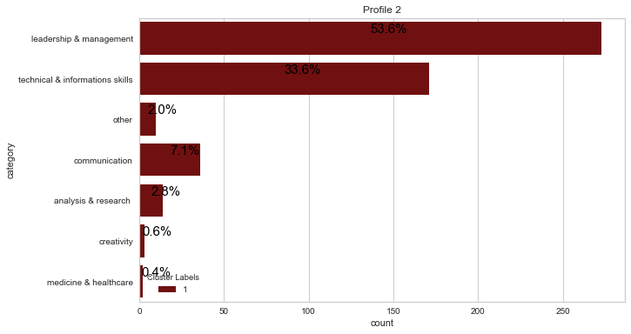
Results
Group Profile 2, most relevant repartition of the categories of skills: 53.6% for leadership & management, 33.6% for technical & informations skills.

Slide 15
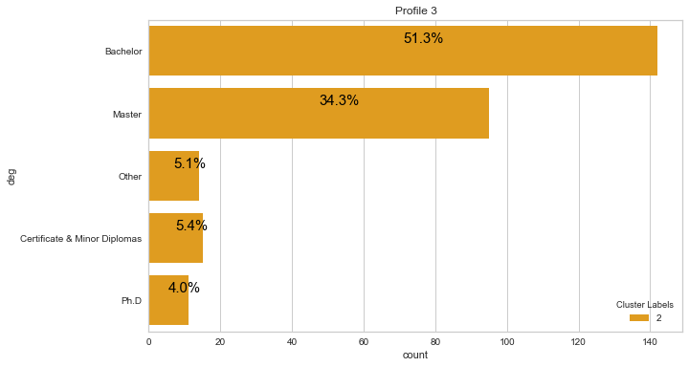
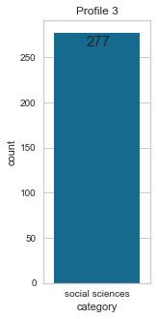
Results
All the profiles of Group profile 3 are from a field of study related to social sciences. Repartition of degrees in group Profile: 51.3% of those profiles have a Bachelor and 34.3% a master.
f

Slide 16
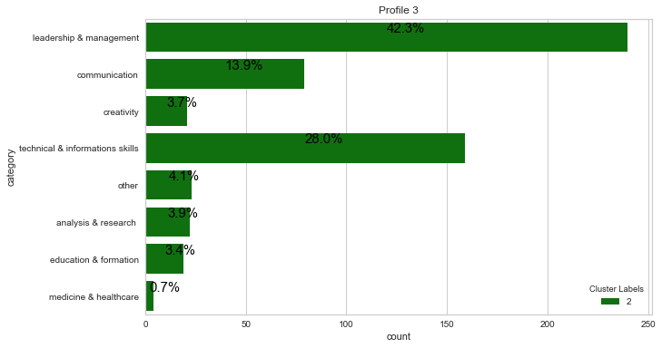
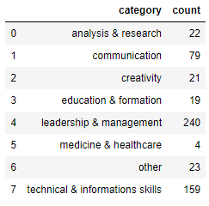
Results
Group Profile 3, 240 skills related to leadership & management, 159 related to technical & informations skills and 79 to communication. The repartition is in group profile 3 is: 42.3% for leadership & management, 28% for technical &informations skills and 13.9% for communication

Slide 17
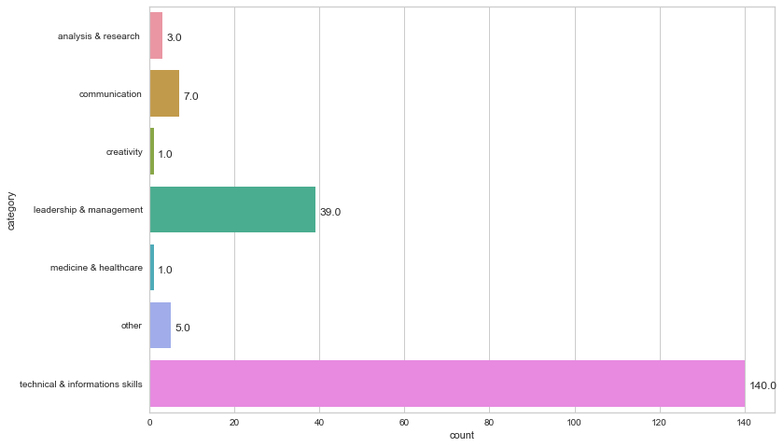
Results
Group profil 4, all the profiles are related to a field of study link to technology granded 140.

Slide 18
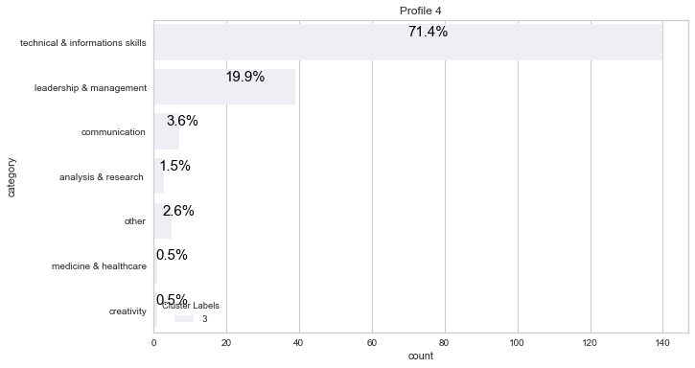
Results
Group Profile 4, We can see in this graph that technical & infromations, granted 71.4%.

Slide 19
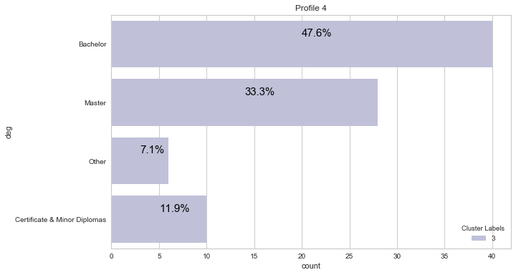
Results
Group Profile 4: 47.6% are Bachelor degrees, 33.3% of master.

Slide 20
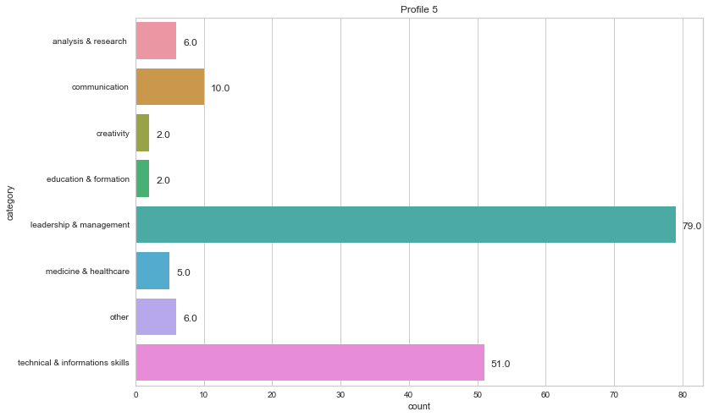
Results
Group profile 5, we notice that most of profiles are related on leadership & management or technical & informations skills, respectively 79 and 51.

Slide 21
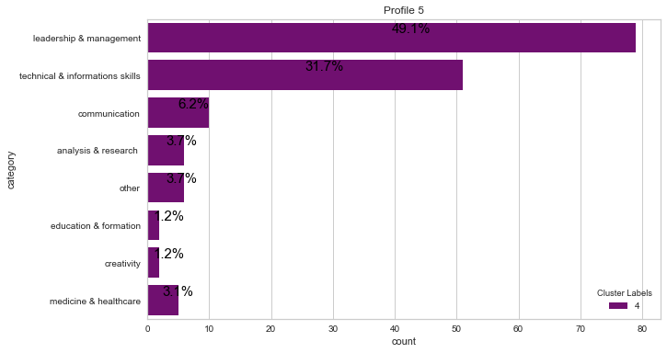
Results
The repartition of the categories of skills in Group profile 5 for the most relevant is: 49.1% for leadership & management and 31.7% for technical & informations skills.

Slide 22
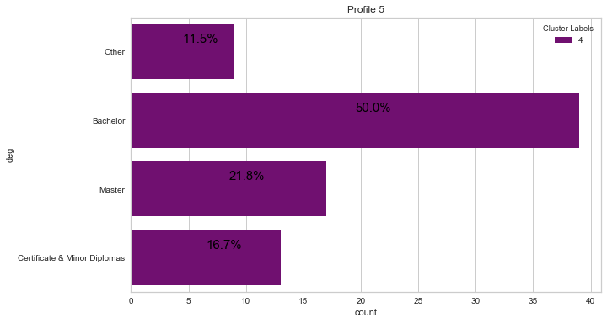
Results
Repartition of degrees: We noticed that the half have a bachelor’s degree, exactly 50%, 21.8% for master, 16.7% for Certificate & Diplomas.

Slide 23
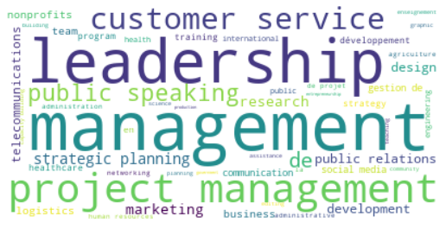
Result
Groupe Profile 1
Highlight specific skills using wordcloud

Slide 24
Result
Group Profil 2,
Highlight specific skills

Slide 25
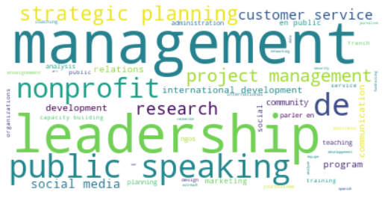
Result
Group Profil 3,
Highlight specific skills

Slide 26
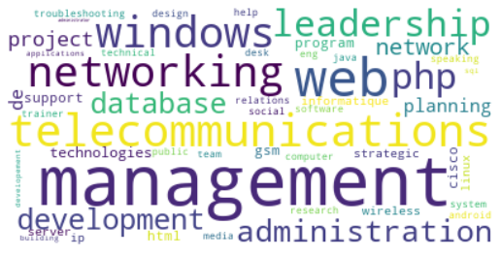
Result
Group profil 4

Slide 27
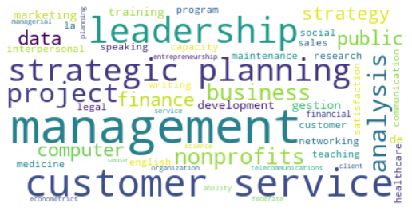
Result
Group profil 5

Slide 28
Discussion & Recommendations
Group / Top | Category skills | Category education | Degree |  | Experience Time/ mean
Profile 1 | leadership & management/ technical & information skills | engineering / health science / natural science | Bachelor’s degree / master |  | 6 years
Profile 2 | leadership & management/ technical & information skills | Business administration | bachelor’s degree |  | 5 years
Profile 3 | leadership & management/ technical & information skills | Social sciences | Bachelor’s degree / master |  | 6 years
Profile 4 | technical & information skills | Technology | Bachelor’s degree / master |  | 6 years
Profile 5 | None | Other | Bachelor’s degree / master |  | 6 years

Slide 29
Discussion & Recommendations
The goal of the project is to provide some insights about the type of skills, of background and the opportunities you can have base on them.

Slide 30
References & Appendices
Link: https://github.com/JeanFrancoChosson/Ayiti_analytics_capstone_project
By: Jean Franco Chosson

