Slide 1

Exploring Background of different professional in Haiti from LinkedIn

Slide 2
Project Description
Haiti is a country with highly educated youth who lack access to opportunity.
why college graduates can’t find a job or a good job? Obtaining employment after college is often difficult. Some graduates accept the first job they find without realizing the potential impact it may have on their future. The primary reason why graduates find obtaining employment difficult is the sheer amount of competition. Not enough opportunity overall in Haiti.
There are many reasons why graduates struggle in their job searching. Personal reasons aside, there are greater causes that many students and recent graduates face such as:
High competition
Little work experience
Few or no skills at all
Little networking
Lack of communication skills

Slide 3
Project Description
Furthermore, I want to focus farther i.e. the choice of the field of study after high school. In Haiti, we do not offer professional orientation to young people. Before choosing a study field, wouldn't it be important to have a clear idea of the opportunities offered in this field, and the skills to be acquired?
what degree or level of education that offer more opportunities or that is the most in demand, what skills are employers looking for? This lead me to explore the backgrounds, experiences, and skills of different professionals in Haiti.
what degree’s lead to what skills?
For this project I want to study the profile of different professionals, and their evolution.
I want to look at their background, the skills they have acquired, and the opportunities they have had.
Graduated high school students will be able to use this study to obtain information on the most demanded study fields. Undergraduate students to get information such whether or not a graduate degree (master’s degree) to get more opportunities in their field of study.

Slide 4
Data acquisition & Methodology
The Data has been acquired from LinkedIn. LinkedIn is a social network for professionals making it the Facebook for your career. This platform is the best for networking with others within your industry or an industry the user may be trying to enter. Not only is this platform great for social networking but it's also great for job searches! So I decided to do my web-scraping project on LinkedIn. I used selenium and beautiful soup to web-scrape different LinkedIn profiles of people located in Haiti.
I was able to build a datasets from 1,093 profiles.
The data set includes information about:
The experiences and its duration
The degrees, certificates and other formations obtained
The different skills obtained

Slide 5
Methodology
I categorized the different formations in: business administration, social science, technology, engineering, natural sciences, health science, art & other.
I categorized the different skills in: analysis & research, communication, creativity, education & formation, leadership & management, medicine & healthcare, technical & information skills and other.
The goal of the project is to analyze those different features and to use Clustering methods to identify groups of similar profiles the data sets collected. Clustering can be considered the most important unsupervised learning algorithm problem; so, as every other problem of this kind, it deals with finding a structure in a collection of unlabeled data. A loose definition of clustering could be “the process of organizing objects into groups whose members are similar in some way”.

Slide 6
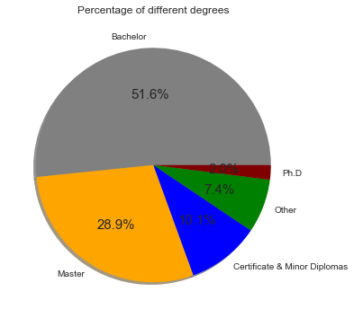
Results
The graph shows us the repartition of the different degrees. Most of the profiles have a Bachelor’s degree, 51.6%, follow with Master 28.9%.

Slide 7
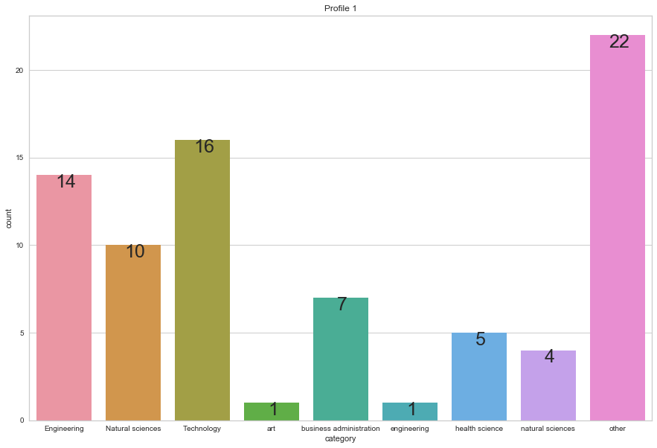
Results
Profile 1:
There are 16 profiles for Technology , 14 for Engineering.
22 profile are from Other that haven’t been able to categorize

Slide 8
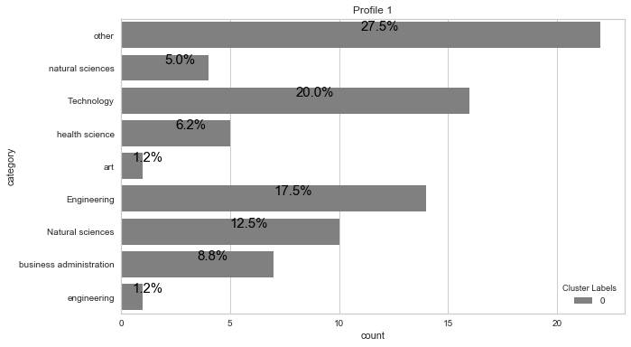
Results
Profile 1:
The repartition of the field of study

Slide 9
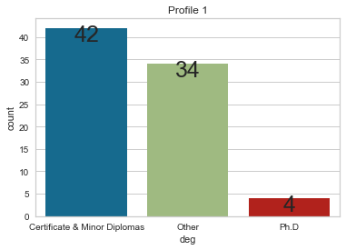
Results
For the profile 1 we can see that most of the profiles have a certificate or minor diplomas granted 42 profiles, and 34 profiles for other ie (unknown or high school). We notice there are 4 profiles that have a Ph.D.

Slide 10
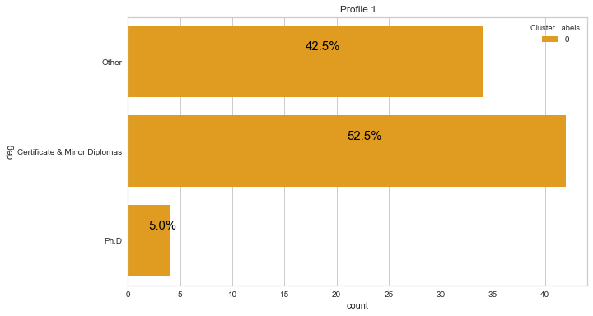
Results
Profile 1
Repartition of the skills

Slide 11
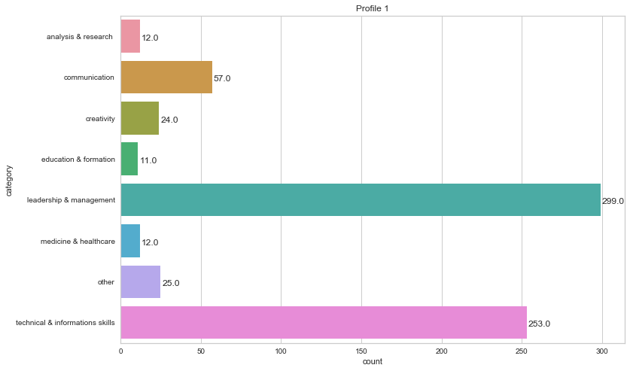
Results
Most of the profiles for Profile 1 are leadership & management and technical & information skills respectively 299 and 253 profiles.

Slide 12
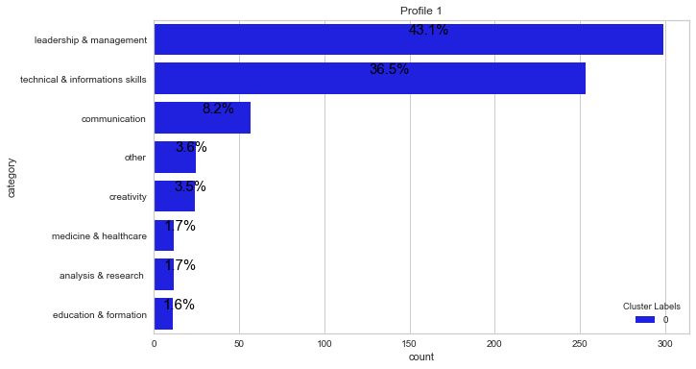
Results
Repartition of the skills in Profile 1

Slide 13
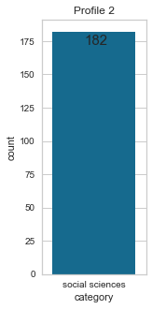
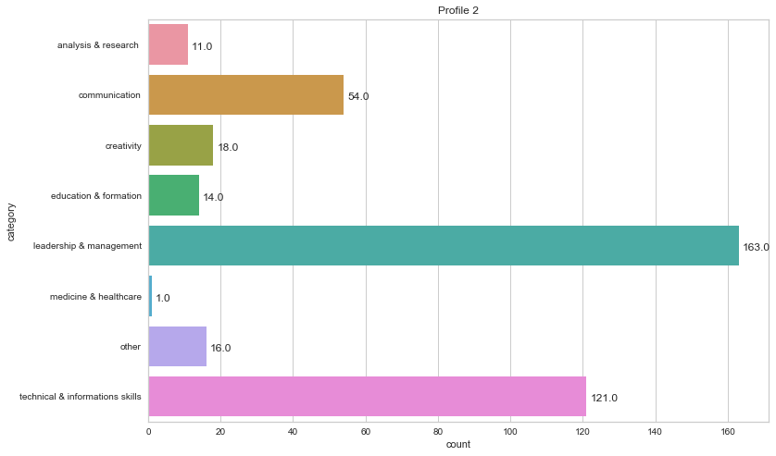
Results
Profile 2
All the profiles are categorized in social sciences, 163 of them have skills categorized leadership & Management
And 121 profiles have skills categorized technical & information skills.

Slide 14
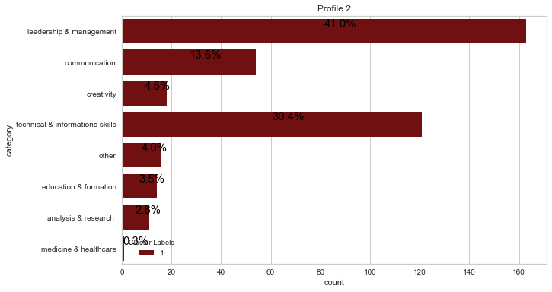
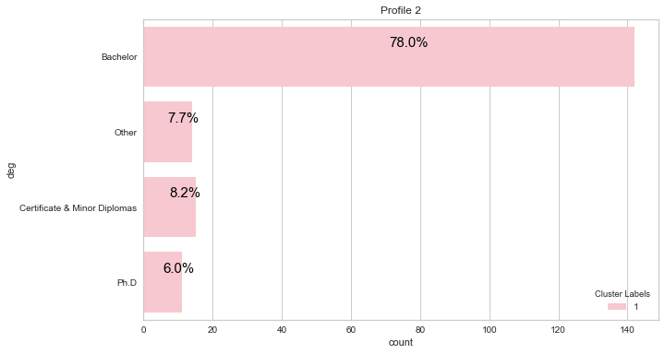
Results
Repartition of category of skills and category of field of study in Profile 2
78% of profiles in profile 2 have bachelor degree and have category of skills in leadership & management, technical & information skills and communication, respectively 41%, 30.4% and 13.6%.
f

Slide 15
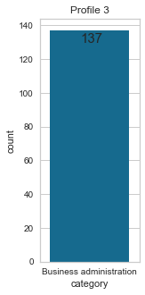
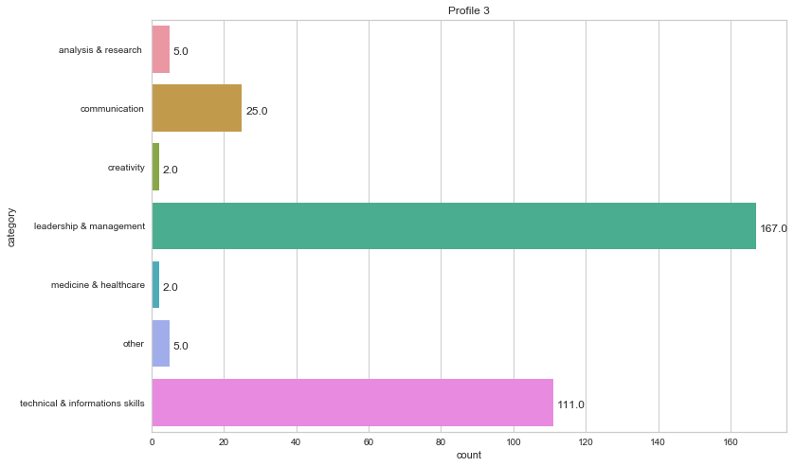
Results
Profile 3, all of those profiles are categorized Business administration,
167 of them have skills of leadership & management, 111 skills of technical & information skills.

Slide 16
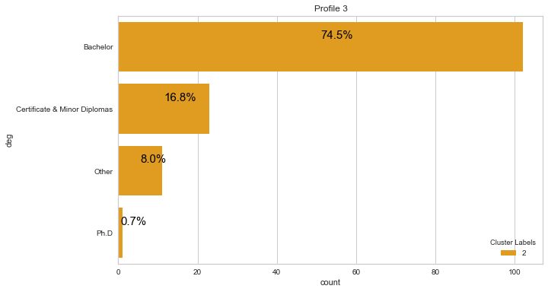
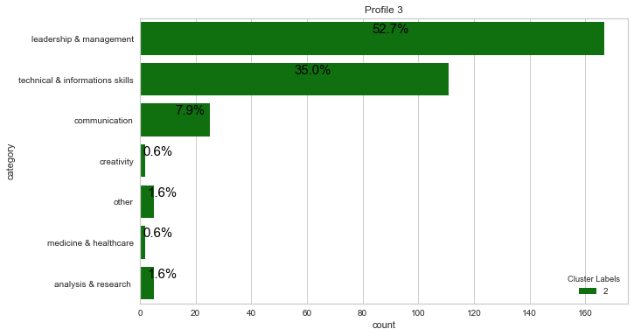
Results
Repartition of category of skills, and degree in group profile 3. We can notice a lot of Bachelor’s degree again granted 74.5% and also leadership & management and technical & informations skills , respectively 52.7%, 36%.
j

Slide 17
Results

Slide 18
Results

Slide 19
Results

Slide 20
Results

Slide 21
Results

Slide 22
Result

Slide 23
Discussion & Recommendations

Slide 24
Discussion & Recommendations

Slide 25
References & Appendices
By: Jean Franco Chosson

