Slide 1
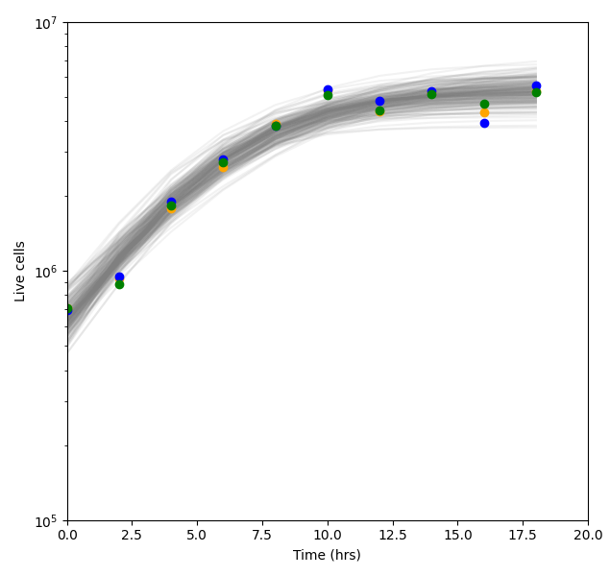
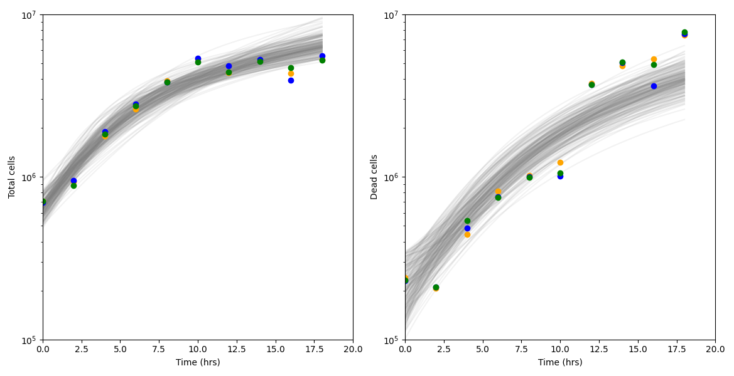
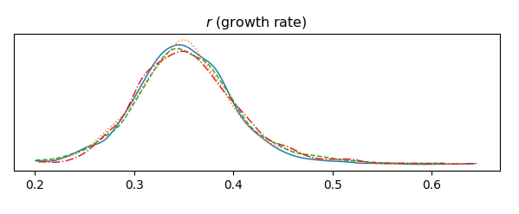
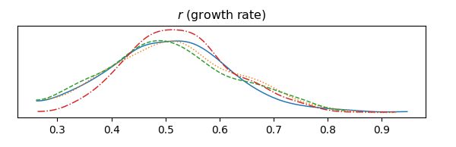

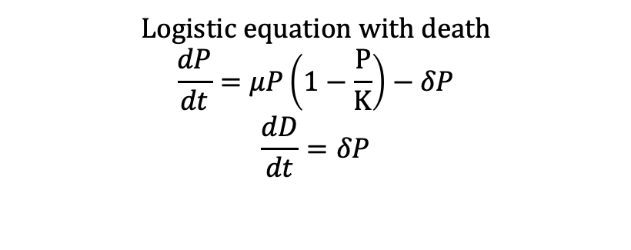
Logistic equation
$$\frac{dP}{dt}=μP\left(1−\frac{P}{K}\right)$$
Logistic equation with death
$$\frac{dP}{dt}=μP\left(1−\frac{P}{K}\right)−δP$$
$$\frac{dD}{dt}=δP$$
P
P+D
D
(a)
(c)
(d)
Total cells/ml
Dead cells/ml
Total cells/ml
Time (days)
Time (days)
Time (days)
(b)
(e)
r (cells/day)
r (cells/day)

