Slide 1
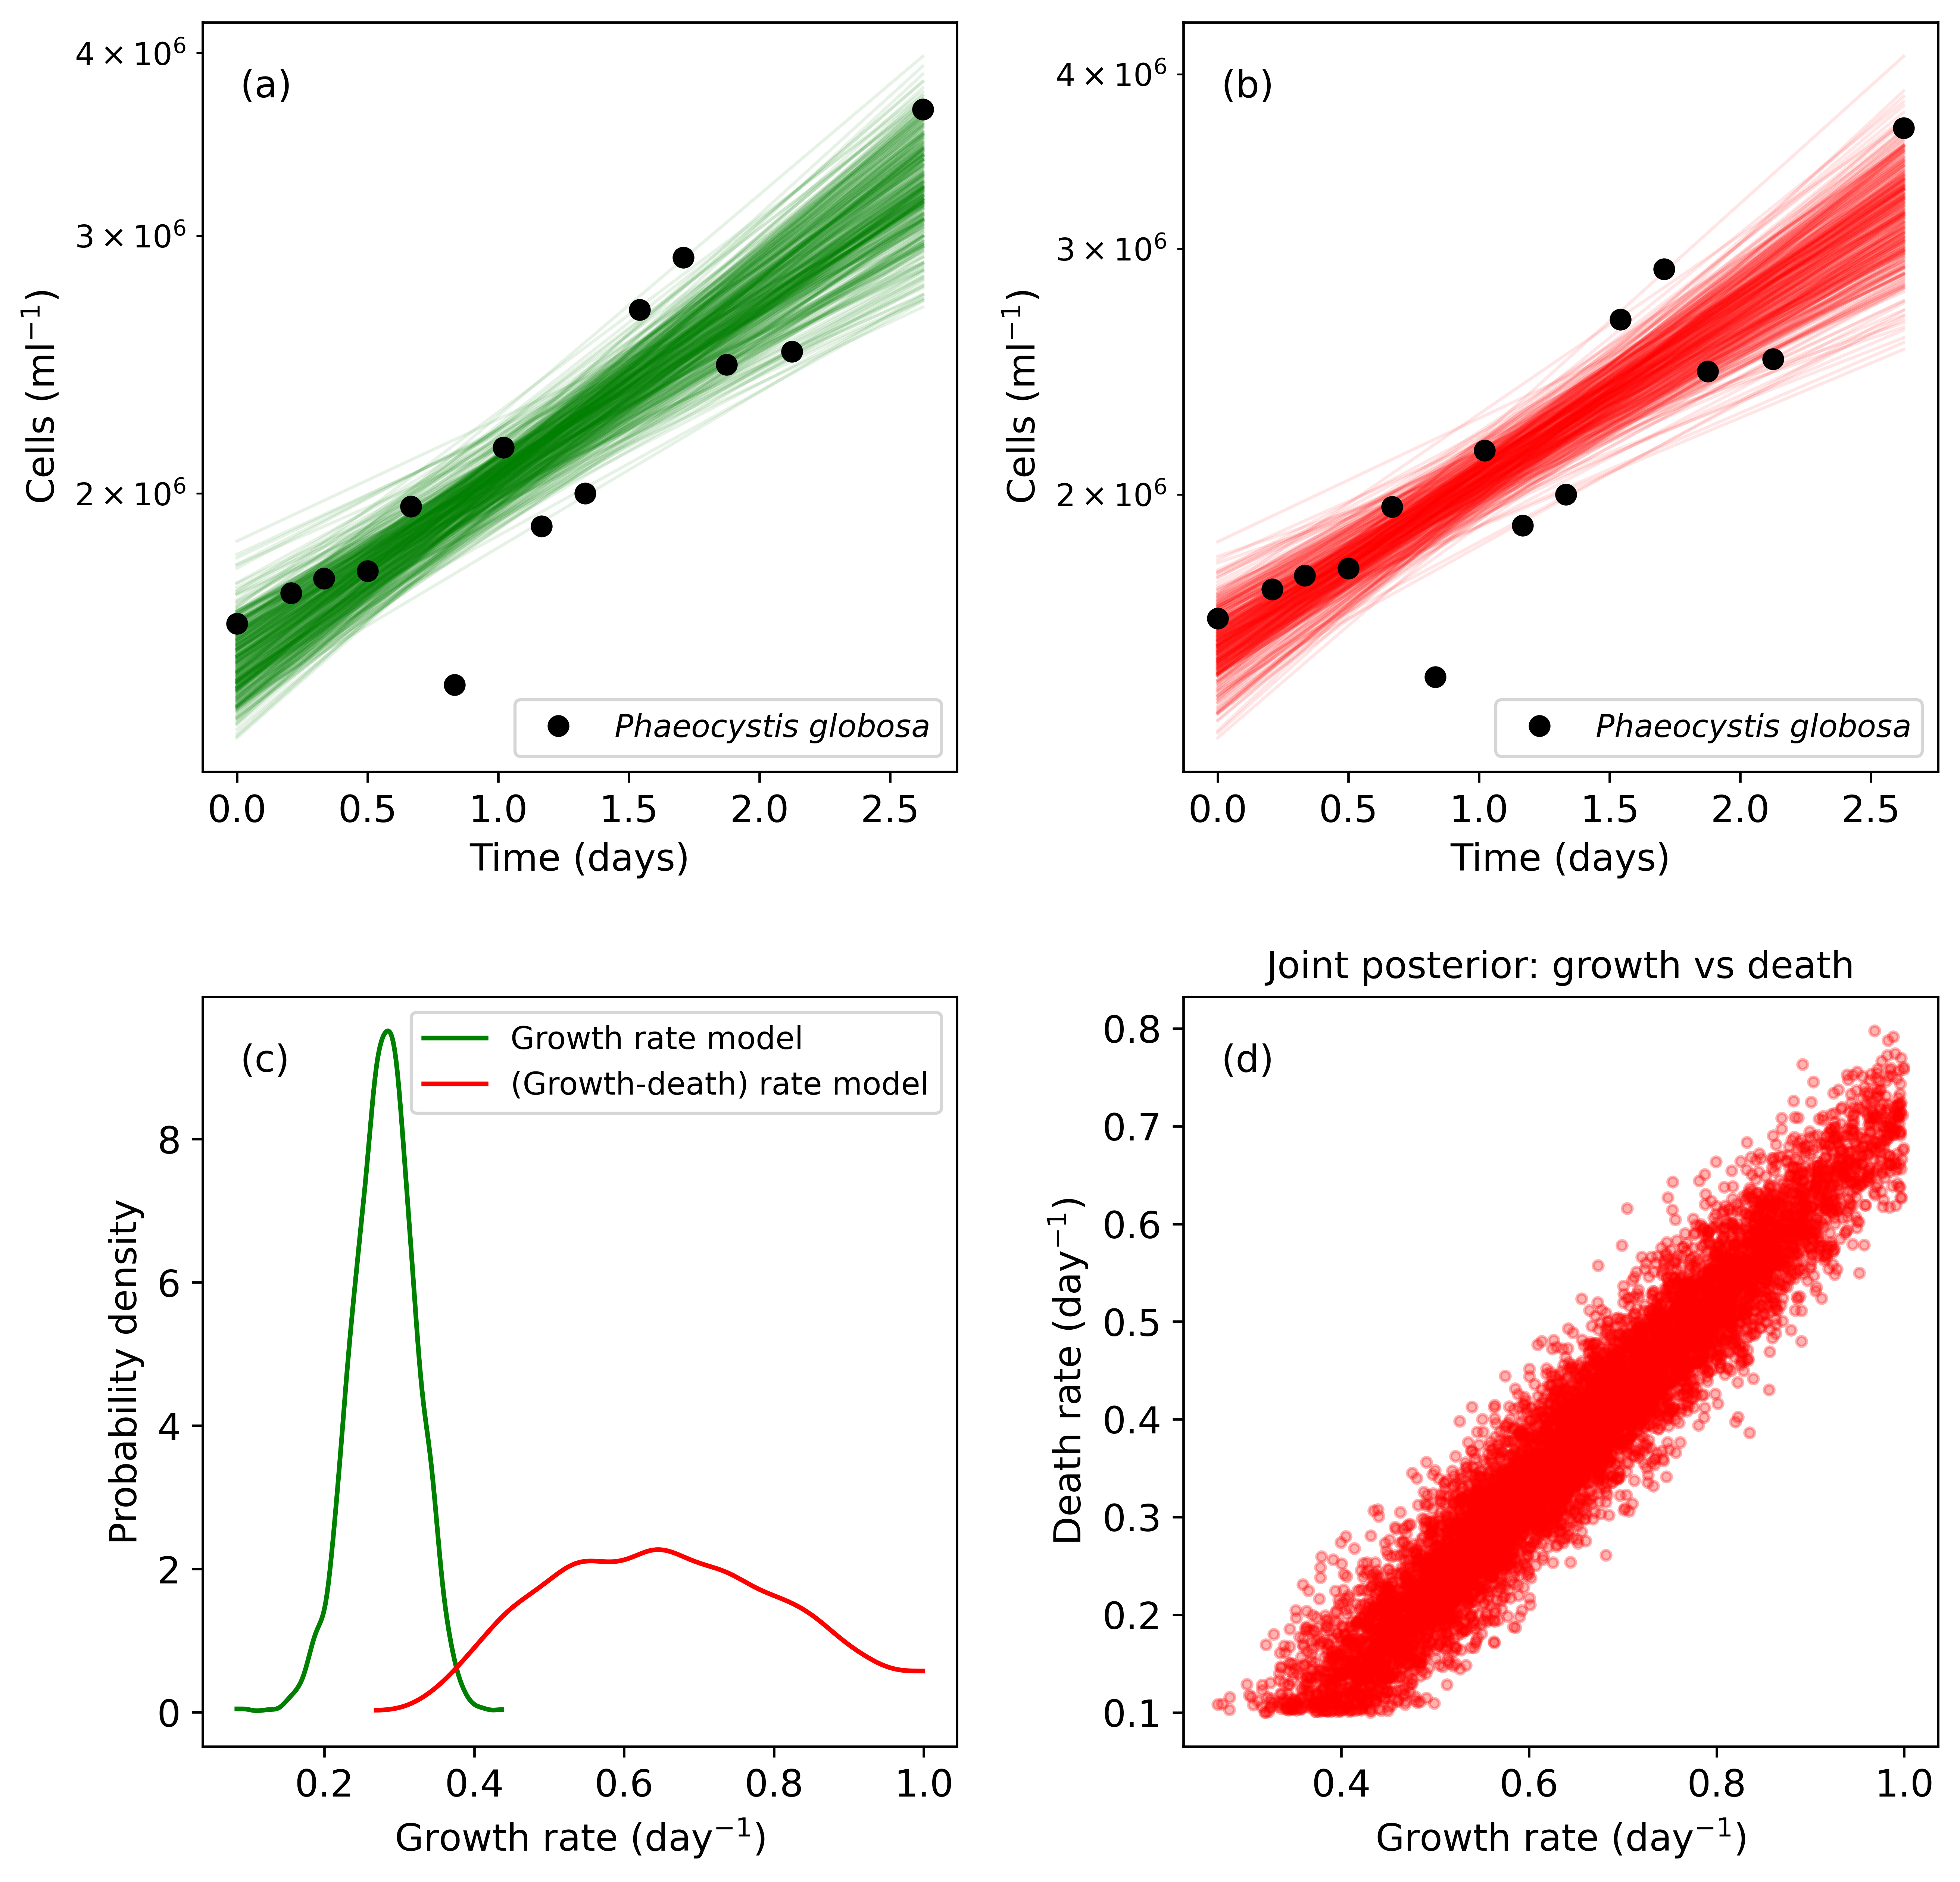
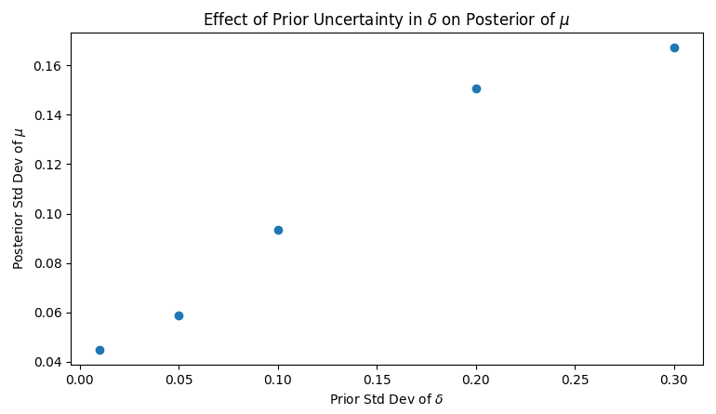
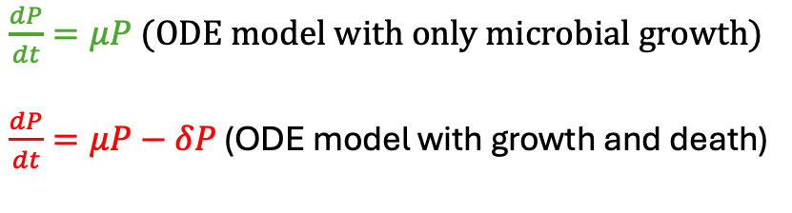
$\frac{dP}{dt}=μP$(ODE model with only microbial growth)
$\frac{dP}{dt}=μP−δP$ (ODE model with growth and death)
(e)

