Slide 1

Chapter 1
Introduction
TCP/IP Protocol Suite
Copyright © The McGraw-Hill Companies, Inc. Permission required for reproduction or display.

Slide 2
OBJECTIVES:
To give a brief history of the Internet.
To give the definition of the two often-used terms in the discussion of the Internet: protocol and standard.
To categorize standard organizations involved in the Internet and give a brief discussion of each.
To define Internet Standards and explain the mechanism through which these standards are developed.
To discuss the Internet administration and give a brief description of each branch.
TCP/IP Protocol Suite

Slide 3
Chapter
Outline
1.1 A Brief History
1.2 Protocols and Standards
1.3 Standards Organizations
1.4 Internet Standards
1.5 Internet Administration
TCP/IP Protocol Suite

Slide 4
1-1 A BRIEF HISTORY
A network is a group of connected, communicating devices such as computers and printers. An internet is two or more networks that can communicate with each other. The most notable internet is called the internet, composed of hundreds of thousands of interconnected networks. Private individuals as well as various organizations such as government agencies, schools, research facilities, corporations, and libraries in more than 100 countries use the Internet.
TCP/IP Protocol Suite

Slide 5
Topics Discussed in the Section
ARPANET
Birth of the Internet
TCP/IP
MILNET
CSNET
NSFNET
ANSNET
The Internet Today
World Wide Web
Growth of the Internet
TCP/IP Protocol Suite

Slide 6
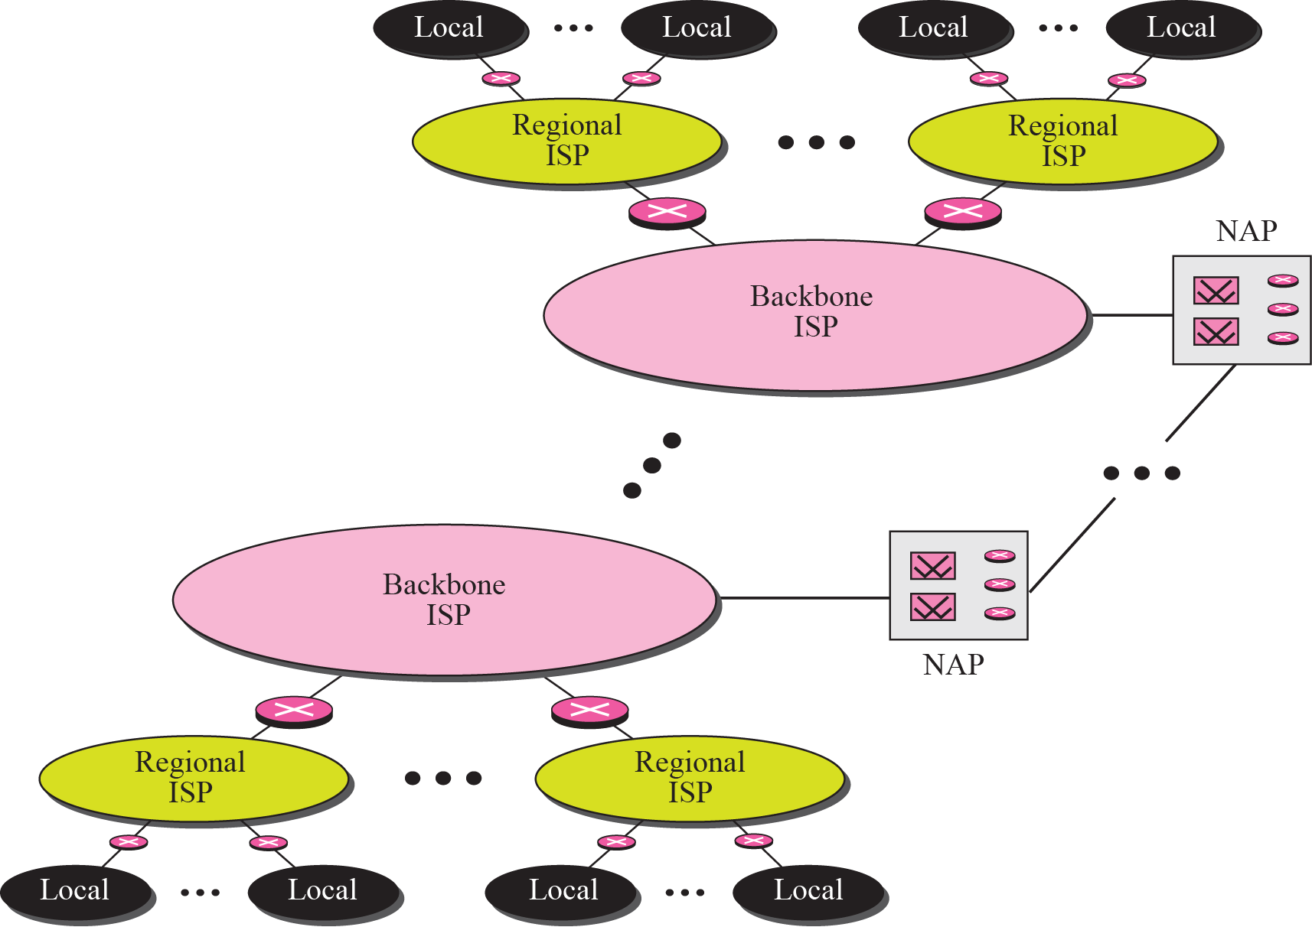
Figure 1.1 Internet today
TCP/IP Protocol Suite
Notes:
To provide connectivity between the end users, these backbone networks are connected by complex switching stations (normally run by a third party) called network access points (NAPs). Some regional ISP networks are also connected to each other by private switching stations called peering points. Backbone ISPs normally operate at a high data rate (10 Gbps, for
example).
Regional ISPs are small ISPs that are connected to one or more backbone ISPs. They are a
Local ISPs provide direct service to the end users. The local ISPs can be connected to regional ISPs or directly to backbone ISPs.t the second level of hierarchy with a lesser data rate.

Slide 7
1-2 PROTOCOLS AND STANDARDS
In this section, we define two widely used terms: protocols and standards. First, we define protocol, which is synonymous with “rule.” Then we discuss standards, which are agreed-upon rules.
TCP/IP Protocol Suite

Slide 8
Topics Discussed in the Section
Protocols
Standards
TCP/IP Protocol Suite

Slide 9
Protocols
A protocol is a set of rules that governs communication.
There is a rule how to make connection (dialing the telephone number), how to respond to the call (picking up the receiver), how to greet, how to let the communication flow smoothly by listening when the other party is talking, and finally how to end the communication (hanging up).
In computer networks, communication occurs between entities in different systems. An entity is anything capable of sending or receiving information.
For communication to occur, the entities must agree on a protocol. A protocol defines what is communicated, how it is communicated, and when it is communicated. The key elements of a protocol are syntax, semantics, and timing.
TCP/IP Protocol Suite

Slide 10
Protocols
Syntax. Syntax refers to the structure or format of the data, meaning the order in which they are presented.
Semantics. Semantics refers to the meaning of each section of bits.
Timing. Timing refers to two characteristics: when data should be sent and how fast it can be sent.
TCP/IP Protocol Suite

Slide 11
Standards
Standards are essential in creating and maintaining an open and competitive market.
They provide guidelines to manufacturers, vendors, government agencies, and other service providers
  to ensure the kind of interconnectivity necessary in today’s marketplace and in international communications
TCP/IP Protocol Suite

Slide 12
Standards
Data communication standards fall into two categories: de facto (meaning “by fact” or “by convention”) and de jure (meaning “by law” or “by regulation”).
  De facto. Standards that have not been approved by an organized body but have been adopted as standards through widespread use are de facto standards.
  De jure. De jure standards are those that have been legislated by an officially recognized body.
TCP/IP Protocol Suite

Slide 13
1-3 STANDARDS ORGANIZATION
Standards are developed through the cooperation of standards creation committees, forums, and government regulatory agencies.
TCP/IP Protocol Suite

Slide 14
Topics Discussed in the Section
Standards Creation Committees
Forums
Regulatory Agencies
TCP/IP Protocol Suite

Slide 15
Standards Creation Committees
International Standards Organization (ISO).
  is a multinational body whose membership is drawn mainly from the standards creation committees of various governments throughout the world
International Telecommunications Union–Telecommunications Standards Sector (ITU-T)
  This committee was devoted to the research and establishment of standards for telecommunications in general and phone and data systems
TCP/IP Pro t ocol Suite

Slide 16
Standards Creation Committees
American National Standards Institute (ANSI).
  ANSI’s expressed aims include serving as the national coordinating institution for voluntary standardization in the United States, furthering the adoption of standards as a way of advancing the U.S. economy, and ensuring the participation and protection of the public interests.
TCP/IP Protocol Suite

Slide 17
Standards Creation Committees
Institute of Electrical and Electronics Engineers (IEEE).
  International in scope, it aims to advance theory, creativity, and product quality in the fields of electrical engineering, electronics, and radio as well as in all related branches of engineering. As one of its goals, the IEEE oversees the development and adoption of international standards for computing and communication.
TCP/IP Protocol Suite

Slide 18
Forums
The forums work with universities and users to test, evaluate, and standardize new technologies.
The forums present their conclusions to the standards bodies. Some important forums for the telecommunications industry include the following:
  Frame Relay Forum
  ATM Forum
  Universal Plug and Play (UPnP) Forum
TCP/IP Protocol Suite
Notes:
Frame Relay Forum. The Frame Relay Forum was formed by Digital Equipment Corporation,
Northern Telecom, Cisco, and StrataCom to promote the acceptance and
implementation of Frame Relay. Today, it has around 40 members representing North
America, Europe, and the Pacific Rim. Issues under review include flow control, encapsulation,
translation, and multicasting. The forum’s results are submitted to the ISO.
❑ ATM Forum. The ATM Forum promotes the acceptance and use of Asynchronous
Transfer Mode (ATM) technology. The ATM Forum is made up of customer premises
equipment (e.g., PBX systems) vendors and central office (e.g., telephone
exchange) providers. It is concerned with the standardization of services to ensure
interoperability.
❑ Universal Plug and Play (UPnP) Forum. The UPnP forum is a computer network
forum that supports and promotes simplifying the implementation of
networks by creating zero-configuration networking devices. A UPnP-compatible
device can join a network without any configuration.

Slide 19
Regulatory Agencies
All communications technology is subject to regulation by government agencies such as the Federal Communications Commission in the United States. The purpose of these agencies is to protect the public interest by regulating radio, television, and wire/cable communications
  Federal Communications Commission (FCC). The Federal Communications Commission (FCC) has authority over interstate and international commerce as it relates to communications.
TCP/IP Protocol Suite

Slide 20
1-4 INTERNET STANDARDS
An Internet standard is a thoroughly tested specification that is useful to and adhered to by those who work with the Internet. It is a formalized regulation that must be followed. There is a strict procedure by which a specification attains Internet standard status. A specification begins as an Internet draft. An Internet draft is a working document with no official status and a six-month lifetime.
TCP/IP Protocol Suite

Slide 21
Topics Discussed in the Section
Maturity Levels
Requirement Levels
TCP/IP Protocol Suite

Slide 22
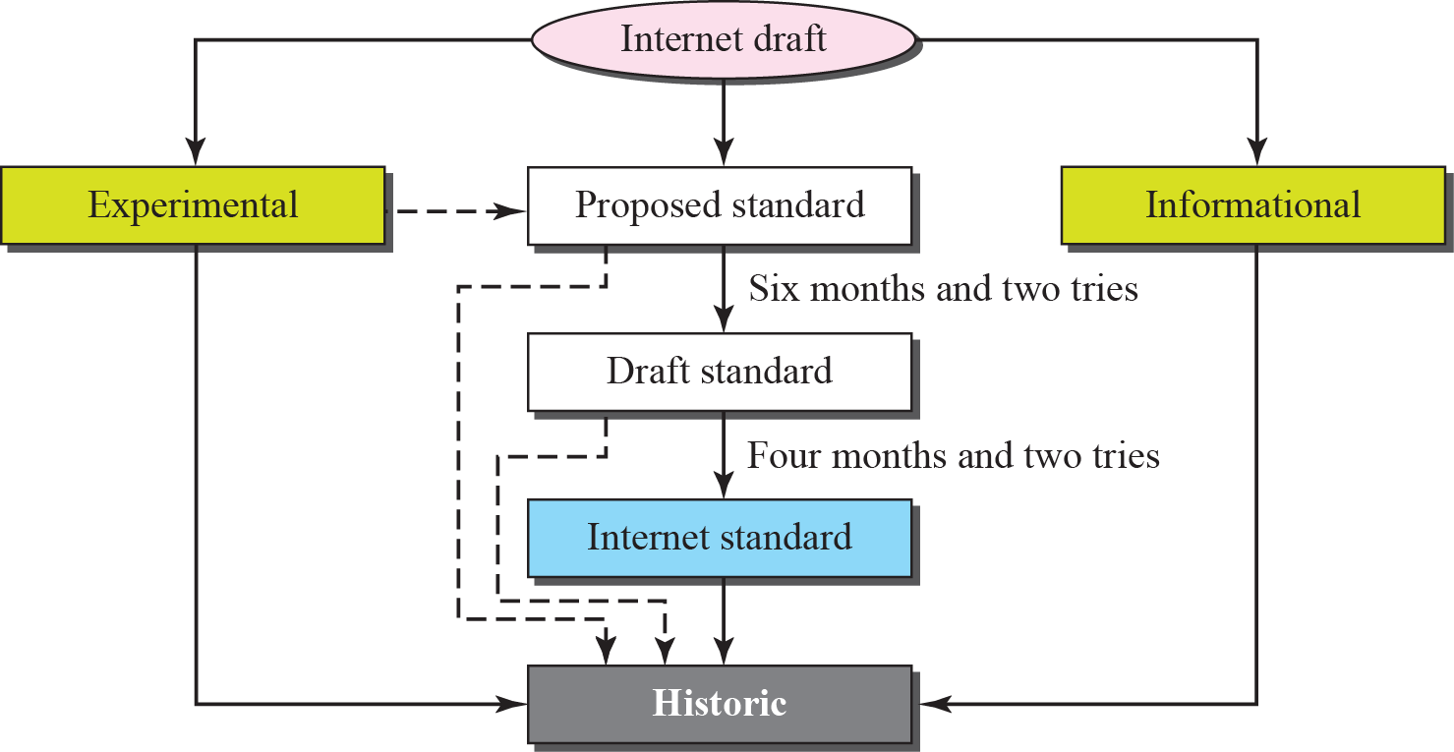
Figure 1.2 Maturity levels of an RFC
TCP/IP Protocol Suite
Notes:
An RFC, during its lifetime, falls into one of six maturity levels: proposed standard, draft
standard, Internet standard, historic, experimental, and informational

Slide 23
Maturity Levels
Proposed Standard
  A proposed standard is a specification that is stable, well understood, and of sufficient interest to the Internet community. At this level, the specification is usually tested and implemented by several different groups.
Draft Standard
  A proposed standard is elevated to draft standard status after at least two successful independent and interoperable implementations. Barring difficulties, a draft standard, with modifications if specific problems are encountered, normally becomes an Internet standard.
Internet Standard
  A draft standard reaches Internet standard status after demonstrations of successful implementation.
TCP/IP Protocol Suite

Slide 24
Maturity Levels
Historic
  The historic RFCs are significant from a historical perspective. They either have been superseded by later specifications or have never passed the necessary maturity levels to become an Internet standard.
Experimental
  An RFC classified as experimental describes work related to an experimental situation that does not affect the operation of the Internet. Such an RFC should not be implemented in any functional Internet service.
Informational
  An RFC classified as informational contains general, historical, or tutorial information related to the Internet. It is usually written by someone in a non-Internet organization, such as a vendor.
TCP/IP Protocol Suite

Slide 25
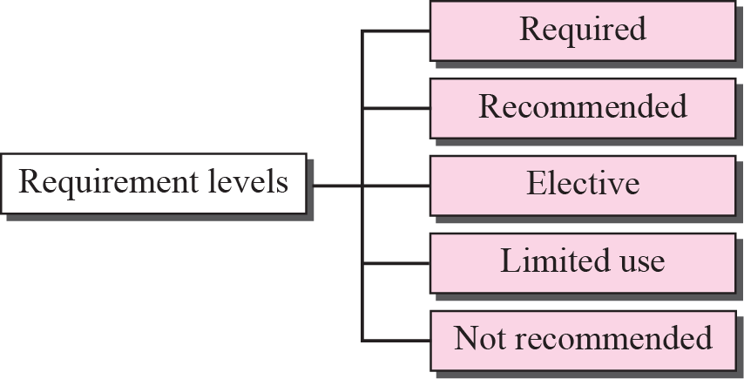
Figure 1.3 Requirement levels of an RFC
TCP/IP Protocol Suite
Notes:
RFCs are classified into five requirement levels: required, recommended, elective,
limited use, and not recommended (see Figure 1.3).

Slide 26
Requirement Levels
Required
  An RFC is labeled required if it must be implemented by all Internet systems to achieve minimum conformance. For example, IP (Chapter 7) and ICMP (Chapter 9) are required protocols.
Recommended
  An RFC labeled recommended is not required for minimum conformance; it is recommended because of its usefulness. For example, FTP (Chapter 21) and TELNET (Chapter 20) are recommended protocols.
Elective
  An RFC labeled elective is not required and not recommended. However, a system canuse it for its own benefit.
TCP/IP Prot ocol Suite

Slide 27
Requirement Levels
Limited Use
  An RFC labeled limited use should be used only in limited situations. Most of the experimental RFCs fall under this category.
Not Recommended
  An RFC labeled not recommended is inappropriate for general use. Normally a historic (deprecated) RFC may fall under this category.
TCP/IP Protocol Suite

Slide 28

Note
RFCs can be found at
http://www.rfc-editor.org.
TCP/IP Protocol Suite

Slide 29
1-5 INTERNET ADMINISTRATION
The Internet, with its roots primarily in the research domain, has evolved and gained a broader user base with significant commercial activity. Various groups that coordinate Internet issues have guided this growth and development. Appendix G gives the addresses, e-mail addresses, and telephone numbers for some of these groups. Figure 1.4 shows the general organization of Internet administration.
TCP/IP Protocol Suite

Slide 30
Topics Discussed in the Section
Internet Society (ISOC)
Internet Architecture Board (IAB)
Internet Research Task Force (IRTF)
Internet Assigned Number Authority (IANA)
Internet Corporation for Names and Numbers
(ICANN)
Network Information Center (NIC)
TCP/IP Protocol Suite

Slide 31


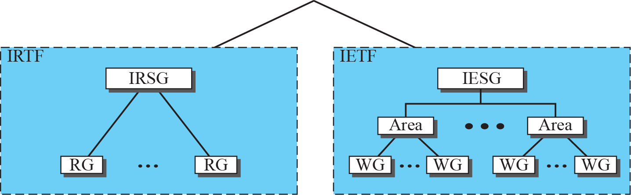
Figure 1.4 Internet administration
TCP/IP Protocol Suite
Notes:
The Internet, with its roots primarily in the research domain, has evolved and gained
a broader user base with significant commercial activity. Various groups that coordinate
Internet issues have guided this growth and development. Appendix G gives the addresses,
e-mail addresses, and telephone numbers for some of these groups. Figure 1.4
shows the general organization of Internet administration.

Slide 32
INTERNET ADMINISTRATION
Internet Society (ISOC) - provide support for the Internet standards process.
Internet Architecture Board (IAB) - is the technical advisor to the ISOC. The main purposes of the IAB are to oversee the continuing development of the TCP/IP
TCP/IP Protocol Suite

Slide 33
INTERNET ADMINISTRATION
Currently nine areas have been defined, although this is by no means a hard and fast number. The areas are:
  ❑ Applications
  ❑ Internet protocols
  ❑ Routing
  ❑ Operations
  ❑ User services
  ❑ Network management
  ❑ Transport
  ❑ Internet protocol next generation (IPng)
  ❑ Security
TCP/IP Protocol Suite

Slide 34
INTERNET ADMINISTRATION
Internet Engineering Task Force (IETF) - IETF is responsible for identifying operational problems and proposing solutions to these problems
Internet Research Task Force (IRTF) - IRTF focuses on long-term research topics related to Internet protocols, applications, architecture, and technology.
TCP/IP Protocol Suite

Slide 35
Note
The addresses and websites for Internet organizations can be found in
Appendix G.
TCP/IP Protocol Suite

