Slide 1

Medi-Caps University
Department of Computer Science & Engineering Faculty of Engineering
September 2021
Team Members:
Supervised By:
Milind Kaul [EN18CS301141]
Mihir Khatri [EN18CS301140]
Prakhar Soni [EN18CS301174]
Dr. KC Bandhu

Slide 2
Integrating Graphology and Machine Learning for Accurate Prediction of Personality : A Novel Approach
Submitted in partial fulfillment of requirement of the Degree of BACHELOR OF TECHNOLOGY in COMPUTER SCIENCE AND ENGINEERING

Slide 3
Introduction
Among all the unique characteristics of a human being, handwriting carries the richest information to gain the insights into the physical, mental and emotional state of the writer. Graphology is the art of studying and analyzing handwriting, a scientific method used to determine a person's personality by evaluating various features from the handwriting.
To make this method more efficient and reliable, introduction of machines to perform the feature extraction and mapping to various personality traits can be done. This compliments the graphologists, and also increases the speed of analyzing handwritten samples. Various approaches can be used for this type of computer aided graphology.

Slide 4
Problem Statement
Automated handwriting analysis can be used to examine personal traits of candidates during interviews accurately as the accuracy of an analyst highly depends on his skill set. Also hiring a graphologist to analyze hundreds of samples for recruitment purpose will be time consuming and not be feasible economically.
The scope of this project is to determine a methodology for analyzing real world handwritten text samples with the aid of technology. Various parameters of the handwritten samples like Margin, Baseline, Size of the letter and Slant will be taken into consideration to determine corresponding traits.

Slide 5
Objectives of Project
Users should be able to upload the image.
System should be able to pre process the given input to suppress the background.
System should detect text regions present in the image.
System should retrieve text present in the image and display them to the user.
The main attention of our project is feature extraction and classification.

Slide 6
Existing Work
A paper published in the year 1995 at the SUNY, Buffalo by Prof S. N. Srihari and two others from the Center of Excellence for document analysis and recognition gave a lot of insights which led to the progress in the field of Computer Aided Graphology. This paper focuses only at the prime features of a page of handwritten sample that are page margins, line spacing, line direction, slant and zone ratios. The methodology used is scanning, preprocessing, feature extraction, analysis and finally, trait determination. This system was mainly designed to prove the validity of the graphology rules that were applied in the implementation of the system. This paper restricts its scope to macro analysis of the handwriting sample. There are no micro features like alphabet, loops etc. taken into consideration.

Slide 7
Existing Work (cont’d)
A paper based on Artificial Neural Network by Dr. KR Ananda Kumar, explores the implementation of a machine learning approach in the field of handwriting analysis. This paper proposed a method to predict the personality traits of a person by analyzing the baseline, pen pressure and the letter “t” as found in the individual's handwriting sample. These extracted features are then given as an input to the artificial neural network which in turn gives output as personality trait to the user. The future work discussed in this paper are, including more features of the handwriting like the size of the letters and the margins as inputs for personality trait determination to improve the system output.

Slide 8
Proposed Method
The proposed work investigates the unique persona prediction of a person using computer-aided technology.
Various methods are utilized, including feature extraction and Support Vector Machine. It is a supervised machine learning algorithmic program used for each classification and regression.
Though we say that Support Vector Machine (SVM) is compatible with regression issues, it's a lot appropriate for classification issues. SVM will take all the parameters as the input and give the unique personality or behavior of the writer as the output.

Slide 9
Scope of the Project
The proposed methodology would help automate the behavioural analysis in handwriting that would determine the personality of the writer. This would save both time and effort of Graphologists in dealing with real world problems.
The limitations encountered in the current technique of using ANN can be solved by combining other Machine Learning Algorithms as well as the usage of Natural Language Processing for image pre-processing. This could improve the speed and efficiency during the handwriting analysis.

Slide 10
Scope of the Project (cont’d)
This tool can also be applied to other applications such as Forensic Graphology, which is used by Forensic investigators to use handwriting pattern/technology to determine personality traits of an individual.
It can also be used by Genealogists and Biographers who want to learn more about the personality traits in Historical Profiling.
Graphology can also help in Corporate training for highlighting the qualities and weakness of the working staff.

Slide 11
Requirements
Sample Training set will be generated using 100 samples of handwriting, which will be examined by a professional Graphologist
The Graphological analysis will be done using Computer Aided Technology. This process will help automate the process of analysing real world text samples as well as efficiently predicting the personality traits of the writer.
Based on the characteristics corresponding to particular trait, as identified by the graphologist, Feature Vector Matrix will be created.

Slide 12
Requirements (cont’d)
The project will be based on the foundation of Artificial Neural Network, implementing various Machine Learning algorithms. Baseline, writing pressure, spacing between letters, words and lines, size of letters, strokes connecting the letters, width of margins, starting strokes, ending-strokes, slant of word etc. are the most common parameters that help in identifying the personality traits of an individual through handwriting analysis.
The Feature Vector Matrix for a new handwriting sample will be created and then its similarity with the trained dataset would be calculated using the similarity matrix method.

Slide 13
Limitations
Graphology is an “observational science”. That means there is no cold, hard, evidence that describes the 99.9% accuracy of the results, nor is there a guarantee that every person behaves the same way as their script says they do.
The studies in this technique originate in the mind of a person (i.e. personality traits). Therefore, it can’t determine the age of a person nor can it detect the gender by simply analysing the handwriting, as both male and female can have similar traits.

Slide 14
Functional And Non-Functional Requirements

Slide 15
Introduction
Requirement specification encompasses the needs of this project. It aims at providing a full description of the requirements based on the concepts deﬁned in the Problem Statement. There are important factors on which a Graphologist predicts the behavior of human being. These features are explained in more detail.

Slide 16
Scope
The scope of this SRS document is to list the features of this system and the functionalities used to overcome the problems encountered and to achieve the objectives mentioned earlier. Here, we will be using certain Graphological Features to determine personality traits of an individual and implementing this using various Machine Learning Algorithms.

Slide 17
Features Recognized
The scope of our work is to be able to predict the characteristic traits of a person intelligently using the process of Graphology. There are various parameters used by graphologists for handwriting analysis. They are:
Baseline
Letter – Slant
Size of the letter
Margin width

Slide 18
Functional Requirements Baseline
The imaginary line along which the writer aligns the bottoms of the middle zone letters when asked to write on a blank paper is called the Baseline.
Slanting downwards, rising upwards and level are the three most common baselines found in handwriting analysis.
The emotional stability and disposition of writer is judged by the baseline in the handwriting. It is obtained by ﬁnding the co-ordinate of all the pixels and the pixels are ﬁtted to a line from left to right.

Slide 19
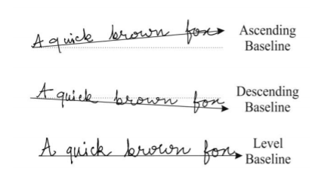
Baseline | Corresponding Traits
Ascending (rising Upwards) | Optimistic
Descending(Slanting Downward) | Pessimistic
Level straight | Balanced

Slide 20
Margin
Margin is the space left while writing either to the left or to the right.
This feature reveals the exquisite temperament, adjustment and social interaction of the person with the society.
It is obtained by applying the bounding box to whole paragraph .
The bounding box gives us values so that we can get the margin distances from those parameters.

Slide 21
Margin | Corresponding Trait
Wide Left | Courageous
Wide Right | A reserved person
No margin | Insecure and devotes oneself Completely
Even Margin | Self disciplined and balanced

Slide 22
Letter Slant
The slant of the letter is used to understand whether an individual's handwriting is inclined towards the right or towards the left or is it vertical. Slant of the handwriting indicates the emotional interactions of the writer.
There are five classes in slant. To determine the slant, the following method is proposed. In the grid of every individual letter that would be obtained after template matching, a line will be drawn between the lowermost and the uppermost points of that letter. Slope of this line will calculate and similarly it would be calculated for all other letters. The average of all slopes calculated will give the slant of the letters.

Slide 23
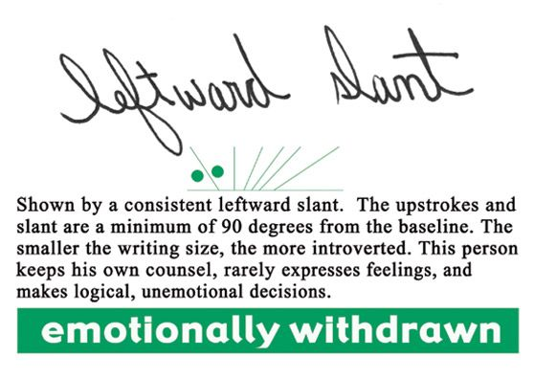
Slant | Corresponding Trait
Extreme Left | Fear of the future, defensive
Extreme Right | Lack of self-control, impulsive, unrestrained, very expressive
Left | Reflective, independent, not sympathetic
Right | Expressive, freedom of thought, extrovert, future orientation.
Vertical | Head controls over heart, independent emotional nature

Slide 24
Size of the letter
Size has its own signiﬁcance in the process of handwriting. Size is an unﬁxed trait; it is the determined by the average height.
To get the average height, image is scanned across column by column to ﬁnd the ﬁrst black pixel and the last black pixel.

Slide 25
Size of the letter | Corresponding Trait
Big | High Self esteem
Medium | Emotionally Stable
Small | Generous

Slide 26
There are some Processes that we are going to use in our research.
1) Inversion : This process is done to invert all the colors from the original image. In this case, the image will be converted into black and white. Image at threshold values 50, 100, 200, and 255. The image at threshold value 255 gives the accurate output for inversion. The visibility of the image increases with the increase in inversion value. This is because the pixel value increases from 0 (black) to 255 (white). This is done thereby keeping in mind that the maximum value for a pixel can only be 255, which will be the brightest and thus be taken in this process.

Slide 27
2) Dilation : This process is used mainly in Contour Formation. Two consecutive lines can easily be segmented for classifications of traits by doing so. Image output at dilated value (5,50), (5,100), (5,200) and (5, 10000). The dilated value (5,100) gives more accurate results.The dilation increases the foreground object area or the image pixels. A kernel value is set to achieve this. From the results obtained, it is clear that the contour formation decreases after a certain threshold with the increase in dilation value. In this case, the kernel value (5,100) gives the best output in contour formation.

Slide 28
3) Changes with Anchor point : In this process, the Line Segmentation is done by selecting the value of the Anchor Point. This value is taken at random, and depending on the result obtained and verifying it manually, an appropriate value is fixed upon. For the result, multiple values of Anchor Point are taken, ranging from 1000 to 15000. Since the accuracy of this process can only be determined manually, this test is carried out on multiple images before fixing an appropriate value of Anchor Point.

Slide 29
4) SVM : SVM classifiers are used to recognize the letters and words in the handwritten samples accurately which are then used for Template Matching. This involves several steps, where each step has its benefit for the recognition process.
Preprocessing
Feature Extraction
Features Normalization
Classification and Recognition

Slide 30
Specifications
Software Specifications:
Operating Systems: Windows
Software: Matlab R2013a / other higher versions.
Hardware Specifications:
Processors: Any Intel or AMD x86 processor supporting SSE2 instruction set.
Disk Space: 1 GB for MATLAB only. 34 GB for a typical installation.
RAM: 1024 MB (At least 2048 MB recommended).

Slide 31
Non Functional Requirement
Performance: Handwritten characters in the input image must be processed accurately.
Functionality: This system will deliver on the functional requirements mentioned in this document.
Flexibility: Easy to use and flexibility to upload multiple image formats.
Learn Ability: Trained to recognize handwriting features to their corresponding personality traits.

Slide 32
The personality traits revealed by baseline, margin, slant of the words and Size of the letter of a person's handwriting were identified.
The baseline would be evaluated using the method of Polygonalization while margin will be calculated using the method of vertical scanning.

Slide 33
Block Diagram

Slide 34
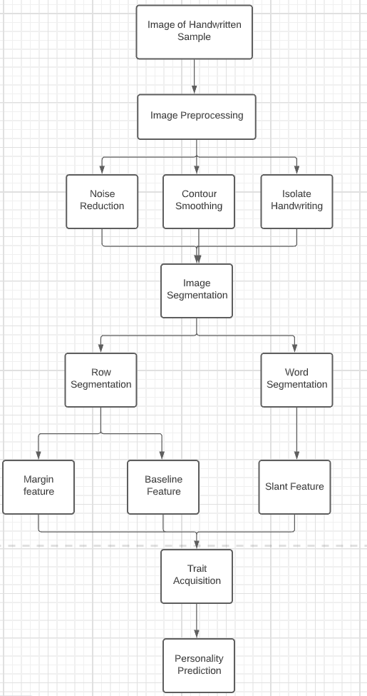

Slide 35
Use Case Diagram

Slide 36
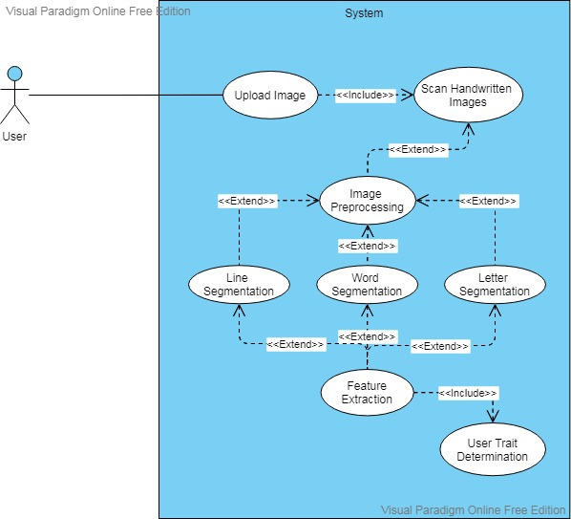

Slide 37
Activity Diagram

Slide 38
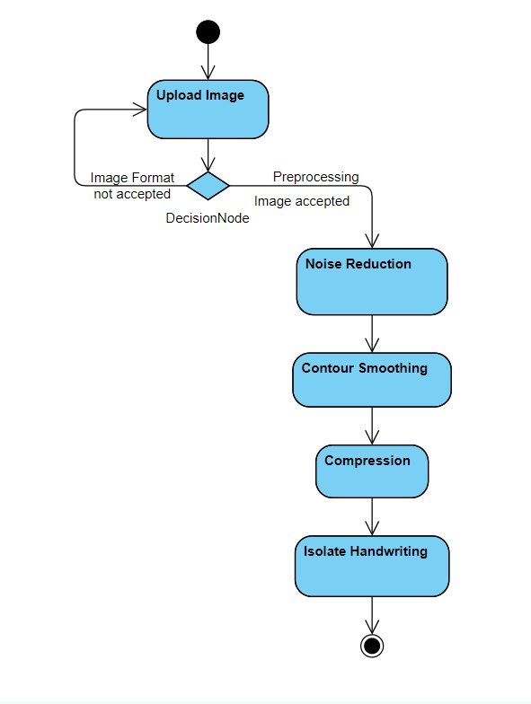
Upload Image & Preprocessing

Slide 39
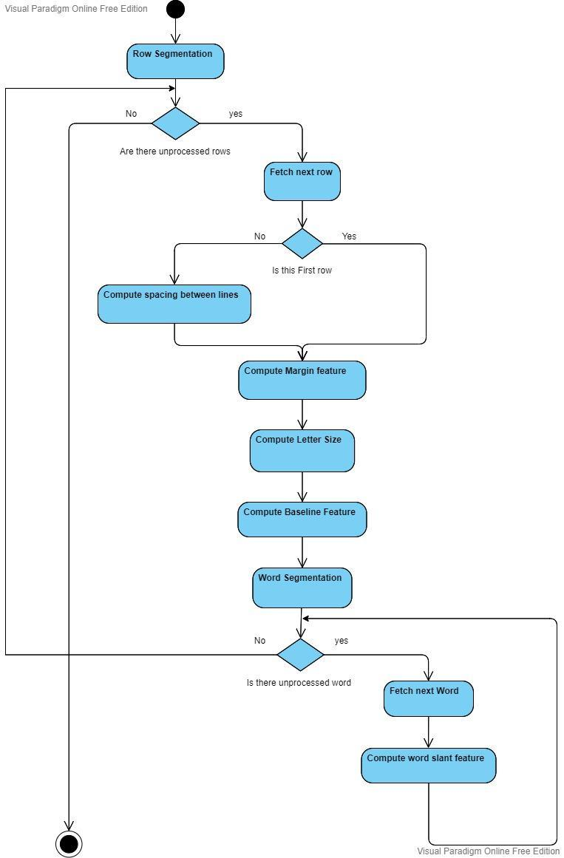

Slide 40
Sequence Diagram

Slide 41
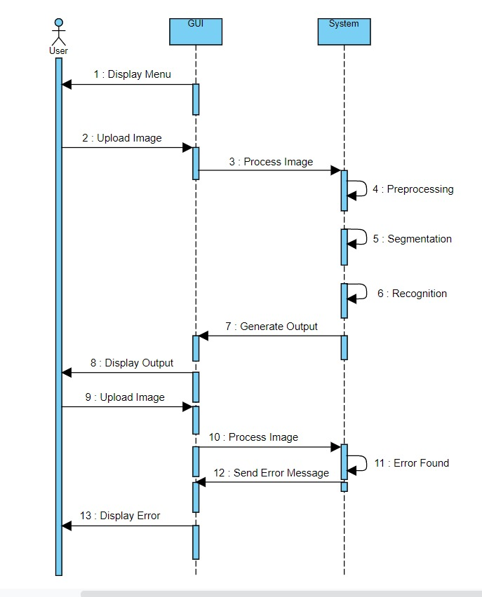

Slide 42
Class Diagram

Slide 43
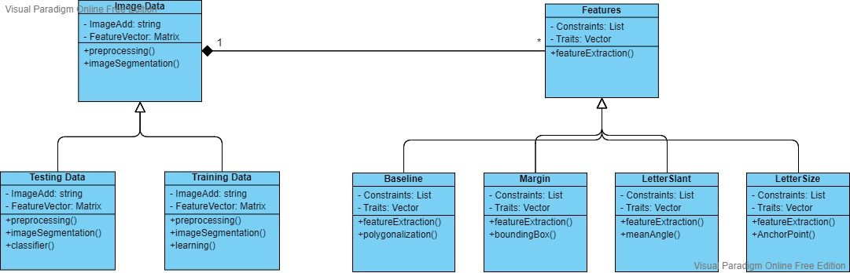

Slide 44
Conclusion
In this work, the unique personality is predicted using a Support Vector Machine with various parameters such as baseline angle, margin width, letter size, and slant of handwriting, and the optimal parameters are found.
The model's accuracy came out to be 95.05% with the optimal parameters’ values; inversion as 255 pixels, dilation at kernel value (5,100), Anchor Point value 6000, and Baseline threshold angle 45 degree, and these parameters gives the best accuracy.

Slide 45
Future Work
There are still some ways in which the proposed work can be improved upon to make the prediction of personality more efficient.
Furthermore, improvements can also be made using machine learning algorithms other than Support Vector Machine to get the optimal result.
Apart from this, a recommender system may improve its prediction accuracy by analyzing personalities from Facebook profile statuses by recommending items, such as TV shows, music, or sports events, according to the user's personality.
Depending on a user's ratings of mutual connections, the items could be recommended. Individuals with similar personalities would be advised. Future work needs to focus on developing and evaluating these approaches.

Slide 46
References
Champa H N and Dr. K R AnandaKumar, “Artificial neural network for human behavior prediction through handwriting analysis”,International Journal of Computer Applications (0975 – 8887) Volume 2 – No.2, May 2010.
Cleber Zanchettin, Byron Leite Dantas Bezerra and Washington W. Azevedo,“A KNN-SVM hybrid model for cursive handwriting recognition”,Neural Networks (IJCNN), The 2012 International Joint Conference.
Seema Kedar and Ms Vaishnavi Nair, Ms Shweta Kulkarni, “Personality Identification through handwriting analysis: A review “,Volume 5, Issue 1,January 2015 ISSN: 2277 128X,International Journal of Advanced Research in Computer Science and Software Engineering.
Srihari S.N., Sung-Hyuk Cha and Sangjik Lee,“Establishing handwriting Individuality using pattern recognition techniques”, Proceedings of the Sixth International Conference on Document Analysis and Recognition, 2001, pp. 1195 – 1204.

Slide 47
THE END

