Slide 1

Automatic Image Captioning Phase-1 Review Group-15, Cohort-20
,
Mentor: Brahmani Nutakki
Team (3): Hanumanth Sangewar, Ritesh K Singh and Raheem Baig

Slide 2

Phase 1: Status Summary
Research/Study
Various papers (arxiv.org), AIML-related internet content, and Kaggle solutions
Understand the various implementations available and learn from available code
Got hands-on with various tools, setup, and Python AIML libs
GIT – created a new repository & practice how to co-work as a team
Local setup (VSCode and JupyterLab) – To work on code development individually
Learnt Python logging and used it to fine-tune the model implementation
Implementation
Selected model based on the research and reference code
CNN for training images – used VGG16 to extract the features
Applied Various Text Clean/process techniques and Tokenized
Caption Generation - Used LSTM to generate captions from the feature vectors and tokens fed to it.
Base model ready with training done on entire flickr8K dataset and reviewed by Mentor

Slide 3
Learning and Challenges
Learnings:
Overall, Experienced as Core Developer during the capstone project phase, after a long time
How to generate feature vectors from the images using CNN.
How to feed both feature vectors and tokens to an LSTM network.
GIT, VSCode, JulyperLab, Python Logging, and setting up the development environment in local PC.
All learning earlier during the course was in Google Collab & TalentSprint-LMS.
Literature Research, refer to internet content and understand the available/implemented code to design our project model,
Challenges:
Encountered issues in training the base model on the entire flickr8K dataset,
Google Collab session was crashing frequently.
Shifted development environment to Ipython/ VS4 to get around crash issues
Caption Generation was tricky
Some captions were empty after initial text cleaning
Used Python Logging libs to debug and fine tune Caption
There were some missing images corresponding to captions present in the tokens file
After a keen look at the logging and images vs captions, we found missing images and corrected/removed the related captions.

Slide 4
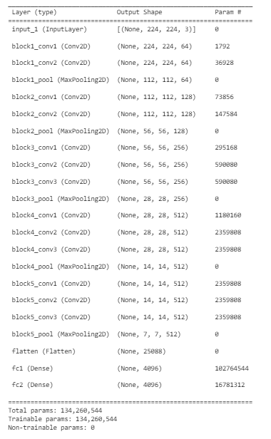
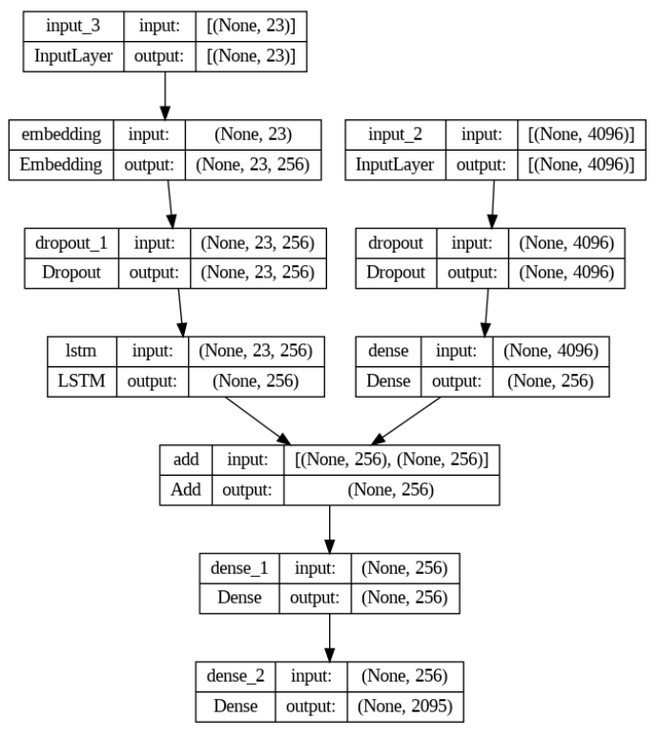
Implementation
CNN -VGG16
CNN + LSTM

Slide 5
Timelines
Present a Summary of 3 research papers
Prepare final documentation and present the learning and status.
Deploy model to local server and test
Fine Tune the model to 8K based on challenges
Complete debug & fine tuning the model to 8K dataset
Use the 8K dataset experience to 30K Flicker dataset
Use other implementations available
Literature Reading
Understand available implementation
Project Proposal
Implement model
Train and test for 8K Flicker Dataset
Phase#4 – 12th Aug’23
Phase#3 – 30th July’23
Phase#2 – 16th July’23
Phase#1 – 1st July’23

Slide 6


