Slide 1
IFE Project 1: Technical Analysis

Slide 2
Group C (G27)
Team Members
Moksha Akshaya Uddanti (B21AI041)
Aashish Kamuju (B21AI001)
Khushi Maheshwar (B21AI052)
Renu Sankhla (B21AI028)

Slide 3
Overview
Dataset - NSEI
Indicators
Calculating using Indicators
Methodology for prediction
Accuracies

Slide 4
INDICATORS
Indicators are tools or calculations based on historical price and volume data that are used to analyze and interpret the current and future direction of asset prices.
Indicators help traders identify the direction of the market trend, whether it is upward (bullish), downward (bearish).
Indicators are not foolproof, and no single indicator guarantees success, we use a combination of indicators, considering their strengths and weaknesses, to make more informed and well-rounded trading decisions.

Slide 5
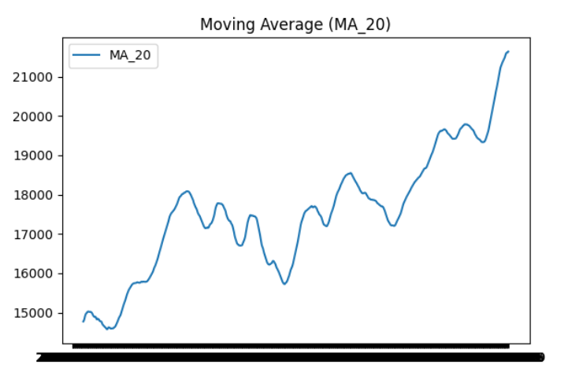
Moving Average (MA)
A Moving Average is calculated by averaging a set of prices over a specific time period.( 20 days in the project).
Rising MA suggests an uptrend.
Declining MA suggests a downtrend.
Smoothes out price fluctuations, making trends more apparent.
Helps identify the direction of the trend.
Lagging indicator; reacts to price changes rather than predicting them.
Sensitive to outliers

Slide 6
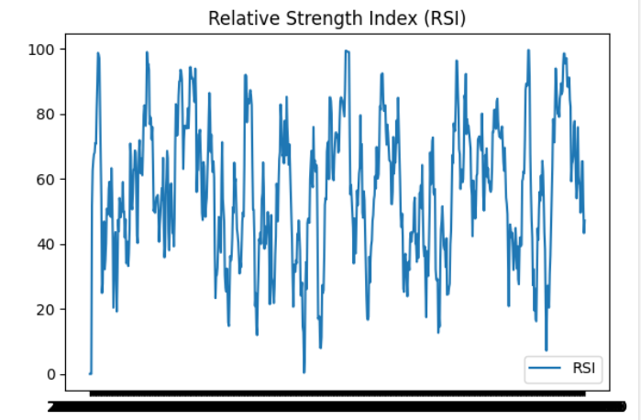
Relative Strength Index (RSI)
RSI measures the speed and change of price movements. It is often used to identify overbought or oversold conditions.
Helps identify potential trend reversals.
Provides a numerical value to assess the strength of a trend.
May produce false signals during strong trending periods.
Doesn't consider the underlying trend.

Slide 7
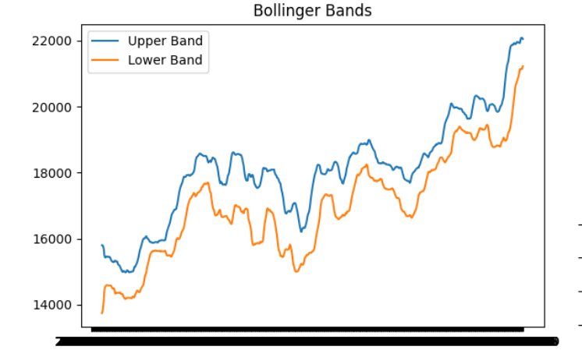
Bollinger Bands
Bollinger Bands consist of a middle band being an N-period simple moving average and upper/lower bands representing N-period standard deviations.
Helps identify volatility and potential price reversals.
Useful for identifying overbought or oversold conditions.
Not suitable for all market conditions.
Lagging indicator; may not provide timely signals.

Slide 8
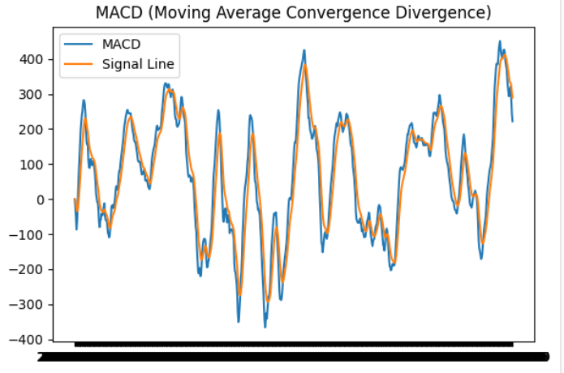
Moving Average Convergence Divergence (MACD)
MACD is a trend-following momentum indicator that shows the relationship between two moving averages of a security's price.
Provides signals for trend changes and momentum shifts.
Helps identify potential buy/sell opportunities.
May generate false signals in choppy or sideways markets.
Lagging indicator; not effective in strongly trending markets.

Slide 9
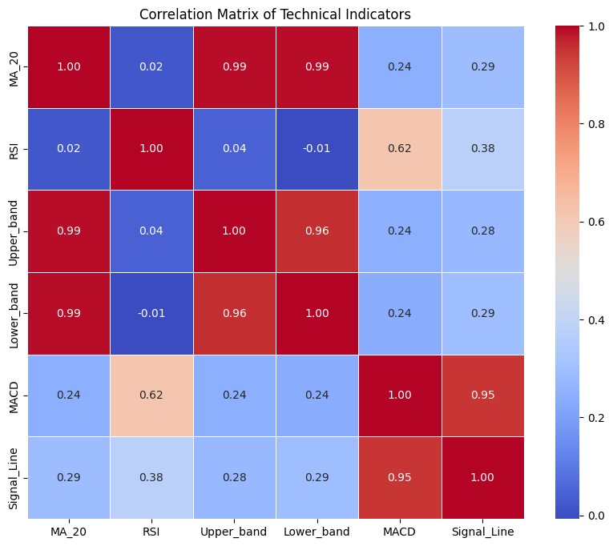
Correlation Matrix
Use this matrix to find the correlation between the indicators .
Those indicators which have higher correlation can be used in building the combined indicator.
This correlation matrix show strong correlation between MA_20 and upper_band/ lower_band and also strong correlation between MACD and Signal Line.

Slide 10
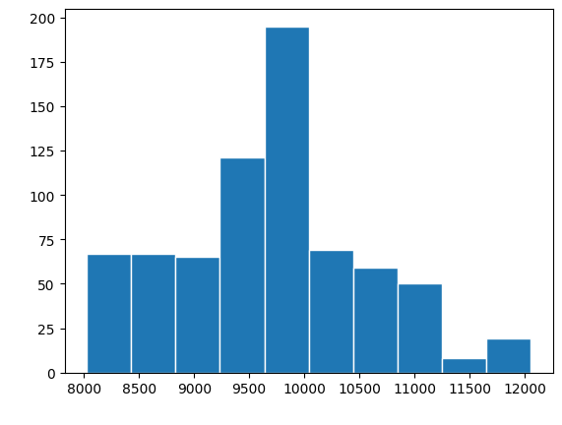
Combined Indicator
Created a combined indicator through a weighted average of individual technical indicators.
Weights are assigned based on the correlation matrix.
Normalized weights to prevent dominance by any single indicator.

Slide 11
Methodology to predict bullish and bearish positions
We formulated a binary classification problem to predict bullish (1) and bearish (0) positions.
Binary Labeling:
Each time-stamp is labeled with a binary value:
1 (Bullish): If the closing price at the next time-stamp is expected to be higher than the current closing price.
0 (Bearish): If the closing price at the next time-stamp is expected to be lower than or equal to the current closing price.
The decision to label a time-stamp as bullish or bearish is based on the directional movement of closing prices. If the closing price at the next time-stamp is anticipated to be higher, it suggests a bullish trend. If the closing price is expected to be lower or equal, it suggests a bearish trend.

Slide 12
Accuracy of prediction.
SVM
Accuracy : 51.35%
Random Forest
Accuracy : 61.62%
Logistic Regression
Accuracy : 54.52%
XGBoost
Accuracy : 59.90%

Slide 13
THANK YOU

