Slide 1
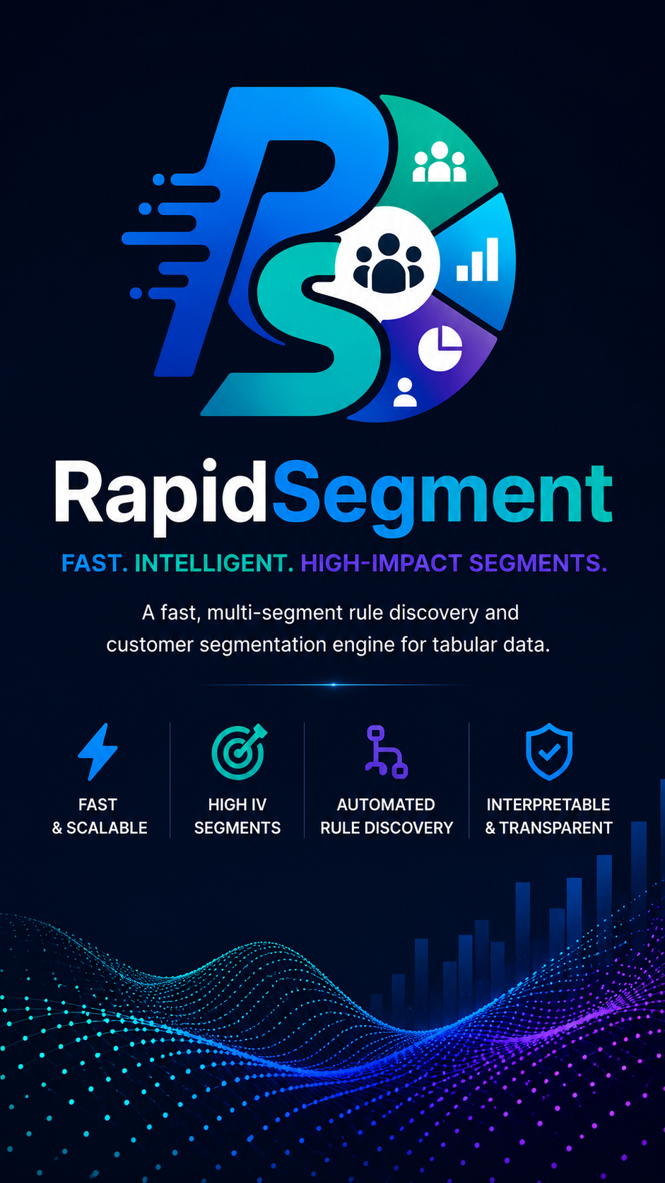
RAPIDSEGMENT
Transparent segments. Production-ready SQL.
No black-box trees.
Strategic Segmentation & Scorecard Engine

Slide 2




The problem with decision trees
Hard to load
Encoding tax
Unreadable
Same root bias
Wide tables, mixed sources, memory spikes
One-hot / label encode kills meaning
Past depth 4 no one can explain it
Always starts from the same variable
RapidSegment · Business Deck
2

Slide 3
DECISION TREE vs RAPIDSEGMENT
A fundamental shift from traditional splitting to stakeholder-centric, robust segmentation.
Key Capability | Decision Tree (DT) | RapidSegment
Splitting Dynamics | Splits on 1 variable at a time (univariate). | Can choose to split up to 3 variable interactions simultaneously.
Feature Reuse | Splits on the same variable at various depths, reducing explainability to stakeholders. | Provides explicit options to reduce feature reuse, keeping rules clean.
Segment Uniqueness | Complementary (Yes/No) branches using similar variables; creates overlapping contexts. | Groups similar variables to select only the best, yielding highly distinct, unique segments.
Business Constraints | Maximizes Gini Gain; only provides basic controls for minimum sample size. | Guarantees hard-defined min event, min lift, and min capture per segment.
NULL Handling | Requires pre-imputation of missing values or relies on complex surrogate splits. | Natively handles NULLs directly within the SQL output without preprocessing.
Output Format | Yields complex, deeply nested IF-ELSE tree paths that are difficult to audit. | Produces flat, audit-ready ANSI SQL rules ready for immediate deployment.
RapidSegment · Business Deck
3

Slide 4


Hours vs minutes
Decision Tree path
RapidSegment path
1. Load & clean
1. Load with UniversalDataLoader
2. Encode categoricals
2. Native categoricals (no encode)
3. Fit tree
3. extract_segments() — one call
4. Extract leaves manually
4. SQL filters produced
5. Residual loops ×4
5. Scorecard JSON + weights
6. Translate to SQL
4–12+ hours
5–15* minutes *Depends on the size of data but mostly faster as tested on 2.5M dataset and 30 columns
RapidSegment · Business Deck
4

Slide 5
What stakeholders actually see
Decision Tree — not human friendly
RapidSegment — readable SQL
max_dpd_12m ≤ 15.5
SEG 1 Lift 4.8× n=2,140
├─ util_avg ≤ 0.42
max_dpd_12m >= 60
AND utilization >= 0.85
│ ├─ risk_seg = Low → Leaf A
│ └─ util_avg > 0.42 → Leaf C/D
└─ max_dpd_12m > 15.5
SEG 2 Lift 3.1× n=5,820
risk_segment = 'High'
AND max_dpd_12m >= 30
├─ util ≤ 0.71 → Leaf E/F
└─ ... 47 more nodes ...
└─ [unreadable]
SEG 3 Lift 2.4× n=3,450
utilization >= 0.90
AND tenure_months < 12
RapidSegment · Business Deck
5

Slide 6



Four building blocks
BigQueryFeatureSelector
UniversalDataLoader
StrategicSegmentBuilder
StrategicSegmentScore
Screen IV in-cloud
Download only winners
CSV · Parquet · Excel
Arrow · Big Query
Finds high-lift rules
Outputs pure SQL
Weights + deciles
JSON scorecard
RapidSegment · Business Deck
6

Slide 7
How it works — 6 steps
Ingest Data
1
Bin & Rank
2
Bin features (Naive or Optimal)
1 / 2 / 3-way
3
Apriori-style search
Rank by IV or Response Rate
Keep top-N variables
Build interaction rules
Prune weak candidates early
Mine Rules
4
Rank by user sort priority
(lift → response → count)
Optional adjacent-bin merge
Iterate on Residual
5
Apply hard constraints (min lift · min events · min size)
Repeat until no valid rule left
Segment Summary
6
Pure ANSI SQL filters
Lift · rate · capture · cumulative capture
Full diagnostic report
Score & Deciles
Weight segments
Score full dataset
Build decile thresholds
Export JSON scorecard
CSV | Parquet | Excel | Big Query
Remove matched rows
RapidSegment · Business Deck
7

Slide 8
How we rank features — IV & WOE (simple)
WOE — Weight of Evidence
IV — Information Value
In plain English
In plain English
How much more (or less) likely an event is
in this group compared with the average.
How useful is this whole feature at
separating events from non-events?
Formula
Formula
WOE = ln( % of non-events / % of events )
IV = Σ ( %non-events − %events ) × WOE
Positive WOE → safer group Negative WOE → riskier group
Higher IV = stronger predictor
Quick example — max_dpd_12m
Bin
% Events
% Non-events
WOE
Contribution
0 days
20%
55%
+1.01
Strong (safer)
30–59 days
25%
25%
0.00
Neutral
60+ days
55%
20%
−1.01
Strong (riskier)
IV ≈ 0.70 → Strong predictor (rule of thumb: IV > 0.30 is useful)
RapidSegment · Business Deck
8

Slide 9



Why teams choose it
No encoding
Multi-way rules
Zero overlap
Categoricals stay categorical
1-, 2-, 3-way via Apriori
Hierarchical residual guarantees it
ANSI SQL
Cloud-first
Full audit
Teams & production share one language
Screen IV inside Big Query
Explain why a feature was selected/not selected at each step
RapidSegment · Business Deck
9

Slide 10
Just 5 lines of code to build Interpretable Segments
from rapidsegment import StrategicSegmentBuilder, StrategicSegmentScore
#Configure Experiment
builder = StrategicSegmentBuilder(target="default_flag",max_segments=10)
#Run Experiment – Build Segment
segments = builder.extract_segments(data)
#View Segments
final_eval = builder.evaluate_final_coverage(data)
#Score on dataset
scorer = StrategicSegmentScore(
target_col="default_flag", primary_key="cust_id",
segment_cols=[...])
#Export Scores
model = scorer.calculate_and_export_weights(df, "model.json")
RapidSegment · Business Deck
10

Slide 11
Diagnostics & Explainability
Complete audit trail for every extraction run
explain_feature_journey(feature)
Full audit trail of a feature across every residual iteration — why it was kept, dropped, or reused.
explain_no_segments()
Human-readable report explaining why extraction stopped early or returned zero segments.
generate_feature_health_report()
Binned feature that determines response concentration. Useful in cases where feature variance in low or has NULL entries
diagnostics_ + candidate funnel
Log showing Per-iteration record of candidates, near-misses, winning segment, and expansion stats.
RapidSegment · Business Deck
11

Slide 12
Stop explaining black boxes.
Start shipping readable rules.
High-lift segments → pure SQL → calibrated scorecard.
Risk, credit, and marketing can all act with confidence.
github.com/B2BDA/RapidSegment · pip install rapidsegment

