Slide 1
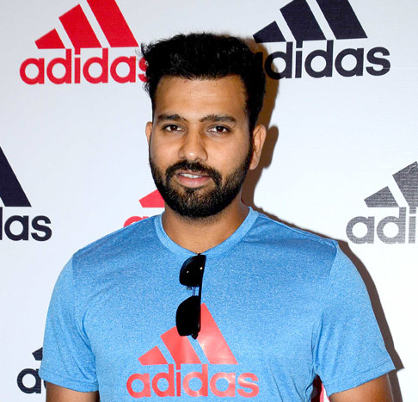
ROHIT SHARMA

Slide 2
Rohit Sharma
Rohit Gurunath Sharma (born 30 April 1987) is an Indian international cricketer who is the current captain of the Indian cricket team in all formats. He is a right-handed opening batsman and considered one of the best white-ball openers to ever play the game. Sharma holds record for scoring most hundreds (5) in a single ICC cricket World Cup.

Slide 3
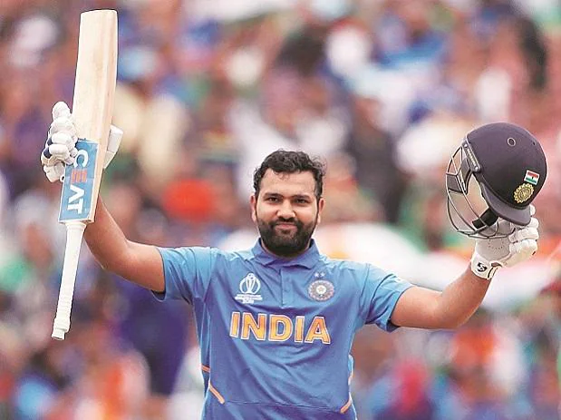

Slide 4
Outside cricket, Sharma is an active supporter of animal welfare campaigns. He is the official Rhino Ambassador for WWF-India and is a member of People for the Ethical Treatment of Animals (PETA). He has worked with PETA in its campaign to raise awareness of the plight of homeless cats and dogs in India.

Slide 5
Rohit sharma
National side
India (2007–present)
Test debut (cap 280) 6 November 2013 v West Indies
Last Test 12 March 2022 v Sri Lanka
ODI debut (cap 168) 23 June 2007 v Ireland
Last ODI 17 July 2022 v England
ODI shirt no. 45 (formerly 77)
T20I debut (cap 17) 19 September 2007 v England
Last T20I 4 October 2022 v South Africa
T20I shirt no. 45 (formerly 77)

Slide 6
Career statistics of r-sharma
Competition Test ODI T20I FC
Matches 45 233 142 106
Runs scored 3,137 9,376 3,737 8,033
Batting average 46.13 48.58 31.40 54.64
100s/50s 8/14 29/45 4/28 25/34
Top score 212 208 118 309*
Balls bowled 383 593 68 2,153
Wickets 2 8 1 24
Bowling average 112.00 64.37 113.00 48.08
5 wickets in innings 0 0 0 0
10 wickets in match 0 0 0 0
Best bowling 1/26 2/27 1/22 4/41
Catches/stumpings 45/– 78/– 50/- 89/-

