Slide 1
HANGMAN
7. Designing Hangman with Flowcharts
8. Writing the Hangman code

Slide 2
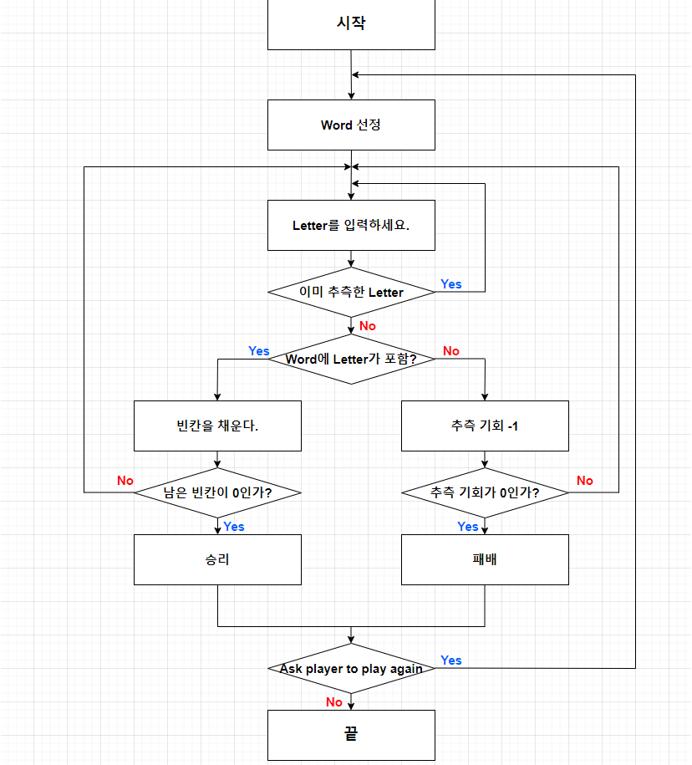
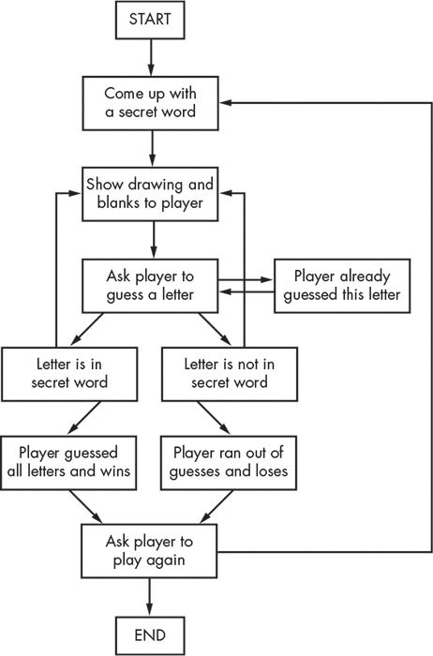
Designing Hangman with Flowcharts
7

Slide 3
Writing the Hangman code
8
1. import random 2. HANGMAN_PICS = [''' 3. +---+ 4. | 5. | 6. | 7. ===''', ''' 8. +---+ 9. O | 10. | 11. | 12. ===''', ''' 13. +---+ 14. O | 15. | | 16. | 17. ===''', ''' 18. +---+ 19. O | 20. /| | 21. | 22. ===''', ''' 23. +---+ 24. O | 25. /|\ | 26. | 27. ===''', ''' 28. +---+ 29. O | 30. /|\ | 31. / | 32. ===''', ''' 33. +---+ 34. O | 35. /|\ | 36. / \ | 37. ==='‘’]
38. words = 'ant baboon badger bat bear beaver camel cat clam cobra cougar coyote crow deer dog donkey duck eagle ferret fox frog goat goose hawk lion lizard llama mole monkey moose mouse mule newt otter owl panda parrot pigeon python rabbit ram rat raven rhino salmon seal shark sheep skunk sloth snake spider stork swan tiger toad trout turkey turtle weasel whale wolf wombat zebra'.split()
39.
리스트 자료형 HANGMAN PICS
교수형의 진행 과정을 아스키 아트로 표현
리스트 자료형 words
게임에 사용될 단어 목록

Slide 4
8
함수 선언
40. def getRandomWord(wordList): 41. # This function returns a random string from the passed list of strings. 42. wordIndex = random.randint(0, len(wordList) - 1) 43. return wordList[wordIndex] 44. 45. def displayBoard(missedLetters, correctLetters, secretWord): 46. print(HANGMAN_PICS[len(missedLetters)]) 47. print() 48. 49. print('Missed letters:', end=' ') 50. for letter in missedLetters: 51. print(letter, end=' ') 52. print() 53. 54. blanks = '_' * len(secretWord) 55. 56. for i in range(len(secretWord)): # Replace blanks with correctly guessed letters. 57. if secretWord[i] in correctLetters: 58. blanks = blanks[:i] + secretWord[i] + blanks[i+1:] 59. 60. for letter in blanks: # Show the secret word with spaces in between each letter. 61. print(letter, end=' ') 62. print() 63.
Word 선정 :
게임에 사용될 단어 목록 wordlist 를 입력하면
그 중에서 게임에 사용될 단어를 무작위로 반환
Word 에 Letter 가 포함? :
입력 받은 Letter 가

Slide 5
8
함수 선언
64. def getGuess(alreadyGuessed): 65. # Returns the letter the player entered. This function makes sure the player entered a single letter and not something else. 66. while True: 67. print('Guess a letter.') 68. guess = input() 69. guess = guess.lower() 70. if len(guess) != 1: 71. print('Please enter a single letter.’) 72. elif guess in alreadyGuessed: 73. print('You have already guessed that letter. Choose again.') 74. elif guess not in 'abcdefghijklmnopqrstuvwxyz': 75. print('Please enter a LETTER.') 76. else: 77. return guess 78. 79. def playAgain(): 80. # This function returns True if the player wants to play again; otherwise, it returns False. 81. print('Do you want to play again? (yes or no)') 82. return input().lower().startswith('y') 83. 84.
Letter를 입력하세요 : 변수 guess에 입력 받은 문자를 저장한다.
입력 받은 문자는 한 글자여야 한다.
입력 받은 문자는 한 글자여야 한다.
이미 입력한 문자를 다시 입력할 수 없다.
입력 받은 문자는 알파벳이어야 한다.
Ask player to play again :
y로 시작하는 텍스트를 입력하면 true를 반환한다.

Slide 6
85. print('H A N G M A N') 86. missedLetters = '' 87. correctLetters = '' 88. secretWord = getRandomWord(words) 89. gameIsDone = False 90. 91. while True: 92. displayBoard(missedLetters, correctLetters, secretWord) 93. 94. # Let the player enter a letter. 95. guess = getGuess(missedLetters + correctLetters) 96. 97. if guess in secretWord: 98. correctLetters = correctLetters + guess 99. 100. # Check if the player has won. 101. foundAllLetters = True 102. for i in range(len(secretWord)): 103. if secretWord[i] not in correctLetters: 104. foundAllLetters = False 105. break 106. if foundAllLetters: 107. print('Yes! The secret word is "' + secretWord + '"! You have won!') 108. gameIsDone = True 109. else: 110. missedLetters = missedLetters + guess 111. 112. # Check if player has guessed too many times and lost. 113. if len(missedLetters) == len(HANGMAN_PICS) - 1: 114. displayBoard(missedLetters, correctLetters, secretWord) 115. print('You have run out of guesses!\nAfter ' + str(len(missedLetters)) + ' missed guesses and ' + str(len(correctLetters)) + ' correct guesses, the word was "' + secretWord + '"') 116. gameIsDone = True 117.
함수 호출을 통한 게임 진행
118. # Ask the player if they want to play again (but only if the game is done). 119. if gameIsDone: 120. if playAgain(): 121. missedLetters = '' 122. correctLetters = '' 123. gameIsDone = False 124. secretWord = getRandomWord(words) 125. else: 126. break

