Slide 1

JATE (Just Another Text Editor)
By: Biplop Giri

Slide 2
Laguage and libraries used
Language
Python for main logic and algorithms
Libraries
'Tkinter' For GUI part
'rsa' and 'base64' for RSA text encryption
're' for regex search implementation
'pickle' for RSA key generation

Slide 3
Features
Basic Features
Undo/Redo
Select All/Cut/Copy/Paste
Scroll Bars
Sorting
Merge Sort
File Operations
Create/Open a file
Save a file
Searching
Binary Search
Regex Search
Encryption/Decryption
RSA
Caesar Cipher

Slide 4
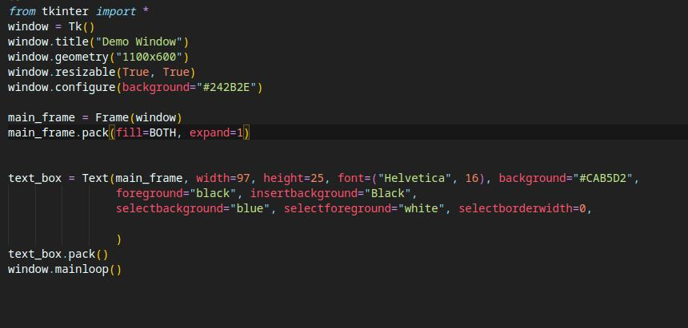
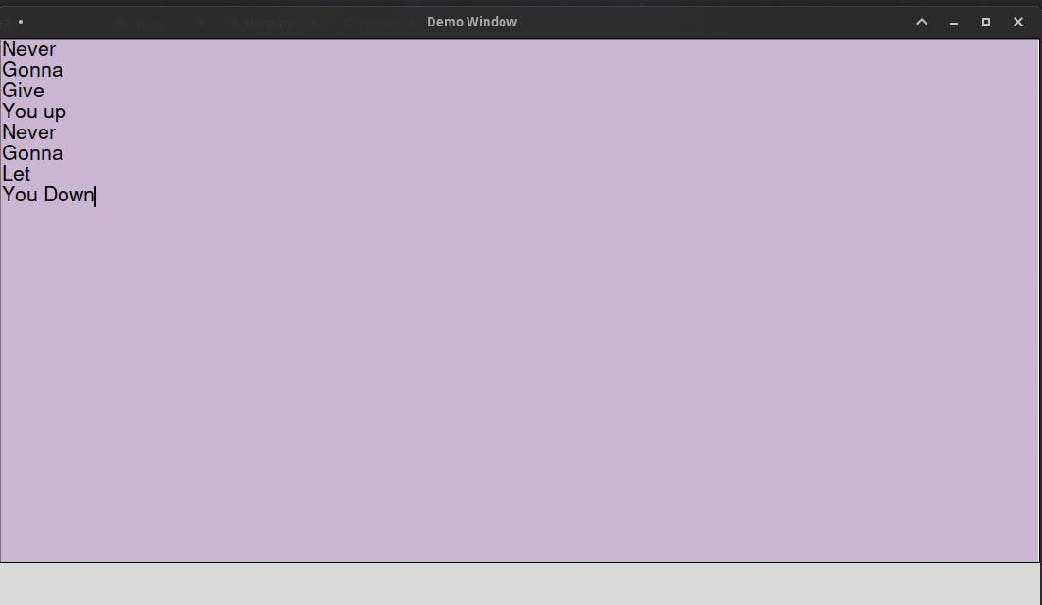
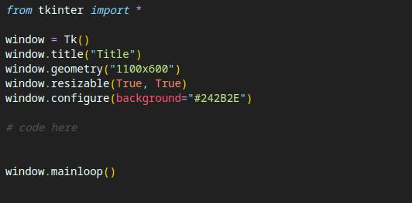
Tkinter at a glance
A python GUI library with lots of features and easy syntax

Slide 5
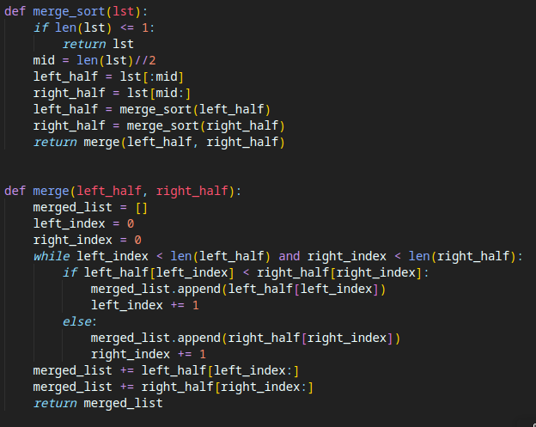
Merge Sort
The divide and conquer sorting algorithm

Slide 6
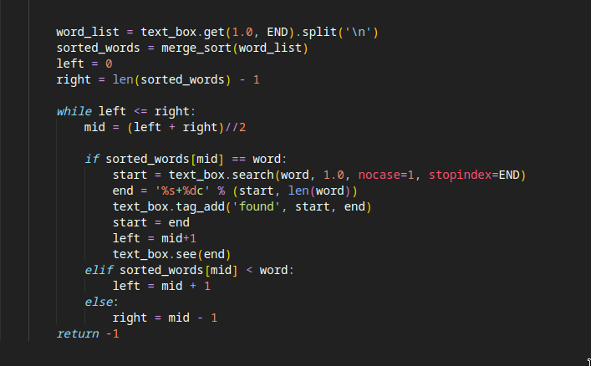
Binary Search

Slide 7
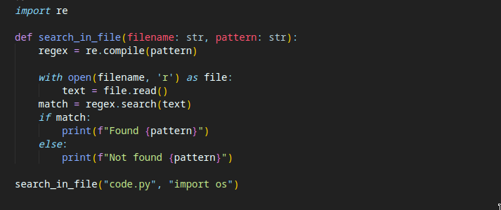
Regex search

Slide 8

The RSA encryption
Private and public keys are generated
If (n,e) is the public key pair and (n,d) is the private key pair
Then text is encrypted using c = m^e mod n.
And decrypted using m = c^d mod n
Used in secure data exchange,Digital signatures,Cryptography etc.

Slide 9
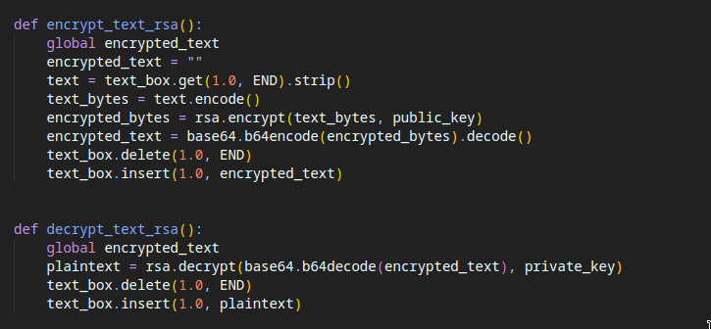

Slide 10
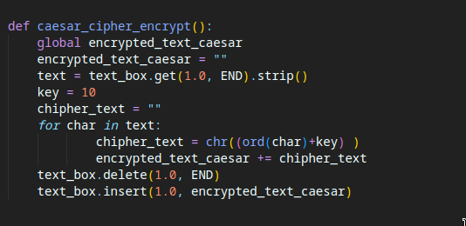
Caesar Cipher
Encrypts and decrypts by operating on the ASCII value of text

Slide 11
…..(Demo part)

Slide 12
THANK YOU

