Slide 1


Basic understanding
of a company’s financial statements
September 2020

Slide 2

Table of contents
What are financial statements?
3
Balance sheet
5
Income statement
16
Cashflow statement
24
2

Slide 3
What are financial statements?

Slide 4
The financial statements
Financial statements are written records that illustrates the business activities and the financial performance of a company. In most cases they are audited to ensure accuracy for tax, financing, or investing purposes.
A methodically work through of the three financial statements in order to assess the Financial health of a company.
Balance Sheet
Balance Sheet is a snapshot at a point in time. On the top half you have the company’s assets and on the bottom half its liabilities and Shareholders’ Equity (or Net Worth). The assets and liabilities are typically listed in order of liquidity and separated between current and non-current.
Statement of financial position
Income Statement
The income statement covers a period of time, such as a quarter or year. It illustrates the profitability of the company from an accounting (accrual and matching) perspective. It starts with the revenue line and after deducting expenses derives net income.
Statement of operation/profit and loss
Statement of Cash Flows
The cash flow statement look at the cash position of the company . It answers it answers the questions ; How much of the organisation’s cash goes to its creditors and shareholders? Does it keep enough for its own investment and growth? has 3 components cash from operations, cash used in investing, and cash from financing. It “undoes” all of the accounting principles and shows the cash flows of the business.
Source CFI

Slide 5
Balance sheet

Slide 6
Balance sheet
The Balance sheet has 3 main categories:
Simplified Balance Sheet Assets
Current vs non-current Current
Liabilities
Current assets
Current liabilities
Assets
Expected to be converted into cash in less than 1 year
Accounts receivable, inventory
Assets
Cash | 20,000 |  | Accounts payable | 2,000 | •
Accounts receivable | 3,000 |  | Accrued expenses | 1,000
Liabilities
Inventory
60,000
Total current liabilities
3,000
Prepaid expenses
11,000
Non current liabilities
11,000
Liabilities
Will be paid in less than 1 year
Trade accounts payable
Equity
Total current assets
94,000
Bank loan
100,000
Non current assets
Shareholder equity
Property plant & equipment
110,000
Common shares
89,000
Retained Earnings
11,000
Intangible assets
10,000
Total liabilities and shareholders equity
214,000
Non-current
Total non current assets
120,000
Assets
Expected to be held greater than 1 year
Property, plant, and equipment
Total assets
214,000
Liabilities
Repayment terms longer than 1 year
Loan repayable over a 5 year period
Source CFI

Slide 7
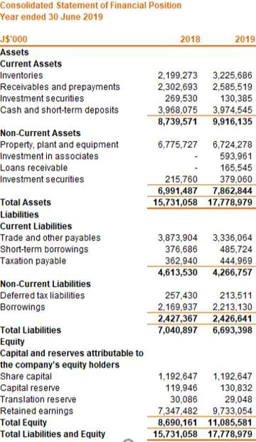
Illustrative balance sheet (assets )
Current
Assets
Expected to be converted into cash in less than 1 year
Accounts receivable, inventory
Non-current
Assets
Expected to be held greater than 1 year
Property, plant, and equipment
See accompanying notes.

Slide 8

Cash and investments
A company will hold external investments for two reasons:
Excess cash
Accumulating cash to make a large purchase A company can also make internal investments
Investments in equity or debt instruments to be held for capital gain and/or income
Investment in subsidiaries, associates and joint ventures
External investments
Internal investments
Short term
Long term
(less than year)
(more than year)
Source CFI
₈8

Slide 9
Other assets
Goodwill
Non-current asset
Company has intangible Value
e.g. brand, customers,intellectual capital If a company is purchased for more than the fair value of net assets (assets less liabilities):
Intangible Asset
Intangible assets are items of value that are used to generate revenues and have no physical substance.
Unearned/Differed Revenue Unearned revenue arises when a company sells something it has not yet delivered e.g. licenses, subscriptions 12 month subscription sold for $1,200 in January:
Trademarks
Earned:
$100
$300 $600 $900 $1,200
Purchase price
X
Patents
Jan Mar Jun Sep Dec
Unearned $1,100 $900 $600 $300 $0
Fair value of net assets acquired
(X)
Goodwill
X
Copyrights
Source CFI

Slide 10
Illustrative balance sheet (liabilities)
Current
Liabilities
Will be paid in less than 1 year
Trade accounts payable
Non-current
Liabilities
Repayment terms longer than 1 year
Loan repayable over a 5 year period
See accompanying notes.
10

Slide 11




Other liabilities
Commitments
Commitments are future obligations that a company agrees to.
Contingencies
Contingencies are liabilities that may or may not happen, depending on circumstance.
e.g. lawsuit
The liability must be recorded if:
A loss will be suffered in the future
The loss amount can be reasonably estimated
If not, just disclose a note.
Contingent gains are never recorded in financial statements.
New buildings
Leasehold improvements
Building improvements
Source CFI

Slide 12
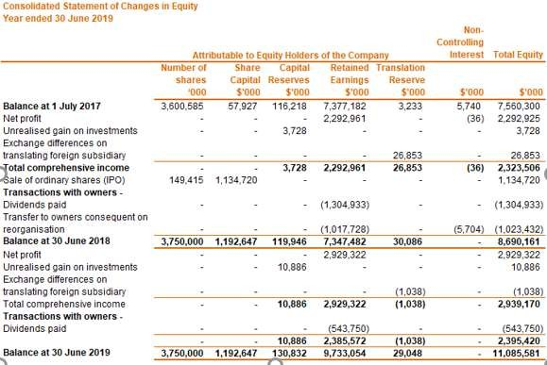

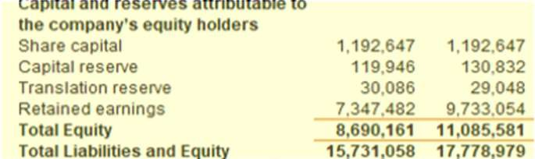
Illustrative balance sheet (statement of shareholder’s equity)
See accompanying notes.

Slide 13
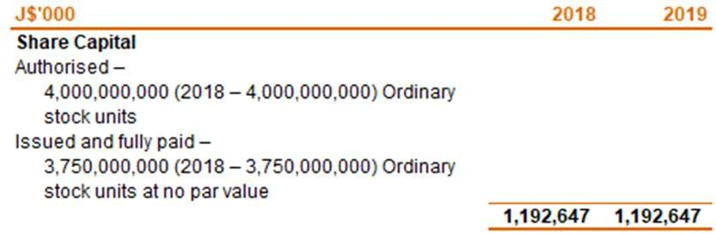
Common vs preferred shares
Authorised shares
The total number of shares a company can sell
Outstanding (Issued) shares
The total number of shares a company has sold/issued
Common shares
Preferred shares
Allow for participation in the profits of the company
Comes in the form of a dividend
Allow for voting rights in a company
One vote for every share held
If dissolved, any residual amount after everyone else is paid would go to the common shareholders
Offer investors a fixed dividend – It may not be paid annually
Will accumulate/pay before common share dividends
Most businesses don’t issue because they are viewed as debt with a tax disadvantage
– Dividends do not reduce taxable income
See accompanying notes.
PwC | Basic Understanding of a Company's Financials
Source CFI

Slide 14


Aspects of the equity
Contributed Surplus
Other comprehensive income
Other comprehensive income (OCI):
certain company gains and losses that are not always recorded through the income statement
e.g. unrealised gains and losses on investments and hedging instruments
Contributed surplus
Par
Receives
e.g. 180,000 shares 40¢/each 25¢/par
Paid-up share capital (180,000 x 25¢)
$45,000
Contributed surplus (180,000 x 15¢)
$27,000
Source CFI

Slide 15
Understanding the income statement and cash flow

Slide 16
Income statement

Slide 17

Income Statement
The Income statement has 3 main sections:
Revenues
Expenses
Profit or loss

Slide 18
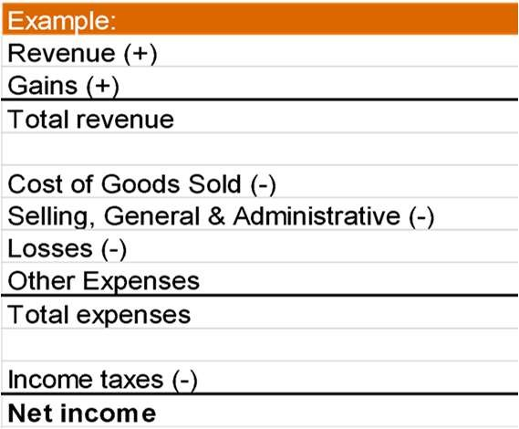
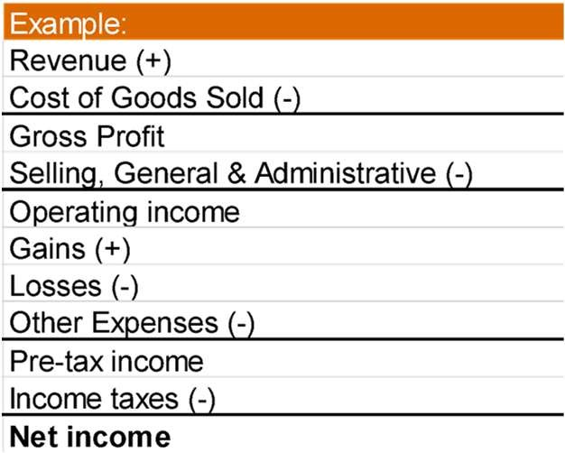
Single step vs multi-step income statements
Single Step
Multiple Step
VS
Source CFI

Slide 19
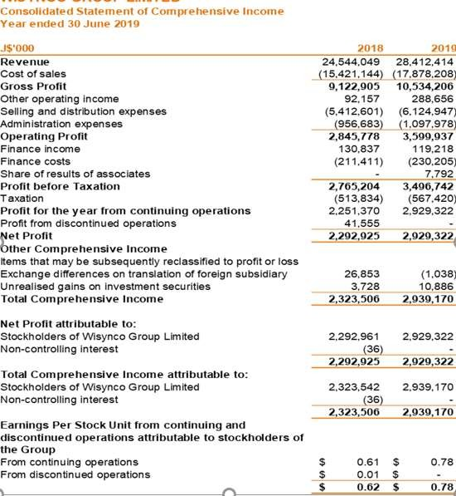
The Illustrative income statement
Operating Profit
Net Operating Profit
OCI-other gains and losses
EPS –Investor Ratio

Slide 20

Cost of sales
Cost of goods sold or Cost of sales:
May be shown as summarised line item
May be broken Down to its expense items
Direct Materials
(e.g. materials used in manufacturing)
Direct Labor
(e.g. professional services delivered)
Direct overhead
(to the production of the goods or services)
Source CFI
20

Slide 21
Selling, general and administrative expenses.
Selling, general and administrative, or SG&A contains a large number of expense items such as:
Advertising and promotion cost
Legal, Insurance and accounting expenses.
Office supplies
Other related expenses.
Source CFI

Slide 22

Gains and losses
Gains and losses may appear separately or grouped after all operating items under “other income or expenses”. They are related to activities that are incidental to operations such as:
Sale of Investments
Foreign exchange translations
Financial Instrument transactions
Source CFI

Slide 23

Other aspects of the Income Statement
Other comprehensive income
Other comprehensive income (OCI):
certain company gains and losses that are not always recorded through the income statement
e.g. unrealised gains and losses on investments and hedging instruments
Source CFI

Slide 24
Cashflow statement

Slide 25
The cash flow statement
Statement of cash flows demonstrates:
Where cash is being generated
Where cash is being used in the business
Day-to-day business operations; Revenues and expenses that have been collected and paid during the year
Depreciation and amortisation are not included.
Operating
Investing
Non-current assets that support the business:
Property, plant and equipment
Business acquisitions
Financing
Transactions regarding shares or debt. Company raises funds by either borrowing or issuing shares.
Source CFI

Slide 26
Statement of Cash Flows
The transactions are sorted by activity type:
Operating
The closing cash balance
Investing
All cash transactions
Financing
The opening cash balance
Source CFI

Slide 27
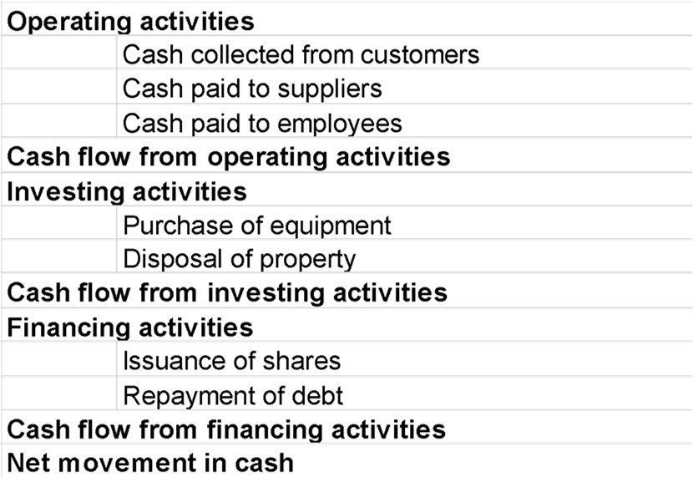
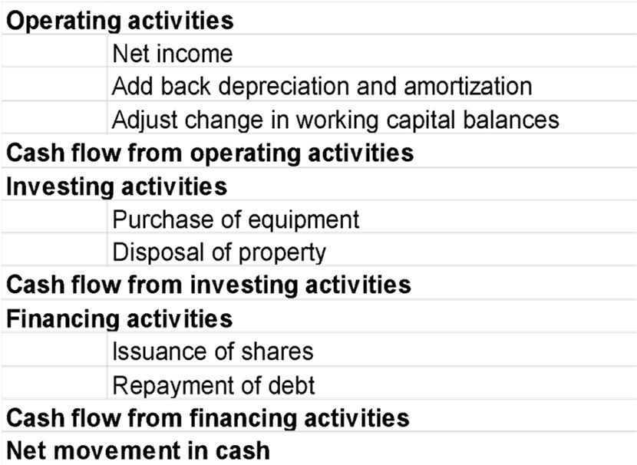
Direct method vs Indirect method
Direct method
Indirect method
Direct method of cash flow starts with cash transactions.
(Transactions are separated into cash received and cash paid.)
Indirect method of cash flow starts with net income. (Non-cash adjustments are then added.)
Source CFI

Slide 28
Key elements in a cash flow statement
Net cash provided by operating activities |  | Represents operating ‘lifeblood’ of business after paying necessary outgoings for financing and tax
Changes in working capital |  | Shows whether business is absorbing funds for working capital or releasing them. Trend may indicate ether financial stress or loose control over working capital
PPE Investment |  | Companies must invest in PPE to maintain their productive capacity. A downward trend may indicate a declining company. Identify the necessary sustainable level of expenditure.
Financing requirement/surplus |  | Shows whether internally generated funds are sufficient to cover investments made in fixed assets and businesses. Continuous deficits indicate that growth depends on regular injections of external finance.
Source CFI

Slide 29
The Full Disclosure Principle
For full disclosure:
Notes are provided to allow the reader of the financial statements to understand and make judgements of financial activities of the company.
See accompanying notes.

Slide 30
Three Key Financial Statements Notes
Significant Accounting Policies
Direct Information
Indirect Information
Indirect Information
Notes of indirect information:
Help provide the entire financial picture of an organisation
Not related to the numbers in the financial statements
Company accounting standards
How inventory & investments are valued
A breakdown of the types of investments
Debt and financial instruments
What is included in:
Financial instruments
Revenue is recognized
Inventory
Intangible assets
Commitments
Contingencies
PP&E
Income taxes
Stock based compensation plans
Property, plant & equipment is amortized
Any other policies
Source CFI
30

Slide 31
Ratio Analysis
The Ratio analysis is a quantitative method of gaining insight into a company's liquidity, operational efficiency, and profitability by studying its financial statements such as the balance sheet and income statement. Ratio analysis is a cornerstone of fundamental equity analysis.
Performance Ratio
Solvency Ratios
Investor Ratios
Net Profit margin,
return on assets (ROA)
return on equity(ROE)
return on capital employed (ROCE),
gross margin ratios
Efficiency (
Solvency Ratios
Current ratio= Current assets/Current liabilities
Leverage or Gearing
Operating cash flow/Interest paid
Operating cash flow/Dividends paid
Operating cash flow/Operating profit
Dividend yield,
P/E ratio,
earnings per share (EPS),
dividend payout ratio
31

Slide 32
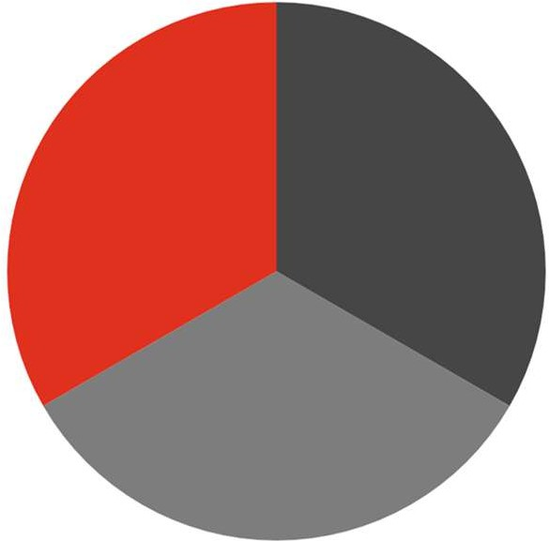
The benefits of an annual report
The annual report contains a significant amount of information:
Financial
Non-financial
Operational performance
Financial performance
Management discussion & analysis(MD&A)
Financial statements
Notes to financial statements
Messages from the Chair, CEO
Corporate profile
MD&A
Risk and control processes and analysis
Strategic direction
Source CFI

Slide 33
Contents of an annual report
The annual report will always include:
01.
Letters to the shareholders
02.
Business description
03.
Management’s Discussion and Analysis (MD&A)
04.
Reporting on internal controls
05.
Audit report
06.
Balance sheet, Income Statement and Statement of Cash Flows
07.
Notes to the financial statements
08.
Earnings per share
09.
Earnings per share Listing of directors of the company
Source CFI

Slide 34



Management discussion and analysis
MD&A provides information regarding past performance and future strategic direction
Acts as sort of variance analysis
Explains company performance
Lists future actions to be taken
Identifies the key risk facing the organization

Slide 35
Thank you
pwc.com/jm
© 2020 PricewaterhouseCoopers. All rights reserved. PwC refers to the Jamaica member firm, and may sometimes refer to the PwC network. Each member firm is a separate legal entity. Please see www.pwc.com/structure for further details.

