Slide 1
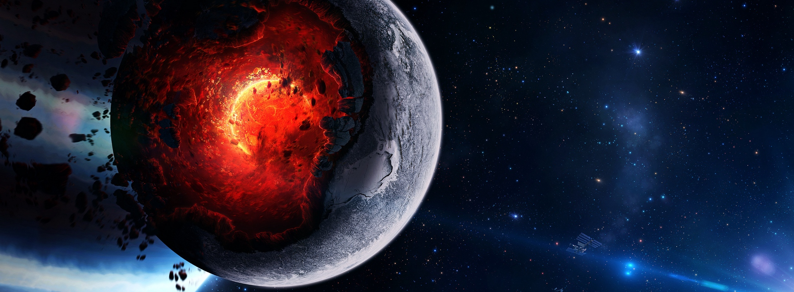
DiscoPlanet
Project 1 – Adventure Game
Flückiger Quentin, Graf Benjamin
BFH-TI BTI7301-18

Slide 2
Table of content
Project description
Approach
Problems
Features
Demo
Conclusion

Slide 3
Project Description
Eckerle
Make an Adventure Game
Probably Unity
Smart enemies (AI)

Slide 4
Approach
Define: adventure game
What do we want it to have?
Getting to know Unity
Tutorials (e.g. 2D GameKit)
Aquire knowledge on AI
Books
YouTube
Implement the idea of the game
Notes:
Define: «a type of video game in which the participant plays a fantasy role in an episodic adventure story”
an unusual and exciting or daring experience

Slide 5
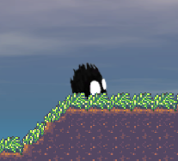
Problems
Too little description (and therefore requirements)
Underestimating required time
Visuals
Mainly animations
Known bugs
Falling animation
Text bubble

Slide 6
Features
Story elements
‘Round’ world
Collisions
Collectables
Progression saved
FSM AI (enemies)

Slide 7
Demo
Spoiler alert

Slide 8
Conclusion
Estimate more time than you think
Don’t procrastinate that much
Interesting
A lot of new things learned
Things to come
Slime configuration
World polish
Perhaps combat for player
Download:
https://bit.ly/2sIwins (Win + Mac)
Have fun & Git gud

Slide 9
Questions?
Any language welcome
(any = english, french, german, C#)

