Slide 1

1
01-Jan-2026
Khulna University of Engineering & Technology
CSE 4224 : Digital Systems Design laboratory
Title:- Thermal Sensor Grid Processing System with Edge Detection and Occupancy Decision
Proposed by-
Peyal Saha
Roll:2007001
&
Ahsanul Haque Hasib
Roll: 2007020
Year: 4th, Semester: 1st
Department of CSE,
Khulna University of Engineering & Technology
Supervised by-
Dr. Muhammad Aminul Haque Akhand
Professor
&
Md. Sakhawat Hossain
Assistant Professor
Department of CSE,
Khulna University of Engineering & Technology

Slide 2
Outlines
01
07
02
08
03
09
2
01-Jan-2026
Project Overview
Booth Multiplier
System Workflow
Decision Logic
System Architecture
Control Unit
04
Memory Mapping
10
Summary
05
11
Sliding Window Mechanism
Conclusion
06
2D Convolution Formula

Slide 3
Project Overview
3
01-Jan-2026
Hardware-based Image Processor: Implemented on FPGA for low-latency execution.
Core Logic: Uses 2D convolution, thresholding, and feature extraction.
Goal: Detect and signal occupancy by identifying patterns in sensor heatmaps.
Key Components: 256-byte Memory, 20-bit ALU, and FSM-based Control Unit.

Slide 4
System Workflow
4
01-Jan-2026
Input: 8x8 Sensor data enters via UART interface.
Process:
    1. Perform Sliding Window analysis on the 64-pixel grid.
    2. Execute 2D Convolution using stored kernel weights.
    3. Compare results against Threshold (TH) values.
Output: Decision logic triggers LED/Buzzer if occupancy is confirmed.

Slide 5
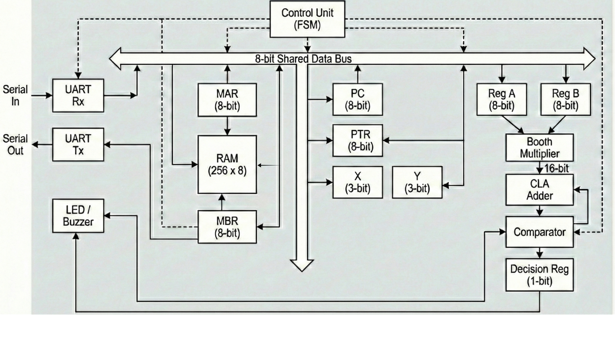
System Architecture
5
01-Jan-2026
Figure 1: System Architecture

Slide 6
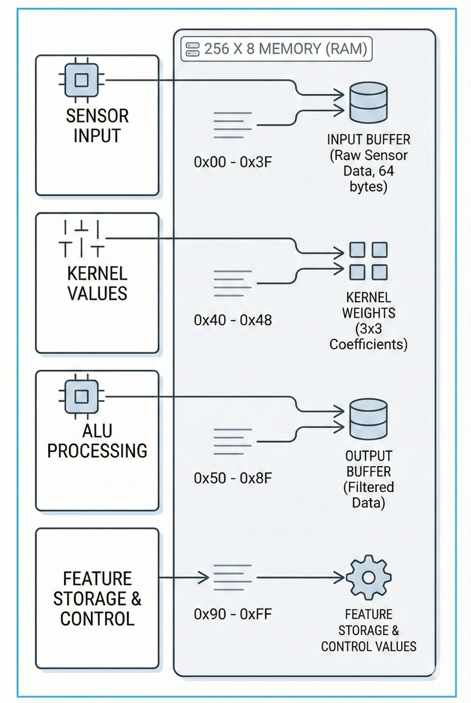
Memory mapping
6
01-Jan-2026
Spatial Separation: 0x00–0x3F: Input Buffer (Raw sensor data
          0x40–0x48: Kernel Weights (3x3 filter coefficients).
0x50–0x8F: Output Buffer (Convolved results).
Integrity: Dedicated pointers (PC and PTR) ensure input data is not overwritten during processing.
Figure 2: System Memory

Slide 7
Sliding Window Mechanism
7
01-Jan-2026
Anchor Pixel: Pointed to by the PTR register.
Window Size: 3x3 pixels (9 total values per step).
Scanning: The FSM moves the window horizontally and vertically across the 8x8 grid.
Boundary Control: X and Y 3-bit registers detect grid edges to prevent calculation errors.

Slide 8
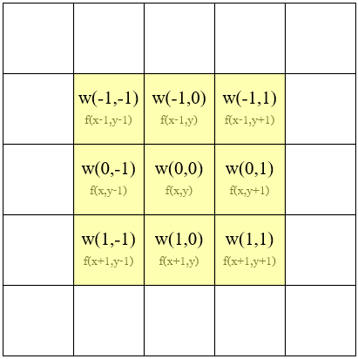
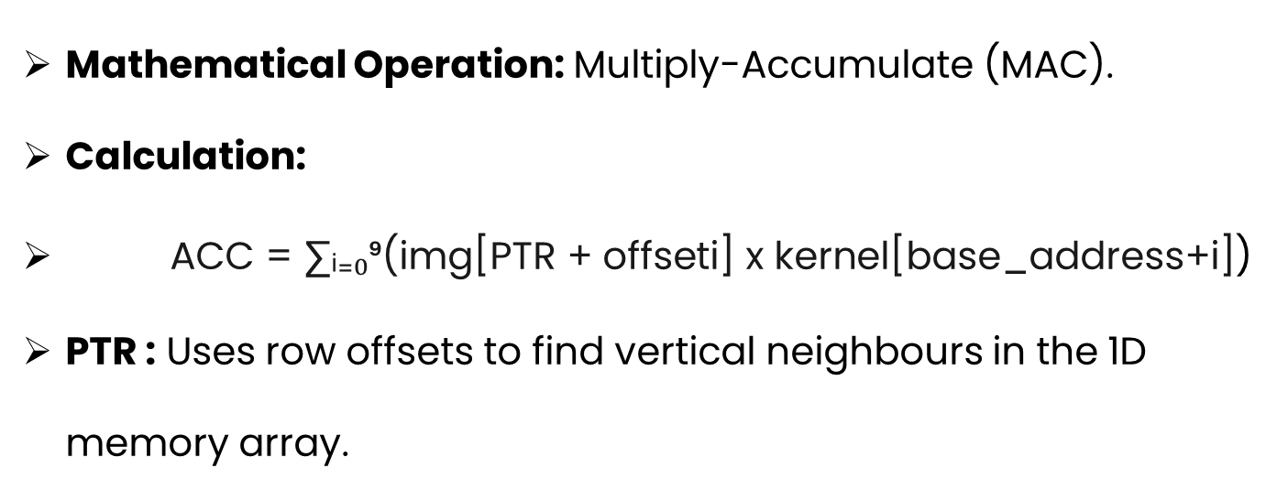
2D Convolution Formula
8
01-Jan-2026
Mathematical Operation: Multiply-Accumulate (MAC).
Calculation:
ACC = ∑ᵢ₌₀⁹$\text{(}\text{img}\text{[}\text{PTR}\text{ + }\text{offseti}\text{] }\text{x} \text{kernel}\text{[}\text{base}\text{_}\text{address}\text{+}\text{i}\text{]}$)
PTR : Uses row offsets to find vertical neighbours in the 1D memory array.
Figure 3: Convolution by a 3x3 kernel

Slide 9
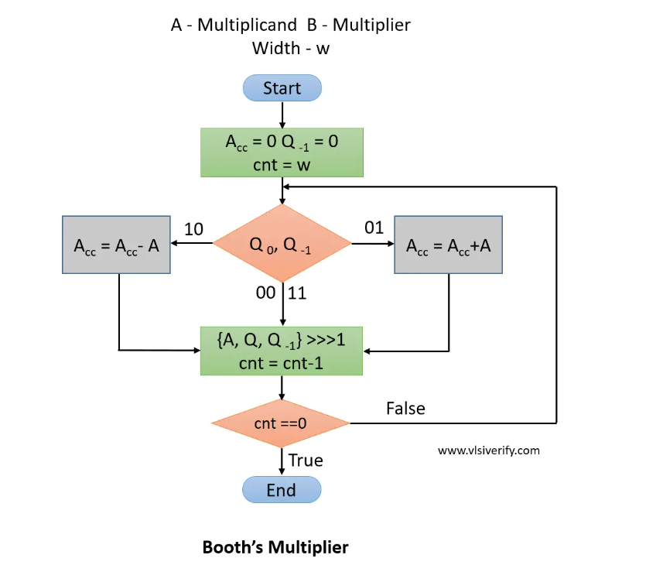
Booth Multiplier
9
01-Jan-2026
Input: Pixel value (8-bit) and Kernel weight (8-bit).
Logic: Uses Booth’s Algorithm for efficient signed multiplication.
Output: Generates a 16-bit product to maintain precision before accumulation.
Figure 4: Booth’s Multiplier

Slide 10
Decision Logic
10
01-Jan-2026
Threshold Check: Convolved pixel values are compared to the TH register.
Feature Extraction:
Heat Detection: Identify pixels exceeding the high-intensity threshold.
Edge Counting: Scan the grid for shape-defining patterns.
Final Decision: Combine Heat and Edge data to confirm object presence.

Slide 11
Control Unit
11
01-Jan-2026
Instruction Sequencing: Directs the flow of the overall system.
Signal Coordination: Generates the Load, Enable, and other necessary pulses and signals for the Memory, ALU, and Registers.
Operational Control: Manages the transitions between Sliding Window Analysis, and Heat map analysis.

Slide 12
Summary
12
01-Jan-2026
Memory Unit: Buffers sensor data and stores the 3x3 kernel.
ALU: Performs the 20-bit MAC operations and threshold comparisons.
Control Unit (FSM): Orchestrates the system workflow from UART load to final output.

Slide 13
Conclusion
13
01-Jan-2026
High-Speed Processing: Real-time occupancy detection via hardwired FPGA logic.
Efficiency: Optimized for 8x8 grids, suitable for embedded smart-home or industrial applications.
Reliability: Hardware-based security ensures consistent detection without software lag.

