Slide 1

A party is held for animals
in a mansion.

Slide 2

During the party,
a dead body which is
stabbed by knife is found.

Slide 3

"There must be a murderer among us"

Slide 4

However the guests tried to escape
from the mansion,
they noticed that the exit door is locked.

Slide 5
While they are confused,
An eerie announcement resounded
through the mansion.

Slide 6

"Let the game begin now.
Murderers are mixed up with you.
Find a hidden key and
escape from this mansion!"

Slide 7
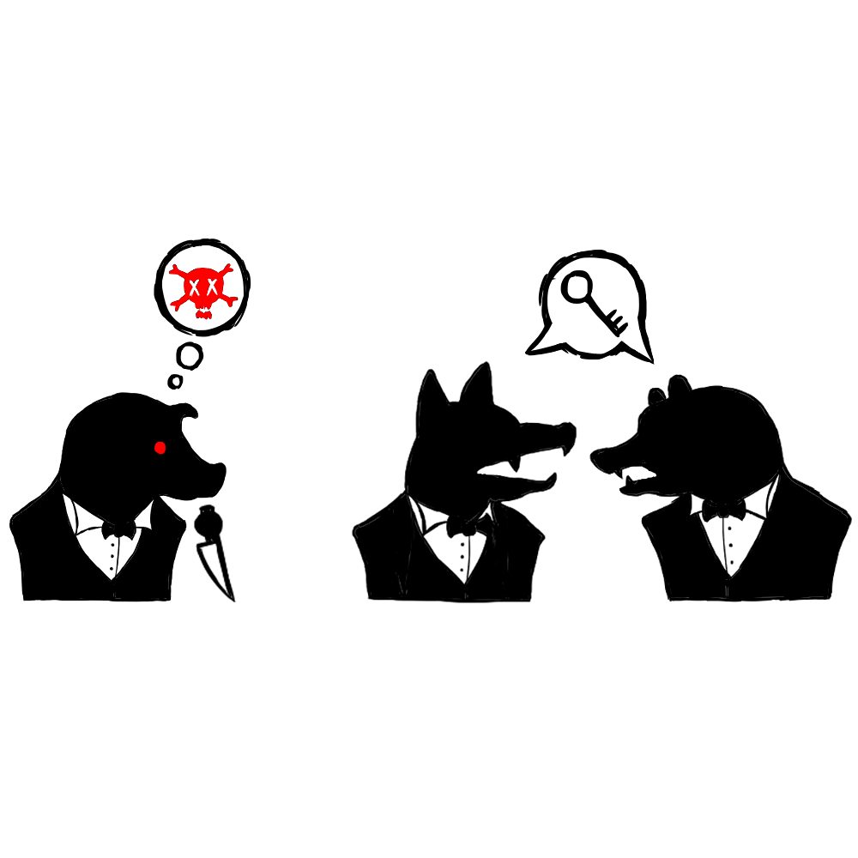
Whereas the party guests
collect clues and find the key,
the murderers kill them all.

