Slide 1
"The Murderer Among Us" is
a deduction party game.
You need 3-10 players to play.

Slide 2
Players join either of two sides
and fight each other.
There are various roles
that have unique abilities in each side.
The side and role of players
will be chosen randomly.

Slide 3

The one is the guest side which aims
to escape from the mansion
by collecting clues and find the key.

Slide 4

The other is the murderer side
which plans to murder
all the party guests.

Slide 5

Players aim for their own victory
as a party participant cooperating
with or cheating each other.

Slide 6

Game progresses by repeating
actions and discussions alternately.

Slide 7
Before the game starts,
choose a game master.
The game master facilitates the game
and guide players by reading display.

Slide 8

At first,
players take their actions in order.
Only the active player can see the display.

Slide 9
After all the players finished
their actions,
check which player is dead
until the round and then
move on to the discussion.

Slide 10
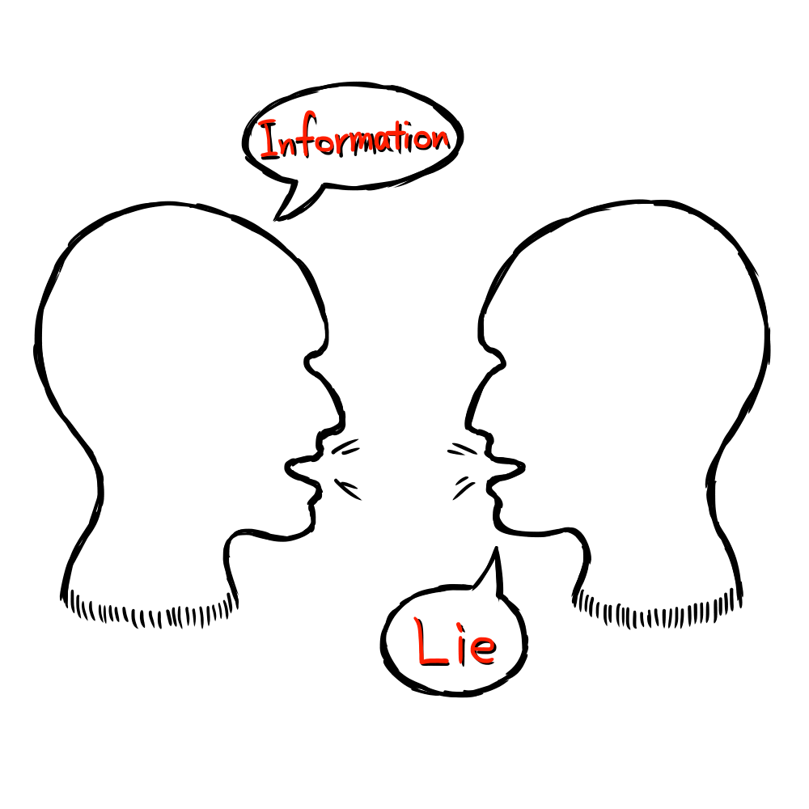
All alive players can
talk to each other
in the discussion time.
Dead players are not allowed
to talk at this time.

Slide 11
The round ends and
move on to the next round
when the discussion time is over.
Repeat these
until either of the sides
achieves their goal.

