Slide 1
Taaable

Slide 2
TABLE OF CONTENTS
1
Introduction & overviews
2
Taaable Inference Engine
3
Taaable Knowledge Management
4
Evolutions and conclusions

Slide 3
Introduction & Overviews

Slide 4
Case-Based Reasoning
Process of solving new problems based on the solutions of similar past problems
Retrieve Blueberry pancakes? Remember when you made plain pancakes
Reuse Adapt the pancake recipe to include blueberries
Revise Test the adapted solution and make necessary adjustments
Retain When a satisfying solution is found, add to knowledge base

Slide 5
Computer Cooking Contest
Case base: provided recipe book (xml file)
Judges: panel of scientists and cooking experts
<RECIPE>
<TI>Glutinous Rice with Mangoes</TI>
<IN>3 c Glutinous rice</IN>
<IN>1 1/2 c Coconut cream</IN>
<IN>1/2 c Sugar</IN>
<IN>1 ts Salt</IN>
<IN>1 1/4 c Coconut cream</IN>
<IN>2 tb Sugar</IN>
<IN>1/4 ts Salt</IN>
<IN>6 Ripe mangoes, well chilled</IN>
<IN>2 tb Sesame seeds, toasted</IN>
<PR>SEASONINGS SAUCE GARNISH Soak the rice in cold water for 2 hours.
Drain. Line a steamer with cheesecloth, heat steamer and lay rice on the cheesecloth. Steam for 30 minutes or until cooked through. The rice will become glossy. Mix the SEASONINGS ingredients in a large bowl and gently mix in the hot steamed rice. Cover tightly and let soak for 30 minutes to absorb the coconut flavour. Blend the SAUCE ingredients in a pot and heat until it just reaches the boiling point. Let cool. Peel the mangoes, slice lengthwise and remove the pits. Divide the rice among 6 plates. Place mango slices on top and cover with the sauce. Sprinkle with the sesame seeds and serve.
</PR>
</RECIPE>

Slide 6
Computer Cooking Contest - Challenges
Main challenge: given a query in NL, find a satisfying recipe adapted from a recipe from the book
Adaptation challenge: Given a recipe and a set of constraints, provide a suitable adaptation of this recipe
Menu challenge: The user gives a list of ingredients and the goal is to retrieve three recipes using these ingredients
Healthy challenge: similar to main challenge but with additional constraints on special diets such as vegetarianism or a gluten-free diet
Open challenge: This challenge was created in order to allow participants to investigate specific issues and demonstrate their results during the contest

Slide 7
Taaable
They combined their skills and knowledge of various research issues: knowledge representation and knowledge management, case base organisation and representation, development of a similarity measure, adaptation knowledge acquisition, formal representation of preparations, retrieval and adaptation strategies in cbr, etc

Slide 8
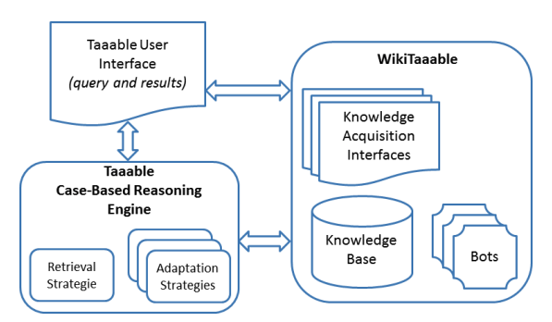
Taaable architecture overview

Slide 9
Taaable Inference Engine

Slide 10
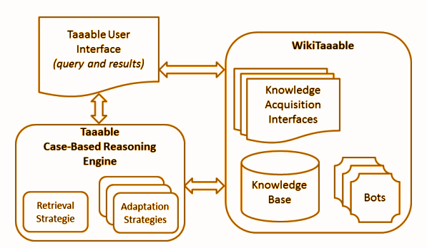
Case Retrieval

Slide 11
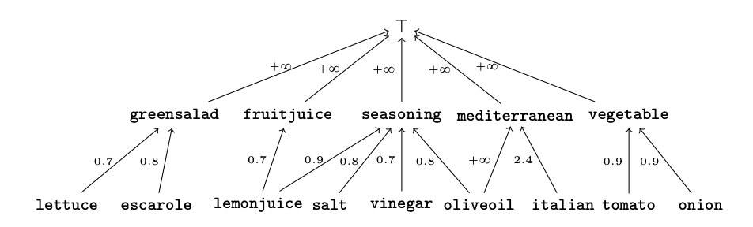
Case Retrieval
- selecting recipes R from the base of recipes where R is a best match to the query Q
- a generalisation Γ(Q): minimal in cost and such that at least one recipe from the base matches
- Domain Knowledge (DK) as a hierarchy (DAG) of knowledge e.g. lemon => citrusfruit

Slide 12
Case Retrieval - Algorithm
Q is transformed in a conjunction of litterals Q = escarole ^ lemonjuice ^ ¬onion = “a recipe with escarole and lemon juice, but without onions”
Γ <- identity function
While no recipe match for Γ(Q)
Γ <- next generalisation
Check for matches for Γ(Q) in DK

Slide 13
Case Retrieval - Generalisations
One step generalisation γ:
Generalisation of a positive litteral
γ = Lemon ~> citrusfruit
Removal of a negative litteral
γ = ¬garlic ~> ø
Γ is a composition of γ’s

Slide 14
Case Retrieval - Cost Function
Cost function for each a ~> b such that a => b in DK
It is assumed that Recipes is homogenous so µ(x) = N(x) / N(T) is a good estimation of the proportion of recipes containing x
If a => b, cost(a ~> b) = µ(b) - µ(a) (first idea)
Adaptation cost depends of types of a and b (ingredients, location…)
Coefficient K depending on the type of classes a and b
Generalisation between different types is forbidden (e.g. oliveoil ~> mediterranean)
K_{ingredient} = 1
K_{locationt} = 10
cost(a ~> b) = K ( µ(b) - µ(a) )

Slide 15
Case Retrieval - Example
Q = escarole ^ lemonjuice ^ ¬onion
Identity function Cost 0
Lemonjuice ~> fruitjuice Cost 0.7
Escarole ~> greensalad Cost 0.8
Lemonjuice ~> seasoning Cost 0.9
Lemonjuice ~> fruitjuice && escarole ~> greensalad Cost 1.5
Lemonjuice ~> seasoning && escarole ~> greensalad Cost 1.7

Slide 16
Case Adaptation

Slide 17
Case Adaptation - Basic Adaptation
Lettuce ~> green salad
Vinegar ~> seasoning
Greensalad ~> escarole
Seasoning ~> lemonjuice
Lettuce ~> escarole && vinegar ~> lemonjuice
Find a recipe R1 that shares a generalisation valid as a generalisation of Q: The substitutions that goes from Q to R1 are the adaptation (Basic adaptation: composition of substitutions)

Slide 18
Case Adaptation - Rule-based Adaptation
Adaptation knowledge in the form of adaptation rules
“In a given context C, some ingredients F can be replaced by other ingredients B” e.g. “In a recipe with green salad, vinegar can be replaced by lemon juice and salt”
greensalad ^ vinegar ~> greensalad ^ lemonjuice ^ salt
Lettuce ~> escarole && vinegar ~> lemonjuice ^ salt

Slide 19
Case Adaptation - Adaptation of ingredients quantities
Q = banana ^ ¬chocolate
flour ^ milk ^ granulatedsugar ^ egg ^ apple AND apple ~> banana
Origin Recipe (flour_{cup}=1)^(milk_{cup}=1)^(egg_{u}=4)^(granulatedsugar_{cup}=1)^(apple_{u}=2)^(banana_{g}=0)
Conversion of all quantities in grams (e.g. 1 apple = 223g)
Generalisation of the recipe
(flour_{cup}=1)^(milk_{cup}=1)^(egg_{u}=4)^(granulatedsugar_{cup}=1)^(fruit_{g})
fruit_{g} = apple_{g} + banana_{g}
Constraints
No apple in adapted recipe
Minimalisation of distance
Notes:
Mixed Linear optimization

Slide 20
Case Adaptation - Textual Adaptation
Concept lattice built using formal concept analysis
We choose the preparation that minimizes the distance with the original ingredients preparation
 | Cut | Halve | Remove | Place | Pour | Dot | Cook | Chill | Combine
Fig R1 |  | X |  | X | X | X | X
Fig R2 | X |  |  |  |  |  |  |  | X
Mango | X |  | X | X |  |  |  | X

Slide 21
Knowledge Management

Slide 22
Knowledge Management

Slide 23
Knowledge Management
Food (Lemon, Garlic...)
Dish types (PieDish, Salad...)
Dish moment (Snack, Starter, Dessert...)
Location (Mediterranean, ...)
Diet (Vegetarian, NutFree...)
Action (Cut, Peel…)

Slide 24
Knowledge Management - Food Hierarchy
From Cook’s Thesaurus and Wikipedia
Association to linguistically preferred form, and lexical variants BokChoy : bok choy - pak choy, chinese cabbage…
Semi automatic process for missing ingredients
Retrieves ingredient lines not linked to food classes
Food class missing in hierarchy
Food class exists but lexical variant missing
Ingredient line contains an error
Information automatically collected: description, lexical variants, compatibility with other diets, link to wikipedia page

Slide 25
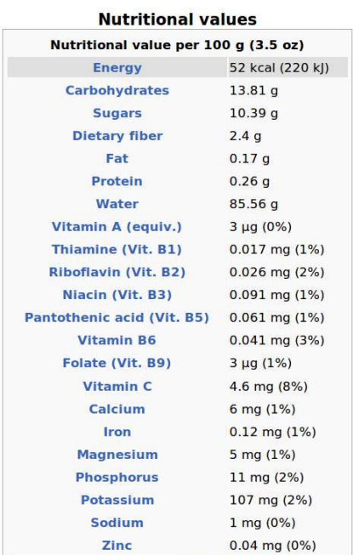
Knowledge Management - Food Hierarchy
Nutritional Data:
Collected automatically from USDA Nutrient database
Nutritional data for the ingredient “apple”

Slide 26
Knowledge Management - Dish Type and Dish Origin
Recipe Source Database
Dish Origin: 41 classes, 2 levels European, Asian - French, German, Spanish...
Dish Type: 69 classes, 3 levels BakedGood, Burger, Dessert - Bagel, Biscuit, Cookie...

Slide 27
Knowledge Management
Dish moments: 8 classes, 1 level
Diets: 7 classes, 1 level
Actions:
449 clases, 5 levels
Described by semantic and syntactic properties

Slide 28
Knowledge Management - Adaptation Knowledge
Adaptation rules: (context, replace, with, provenance) e.g. (“Chocolate and Banana Cake”, Banana, Apple, TAAABLE)
4 sources:
TAAABLE
AK extractor (knowledge added to WikiTaaable)
User (editing the wiki)
Recipe (e.g. “100g of butter or margarine”)

Slide 29
Knowledge Management - WikiTaaable
Semantic Wiki used to represent, edit and maintain knowledge
Semantic Media Wiki Knowledge encoded as a set of semantic wiki pages
Import Bots Import knowledge once at creation (set given by CC)
Recipe Annotation Bot Parses pages and add annotations and categorisation Triggered each time a recipe is added
Knowledge Acquisition Interfaces

Slide 30
Knowledge Management - Case Acquisition
Ingredient list parsed: “1kg of sliced pak choy” -> (1, kg, BokChoi, sliced)
Lexical variants
Regular expressions
Origin and type of dish: from RecipeSource
There is a recipe with the same title: origin and type are kept
Title of recipe contains keywords corresponding to classes: assigned
Data mining of recipe source: set of associations <set of ingredients> -> <origin or dish type>

Slide 31
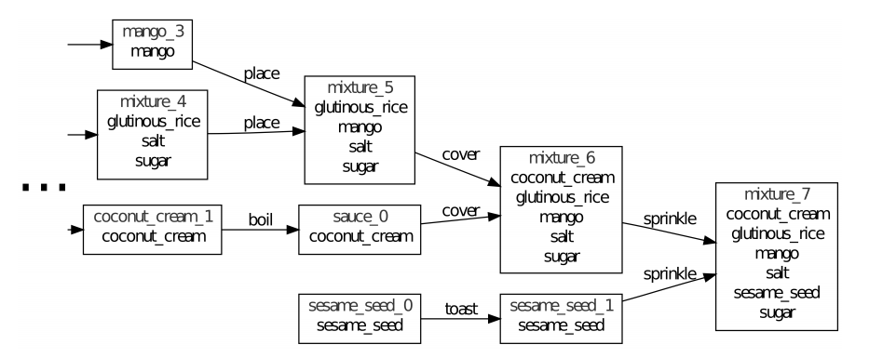
Knowledge Management - Preparation annotation
Built iteratively verb by verb
Only the leftmost part of the tree is replaced or used as a replacement
Extract of the representation of “Glutinous rice with mangoes”

Slide 32
Knowledge Management - Adaptation Knowledge Acquisition
WikiTaaable produces an ingredient substitution
Asks user about the substitution
User is satisfied: Ingredient adaptation is stored in WikiTaaable as an AK
User is not satisfied: Explanation of failure is identified with user interaction User choses a repair strategy A new substitution is then proposed

Slide 33
Knowledge Management - Adaptation Knowledge Acquisition
The user selects the problematic substitution A ~> B
An ingredient x of B requires an ingredient y which is not in the adapted recipe
An ingredient x of the adapted recipe requires an ingredient y of A which has just been removed
An ingredient x of B is not compatible with an ingredient y of the adapted recipe.

Slide 34
Knowledge Management - Adaptation Knowledge Acquisition
“apple pancakes” with substitution apple ~> pear
The user selects the substitution apple ~> pear
Explanation selected: pear is not compatible with cinnamon
remove cinnamon
find a substitute for cinnamon
Remove cinnamon
New substitution apple ^ cinnamon ~> pear

Slide 35
Evolutions
And
Conclusions

Slide 36
Results
Vice champion 2008 & 2009
Adaptation challenge champion 2009
World champion 2010

Slide 37
Evolutions
New challenges: salad, sandwich and cocktail
What’s in the fridge? Find / Create a recipe using only a given set of ingredients
Cocktail names

Slide 38
Evolutions - What’s in the Fridge?
Recipe that matches a user query according to a set of available food provided by the CCC

Slide 39
Evolutions - Cocktail names
Mixology challenge: cocktail that matches a user query according to a set of available food provided by the CCC
“Alcohol abuse is dangerous for health”: Removing alcohol: add “Virgin”
Default Strategy: “The new”
Turn constants into variables Find explanation for words in the title, draw conclusions from adaptations “Green Russian” + MintLiquor ~> Curacao => “Blue Russian”
Generalization-Specialization of dependencies “Green Russian” + MintLiquor ~> IndianTonic IndianTonic has properties “sparkling” and “bitter” New names suggestions “Sparkling Russian” and “Bitter Russian”

Slide 40
Possible evolutions
Different viewpoints
e.g. avocado: in France mostly starter, in Brazil often dessert
Utensils?

Slide 41
Use Cases
Adapt a recipe to a specific diet (gluten-free, vegetarian, etc)
“Lighten” recipes
What’s in the fridge?

Slide 43
Sources
Taaable: a Case-Based System for personalized Cooking https://hal.inria.fr/hal-00912767/document
Improving Ingredient Substitution using Formal Concept Analysis and Adaptation of Ingredient Quantities with Mixed Linear Optimization https://hal.inria.fr/hal-01240383/document
Adaptation of TAAABLE to the CCC'2017 Mixology and Salad Challenges, Adaptation of the Cocktail Names http://ceur-ws.org/Vol-2028/paper29.pdf

