Slide 1
Introduction

Slide 2
Security: Measures taken to protect something
Computer Security - generic name for the collection of tools designed to protect data and to prevent hackers
Network Security - measures to protect data during their transmission
Internet Security - measures to protect data during their transmission over a collection of interconnected networks
our focus is on Internet Security

Slide 3
Security Goals
Confidentiality: ensures that computer related assets are accessed only by authorized parties
Integrity: Assets can be modified only by authorized parties or only in authorized ways
Availability: Assets are accessible to authorized parties at appropriate times

Slide 4
Aspects of Security
consider 3 aspects of information security:
  security attack
  security mechanism
  security service

Slide 5
Security Attacks
Any action that compromises the security of information owned by an organization
Attacks are classified as: Active Attacks & Passive Attacks
Passive Attacks: Attempts to learn or make use of information from the system but does not affect system resources
Active Attacks: Attempts to alter system resources or affect their operation

Slide 6
Passive Attacks
Goal of opponent is to obtain information that is transmitted
Passive attacks do not affect system resources
  Eavesdropping, monitoring
Two types of passive attacks
  Release of message contents
  Traffic analysis

Slide 7

Passive Attacks (1)
Release of Message Contents

Slide 8
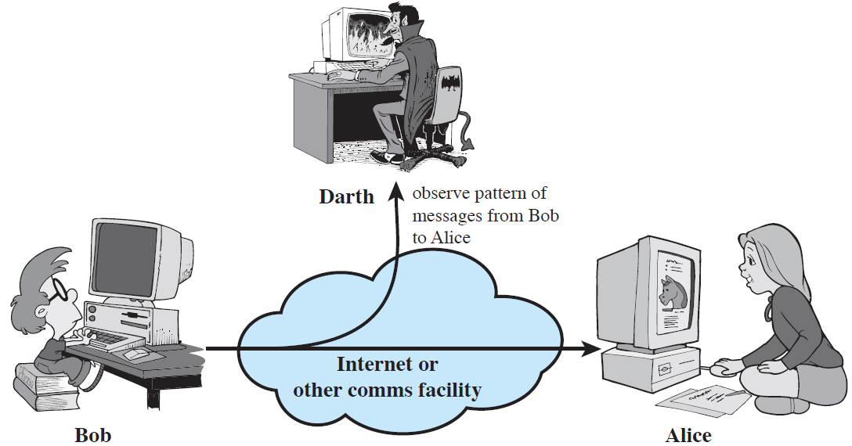
Passive Attacks (2)
Traffic Analysis

Slide 9
Active Attacks
Involve some modification of the data stream or creation of a false stream
Divided into:
Masquerade: One entity pretends to be a different entity
Replay: Passive capture of a data unit and its subsequent retransmission to produce an unauthorized effect
Modification of messages: Some portion of a legitimate msg is altered ,or that msg’s are delayed or reordered to produce an unauthorized affect
Denial of service: Prevents or inhibits the normal use or management of communication facilities

Slide 10
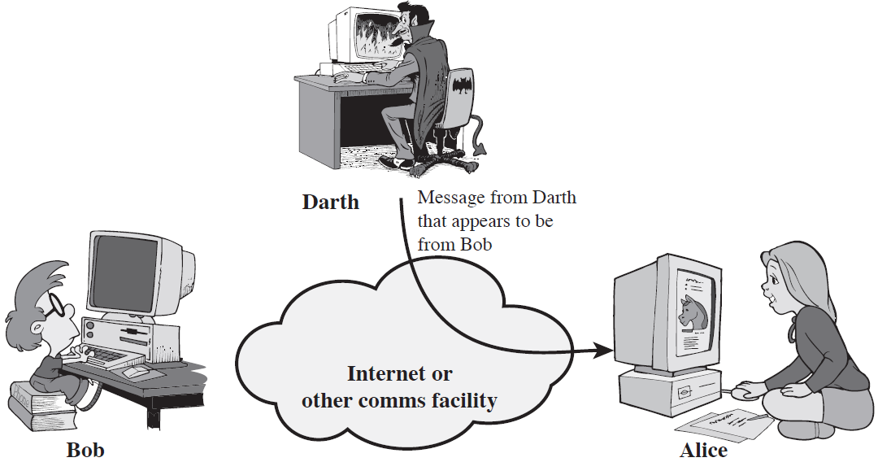
Active Attacks (1)
Masquerade

Slide 11

Active Attacks (2)
Replay

Slide 12
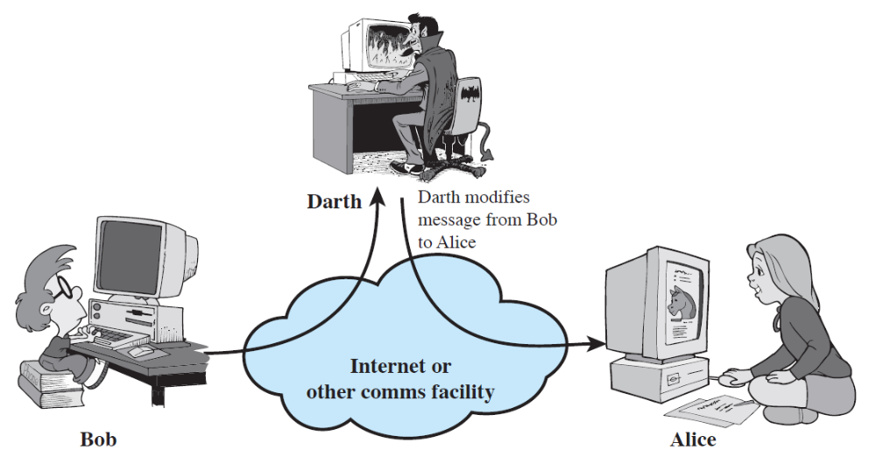
Active Attacks (3)
Modification of Messages

Slide 13
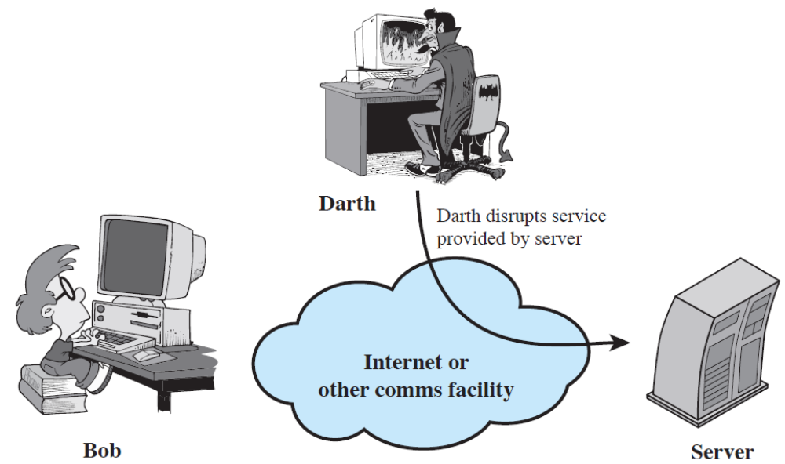
Active Attacks (4)
Denial of Service

Slide 14
Types of Attacks/Threats
Interruption
Interception
Modification
Fabrication

Slide 15
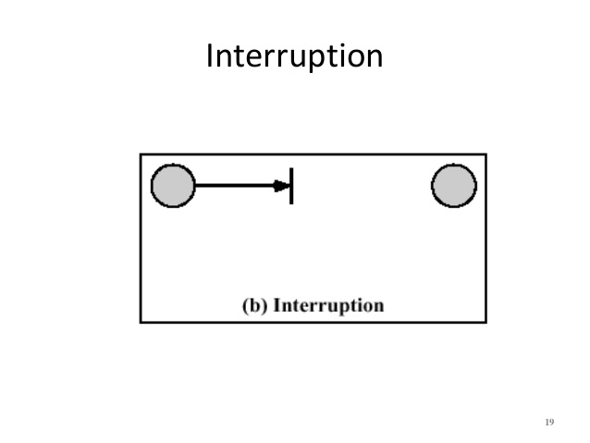

Slide 16
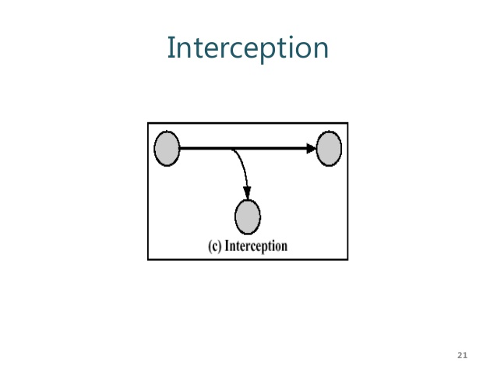

Slide 17
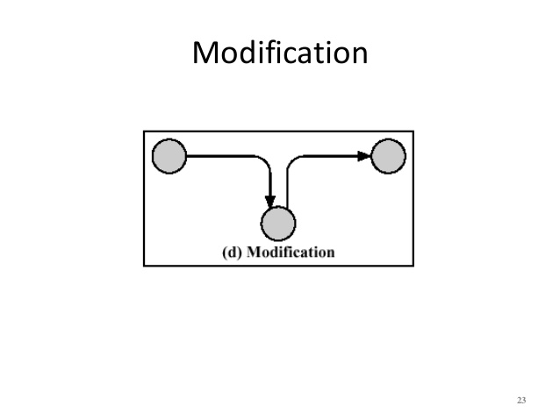

Slide 18
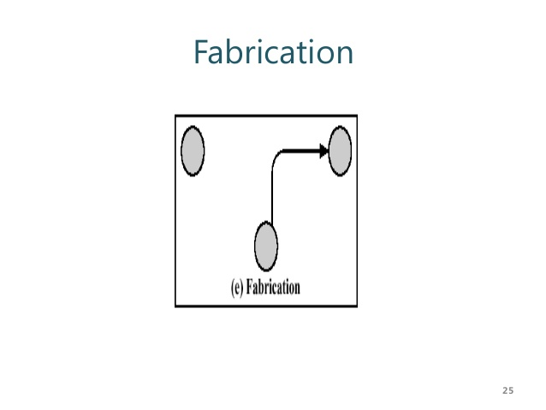

Slide 19
Security Services
  Enhance security of data processing systems and information transfers of an organization
  Intended to counter security attacks
  Using one or more security mechanisms
  Implement security services and are implemented by security mechanisms

Slide 20
Security Services
X.800:
  “a service provided by a protocol layer of communicating open systems, which ensures adequate security of the systems or of data transfers”
RFC 2828:
  “a processing or communication service provided by a system to give a specific kind of protection to system resources”

Slide 21
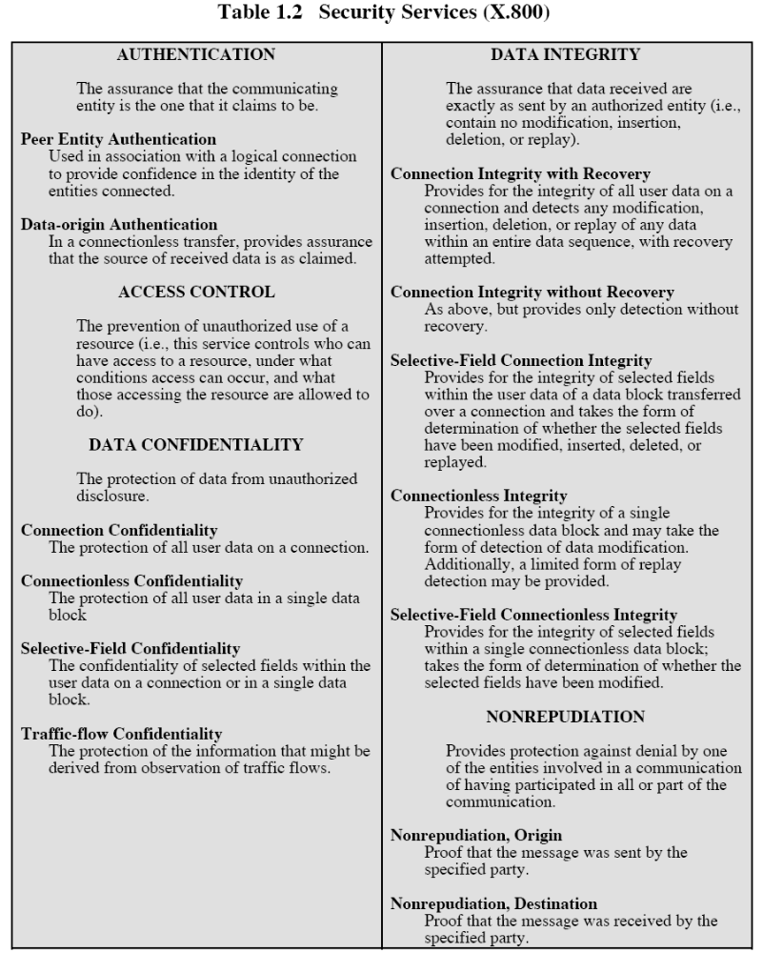

Slide 22
Security Services (X.800)
Authentication - assurance that communicating entity is the one claimed
  have both peer-entity & data origin authentication
Access Control - prevention of the unauthorized use of a resource
Data Confidentiality –protection of data from unauthorized disclosure
Data Integrity - assurance that data received is as sent by an authorized entity
Non-Repudiation - protection against denial by one of the parties in a communication
Availability – resource accessible/usable

Slide 23
Security Mechanism
feature designed to detect, prevent, or recover from a security attack
no single mechanism that will support all services required
however one particular element underlies many of the security mechanisms in use:
  cryptographic techniques
hence our focus on this topic

Slide 24
Security Mechanisms (X.800)
specific security mechanisms:
  encipherment, digital signatures, access controls, data integrity, authentication exchange, traffic padding, routing control, notarization
pervasive security mechanisms:
  trusted functionality, security labels, event detection, security audit trails, security recovery

Slide 25
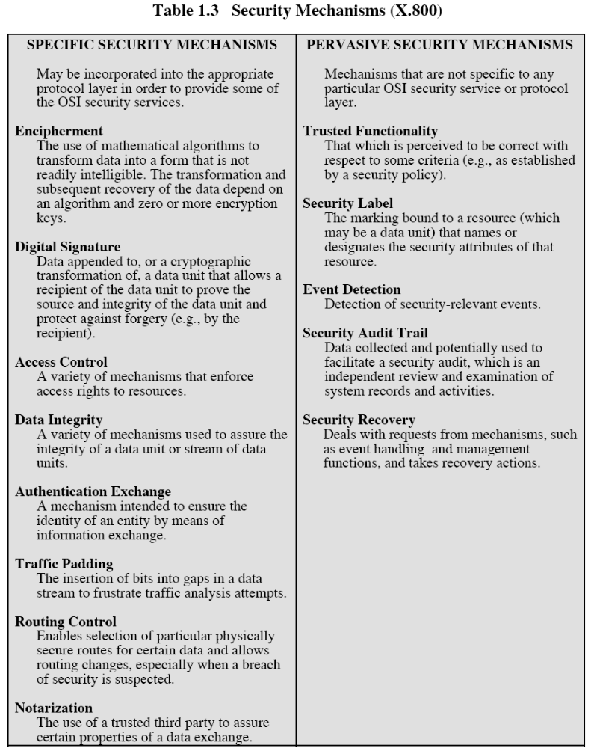

Slide 26
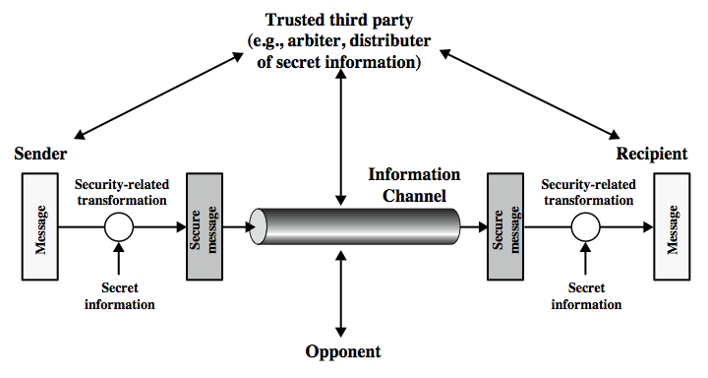
Model for Network Security

Slide 27
using this model requires us to:
  design a suitable algorithm for the security transformation
  generate the secret information (keys) used by the algorithm
  develop methods to distribute and share the secret information
  specify a protocol enabling the principals to use the transformation and secret information for a security service

Slide 28
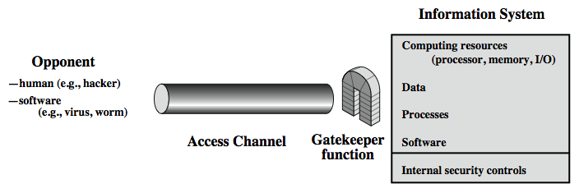
Model for Network Access Security

Slide 29
Model for Network Access Security
using this model requires us to:
  select appropriate gatekeeper functions to identify users
  implement security controls to ensure only authorised users access designated information or resources

