Slide 1
LUNCHBOX / THE PRODUCT IDEA
LunchBox
A LITTLE HELP WITH TONIGHT
PANTRY-FIRST MEAL PLANNING
“Use my tomatoes.
Keep it easy.”
Dinner starts
with what
you have.
A GOOD FIT FOR YOUR KITCHEN
Tomato &
lentil skillet
25 min / 2 servings / 1 pan
Uses your garden tomatoes.
One missing ingredient goes on the list.
Your pantry, recipes and grocery list.
Finally working as one kitchen.
PANTRY → RECIPE → GROCERY LIST
Product strategy / UX concept / Interactive prototype
CONCEPT PORTFOLIO · SEPTEMBER 2026
01
Notes:
Concept portfolio based on the founder’s LunchBox brief. This is a proposed product direction, not evidence of a launched product, validated market, or measured outcomes. All screens use illustrative household data. The accompanying HTML prototype uses fixed recipes and no external services. Core promise: take the guesswork out of meals by connecting what is on hand with what the household wants to eat.

Slide 2
LUNCHBOX / PRODUCT THESIS
Not more recipes. Better answers.
The opportunity is to turn kitchen context into a meal someone can actually make.
“What makes sense
to cook next?”
01
What is already here?
Food is scattered across cupboards, the fridge,
the freezer, and the week’s garden harvest.
A useful answer knows the food,
the people, and the moment.
02
What fits real life?
Time, tools, tastes and energy change
from one evening to the next.
03
What needs to happen next?
DESIGN HYPOTHESIS — TO VALIDATE
A recipe becomes useful only when shopping,
preparation and inventory stay connected.
Start with busy households that want to cook at home,
but do not want meal planning to become another job.
CONCEPT PORTFOLIO · SEPTEMBER 2026
02
Notes:
The starting segment is a hypothesis, not a researched persona. The founder’s problem spans decision effort, food utilization and healthier eating. This proposal avoids reducing the product to calorie tracking or an endless recipe feed. The job-to-be-done is: When I need to feed myself or my household, help me choose something that fits the food and constraints I have, then take care of the resulting list and inventory changes.

Slide 3
LUNCHBOX / PRODUCT ARCHITECTURE
Three modules. One connected loop.
The meal plan is a shared workspace across the modules—not a disconnected fourth database.
01 / WHAT WE HAVE
02 / WHAT WE COULD MAKE
03 / WHAT WE STILL NEED
Pantry
Recipe engine
Grocery list
→
→
Ingredients and amounts
Storage and freshness reminders
Garden, farm-share and grocery inputs
Generate, adapt and explain
Save favorites and import recipes
Match food, tools and preferences
Merge missing ingredients
Check off and confirm purchases
Keep staples from running low
MEAL PLAN
Choose → Reserve → Shop → Cook → Reconcile
Shared foundation: household preferences, equipment, ingredient identities, quantities, and a reversible action history.
CONCEPT PORTFOLIO · SEPTEMBER 2026
03
Notes:
Interface navigation may have four destinations: Meal plan, Recipes, Pantry and Grocery list. The plan is an orchestration view: it stores scheduled meal instances and their status; pantry records remain the physical source of truth and grocery needs are derived. Do not create four competing copies of an ingredient. Shared preferences include dietary rules, explicit allergies, dislikes, serving sizes, available equipment, time limits and priorities. AI is most visible in the recipe engine. Pantry and grocery intelligence stays quiet and contextual.

Slide 4
LUNCHBOX / THE CORE JOURNEY
From “What’s for dinner?” to a closed loop.
A concrete example: tomatoes from the garden, dinner for two, one missing ingredient.
01
02
03
PANTRY
RECIPES
MEAL PLAN
Bring food in
Find a good fit
Make a plan
Add 800 g of garden tomatoes.
Mark them “use soon.”
Ask for an easy dinner.
See a skillet recipe and why it fits.
Accept Monday’s meal.
Reserve 400 g; leave stock unchanged.
04
05
06
GROCERY LIST
PANTRY
CLOSE THE LOOP
Fill the gap
Confirm what came home
Cook, then keep the rest
Need 100 g of spinach.
One combined grocery line appears.
Buy a 200 g bag.
Put-away confirmation adds 200 g.
Confirm actual ingredients used.
Save any uneaten portions as leftovers.
CONCEPT PORTFOLIO · SEPTEMBER 2026
04
Notes:
This worked example is also implemented in the HTML prototype. The sample is not the user’s actual pantry. Planning the tomato-and-lentil recipe leaves tomatoes at 800 g. Shopping demand includes 100 g spinach. Checking the item in the store does not add inventory. Confirming 200 g received adds the actual amount. Cooking consumes the reviewed recipe quantities: tomatoes become 400 g and spinach becomes 100 g. Two prepared servings can become one eaten serving and one leftover. Eating that leftover later does not deduct the ingredients again. All changes can be undone.

Slide 5
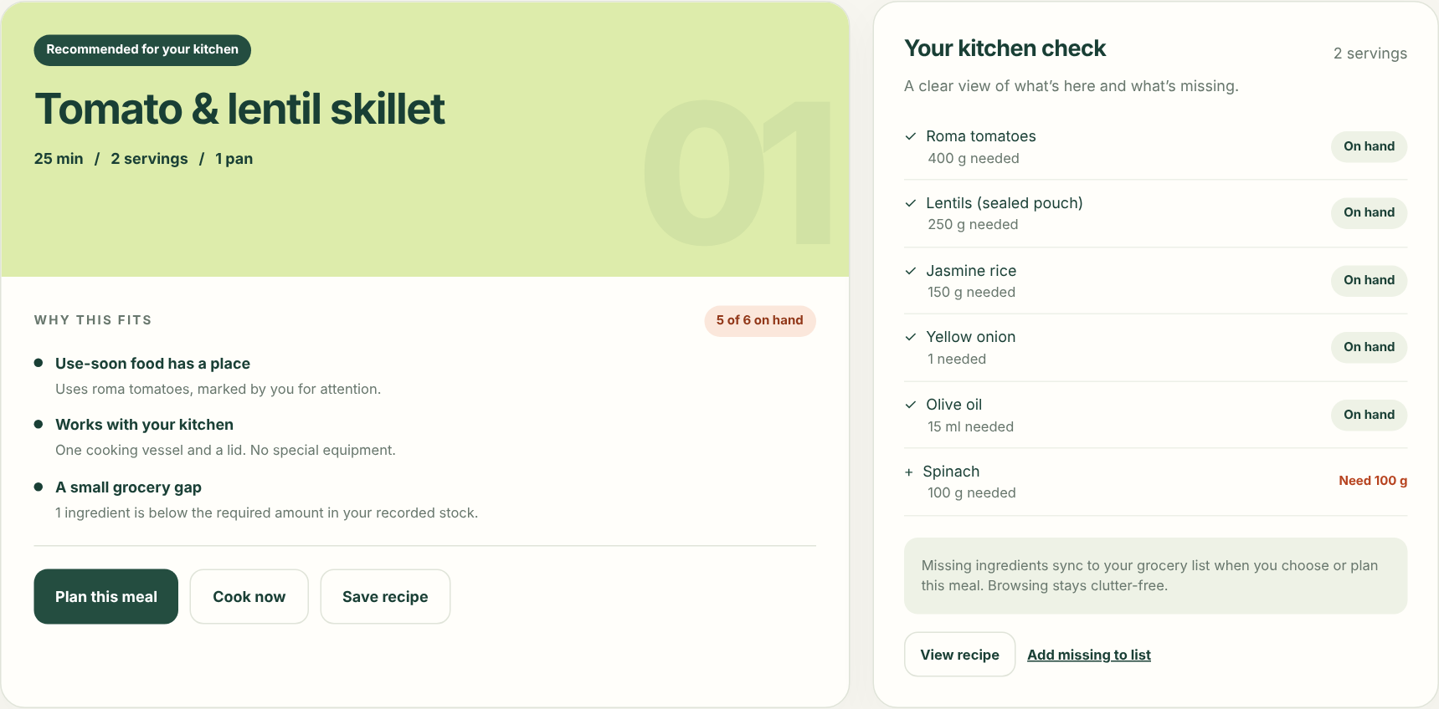
LUNCHBOX / SCREEN 01 / RECIPES
The AI should explain its recommendation.
A small set of relevant options beats an endless feed. Let the household see the tradeoffs.
01
Context before inspiration
02
Reasons, not a mystery score
03
A choice that leads to action
Food, time, servings and equipment.
Use-soon food, effort, and missing items.
Plan it, cook it, save it, or adapt it.
CONCEPT PORTFOLIO · SEPTEMBER 2026
05
Notes:
Proposed recipe-generation flow: gather the household’s hard constraints, select a priority such as use soon or no shopping, rank candidate meals, and show three understandable options. The first option should have a clear why-this-fits explanation and an explicit ingredient check. Suggestions should include ready-now, one-small-addition, and different-effort alternatives when possible. Browsing suggestions must not pollute the shopping list. Selecting Add missing, accepting a plan or choosing a meal commits a grocery need. Display estimates as estimates; do not imply laboratory nutrition precision or guaranteed freshness. The screenshot is a local concept prototype with three fixed recipes, not live AI output.

Slide 6
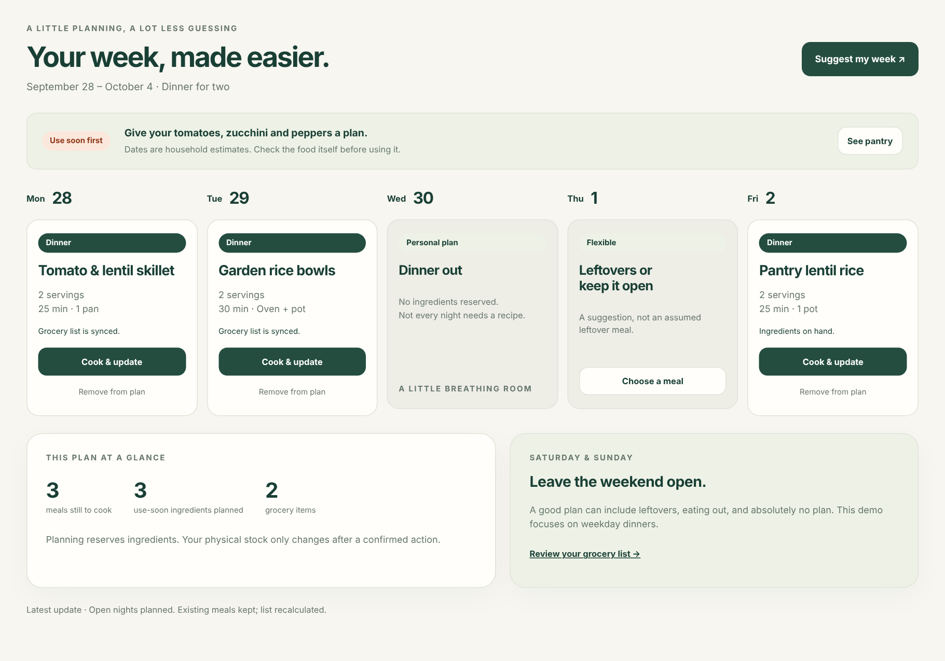
LUNCHBOX / SCREEN 02 / MEAL PLANNING
Plan enough. Leave room for life.
Batch the decisions without pretending every breakfast, lunch and dinner must be optimized.
01 / KEEP CONTROL
Fill empty slots.
Keep locked meals.
Generate a proposal, then review it. Do not silently replace plans the household already made.
02 / SEE THE CONSEQUENCE
One edit updates
the connected plan.
Rescale servings, swap a recipe, or remove a meal. Reservations and grocery needs follow.
CONCEPT PORTFOLIO · SEPTEMBER 2026
06
Notes:
Proposed full experience supports breakfast, lunch, dinner, batch prep, prepared leftovers, eating out, and blank slots. Start the first pilot with dinners and a lightweight week view; the demo intentionally limits itself to a sample weekday-dinner plan. Users can ask the agent to fill open nights with constraints such as three dinners, two one-pan meals, use the tomatoes, and leave Friday open. A future leftover plan is an intention; prepared food is not physically available until cooking confirms its yield. The plan should consider quantities reserved by other meals and warn when a proposed swap would create a shortage.

Slide 7
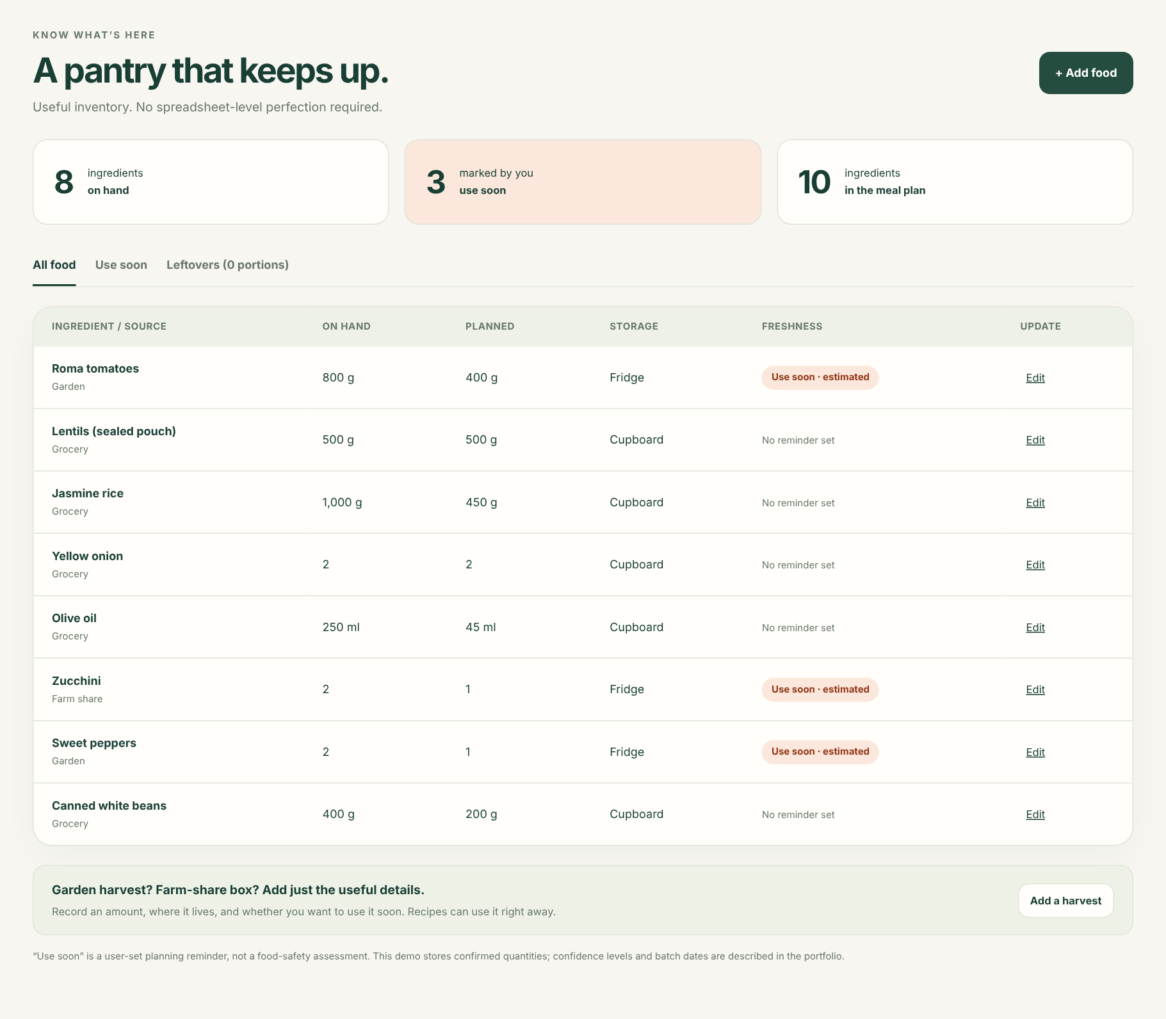
LUNCHBOX / SCREEN 03 / PANTRY
Useful inventory, not another chore.
Accuracy matters. So does making correction easier than abandoning the system.
01
Keep the useful details
Amount, unit, storage, source, and freshness reminder. Add an opened date or batch only when it helps.
02
Show uncertainty honestly
Known, approximate, or unknown. “Unknown” is not “zero,” and a reminder is not a food-safety verdict.
03
Make small updates effortless
Add a harvest, adjust a count, mark food used elsewhere, or record waste. Let the next plan adapt.
CONCEPT PORTFOLIO · SEPTEMBER 2026
07
Notes:
Pantry design requirements: store ingredient identity separately from batches/lots. Preserve original item names, units, raw versus cooked state, and source. Support known and estimated quantities, plus explicit unknown values. Offer lots when expiry dates differ; prioritize the household’s use-soon lots without making safety guarantees. Quick actions should include Used some, Finished it, Froze it, Discarded it, and Added more. The prototype implements confirmed amounts, manual use-soon flags, garden/farm-share sources, corrections, and prepared leftovers; batch dates and confidence states remain proposed. Stock that is reserved for a plan still exists physically but is not free for additional meals. Inventory upkeep is the highest-risk retention assumption to test.

Slide 8
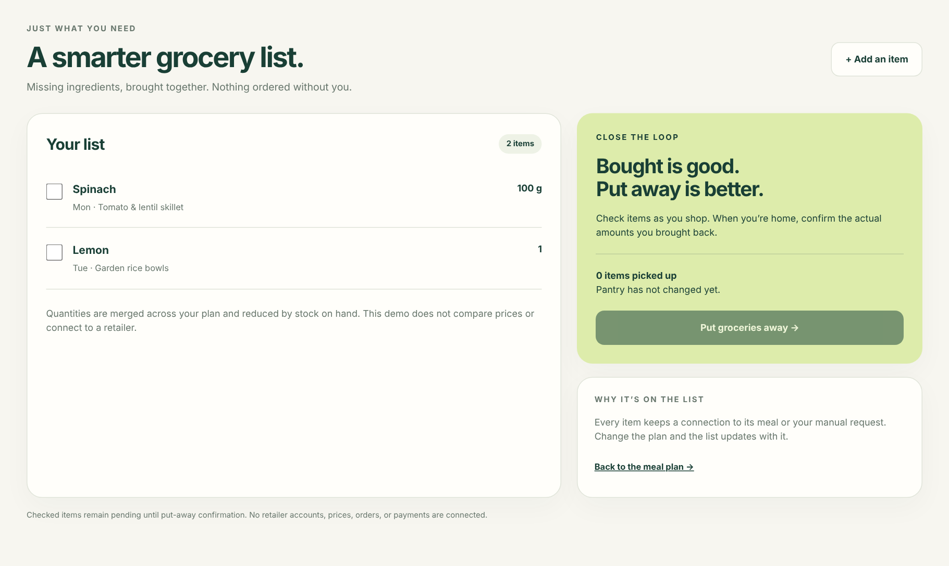
LUNCHBOX / SCREEN 04 / GROCERY LIST
A list with a reason behind every item.
The list should feel simple in the store, even when the logic behind it is doing more work.
LESS MENTAL ARITHMETIC
Need 100 g.
Buy a 200 g bag.
Record 200 g.
Check off while shopping. Confirm quantities and substitutions when putting groceries away.
NO SILENT PURCHASES
CONCEPT PORTFOLIO · SEPTEMBER 2026
08
Notes:
The core list aggregates recipe needs in compatible units, subtracts usable stock once across the whole plan, and preserves why each line exists. Users can add manual extras and define replenishment preferences for staples. Never assume that a checked checkbox is a confirmed quantity received. Keep picked-up items pending; a canceled recipe must not erase food already bought. Receipt imports, retailer carts and prices are later integrations. Any best-price comparison must account for package size, unit price, availability, delivery fees, minimum orders and user-approved substitutions; disclose coverage rather than claiming a universal cheapest basket. Household confirmation is required before any paid order. These integrations are not connected in the prototype.

Slide 9
LUNCHBOX / INVENTORY LOGIC
Cooked is not the same as eaten.
Keep ingredients, reservations and prepared meals separate so food is never counted twice.
ON HAND
PLANNED
COOKED
LEFTOVER
800 g
→
400 g reserved
→
400 g left
→
1 portion
Tomatoes in the pantry
Still 800 g physically
400 g ingredients used
Ingredients already deducted
RULE 01
RULE 02
RULE 03
Plan or reschedule
Cook or assemble a meal
Eat a leftover
Change reservations and shopping needs.
Do not change physical stock.
Review actual use. Deduct ingredients.
Create the confirmed prepared portions.
Deduct a prepared portion only.
Do not deduct the recipe again.
Every change needs a reason, a preview when consequential, and an undo path. Shared-household writes must not apply twice.
CONCEPT PORTFOLIO · SEPTEMBER 2026
09
Notes:
Proposed state model: Ingredient, InventoryLot, RecipeVersion, PlannedMeal, Reservation, GroceryNeed, PurchaseReceipt, CookEvent, PreparedMeal and InventoryAdjustment. Planning creates demand; it does not assert that food was consumed. Cooking consumes actual lot quantities and records yield. Eating prepared portions never consumes the same ingredients twice. Waste, unplanned use and corrections are first-class events. Undo restores all connected records coherently. Ingredient normalization and unit conversion belong to deterministic services, not unverified model arithmetic. Do not convert volume to mass without an ingredient-specific rule or reviewed assumption. Shared household actions need idempotency, current-state validation and a conflict path. Inventory confidence must be preserved rather than invented.

Slide 10
LUNCHBOX / AGENT EXPERIENCE
Smart suggestions. Predictable consequences.
Use AI for interpretation and possibilities. Use explicit rules for quantities, constraints and actions.
THE HOUSEHOLD DEFINES
THE AI PROPOSES
THE PRODUCT ENFORCES
What matters
What could work
What changes
Hard constraints
Generate and explain
Deterministic accounting
Explicit allergies, dietary exclusions,
equipment and non-negotiable limits.
Offer a few relevant meals and show
what each option optimizes.
Scale quantities, merge shopping needs,
reserve stock and validate updates.
Soft preferences
Adapt and learn
Human confirmation
Taste, nutrition priorities, use-soon food,
cost, variety, effort and cleanup.
Use favorites and explicit feedback.
Suggest substitutions for review.
Approve plans, imports, actual use
and any eventual paid order.
Do not relax a hard constraint to improve a score. Do not infer allergy tolerance. Unknown ingredients or quantities require review.
CONCEPT PORTFOLIO · SEPTEMBER 2026
10
Notes:
The main agent interface is the recipe studio. Pantry AI can parse an intake note, suggest likely ingredient matches, or surface a discrepancy; grocery AI can suggest a reviewed substitute or later compare supported stores. Hard constraints should be filtered before ranking. A time limit can be either a preference or a hard constraint depending on user intent. Avoid an opaque global meal score; show why one choice better fits the current priority. Nutrition requires a defined data source, portion basis and clearly identified estimates before launch. Allergy controls are product safeguards, not a guarantee against ingredient errors or cross-contact. Preserve the original imported recipe, validate extracted quantities and servings, and version adaptations. No external integration or inferred preference should silently override explicit household rules.

Slide 11
LUNCHBOX / ONBOARDING & RETENTION
Earn trust before asking for a complete pantry.
Get to a useful meal first. Grow the inventory and preferences through normal cooking.
01
Set the boundaries
People and servings, kitchen tools, hard dietary rules, and tonight’s time limit.
A GENTLE FIRST RELEASE
You don’t need
a perfect pantry
to make a
good dinner.
02
Add a useful handful of food
Start with 5–10 ingredients, especially perishables. Pantry staples stay unconfirmed until checked.
03
Make one good decision
Choose a meal, review the gaps, and see the grocery list update automatically.
04
Build a kitchen that feels like yours
Prompt for small corrections
when they matter—not a
full inventory audit every week.
Save favorites, import your recipes, and give explicit “more like this” or “less like this” feedback.
CONCEPT PORTFOLIO · SEPTEMBER 2026
11
Notes:
The friction hypothesis is that people will maintain a small amount of inventory if the product repeatedly gives useful dinner answers. Do not demand a complete barcode scan of the kitchen at onboarding. Offer staples as suggestions but do not silently assume possession. Imported recipes should be normalized only after a review step for ingredient identity, amount, unit, preparation state and serving count. Keep the source and original text. Start with manual entry and pasted text; photo, URL and bulk imports can follow after parser quality is tested. Users need delete/export controls and a clear distinction between deliberate preferences and inferred suggestions. Household dietary data should be handled with appropriate consent and privacy, not used for unnecessary personalization.

Slide 12
LUNCHBOX / VISUAL & INTERACTION DIRECTION
A calm kitchen companion.
Warm and practical—not a diet dashboard, an AI chat wrapper, or an enterprise inventory system.
LunchBox
Quiet confidence
Clear hierarchy, a few useful choices, and room to breathe.
Good food.
Less friction.
Meaning before decoration
Explain the recommendation and the next action before showing a food photo.
Accessible by design
Visible keyboard focus, text labels beyond color, readable contrast, and generous touch targets.
Mobile everyday. Larger when helpful.
Shop and cook on a phone; plan a week comfortably on a larger screen.
PAPER
PANTRY
FRESH
USE SOON
TYPOGRAPHY
Inter / clear, warm, readable
CONCEPT PORTFOLIO · SEPTEMBER 2026
12
Notes:
Proposed identity: an uncomplicated lunchbox line mark, dark green typography, warm paper background, fresh pale green for positive guidance, and warm orange used sparingly for attention. Color is never the only status signal. Tone is supportive and specific: Need one ingredient rather than Pantry incomplete; Keep it open rather than Missed meal; Use soon rather than Bad food. A responsive web experience is the proposed first platform, not a validated platform requirement. The prototype includes responsive layouts, labeled controls, focus states and dialog keyboard handling. This is not a completed accessibility audit or a claim of compliance. Fonts are referenced by family and are not distributed with the deliverables.

Slide 13
LUNCHBOX / A FOCUSED FIRST RELEASE
Prove the kitchen loop before the integrations.
A broad vision is useful. A narrow first release makes it possible to test the hardest assumption.
01 / FIRST RELEASE
02 / LESS MAINTENANCE
03 / CONNECT COMMERCE
The core loop
Reduce the upkeep
Shop beyond the list
Manual pantry + garden intake
Household preferences and tools
Curated + AI-assisted recipe options
Manual / pasted recipe entry and favorites
Light weekly dinner planning
One aggregated grocery list
Confirm put-away, cooking and leftovers
Corrections and undo
Shared-household sync
Receipt and photo intake
Reviewed URL / image recipe imports
Inventory confidence and dated batches
User-set staple replenishment prompts
Farm-share manifests and garden feeds
Deeper meal slots and batch prep
Supported retailer connections
Package and unit-price comparisons
Availability-aware substitutions
User-approved carts and checkout
Fees and minimum-order visibility
Coverage and commercial disclosures
Phase gates are learning goals, not committed dates. Do not build integrations to compensate for an unproven everyday habit.
CONCEPT PORTFOLIO · SEPTEMBER 2026
13
Notes:
First release is a real pilot beyond this prototype: it requires secure persistence, a reviewed recipe corpus or generation service, basic ingredient normalization, serving scaling, grocery aggregation, and a reliable confirmation/undo loop. The concept prototype only implements fixed recipes and local sample state. The expansion stages are conditional on evidence that households repeatedly use the loop. Automatic replenishment should initially mean suggesting a restock, not making a purchase. Integrations must be evaluated for access, coverage, licensing and operational reliability before they are promised. This deck makes no claims about the availability of any specific retailer API or farm-share platform.

Slide 14
LUNCHBOX / WHAT TO TEST NEXT
The key risk is not recipe generation. It is upkeep.
Would people maintain enough context for LunchBox to keep earning its place in the kitchen?
01
Can they get value before perfect setup?
PROPOSED NORTH-STAR METRIC
Observe first-meal selection from a small, incomplete pantry.
Weekly meals
actually made
with LunchBox.
02
Does the system remain believable?
Run a 14-day household pilot; inspect stock mismatches and corrections.
03
Does the plan survive real life?
Test skipped meals, substitutions, leftovers, eating out and shared use.
04
Is the result worth the effort?
Measure completed cooking actions
per active household—not recipes
generated or meals merely planned.
Compare time spent deciding with time spent maintaining the system.
Guardrails: no silent constraint overrides, no unexplained stock changes, low correction burden, and user-controlled notifications.
CONCEPT PORTFOLIO · SEPTEMBER 2026
14
Notes:
Suggested discovery plan: recruit 5–8 target households for moderated task tests, then run a two-week diary-supported pilot. These are proposed research activities, not completed research. Test a night with no plan, a weekly plan with some locked nights, a mismatched purchase quantity, an unplanned meal, and a batch cooked with leftovers. Track time to a workable meal, confirmed cooked meals, inventory correction frequency, retained household usage, grocery rework and voluntarily reported food discard. Avoid claiming that every use-soon ingredient was saved from waste. Waste reduction and healthy-eating support are intended outcomes that require baseline evidence and appropriate definitions. No performance, retention, cost savings, nutrition or waste-reduction results are claimed in this portfolio.

Slide 15
LUNCHBOX / THE CONCEPT IN YOUR HANDS
Try the loop. Then build the smallest real version.
The interactive prototype demonstrates the connections—not live AI, nutrition, or retailer integrations.
IN THE INCLUDED HTML PROTOTYPE
INTERACTIVE TODAY
Plan → Shop → Put away → Cook
Four connected views
Sample recipe library
Reservations and shopping math
Actual receipts, cooking and leftovers
Local browser state and undo
1. Plan the tomato & lentil skillet for Monday.
2. Check spinach off the grocery list.
3. Put away 200 g, even though the recipe needs 100 g.
NOT CONNECTED
4. Cook two portions; record one as eaten now.
Live AI, nutrition calculation, recipe imports,
cloud / household sync, price comparison,
online ordering, and external inventory feeds.
5. Eat the leftover later. Watch raw stock stay unchanged.
Also try: suggest a week, save a recipe, add garden food,
correct an amount, and undo a change.
CONCEPT PORTFOLIO · SEPTEMBER 2026
15
Notes:
Deliverables: LunchBox_Product_Design_Portfolio.pdf, an editable PowerPoint version, and LunchBox_Interactive_Concept.html. Open the HTML file in a browser. It has no external dependencies or analytics and does not require an account. The prototype offers three fixed recipes and one sample week. The main tested loop includes planning reservations, grocery shortfalls and merged needs, picked-up versus put-away states, actual quantities received, cooking deductions, leftovers, undo, form validation and mobile-width layouts. No server, live model, retailer, nutrition database or household synchronization is connected. Next build decision: validate inventory-maintenance burden and confirm the first target household before adding external integrations.

