Slide 1


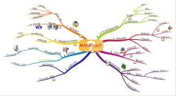
R Script
.R
md2r()
md2mm()
mm2md()
r2md()
mindr
Markdown
.Rmd .md
Mind Maps
.mm
md2mm()
mm2md()

