Slide 1
AI-Driven Traffic Signal Optimization Using Reinforcement Learning
NAME: BENJAMIN WANJOHI MWANGI
ADM. NO.: SB06/JR/MN/14034/2022
SUPRVISOR: MR. KEMBOI

Slide 2
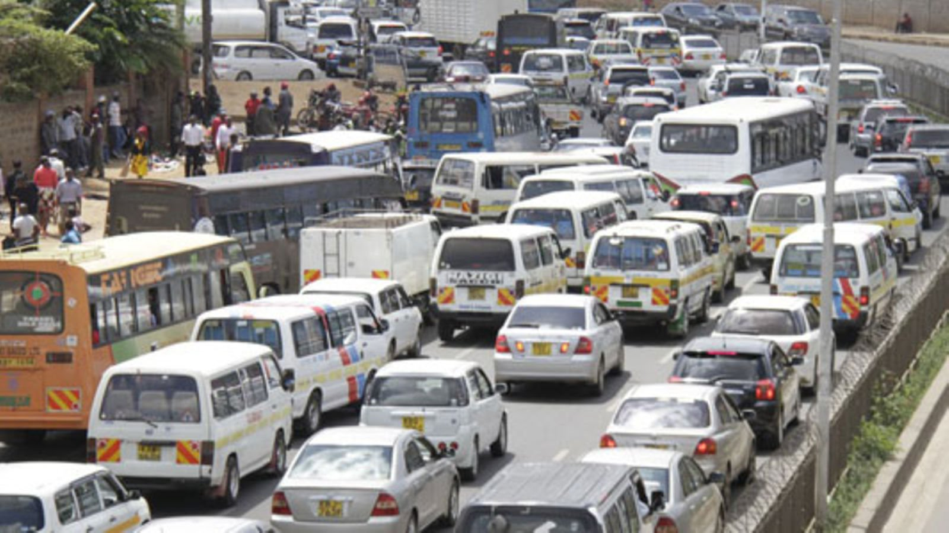
INTRODUCTION
Urbanization & Traffic Challenges
Cities are experiencing unprecedented traffic congestion due to increased vehicle density.
Traditional fixed-timing traffic signals are ineffective in managing dynamic traffic conditions.
With rapid urbanization and rising vehicle numbers, traditional traffic management systems struggle to maintain efficiency. Fixed-timing signals often lead to congestion, increased fuel consumption, and frustrated commuters. To address these challenges, this project explores AI-driven traffic optimization using reinforcement learning, leveraging real-time data from IoT sensors and simulations to dynamically adjust signal timings.

Slide 3
PROBLEM STATEMENT
Urban centers continue to struggle with severe traffic congestion, resulting in excessive delays, increased fuel consumption, and environmental degradation. Existing traffic management systems, primarily dependent on fixed-timing signal controls, lack adaptability to dynamic road conditions, leading to inefficient traffic flow and heightened commuter frustration.

Slide 4
General Objectives
Develop an AI-driven traffic control system using reinforcement learning to optimize signal timing at multiple junctions.
Minimize congestion by dynamically adjusting traffic signals based on real-time queue lengths and phase statuses.
Enhance scalability by creating a framework that can be expanded across multiple urban intersections.
Improve urban mobility by reducing average waiting time and total queue lengths across traffic nodes.
Provide a foundation for smart city solutions using AI for intelligent transportation systems.
SPECIFIC OBJECTIVES
Design and develop an AI-powered system that leverages computer vision and IoT sensors for real-time traffic monitoring, providing accurate insights into road conditions, congestion patterns, and traffic violations (Lane detectors for SUMO).
Implement an intelligent traffic signal control mechanism that dynamically adjusts signal timings based on real-time traffic density and flow, ensuring smoother and more efficient movement across intersections using reinforcement learning techniques.
Analyz and refine reinforcement learning techniques for traffic optimization, specifically focusing on Q-learning and Deep Q-learning, tuning hyperparameters and reward functions to improve decision-making in urban mobility scenarios.
Integrate AI-driven traffic control models within SUMO, enabling multi-junction optimization and allowing for comprehensive evaluations of various control strategies under diverse traffic conditions.

Slide 5
Justification
The implementation of reinforcement learning for traffic control is crucial for addressing the increasing congestion in urban areas. Nairobi, like many cities, experiences severe traffic bottlenecks, leading to longer travel times, increased fuel consumption, and environmental pollution. Traditional traffic signal systems rely on static timing, which does not adapt to fluctuating vehicle densities, often resulting in inefficient flow.
This study justifies the need for AI-driven traffic optimization by focusing on:
Real-time adaptability – Reinforcement learning enables dynamic signal control based on actual queue lengths, improving intersection efficiency.
Reduced congestion – By minimizing queue lengths across multiple junctions, the system enhances mobility and travel experience for commuters.
Scalability for smart cities – A modular framework allows easy expansion to more intersections, supporting future urban planning initiatives.
Environmental benefits – Smoother traffic flow leads to lower emissions and fuel savings, contributing to sustainable transport solutions.
Economic impact – Reducing delays improves business productivity by enabling faster movement of goods and services.
By leveraging AI and simulation-based validation, the proposed model represents a step toward smarter urban mobility, improving efficiency and sustainability.

Slide 6
methodology
Developing an AI-driven traffic optimization system requires a structured, iterative approach that balances theoretical reinforcement learning principles with real-world urban traffic constraints. This methodology follows an Agile Kanban framework, allowing for flexibility in design, testing, and refinement while adapting reinforcement learning models within the SUMO traffic simulation environment. By leveraging computer vision, IoT sensors, and data-driven algorithms, the system dynamically adjusts traffic signals based on real-time observations, optimizing urban mobility efficiency.
Agile methodology ensures iterative development, continuous testing, and adaptability to evolving requirements.

Slide 7
methodology
AGILE STEPS:
1. Iterative Development
The RL model is built incrementally, refining decision-making algorithms with real-time feedback from traffic simulations.
Junctions are integrated gradually, allowing for step-by-step improvements in scalability.
2. Continuous Testing and Refinement
Each iteration of training validates queue length reductions and phase-switching effectiveness.
Simulation results guide hyperparameter tuning (learning rate, discount factor, exploration rate) to optimize performance.
3. Collaboration and Feedback
Results are analyzed in short development cycles, allowing for rapid adjustments based on observed traffic behaviors.
Stakeholder feedback—such as policy recommendations or real-world applicability—drives refinements.
4. Adaptability and Scalability
The system remains flexible, accommodating new junctions and urban expansion without extensive rework.
The modular RL framework allows seamless integration of multi-agent coordination for network-wide optimization.

Slide 8

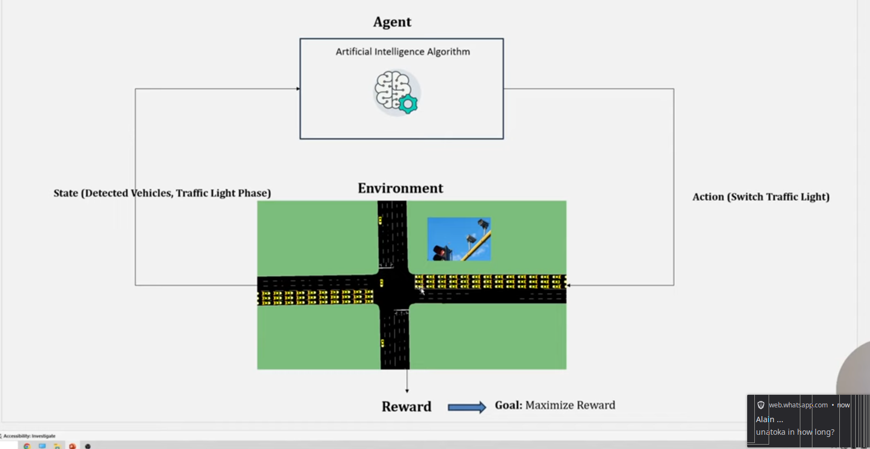
proposed Model/system/method
1. System Architecture
WTraffic Simulation (SUMO + Traci): Provides a realistic traffic environment for RL training.
State Representation: Captures queue lengths and signal phases for each junction.
Action Space: Each junction independently decides whether to switch or maintain its phase.
Q-Learning Algorithm: Updates signal timing decisions based on learned experience.
2. Adaptive Reinforcement Learning Framework
State Definition:
Inputs: Vehicle queue lengths from detectors at multiple intersections.
Phases: Current active signal phase per junction.
Reward Function:
Penalizes high congestion levels.
Encourages decisions that reduce total waiting time.
Policy Selection:
Exploration (Epsilon-Greedy): Balances exploration vs. exploitation.
Q-value Updates: Adjusts based on learning rate (α) and discount factor (γ).

Slide 9
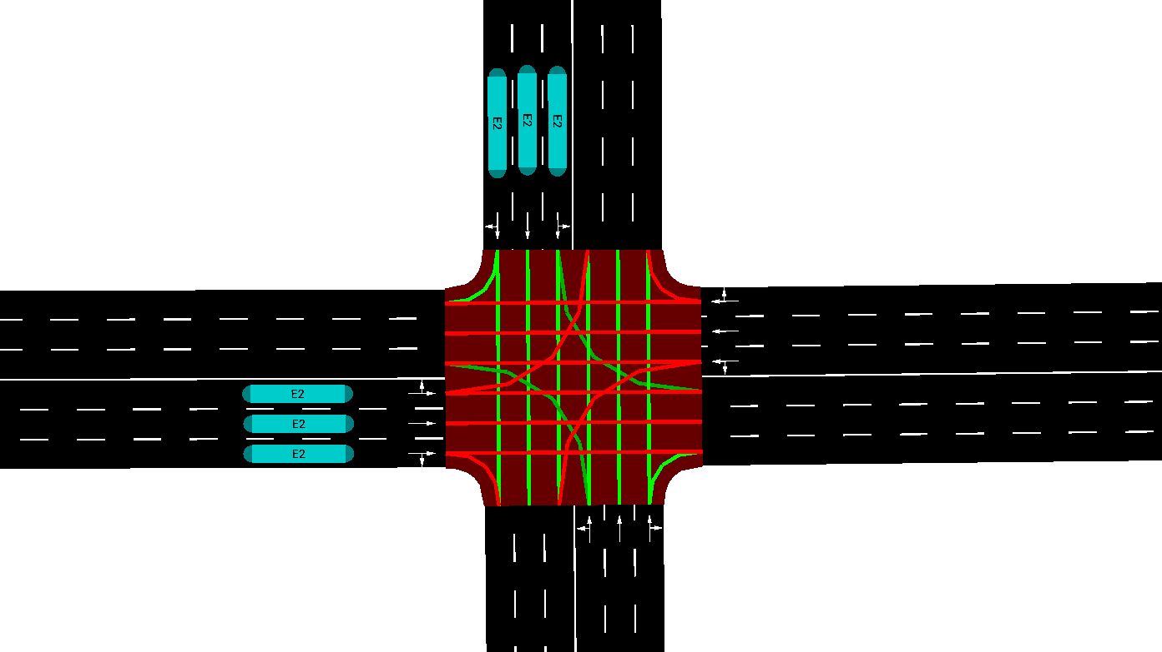
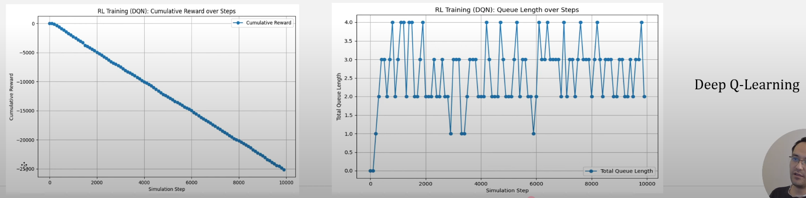
3. Multi-Junction Coordination & Scalability
Expands from two junctions to eight with modular integration for broader application.
Allows independent junction control, minimizing disruption across the urban network.
Supports policy refinement for coordinating multiple intersections dynamically.
4. Performance Evaluation & Implementation Strategy
Online learning integration ensures continuous improvement in traffic efficiency.
Simulation trials measure queue reductions, phase switching frequency, and cumulative rewards.
Future enhancements include multi-agent RL coordination for joint optimization across junctions.

Slide 10
Experiments, Analysis, Design, and Tools
1. Experimental Setup
Traffic Simulation: Using SUMO (Simulation of Urban Mobility) to model realistic urban conditions in Nairobi.
Reinforcement Learning Training: Conduct fully online continuous learning to update signal timings dynamically.
Multi-Junction Integration: Expanding RL optimization to eight intersections, with independent state/action handling.
2. Performance Analysis
Queue Reduction Metrics: Measure total vehicle queue lengths at each junction.
Reward Trends: Evaluate cumulative rewards to ensure improved efficiency over time.
Phase Transition Frequency: Track how often junctions switch signals for better coordination.
Comparison to Static Timing: Benchmark RL against predefined traffic light schedules to quantify improvements.

Slide 11
Experiments/Analysis/Design/Tools
FIXED TIMING
Q-LEARNING
DEEP Q-LEARNING
ARE THE MODELS I WILL BE RUNNING ANALYZE AND COMPARE TRAFFIC PERFORMANCE

Slide 12
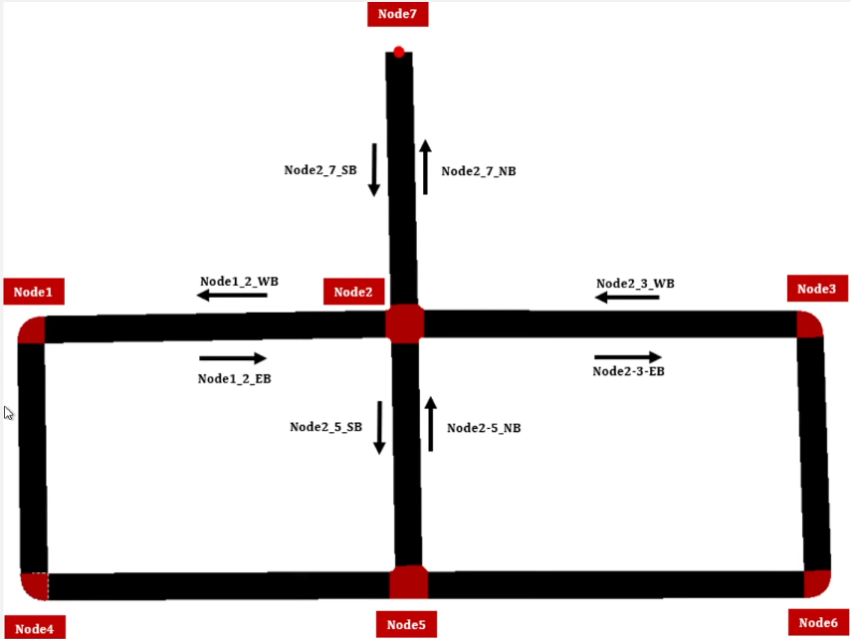
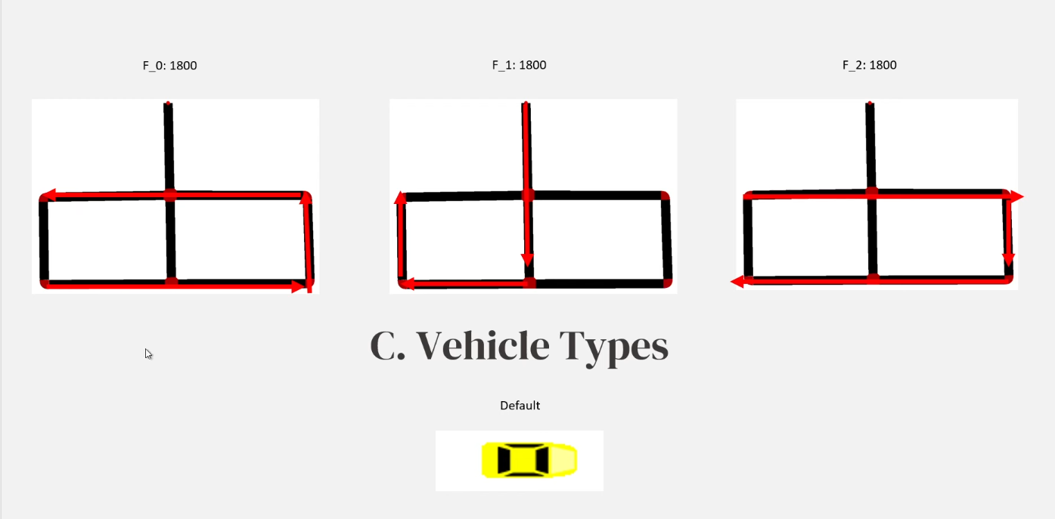
CREATING THE SIMULATION
A) CREATE NETWORK AND NAME IT PROPERLY B)ADDING TRAFFIC CARS VOLUME AND SPEED, add detecors and traffic ligjhts

Slide 13
FIXED TIMING - Traffic lights follow predefined schedules without adapting to real-time congestion.
Q-LEARNING - Uses a table-based reinforcement learning approach to optimize signal timing based on queue lengths.
DEEP Q-LEARNING - Utilizes neural networks to approximate Q-values, enabling more scalable and efficient traffic signal control.

Slide 14
Challenges & future improvements
Challenges
1. State Space Complexity – As the number of junctions increases, managing a large state space becomes computationally demanding.
2. Real-World Uncertainty – Unpredictable events like accidents or pedestrian movements can disrupt learned traffic patterns.
3. Multi-Agent Coordination – Ensuring seamless collaboration between multiple junctions while preventing conflicting decisions.
4. Training Time & Computational Cost – Deep Q-learning requires significant time and resources for convergence.
5. Data Availability – Real-world traffic data may be limited or inconsistent, affecting model accuracy.
6. Generalization Issues – Policies learned in simulation may not directly translate to unpredictable real-world scenarios.
Future Improvements
1. Multi-Agent Reinforcement Learning – Implement coordinated learning for multiple junctions rather than independent optimization.
2. Deep RL Integration – Replace Q-tables with neural networks to improve scalability and adapt to complex intersections.
3. Hybrid Learning Models – Combine RL with heuristic or optimization techniques to refine traffic control strategies.
4. Real-World Deployment – Integrate sensor-based traffic monitoring for direct application beyond simulation.
5. Adaptive Reward Functions – Adjust rewards dynamically based on traffic density, emergency vehicle presence, or time-based priorities.
6. Robust Uncertainty Handling – Introduce **stochastic models** to manage sudden traffic disturbances like lane closures or events.

Slide 15
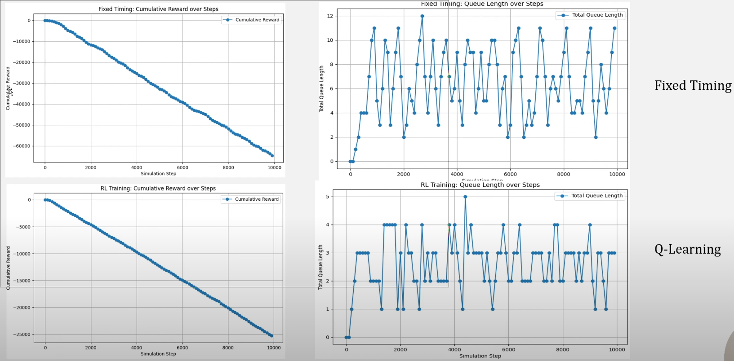
Testing and Evaluation

