Slide 1
How reliable is the dxFeed demo feed?
Data consistency, behaviour under load, and what I would do about it
Irakli · L2 Support Engineer assessment · Task C
Measured on Friday 16 October 2026 · every number reproducible offline from evidence/
Notes:
Hi, I'm Irakli. For Task C I treated the demo feed the way I would treat a client saying 'your data looks wrong'. I pulled enough history to test it properly, rebuilt the bigger candles from the smaller ones, compared everything, and then put some polite load on it. All of this was on Friday 16 October. Everything I show today can be recomputed from the saved files without touching the demo again.

Slide 2
CONTEXT
What I will cover
01
Task A calendar
Where the holiday data comes from, and what I could not get
3 min
02
Data consistency
Delay, the silent history cap, volume, prices, FX sessions
15 min
03
Behaviour under load
What happens when I add parallel requests
9 min
04
Risk, incident, improvements
What I would escalate, a drill, three proposals
10 min
Questions
5 min
dxFeed demo assessment · Irakli
2
Notes:
Four parts. Most of the time goes to data consistency, because that is where the interesting problems are. Every slide has a tag in the corner: verified means I reproduced it from the saved data, hypothesis means it fits but I could not prove it, not done means exactly that.

Slide 3
CONTEXT
VERIFIED
The short version
58,315
900 s
8,000
130 + 1
candles pulled and checked
delay on every symbol: the feed is 15 min behind
candles per series, then it stops and still says OK
AAPL hours where 1h volume ≠ sum of 5m (ETH + RTH)
50
~3 req/s
0
75
EUR/USD 1-minute candles outside the FX session
throughput ceiling; more workers just wait longer
HTTP errors in 648 load requests, and no 429
holiday rows from the Task A scraper
dxFeed demo assessment · Irakli
3
Notes:
If you remember one slide, this is it. The feed is delayed by exactly fifteen minutes. History silently stops at about eight thousand candles. Hourly volume for US stocks doesn't match the five-minute candles outside regular hours. FX prints a few candles when the market is closed. And under load the service queues instead of saying slow down. All latencies today are in seconds, not milliseconds.

Slide 4
CONTEXT
How I worked
Pull
Validate
Rebuild
Compare
Load
Recheck
96 chunked requests, 4 instruments, 1m / 5m / 1h
gaps, order, grid, NaN, sessions, holidays, DST
5m from 1m, 1h from 5m, compare candle by candle
SSE stream and the Radar web tool
1 → 50 workers with automatic stop rules
every headline number recomputed from disk
Instruments
Logged for every call
Polite by design
AAPL · US stock
TSLA · high volatility (no crypto on demo)
EUR/USD · FX, bid candles only
/ESZ26 · futures, used as a control
URL and parameters, UTC time
latency, status, body hash
raw body saved (gzip)
one client, think time 0.25 s
stop on 429, errors, p50 > 8 s
budget of 3,500 requests
Rule I kept: a number goes on a slide only if I can recompute it offline.
dxFeed demo assessment · Irakli
4
Notes:
This is the pipeline. I pulled history in chunks, validated each series, rebuilt the bigger timeframes from the smaller ones, cross-checked against the stream and Radar, then ran the load test. At the end I re-ran every headline number offline, and that re-check corrected four of my own earlier claims. I'll point them out when we get there. Crypto was in the brief, but every crypto symbol timed out on the demo, so TSLA is my high-volatility instrument.

Slide 5
01
Task A: holiday calendar
The calendar Task C uses to tell a holiday from a gap
about 3 minutes
Notes:
Task A: holiday calendar. About 3 minutes. The calendar Task C uses to tell a holiday from a gap

Slide 6
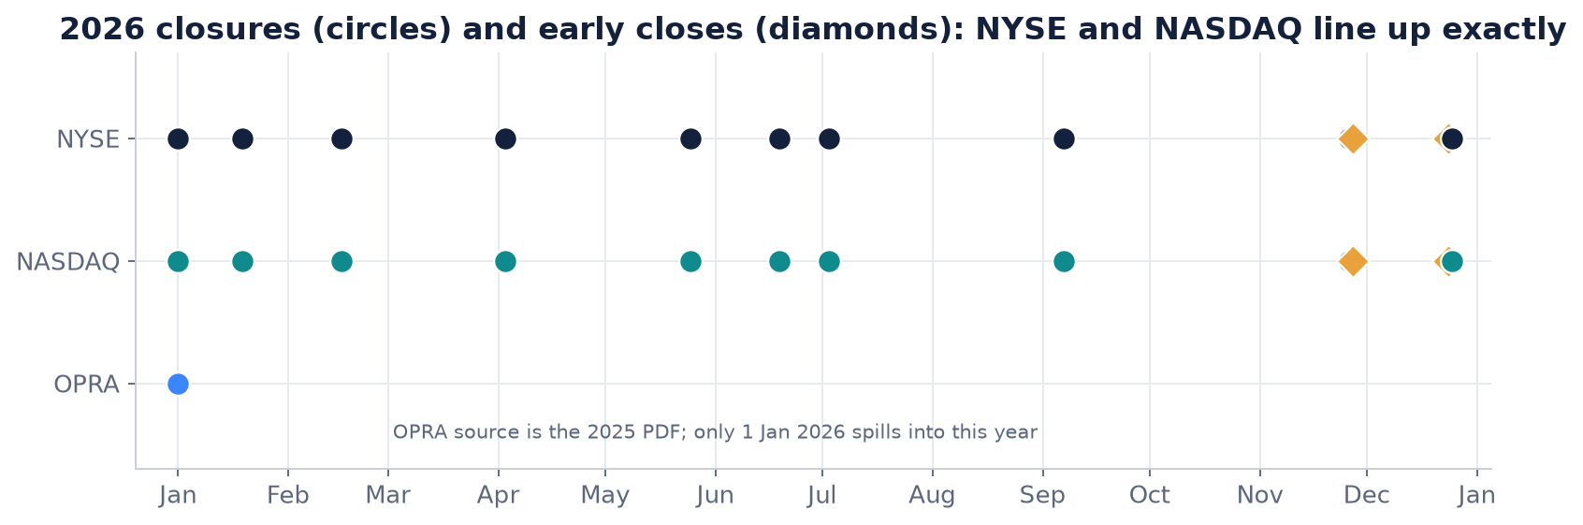
TASK A CALENDAR
VERIFIED · GAPS LISTED
NYSE and NASDAQ agree on every 2026 date
1
75 rows: NYSE 34, NASDAQ 12, OPRA 14, CME 15.
2
2026: NYSE = NASDAQ, 0 differences.
3
Years: NYSE 2026–28, NASDAQ 2026, OPRA 2025.
4
Drive: uploaded by hand; API path untested.
75 rows from four exchanges, weekly on GitHub Actions. Validation: WARN, not FAIL.
dxFeed demo assessment · Irakli
6
Notes:
I built a small scraper with one adapter per exchange. It writes one CSV per exchange plus a combined file, and validates them. There are 75 rows: NYSE 34, NASDAQ 12, OPRA 14 and CME 15. NYSE and NASDAQ match on every closed day and early close in 2026, which is the year the Task C data sits in. The overall result is WARN, not FAIL, and the warnings are about which years each source has published, not about wrong dates. I uploaded the CSVs to Drive myself. The automated Drive upload is written but has not run with real credentials.

Slide 7
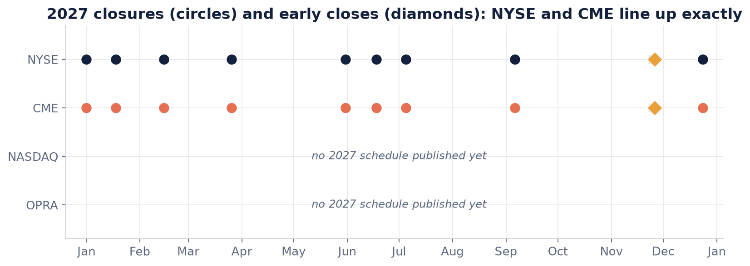
TASK A CALENDAR
VERIFIED · GAPS LISTED
CME matches NYSE on every 2027 date
1
CME: manual xlsx, Equities row only.
2
2027: NYSE = CME, 0 differences.
3
NASDAQ 2027 not published yet.
4
OPRA 2026 / 2027 PDFs return 403.
CME comes from Trading Hours files I downloaded. The site itself is never scraped.
dxFeed demo assessment · Irakli
7
Notes:
CME's website blocks scripts and its terms forbid scraping, so I don't scrape it. Instead I downloaded the Trading Hours holiday spreadsheets by hand: Thanksgiving and Christmas 2026, and the full 2027 set. The adapter reads the Equities row of each file. An empty cell means closed, and a close before the normal 4 pm Central means an early close. That gives 15 CME rows. For 2027, CME and NYSE agree on all ten closures and on the early close after Thanksgiving; the validator now checks that automatically. NASDAQ only publishes the current year and OPRA hasn't published 2026 or 2027 yet, so those rows are missing rather than guessed.

Slide 8
02
Data consistency
What is right, and the problems that do not raise an error
about 15 minutes
Notes:
Data consistency. About 15 minutes. What is right, and the problems that do not raise an error

Slide 9
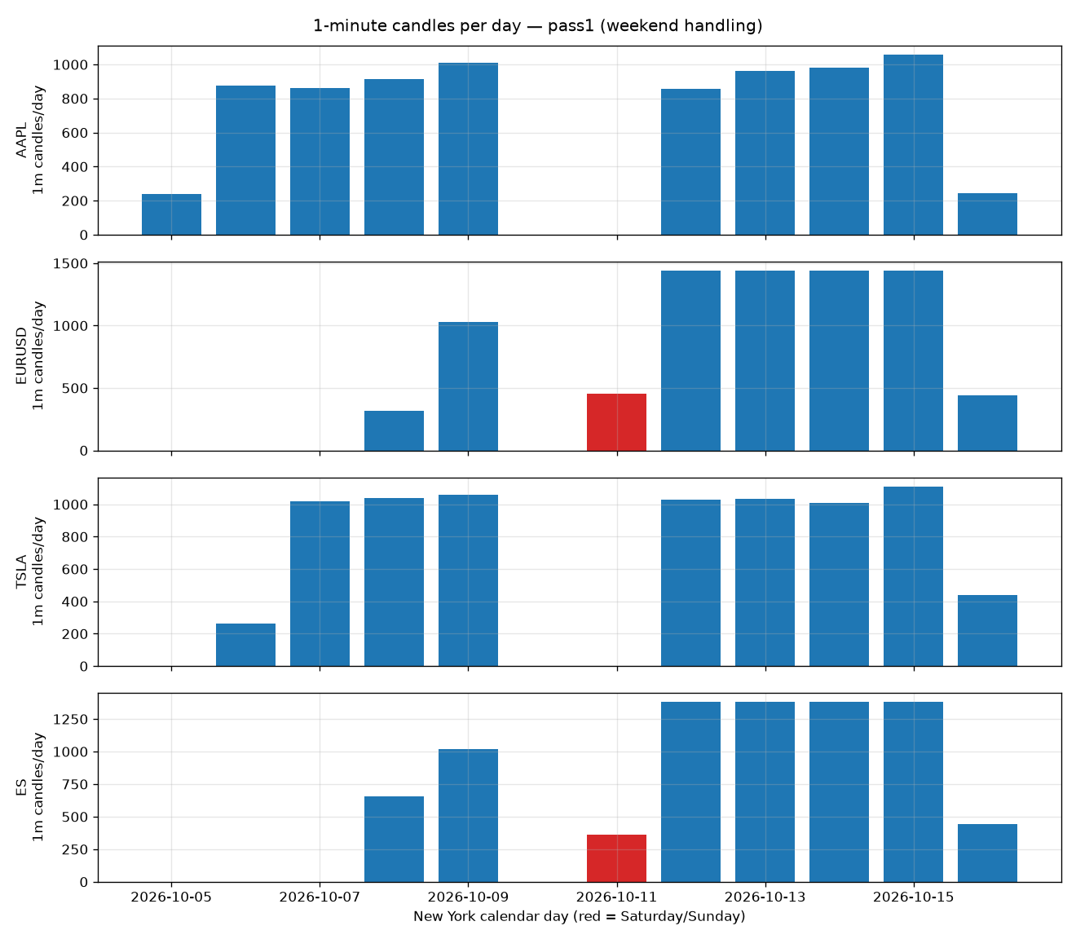
DATA CONSISTENCY
VERIFIED
What is right: the basics are clean
1
0 timestamps off the grid, out of order, or NaN.
2
Holidays match my Task A calendar exactly.
3
21 duplicates at chunk edges, all identical.
4
DST handled; first bar is 00:00 ET.
58,315 candles: the price path is sound. The problems are quieter than that.
dxFeed demo assessment · Irakli
9
Notes:
I want to say what works before the problems. Across all twelve series there are no misaligned timestamps, nothing out of order, no NaN prices. Equities are empty on every NYSE holiday, matching Task A, and EUR/USD trades through them, which is correct. The 21 duplicates come from toTime being inclusive, and they carry identical values, so dropping them is safe.

Slide 10
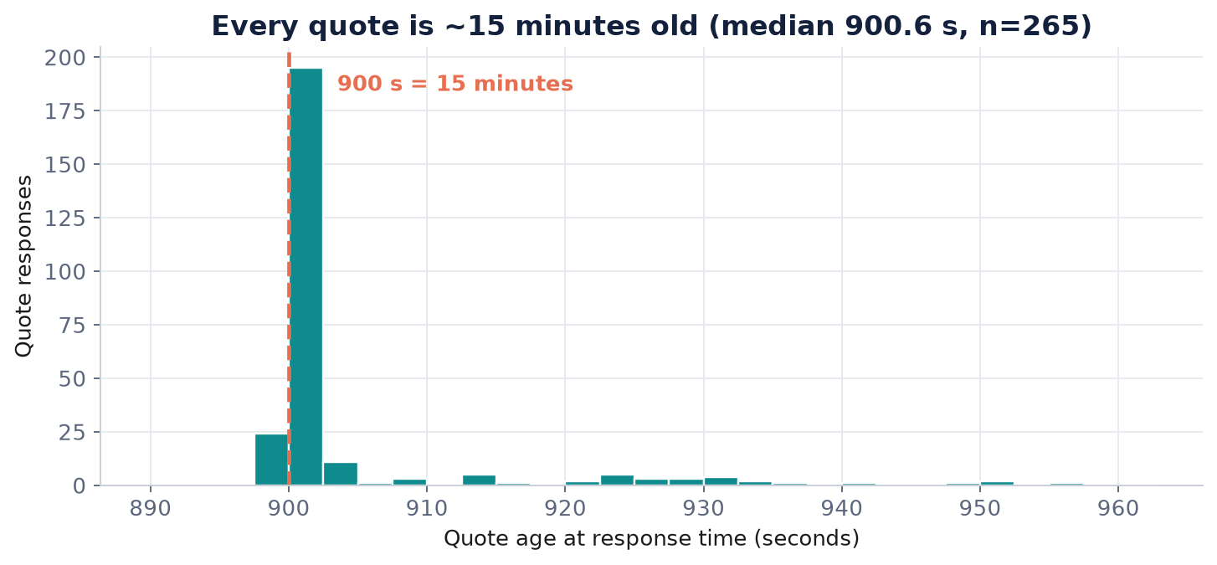
DATA CONSISTENCY
VERIFIED
Every quote is exactly 15 minutes old
1
Median 900.6 s on REST, SSE and Radar.
2
Load did not change it. Latency moved, freshness did not.
3
Nothing in the payload says the data is delayed.
Any freshness alert has to start from a 900-second floor, not from zero.
dxFeed demo assessment · Irakli
10
Notes:
Quote age sits on nine hundred seconds for every symbol, on every surface. That's fine for a demo, but nothing in the response says it is delayed. A client who builds a 'data is stale' alert from zero will page all day. I'd want the delay in the payload.

Slide 11
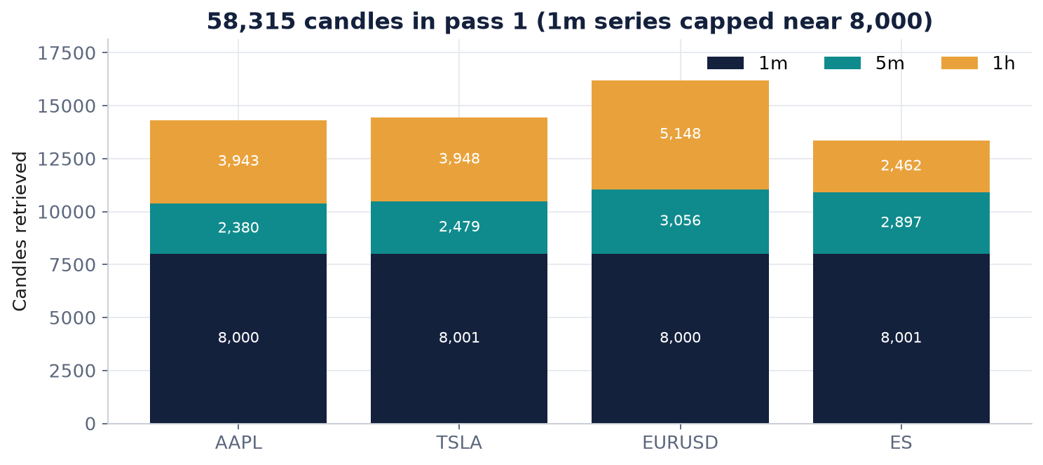
DATA CONSISTENCY
VERIFIED
History stops at 8,000 candles and still says OK
1
All four 1-minute series stop at 8,000 or 8,001.
2
Older window: status OK, empty body, 15 bytes.
3
So it is retention, not a response-size limit.
A two-week backtest silently loses a week. To the client it looks like a holiday.
dxFeed demo assessment · Irakli
11
Notes:
This is the one I'd escalate first. I asked for two weeks of one-minute AAPL and got the newest eight thousand, with status OK. The decisive test was a window completely before that edge: OK again, empty body. It may well be an intentional demo quota, and that's fine. The problem is the silence. A truncated flag, or one sentence in the docs, fixes it. I can show this live with chunks.jsonl.

Slide 12
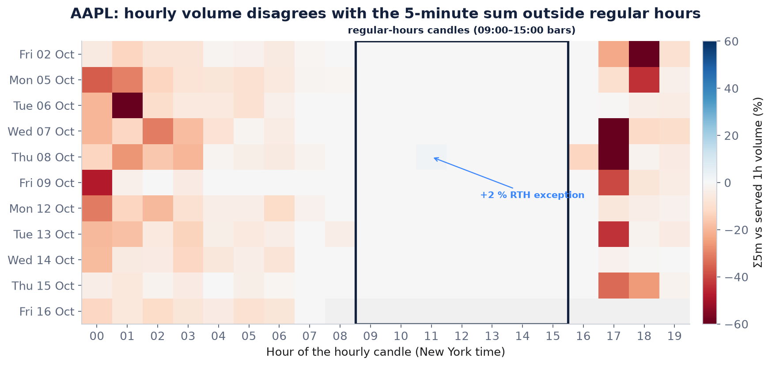
DATA CONSISTENCY
VERIFIED · CAUSE OPEN
Hourly volume breaks outside regular hours
1
Red = hourly bar has more volume, up to 99 %.
2
Boxed regular hours are clean except one cell.
3
TSLA shows the same shape.
4
1m and 5m agree on every complete bucket.
AAPL: 130 extended-hours mismatches and 1 in regular hours. TSLA: 118 + 2. Cause not proven.
dxFeed demo assessment · Irakli
12
Notes:
This is the most interesting finding. Each cell is one hour; red means the served hourly bar has more volume than its five-minute bars add up to. The boxed regular-hours block is white, and outside it the difference goes up to 99 percent. There is one blue cell inside regular hours, 8 October 11:00 ET, plus 2 percent the other way. TSLA has two exceptions on the same day and hours, which points to a market-wide event, not an AAPL thing. Re-fetching 11 minutes later gave the same values. The test that would explain it needs TimeAndSale, and that timed out on the demo. So: real pattern, cause open.

Slide 13
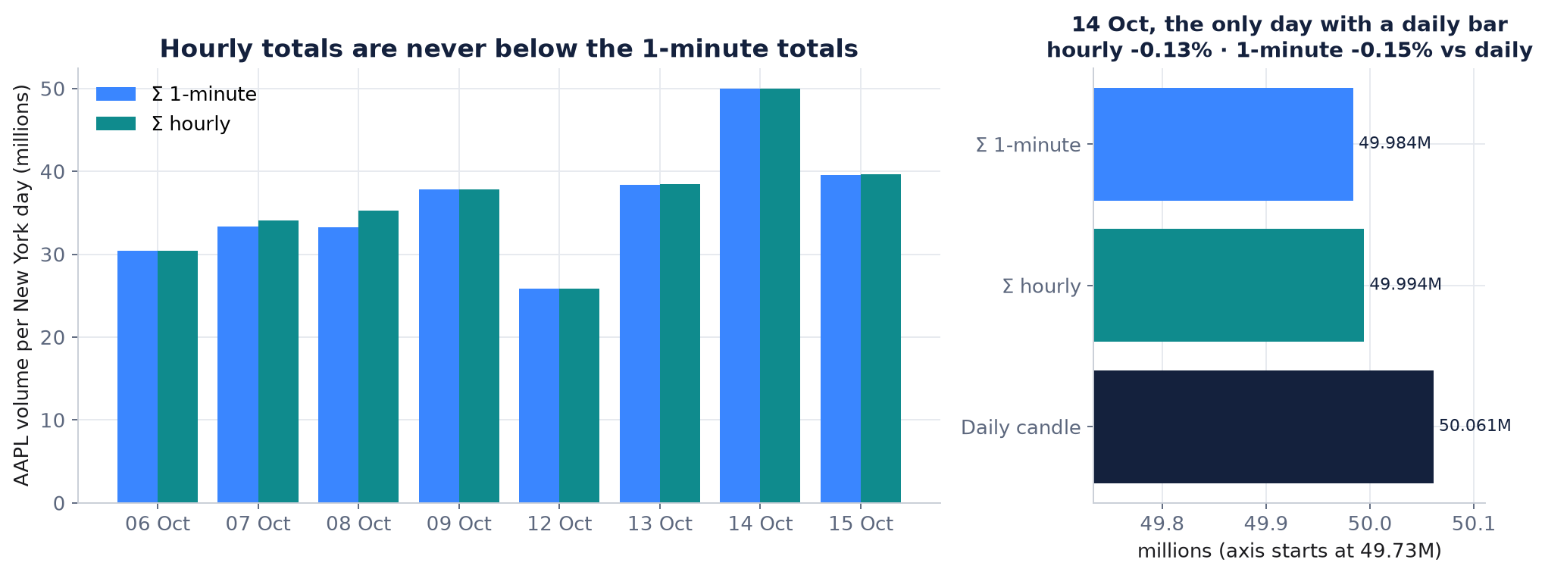
DATA CONSISTENCY
VERIFIED · CAUSE OPEN
Which volume is right? Not decided yet
1
14 Oct daily candle: hourly −0.13 %, 1-minute −0.15 %.
2
Hourly is never below 1-minute on any day.
3
One day is not enough to pick a reference.
What I would tell a client: we are confirming which series is the reference. No workaround yet.
dxFeed demo assessment · Irakli
13
Notes:
This slide changed my advice. My first draft said 'build extended-hours analytics from one-minute data'. The data doesn't support that: on the only day with a daily candle, the hourly sum is slightly closer. One data point, so I don't pick a winner. tho=true might be a workaround but I never tested it.

Slide 14
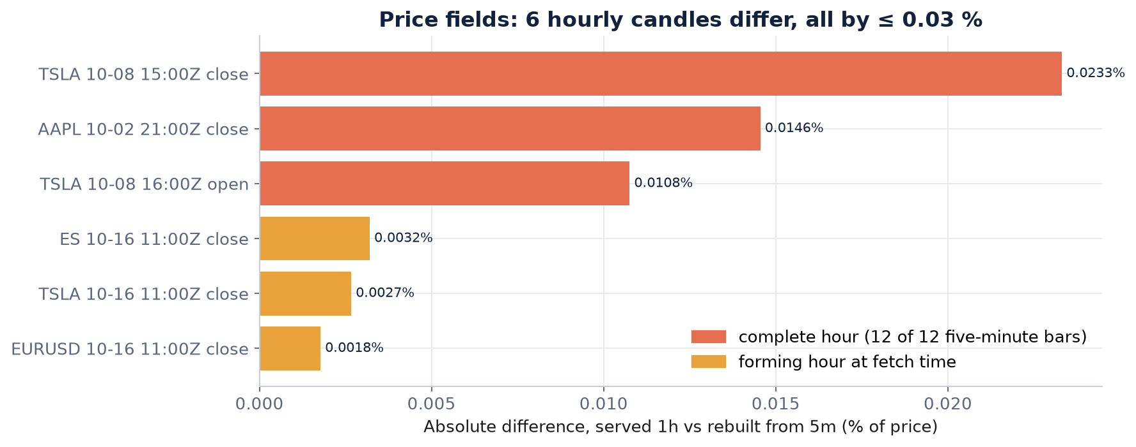
DATA CONSISTENCY
VERIFIED · CORRECTED
Prices are almost, not perfectly, consistent
1
6 hourly candles differ from their 5-minute rebuild.
2
3 are the bar still forming at fetch time.
3
3 are complete hours. Largest gap 0.023 %.
I first wrote 'OHLC always agrees'. It doesn't. The gaps are tiny, but real.
dxFeed demo assessment · Irakli
14
Notes:
I'm correcting myself here. An earlier draft said prices always agree. They nearly do. Three of the six differences are the bar that was still forming, which is expected. Three are complete hours, and two of those are TSLA on 8 October, the same block as the volume exception. Small, but I'd rather say it.

Slide 15
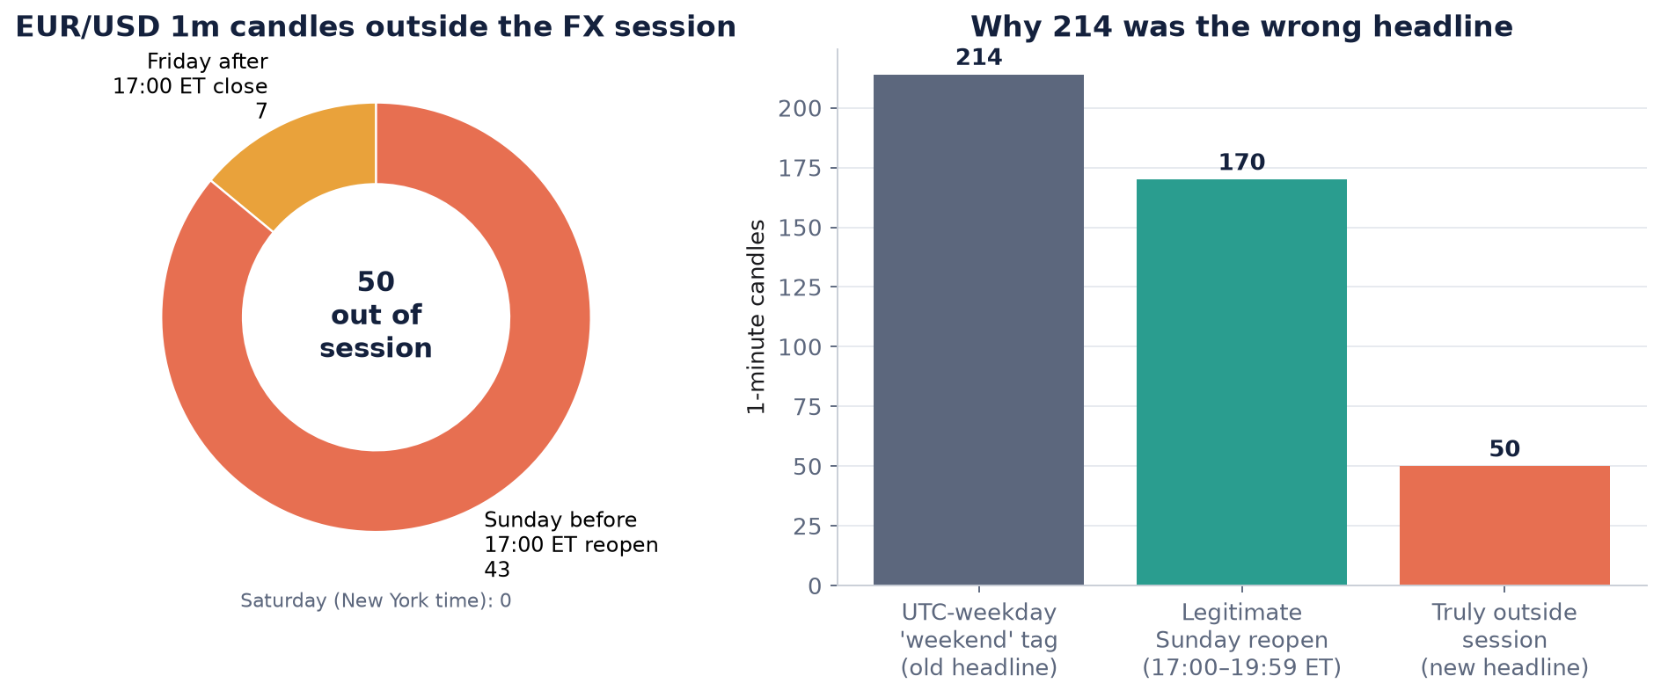
DATA CONSISTENCY
VERIFIED · CORRECTED
EUR/USD prints 50 candles while FX is closed
1
7 after the Friday close, 0 Saturday, 43 Sunday early.
2
170 Sunday-evening candles are the normal reopen.
3
ES futures: 0 outside session, so the method works.
I first counted 214 by UTC weekday. Against the real FX session it is 50.
dxFeed demo assessment · Irakli
15
Notes:
FX trades Sunday 17:00 to Friday 17:00 New York time. My first count used the UTC weekday and got 214, but 170 of those are just the Sunday reopen. Against the real session it's 50. They might be indicative quotes or a heartbeat; I set up a weekend logger to tell them apart, but it stopped on Saturday, so that stays open. The client risk is session logic: 'last candle is fresh' would call FX open on Sunday morning.

Slide 16
DATA CONSISTENCY
VERIFIED
Small things that turn into tickets
Where | What happens | What the client sees
EUR/USD{=1m} | OK, no candles. Only price=bid works | Silent empty result
Daily candle | Stamped 00:00 UTC = 20:00 ET the day before | Wrong date once shown in ET
toTime | Inclusive: 60 minutes returns 61 candles | Duplicates at chunk edges
Unknown symbol | HTTP 200 + TIMED_OUT after 3.3 s (29 s under load) | Looks like success, slows everything
Forming candle | No flag on it (eventFlags = 0) | Client stores a bar that changes
SSE in delay window | NaN candles dated 2038-01-19 | Parsers store garbage
Radar vs REST | Radar shows NVDA, REST times it out | 'But it works in Radar'
None of these is an error. Each one cost me an experiment, so each will cost a client a ticket.
dxFeed demo assessment · Irakli
16
Notes:
These are the small ones. None of them throws an error, which is exactly why they turn into tickets. My favourite is the 2038 date: if you open the stream inside the delay window you get NaN candles dated 2038. A parser that ignores the flags stores them. Radar versus REST is just different symbol lists, but support will hear 'it works in Radar' a lot.

Slide 17
03
Behaviour under load
What happens when one client adds parallel requests
about 9 minutes
Notes:
Behaviour under load. About 9 minutes. What happens when one client adds parallel requests

Slide 18
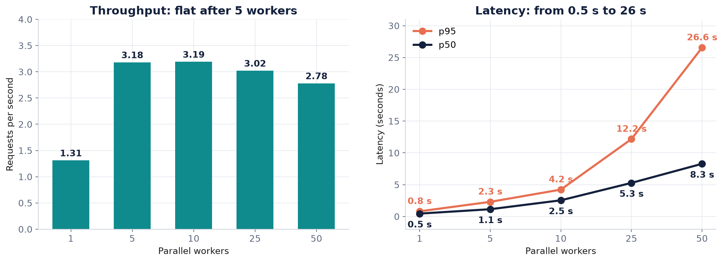
BEHAVIOUR UNDER LOAD
VERIFIED · CORRECTED
More workers did not buy more throughput
1
Pre-market plateau was lower: ~1.6 req/s.
2
648 requests, 0 HTTP errors, no 429.
3
Earlier '4.6 req/s' ignored in-flight requests.
Throughput stays near 3 req/s while median latency goes 0.5 s → 8.3 s. Seconds, not milliseconds.
dxFeed demo assessment · Irakli
18
Notes:
Market-hours run. Left: throughput measured through completion. It jumps from one to five workers and then stays flat around three requests a second, and drops a little at fifty. Right: latency. Median goes from half a second to eight seconds, p95 to twenty-six. I want to be careful about two things. An earlier version said throughput rose to 4.6; that number ignored requests still in flight, and it's wrong. And these are seconds. Zero errors, no 429, no Retry-After: the service queues, it never tells the client to back off.

Slide 19
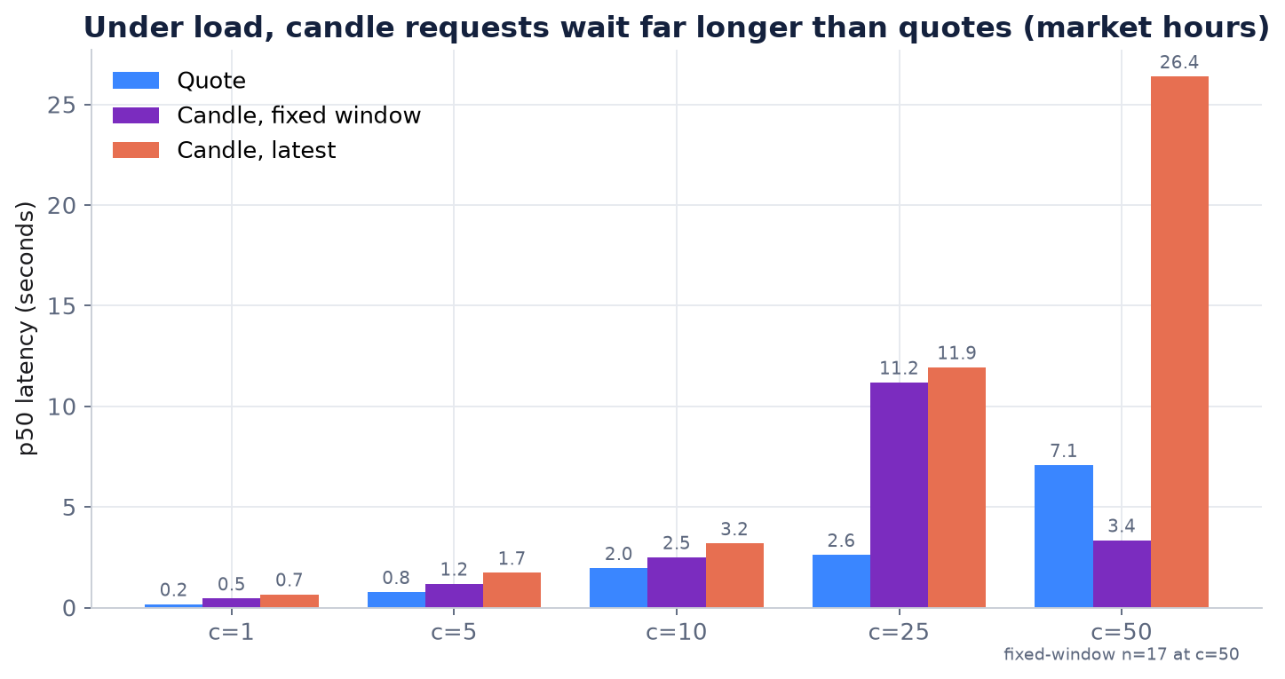
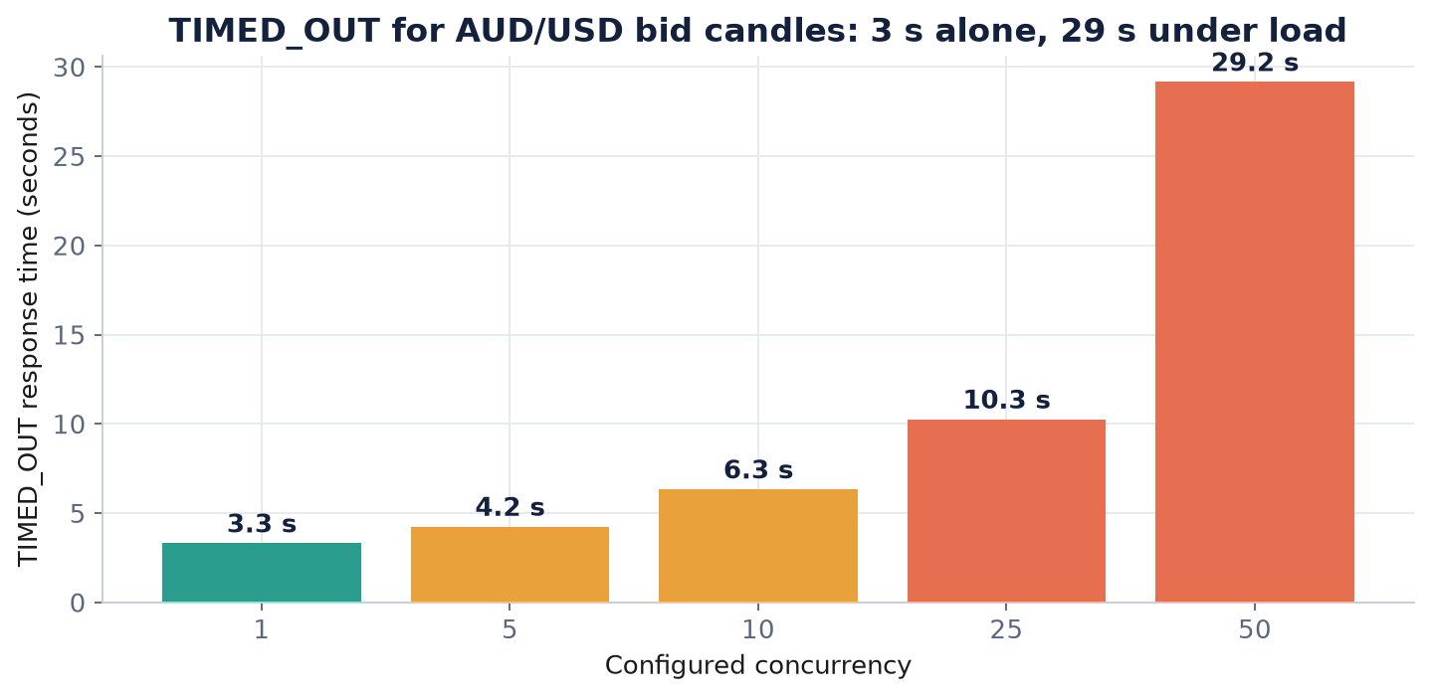
BEHAVIOUR UNDER LOAD
VERIFIED
Candle requests queue first, and timeouts stretch
Median latency by request type (seconds)
TIMED_OUT response time (seconds)
At 25 workers quotes take 2.6 s, candles 11–12 s. An unknown symbol goes from 3.3 s to 29 s.
Percentiles count completed requests only, so at 25 and 50 workers the real tail is worse.
dxFeed demo assessment · Irakli
19
Notes:
Queueing isn't uniform. Quotes stay fairly quick while both candle requests wait eleven or twelve seconds. That fits per-request cost or separate queues, not one simple line. On the right, the timeout for an unknown symbol: three seconds alone, twenty-nine under load, because queue time is added before the server's own timeout starts. A dashboard mixing quotes and candles will look half alive.

Slide 20
BEHAVIOUR UNDER LOAD
VERIFIED
Was the bottleneck my client? No.
in-flight = setting
52 ≥ 50
1 client
Little's law at 5 and 10 workers: my workers really were all waiting on the server.
Connection pool limit was above the highest concurrency, so it could never bind.
Per-IP throttle or shared capacity? I can't tell without a second IP. Not run.
This shows how this shared demo behaves for one client. It is not a production capacity number.
dxFeed demo assessment · Irakli
20
Notes:
The first question I asked myself was whether I was the bottleneck. Little's law says no: at five and ten workers the average in flight equals the setting, so they were all waiting on the server. The pool allowed 52 connections and I never ran more than 50. What I can't say is whether the cap is per IP or shared with other demo users. That needs a second client at the same time, and I didn't run it. If anyone asks for a production number: I won't extrapolate one from a free demo.

Slide 21
04
Risk, incident and improvements
What I would escalate, how I'd run the incident, what I'd fix
about 10 minutes
Notes:
Risk, incident and improvements. About 10 minutes. What I would escalate, how I'd run the incident, what I'd fix

Slide 22
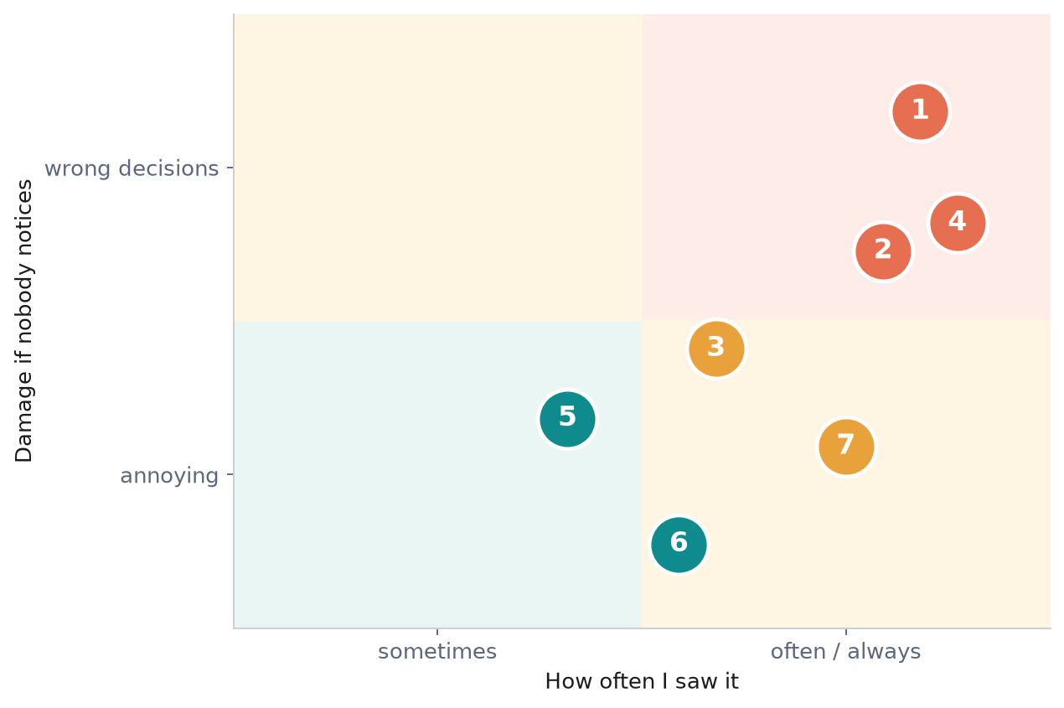
RISK, INCIDENT, IMPROVEMENTS
What I would escalate, in order
1
Silent 8,000 cap
2
Volume depends on timeframe
3
Queues, never says 429
4
Stale looks like closed
5
Symbol quirks (TIMED_OUT, FX bid)
6
FX prints outside session
7
Monitors only watch HTTP errors
Silent beats loud: a wrong answer with status OK is worse than an error.
dxFeed demo assessment · Irakli
22
Notes:
I ranked risks by how often I actually saw them and how much damage they do if nobody notices. Silent ones go to the top: the 8,000 cap, the volume difference, and staleness that looks like a closed market. Queueing without a 429 is next. The FX prints are real but low impact if clients use a proper session calendar.

Slide 23
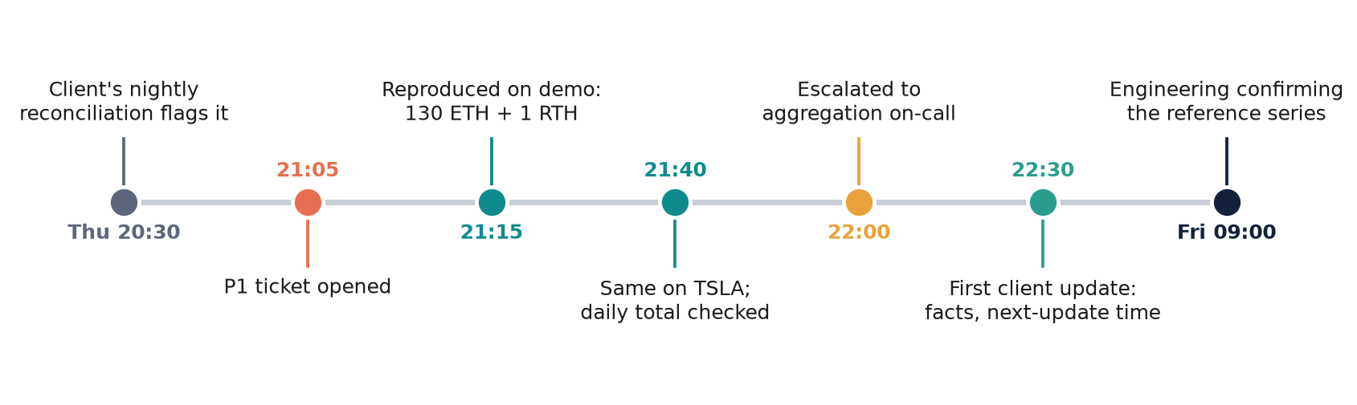
RISK, INCIDENT, IMPROVEMENTS
SIMULATION
Incident drill: 'AAPL hourly volume is corrupted'
First 15 minutes
What the client hears
Reproduce from public endpoints: −98.4 % on 2 Oct 18:00 ET.
Count: 130 extended-hours, 1 regular-hours.
Confirm 5m = 1m; check the daily total.
Escalate with the CSV and one question: which series is the reference?
“We reproduced it. It affects hourly volume for US stocks, almost only outside regular hours. Prices agree. We are confirming the reference series. Next update 10:00 UTC.”
No root cause, no untested workaround.
dxFeed demo assessment · Irakli
23
Notes:
The scenario is invented, the numbers are real. A quant client's nightly reconciliation flags the 18:00 hour. In the first fifteen minutes I reproduce it from public endpoints, count how many hours are affected, check five-minute against one-minute, and escalate with the CSV and one clear question. The client message gives facts and a next-update time. It doesn't guess a cause and it doesn't offer tho=true, because I never tested it.

Slide 24
RISK, INCIDENT, IMPROVEMENTS
PROPOSAL
Three things I would change
TECHNICAL
MONITORING
DOCUMENTATION
Say what the response is
Catch it before the client does
One 'demo facts' page
• Add truncated, serverTime, delaySeconds to the response.
• Flag the forming candle.
• Return UNKNOWN_SYMBOL at once, not TIMED_OUT.
• One synthetic probe per asset class.
• Age vs calendar, 1h vs 1m volume, p95 at low concurrency.
• Budget the probes: the service queues.
• Delay, retention cap, symbol list.
• FX needs price=bid; toTime is inclusive.
• Radar vs REST differences.
Effort Medium
Effort Small–medium
Effort Small
Impact Removes the top two 'wrong data' tickets
Impact Client-found incidents become ours
Impact Fewer first-contact tickets
dxFeed demo assessment · Irakli
24
Notes:
Three proposals. The technical one matters most, because a truncated flag fixes the silent cap with an additive JSON field. Monitoring: the scripts I wrote are most of a probe already; what's missing is wiring and a session calendar. Documentation is the cheapest: one page, and my report is the draft.

Slide 25
RISK, INCIDENT, IMPROVEMENTS
VERIFIED · CORRECTED
Four things I got wrong first, and fixed
“214 weekend FX candles”
50 outside the real FX session
I counted by UTC weekday
“Throughput rises to 4.6 req/s”
Flat at ~3 req/s
I ignored requests still in flight
“OHLC always agrees”
6 small differences, ≤ 0.023 %
My first check was too loose
“Rebuild ETH volume from 1m”
Reference series not decided
The daily candle says otherwise
Re-running everything offline is what caught these. That re-check is now part of the method.
dxFeed demo assessment · Irakli
25
Notes:
I'd rather show you this than have you find it. Each of these was in an earlier draft. The offline re-check caught all four, and every slide today uses the corrected numbers.

Slide 26
RISK, INCIDENT, IMPROVEMENTS
NOT DONE
What is still open
Waiting on the clock
Blocked on the demo
• Pass 2 re-pull after Monday 19 Oct 15:30Z
• Weekend logger: stopped Sat 14:28Z, Sunday not covered
• TimeAndSale / Trade history: TIMED_OUT or empty
• So the volume cause stays a hypothesis
Not run
Task A
• SPY / MSFT check of 8 Oct 11:00 ET; tho=true
• Second client / IP; burst and batching tests
• NASDAQ 2027, OPRA 2026/27 not published
• CME refresh is manual; Drive API untested
dxFeed demo assessment · Irakli
26
Notes:
If you ask what I didn't verify, this is the answer. Pass 2 and the logger are only waiting on the clock. The volume cause is blocked because the demo doesn't serve TimeAndSale history. The rest I simply didn't run, and I'm not going to present them as results.

Slide 27
Questions
Happy to open any evidence file live.
I can show live
I won't claim
The 8,000 cap: a long fromTime, or chunks.jsonl
The AAPL −99 % and +2 % volume rows in the CSV
Radar screenshots and the SSE comparison
A root cause for the volume split
That the FX prints are trades
A production capacity number
Notes:
That's it from me. If you ask whether the 8,000 cap is just a quota: possibly, and the missing signal is still the defect. If you ask about production capacity: the monitoring design transfers, the numbers don't.

