Slide 1


RFID for Breath Monitoring
Jiaqi Wu, Ranxuan Zhang, Birtukan Fozzati

Slide 2
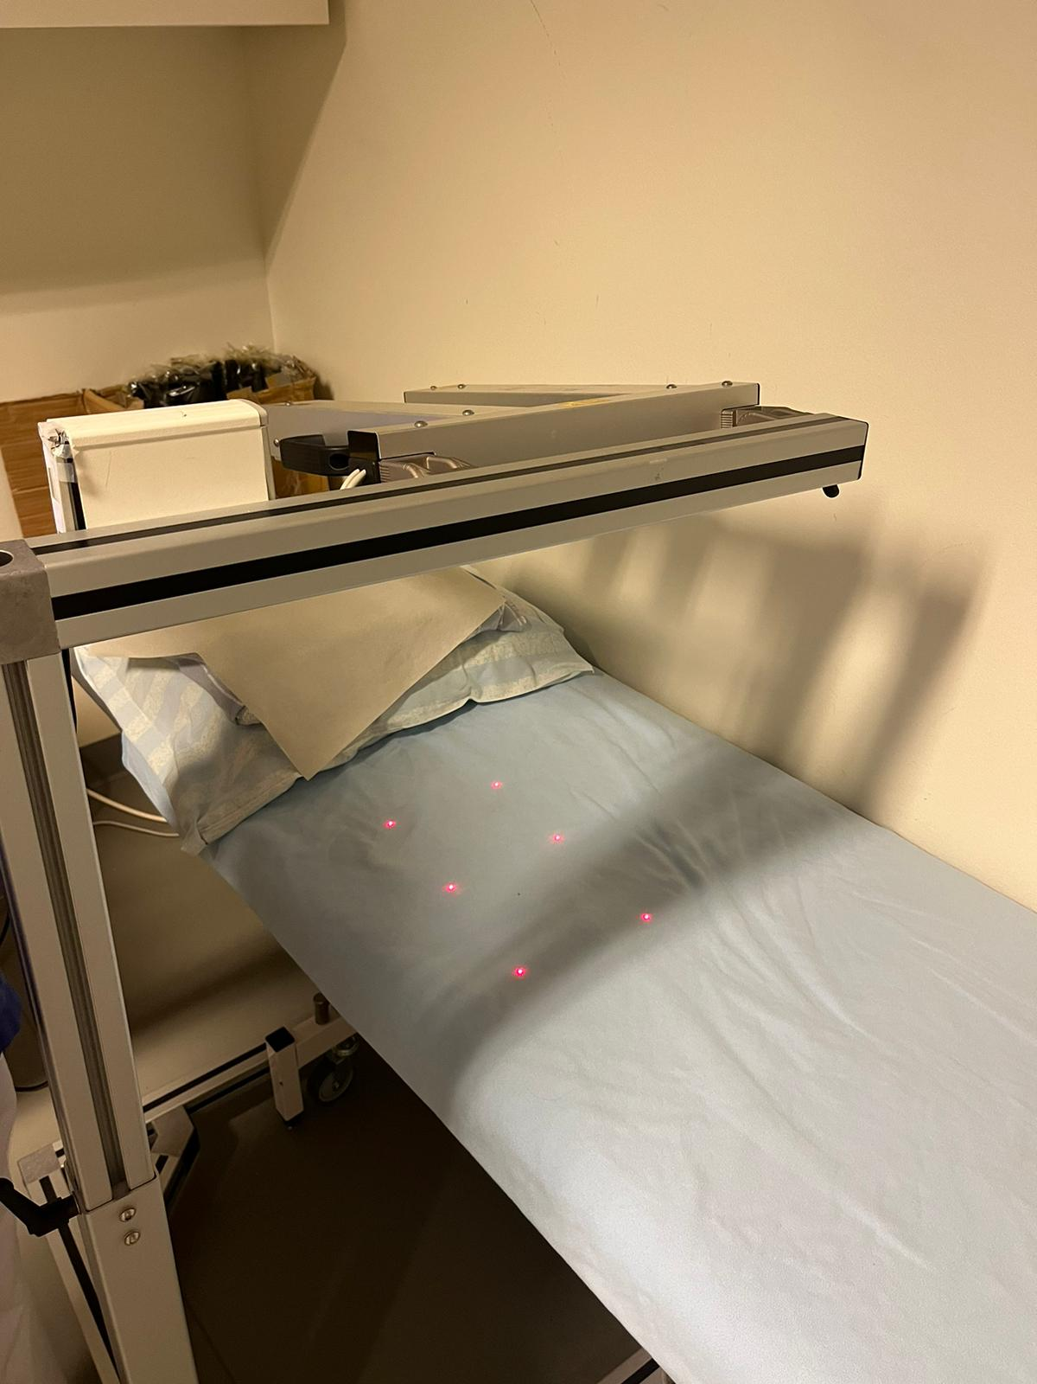
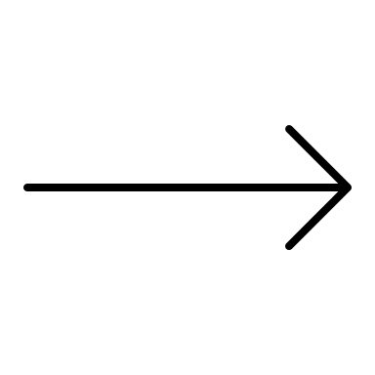
INTRODUCTION: BACKGROUND
Respiration and heart rates are vital health indicators in healthcare
Traditional methods :intrusive, less practical, expensive
Example: RMMI
Bulky
Expensive
Patient Discomfort
Requires Regular Maintenance
Limited portability
Sensitive to external interference
Figure1.RMMI at Sahlgrenska

Slide 3
INTRODUCTION: BACKGROUND
Wireless Methods
Pros: Non-intrusive, user-friendly
Challenges:
Limited range
Signal interference
Difficulty recognizing multiple users at once
RFID Technology
Pros:
Unique user identification and differentiation
Cost-effective

Slide 4
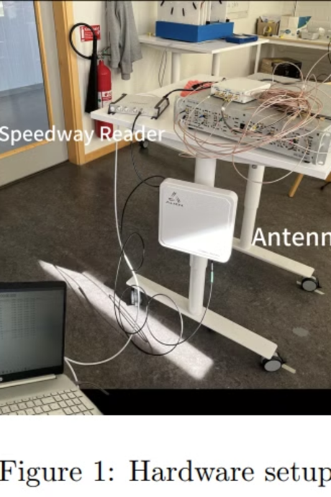
INTRODUCTION: PURPOSE
Objective:
Implement an RFID-based approach for traking respiratory motion using passive RFID tags
Technlogy: wireless tags and reader
Components:
RFID Reader : Sends signals,receives data,detects position
RFID Tag: Small device( active/passive) that stores and shares data with reader

Slide 5


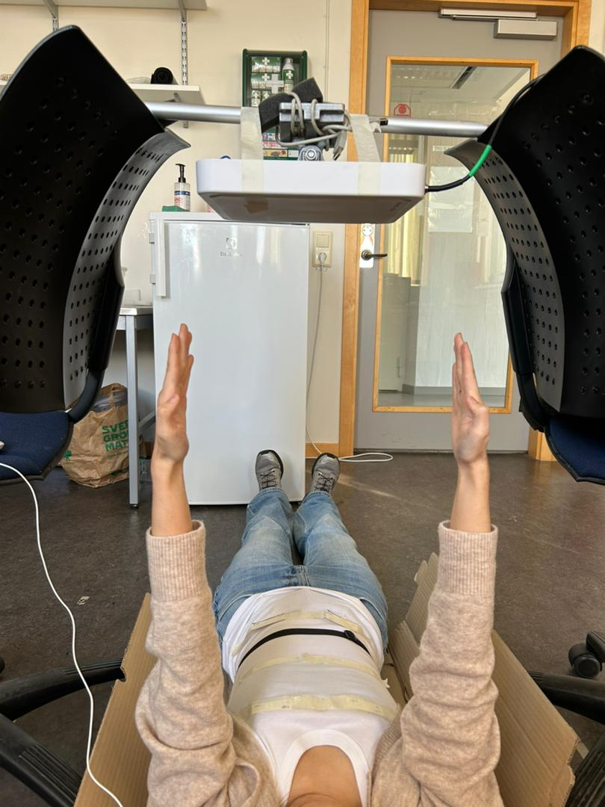
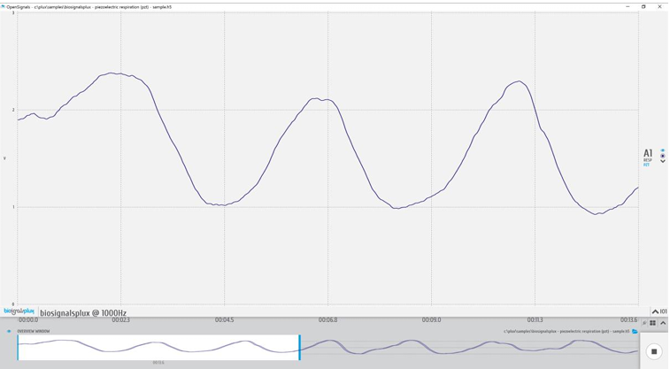
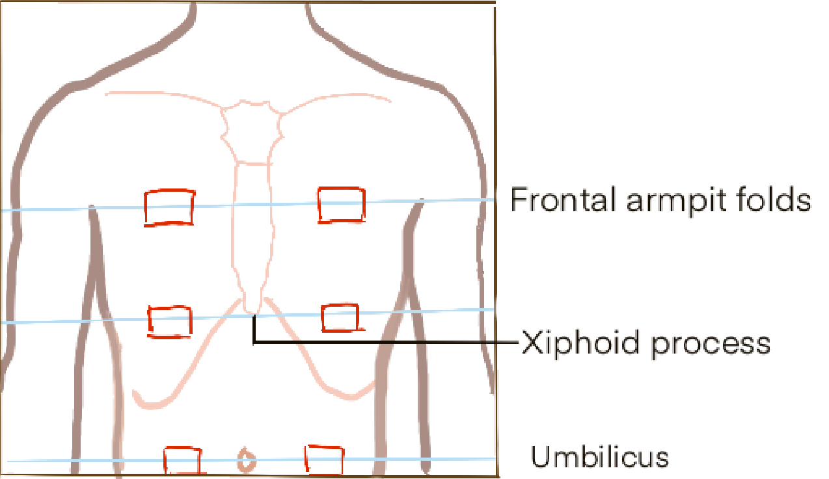
Methods
System Setup
• Fix antenna
• Power the reader and Connect to the antenna and computer
• Prepare tag
• Application for data report
ItemTest, Octane SDK
• Ground truth
Test
Normal breathing
Deep breathing
Hybrid breathing
OpenSignals

Slide 6
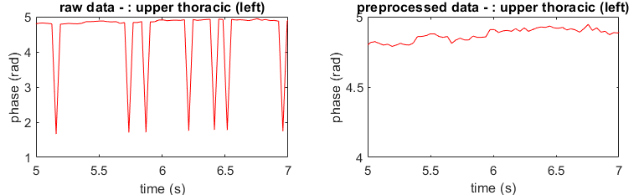
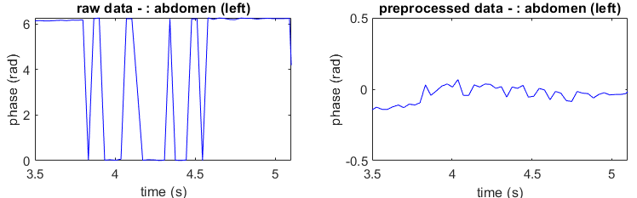
Method
Data preprocess
• phase ambiguity
Respiratory rate extraction:
DC (zero frequency) component removal
Butter-​worth bandpass filtering
Fast Fourier Transform (FFT)
• phase transition​

Slide 7
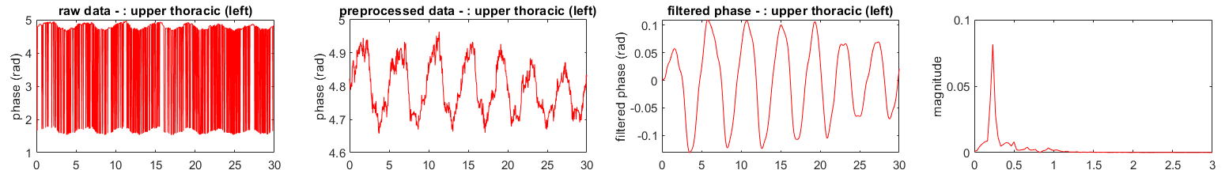
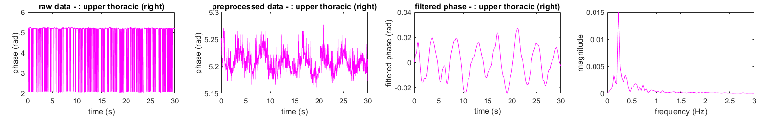
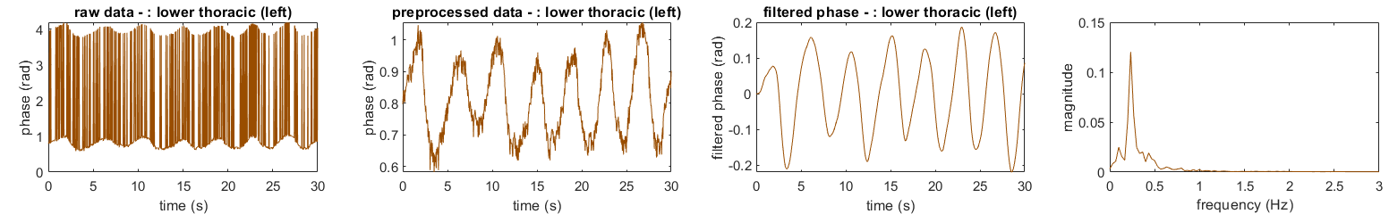
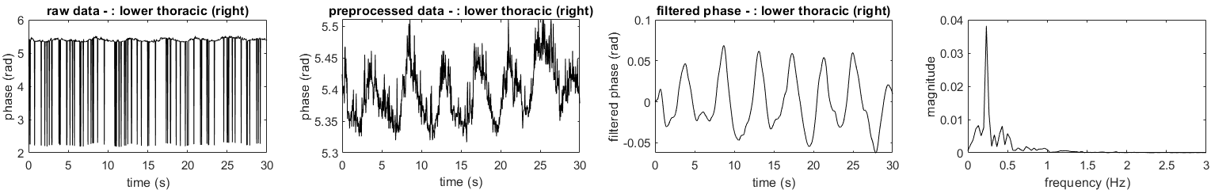
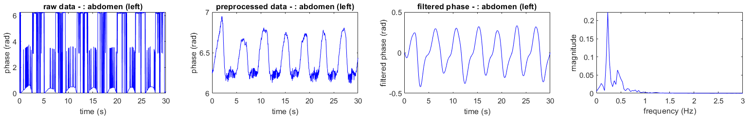
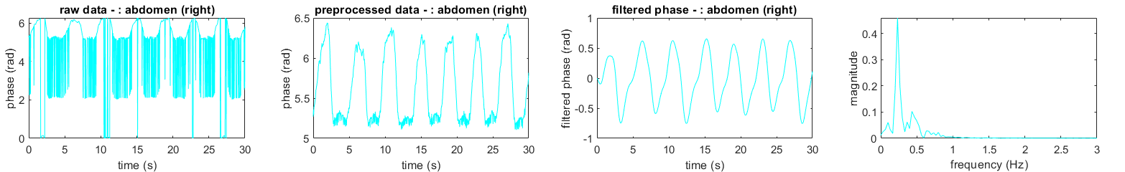
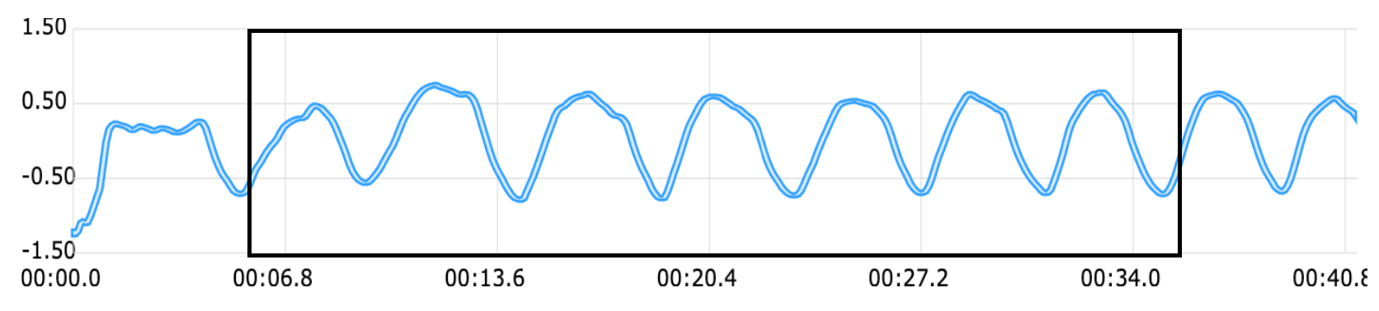
Results
Frequency: 0.23
Frequency: 0.23
Resulted phase: 7 peaks
Resulted phase: 7 peaks
Reference value from Opensignal: 7 peaks for 30s
*RIP sensor only detects the ground truth on the abedomen

Slide 8
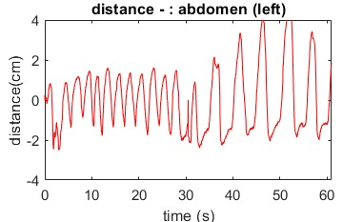
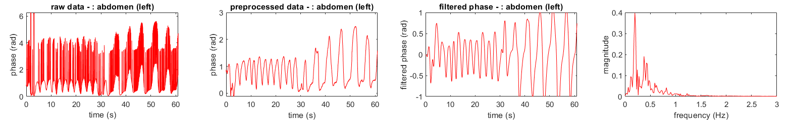
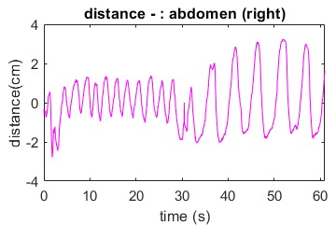
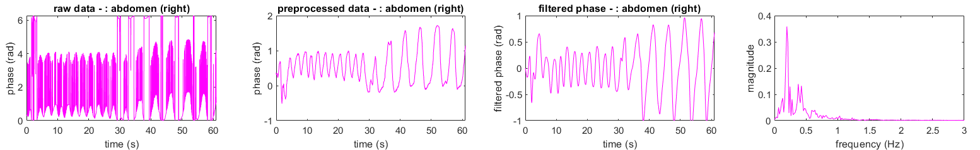
Results
Hybrid breathing
Change from normal breath to deep breath

Slide 9
Discussion
RFID technology can effectively track respiratory movements from different body part
Signal amplitudes differ across body sides due to natural asymmetry.
Tags on cloth (tight or loose)
Sitting or lying
Initialization

Slide 10
Future work
Hardware:
Develop a better way to attach the tag to the body
Optimize the placement and setup of the device
Use a dummy model to obtain more accurate ground truth values
Software:
Validate and refine the phase processing algorithm
Implement real-time signal display for RFID data.
Package and integrate the existing system to meet clinical requirements.
Data:
Test on more people.
Different distance between antenna and tags

Slide 11
Challenges
Chest Tags: Limited performance; improved with varied breathing techniques
Clothing Fit: Loose clothing affected readings ;lying down helped improve accuracy
Data Stability: Results were inconsistent; may need more preprocessing
Tag and Antenna Position: Requires optimization for improved reliability
Conclusion
Successfully measured basic respiratory rate for different body part, capturing phase and distance.
The data quality from different part, especially the chest part, seems to highly depend on the breathing method
(stomach/chest).

Slide 12
Thank you!

