Slide 1

Melbourne Restaurant Reviews
(Natural Language Processing (NLP) using Sentiment Analysis)
Notes:
Greet

Slide 2

Project Overview
Gather the most recent reviews of restaurants in Melbourne CBD
Perform sentiment-analysis using a pre-trained model
Positive, negative, neutral
Analyse the reviews to build a
restaurant recommender
Based on overall positive percentage reviews per restaurant

Slide 3


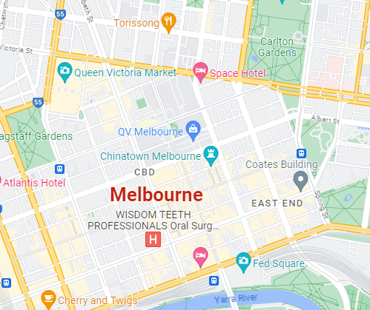
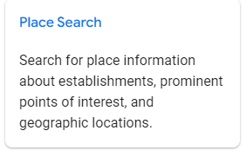
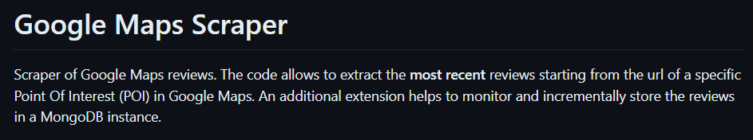
Data Collection
Search for Restaurants -> Google Place API
First issue – API only accepts a single lat/long value and only returns 60 places around each coordinate
Second issue – Google API can only return 5 reviews per establishment

Slide 4

Data ETL
Scope
Melbourne CBD, Australia
652 Restaurants
>14,000 reviews
~30 most recent reviews per restaurants only
Limitation
Only text reviews (no emojis)
Only English-language reviews

Slide 5
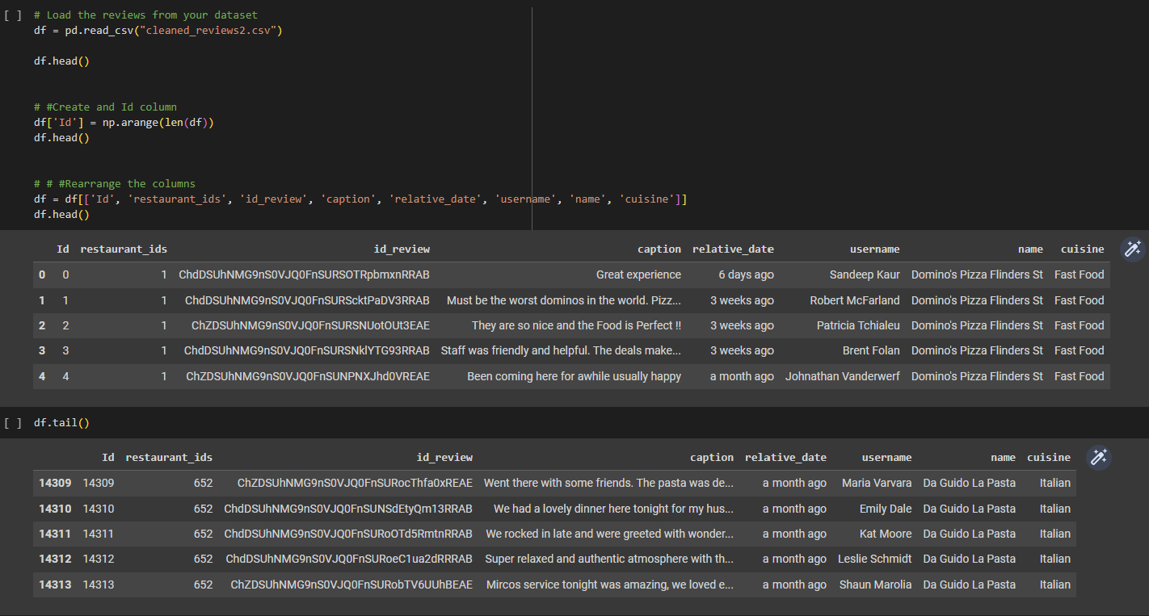

Slide 6
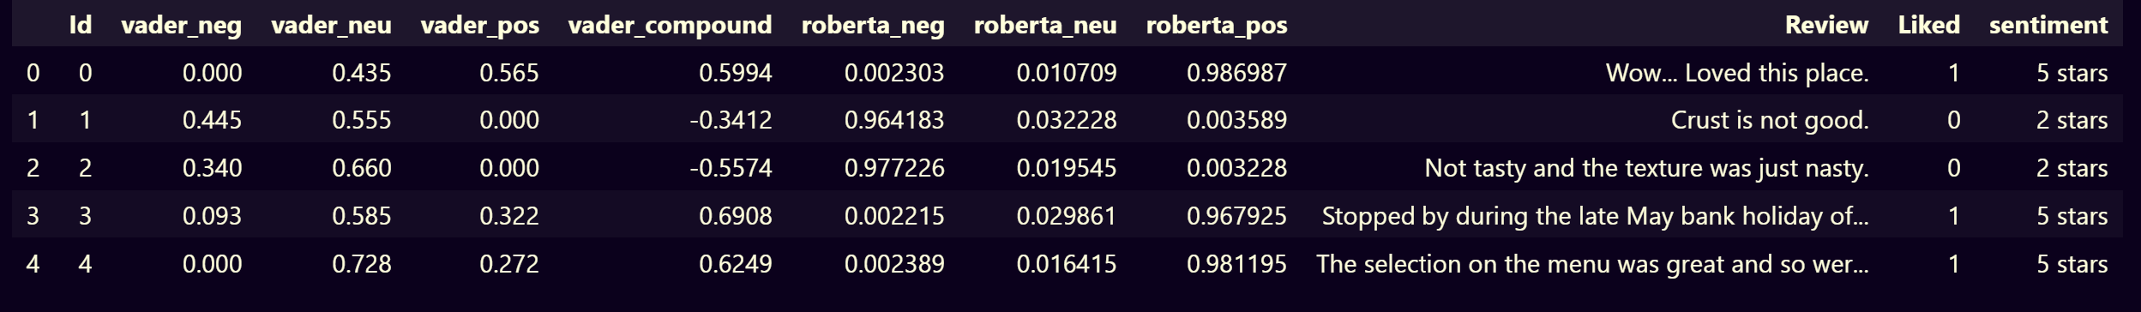
Sentiment Analysis
Text analysis or “opinion-mining”
Sentiment detection and classification: POSITIVE, NEGATIVE, NEUTRAL
NLTK Library
Transformers Library
VADER SIA
cardiffnlp/roBERTa
BERT

Slide 7
RoBERTa: Robustly Optimized BERT Pretraining Approach
Model: cardiffnlp/twitter-roberta-base-sentiment
trained on ~58M tweets and fine-tuned for sentiment analysis
suitable for English
Workflow for analysis:
Pre-process the data
Use AutoTokenizer.from_pretrained and AutoModelForSequenceClassification.from_pretrained
Create a loop function for the whole dataset

Slide 8
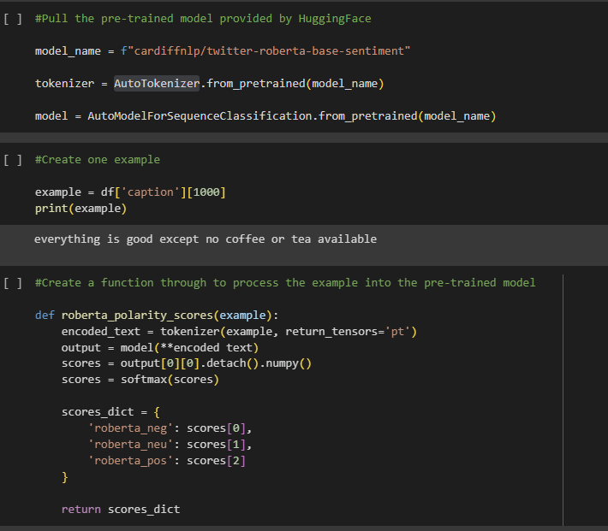
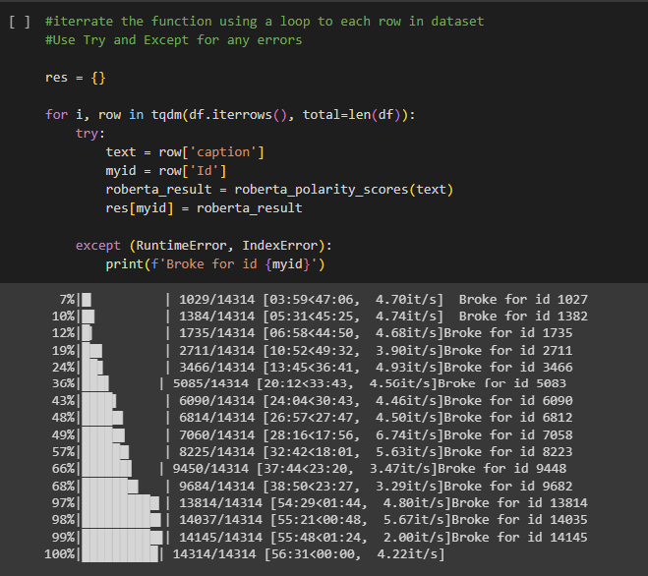
Used Google Collab for faster computation of the model! Took less than an hour to process 14,000 reviews

Slide 9
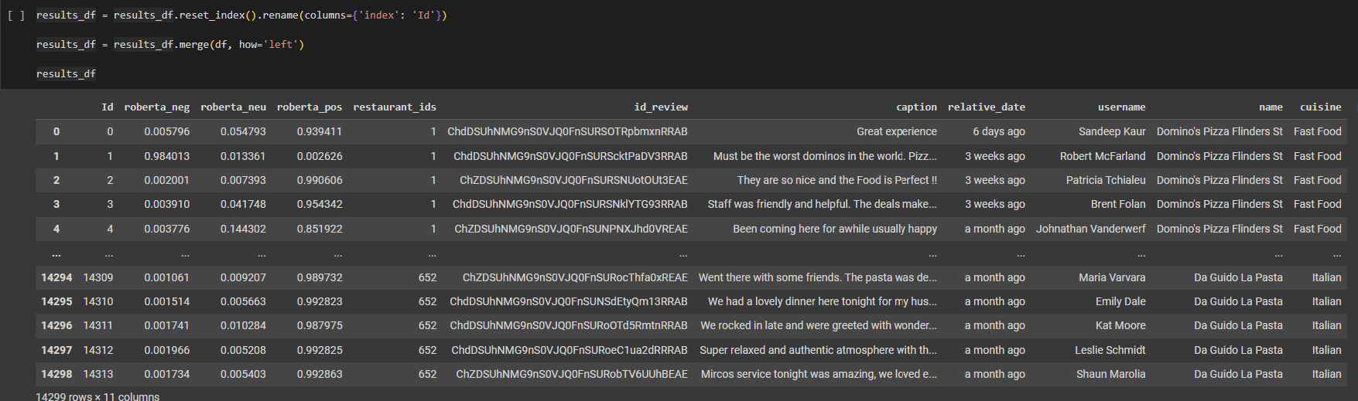

Slide 10
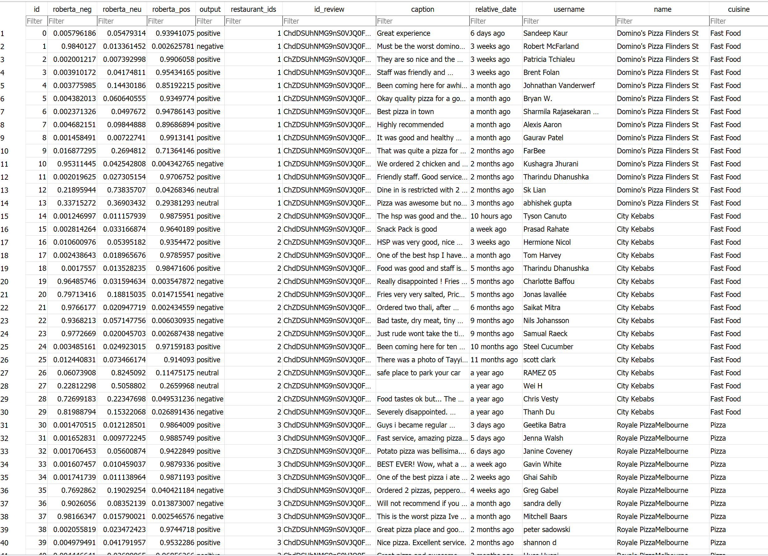
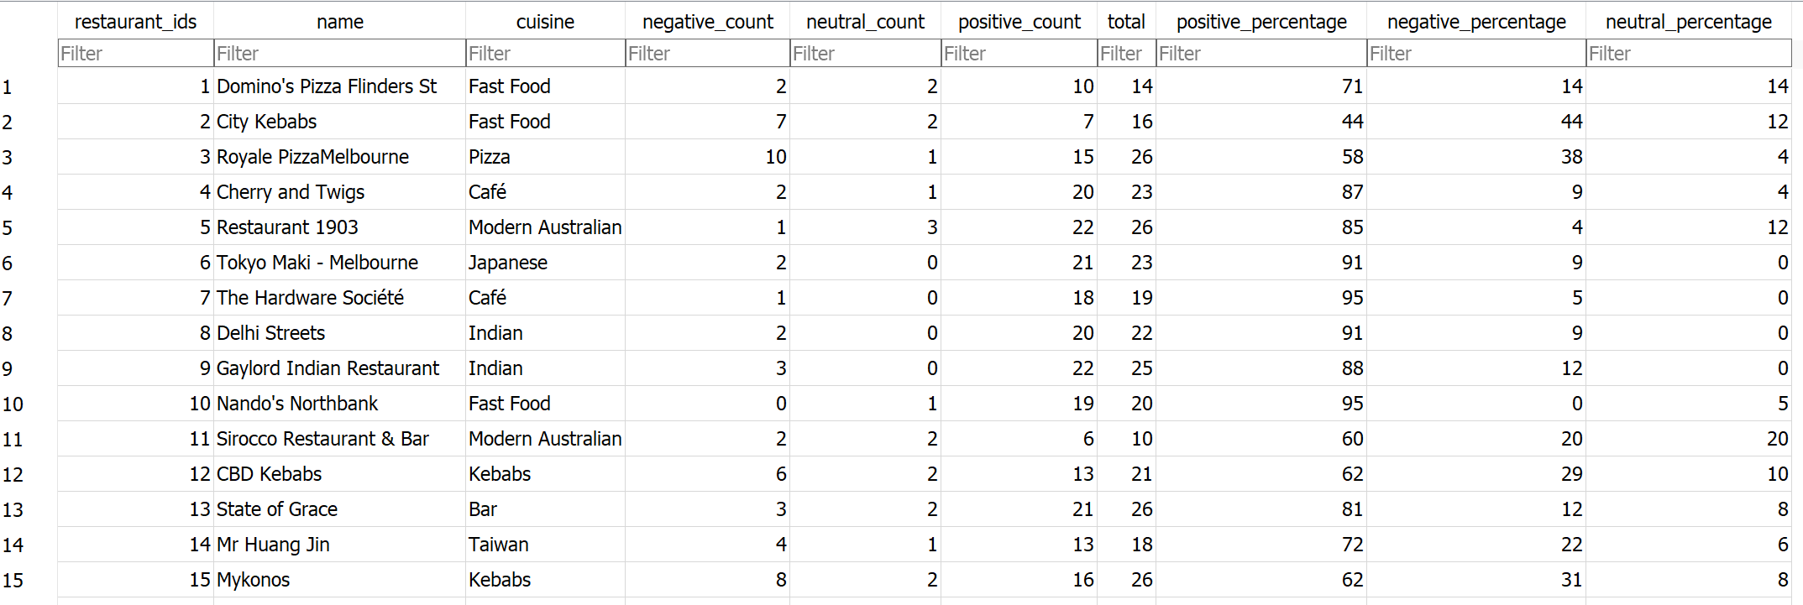
SQLite Database
3 Tables in Database:
Restaurant Info
Raw Roberta Scores
Final Calculations

Slide 11
Web Flask Application
(base) DABC-Project-3 % conda activate virtual_env
(virtual_env) DABC-Project-3 % python app.py

