Slide 1

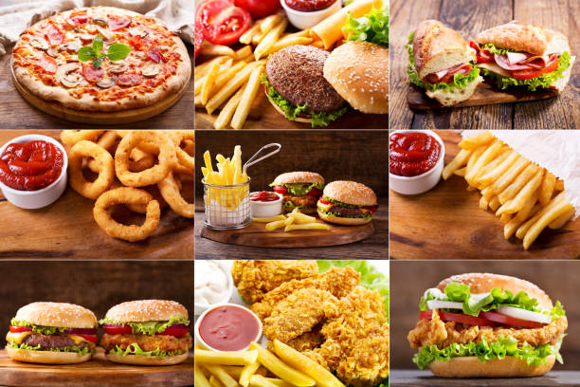
Strategic Market Entry Analysis and Business Model Development for a Snack Shop
Business Analysis and Strategic Recommendations for starting a Snack Shop
Presentation by : SRINAL

Slide 2



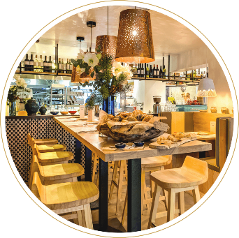


Overview
01
Location analysis of Boring Road
02
Competitor Analysis Revealing Gaps in the Market
Strategic Recommendations for Menu Offerings
Financial Planning within a ₹10 Lakh Budget
03
04

Slide 3

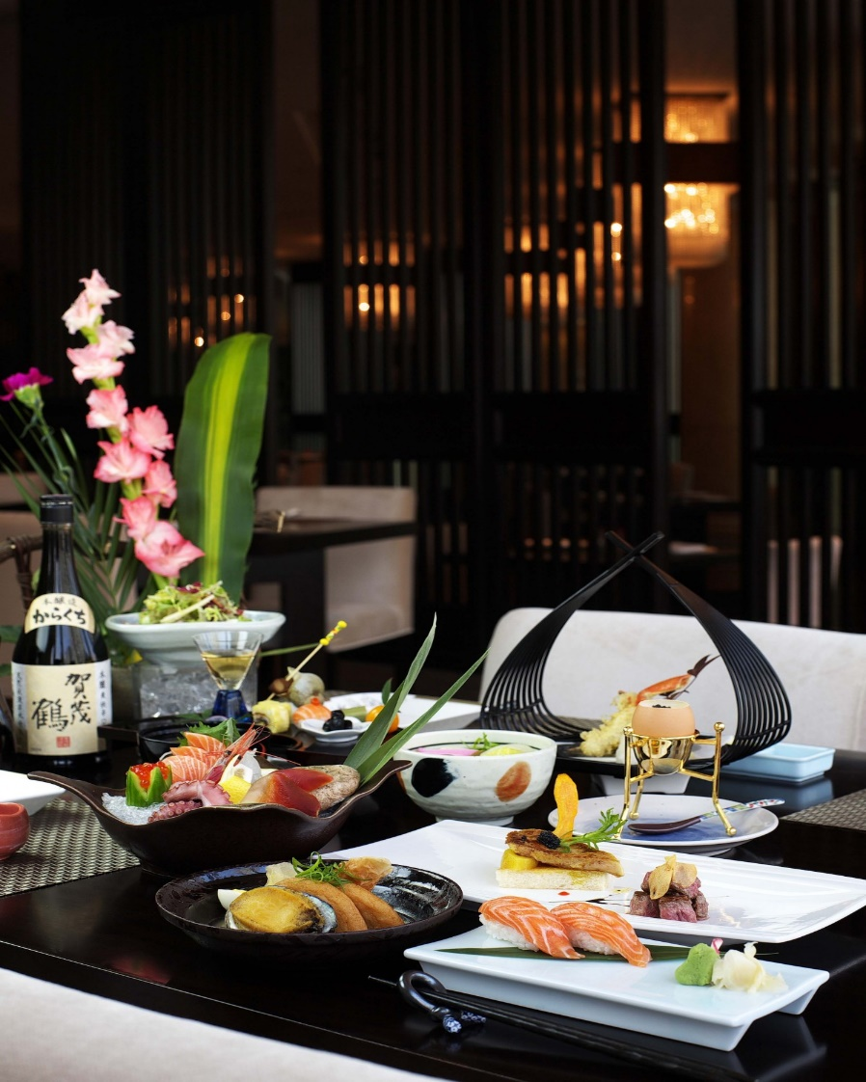
Objectives
1
Identify profitable snack items for a new shop in a competitive area.
2
Leverage the prime location of Boring Road for strategic advantage.
3
Target the local student population with innovative and healthy snack offerings.
4
Ensure maximum returns on a limited budget.

Slide 4
Analysis Strategies
01
Market Gaps
Identifies unmet needs and targets opportunities with low competition.
Customer Insights
Aligns offerings with customer preferences to enhance satisfaction and sales.
02
Diverse Choices
Attracts a broader customer base by catering to varied tastes and preferences.
Innovative Flavors
Differentiates the menu with unique flavors, appealing to adventurous customers.
03
04

Slide 5
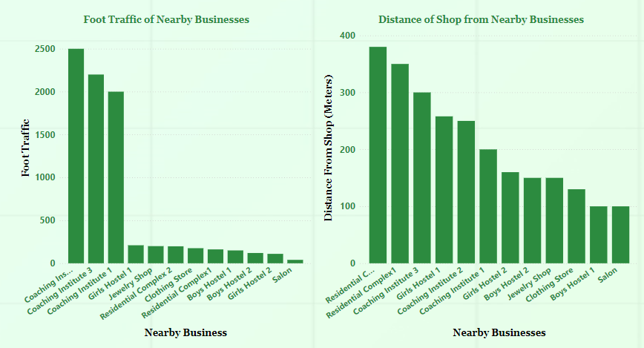
Location & Demographic Insights
Boring Road is a bustling retail hub with high foot traffic in Patna.
Close proximity to residential complexes, clothing stores and jewellery shops.
Surrounded by three major coaching institutes and Hostels.
Significant opportunity to capture a large student customer base.

Slide 6
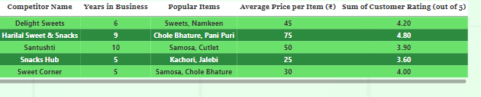
Competitor Analysis
Five key competitors identified in the vicinity, all established for over five years.
Competitors offer similar snacks and sweets like samosas, chole bhature, and kachoris.
Despite their popularity, there is a noticeable gap in the market.
Opportunity for differentiation with rolls and other quick, healthy options.

Slide 7
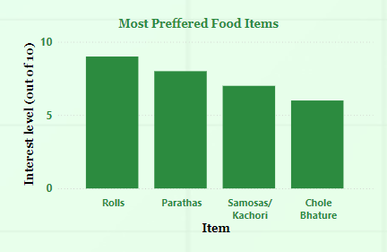
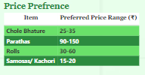
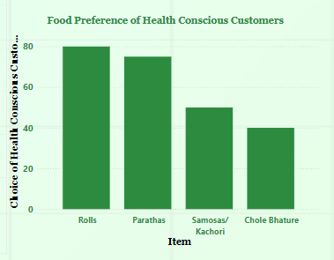
Understanding Customer Preferences
Surveys reveal strong student preference for quick, affordable, and healthy snacks.
Rolls are highly desired by students.
Parathas are popular due to their balance of taste and health benefits.
Majority of students prefer snack items priced between ₹70-90.

Slide 8


Targeting Profitable Snack Items
Positive Aspects Negative Aspects
High Demand: Identified snacks like rolls and parathas cater to strong student preferences.
Competition: Established competitors might quickly replicate successful snack items.
Market Gap: Opportunity to introduce healthy options not currently offered by competitors.
Limited Appeal: New and healthy snack options may have limited appeal beyond the student demographic.
Price Flexibility: Ability to set competitive pricing due to low production costs.
Price Sensitivity: Target customers may be highly price-sensitive, affecting profitability.
Health Trend: Rising demand for healthier snack options among students.
Supply Chain Risks: Sourcing fresh ingredients for healthy snacks may increase operational complexities.

Slide 9

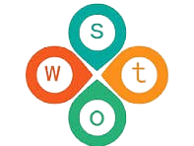
SWOT Analysis
STRENGTHS
The prime location on a busy retail road ensures high visibility.
There is a high potential demand from the student community.
WEAKNESSES
THREATS
Every opportunity has its challenges, and our limited budget is a notable concern.
The presence of established competitors poses a significant hurdle.
Strong competition looms as a considerable threat to our business.
Potential price sensitivity among target customers adds another layer of challenge.
OPPORTUNITIES
The untapped market for healthy snacks presents a significant opportunity.
With a large student population nearby, we can cater to health-conscious consumers.

Slide 10
Financial Planning Insights
₹7.5L | ₹1.2L | 15%
Budget Allocation | Cost Savings | Investment Growth
₹50k | ₹1L | Quarterly
Debt Management | Emergency Fund | Annual Review

Slide 11
Marketing Strategies
01
STUDENT CENTRIC PROMOTIONS
Discount Programs: Offer exclusive discounts during off-peak hours (after classes) to attract students. Introduce “Happy Hours” where specific items like rolls or parathas are available at reduced prices.
Loyalty Programs: Implement a points-based loyalty system where students earn rewards for repeat purchases, redeemable for free items.
02
STRATEGIC PROMOTIONS
Coaching Institutes: Partner with local coaching institutes to provide discounts for their students, potentially offering meal deals or bulk orders for study groups.
Hostel Collaborations: Collaborate with nearby hostels to provide exclusive meal plans or discounts for residents, fostering a loyal customer base.
03
SOCIAL MEDIA ENGAGEMENT
Instagram Campaigns: Create visually appealing content showcasing the variety and health benefits of the menu. Use student influencers to promote the shop, offering them free meals in exchange for posts.
04
TARGETED ADVERTISING
Flyer Distribution: Distribute flyers with discount coupons in high-traffic student areas like coaching centers, hostels, and public transport hubs.

Slide 12
Strategic Insights for Launch Success
Primary Menu Offerings
Introduce rolls and parathas as the core menu items to differentiate from existing competitors.
Focus on healthy and quick options to appeal to the health-conscious and time-constrained student demographic.
Ensure a variety of fillings and flavors to cater to diverse tastes and dietary preferences.
Competitive Pricing
Set prices within the ₹30-60 range for rolls and ₹90-150 range for parathas to align with student budgets.
Offer combo deals (e.g., roll + drink) to increase average transaction value while maintaining affordability.
Implement dynamic pricing strategies during peak hours to maximize revenue.
Health Centric Branding
Emphasize the health benefits of the ingredients used in rolls and parathas through branding and communication.
Highlight options like whole wheat parathas and low-oil preparations to appeal to health-conscious consumers.
Collaborate with local fitness centers and coaching institutes to promote the healthy aspect of the offerings.

Slide 13
Conclusion
The strategic location on Boring Road, combined with a unique and health-focused menu, positions the snack shop for success in a competitive market.
1
4
With careful financial planning and targeted marketing efforts, the shop is expected to thrive, offering students and locals a fresh alternative in the snack market.
2

