Slide 1
灵长类视觉组会 0513

Slide 2

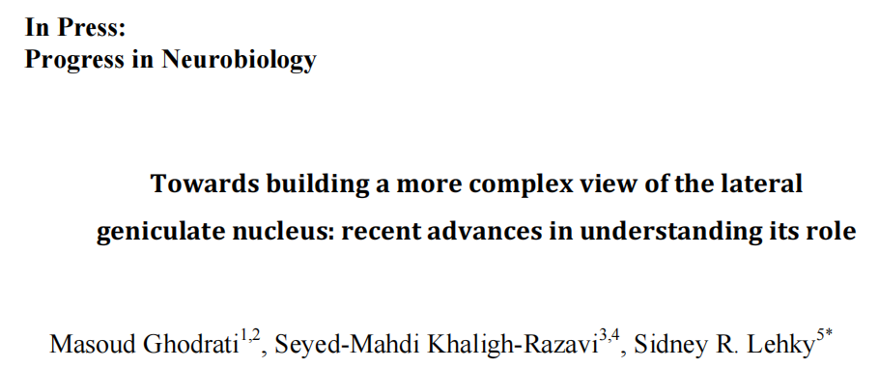
General anatomy and physiology → LGN circuitry → modeling
Notes:
2017

Slide 3
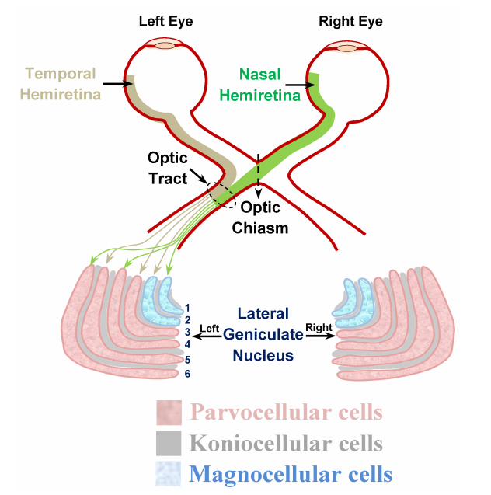
LGN的结构
①灵长类动物（除了长臂猿），食肉类动物（比如猫），他们LGN结构都有明显的层次结构。
②空间感受野与输入的视网膜神经节细胞很类似，但时间感受野有比较大的差距。
③LGN接收来自皮层反馈突触的数量远大于接收来自视网膜前馈输入的数量
每侧LGN接收对侧视场。
每层LGN接收单侧眼输入。

Slide 4
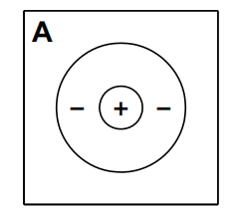
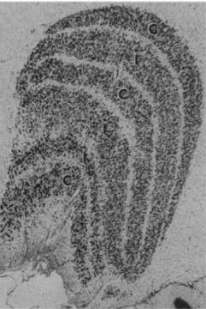
On-center cell
6
On-center cell
5
4
3
Off-center cell
2
1
mixed
LGN细胞层间连接很少

Slide 5
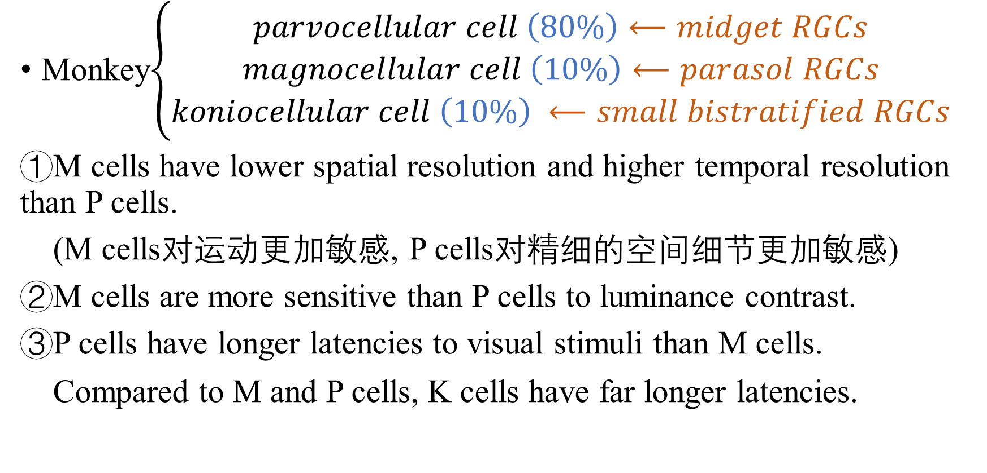
LGN不同种类神经元及其功能
Monkey$\left\{\begin{aligned}parvocellular cell \left(80\%\right)⟵midget RGCs \\ magnocellular cell \left(10\%\right)⟵parasol RGCs \\ koniocellular cell \left(10\%\right) ⟵small bistratified RGCs\end{aligned}\right.$
①M cells have lower spatial resolution and higher temporal resolution than P cells.
(M cells对运动更加敏感, P cells对精细的空间细节更加敏感)
②M cells are more sensitive than P cells to luminance contrast.
③P cells have longer latencies to visual stimuli than M cells.
Compared to M and P cells, K cells have far longer latencies.
Notes:
来自于拉丁文，M大细胞，P小细胞，konio来自希腊文灰尘的意思
延迟期更长因为他继承的视神经节细胞的轴突直径更小，传导速度更慢

Slide 6
④P cells show red/green center surround color opponency, excited by one color in the center and inhibited by a different color in the surround.
( P cells对于红绿颜色对比度比M cells更加敏感）
⑤Many K cells have blue/yellow color opponent responses.
(并且blue-ON cells数量远大于blue-OFF cells)
⑥K cells have larger receptive fields than P or M cells, despite having smaller cell bodies.
⑦K cells project to the superficial layers of striate cortex, unlike M and P cells that project to layers 4 and 6.
⑧K cells are the only LGN cells to receive signals originating from blue cones and superior colliculus
（靠近腹侧的k cells接收上丘输入，靠近背侧的k cells接收蓝锥输入）

Slide 7
In summary, monkey LGN can be viewed as having two spatiotemporal channels, the P cells (high spatial resolution/low temporal resolution), and the M cells (low spatial resolution/high temporal resolution), as well as two color channels, the P cells (red/green) and K cells (blue/yellow), with the M cells being achromatic.

Slide 8
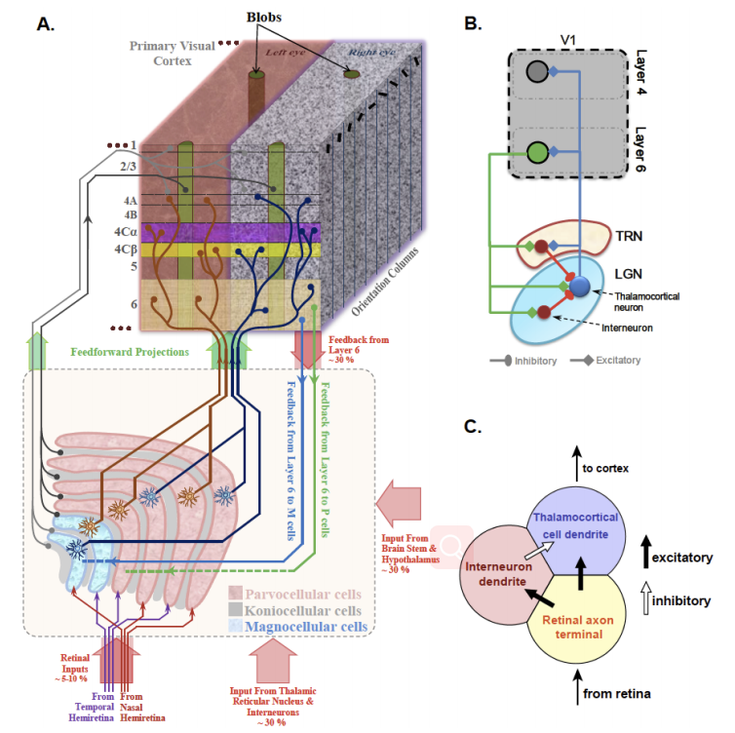
LGN前馈和反馈连接
①10%输入来自视网膜
②一个LGN thalamocortical cell一般只接受一个视网膜神经节细胞的输入，少数接受2-3个神经节细胞输入
③interneuron占全部LGN细胞的25%，且全部是抑制神经元
④LGN大约只传递他从视网膜接收到的spike的一半
⑤thalamocortical cells之间几乎没有兴奋性作用，只有抑制性作用，是通过LGN的interneuron和丘脑网状核的抑制神经元介导的

