Slide 1
灵长类视觉——LGN
0808
Notes:
首先介绍视觉系统解耦不同特征的机制，介绍三条通路输入输出连接，介绍两个模型，加入检索的一些paper是否能提供一定的约束，V1信息整合机制

Slide 2
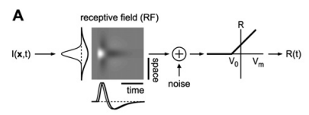
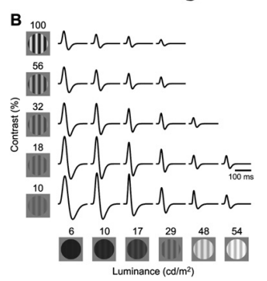
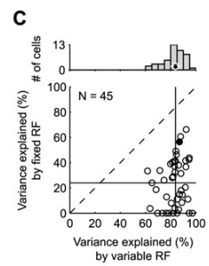
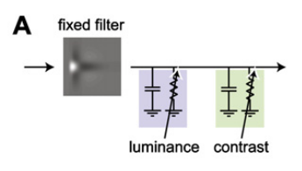
经典的早期视觉系统模型
a center-surround linear receptive field (RF) followed by a nonlinearity that produces firing rates
Increases in luminance or contrast diminish both the amplitude of the RF, the neuron’s gain, and the duration of its temporal profile, the neuron’s integration time
general functional model of LGN responses
integrating the basic mechanisms of RF and firing rate generation together with the fast adaptation mechanisms of light adaptation and contrast gain control
Mante, V., Bonin, V., & Carandini, M. (2008). Functional Mechanisms Shaping Lateral Geniculate Responses to Artificial and Natural Stimuli. Neuron, 58, 625-638.
Notes:
线性感受野增加两个分别对亮度，对比度快速适应机制，来拟合自然刺激下LGN响应。在简单刺激下拟合参数然后在复杂刺激下预测

Slide 3
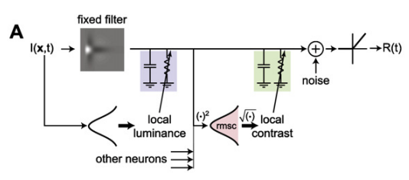










The model consists of six consecutive stages: (1) a fixed linear filter, (2) light adaptation, (3) subtractive adaptation, (4) contrast gain control, (5) a fixed temporal filter, (6) rectification.
(1)Fixed linear filter
(2) Light adaptation (consists of a batch of $n_{L}$ RC circuits)
(3) Subtractive adaptation (its steady-state value in response to a static, spatially uniform stimulus of luminance L is zero)
(4) Contrast gain control(a batch of $n_{C}$ RC circuits in series)
(5) Fixed temporal filter
(6) rectification

Slide 4
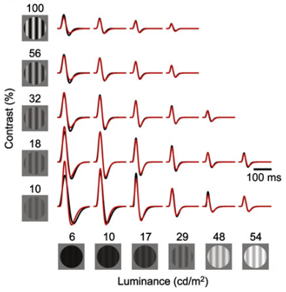
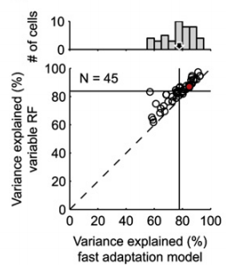
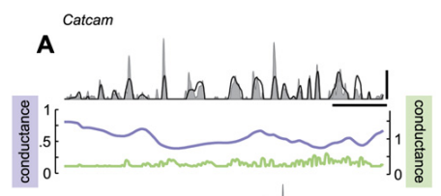
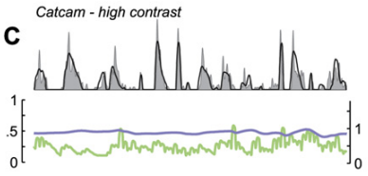
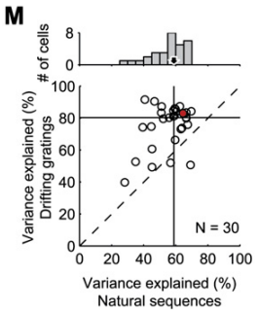
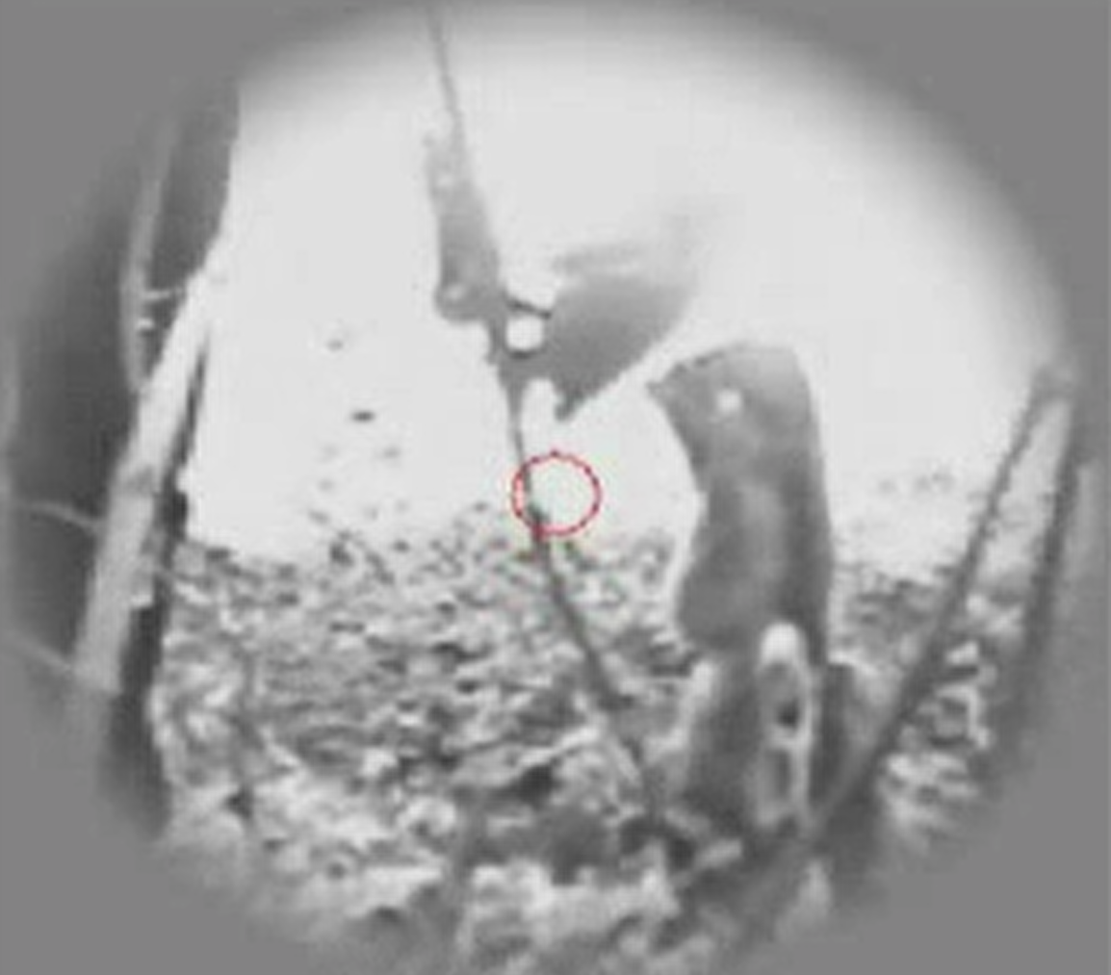
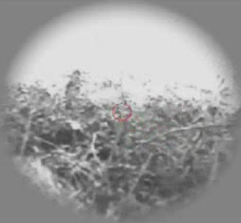
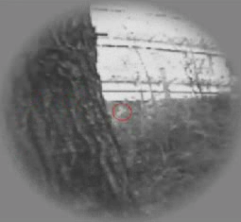
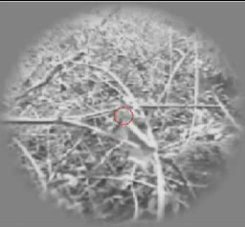
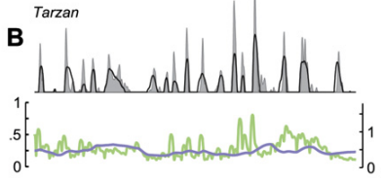
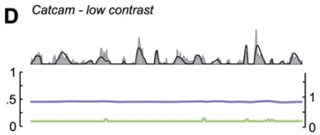
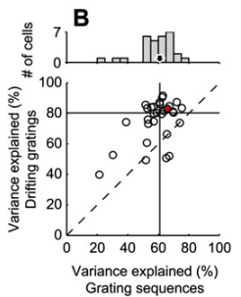
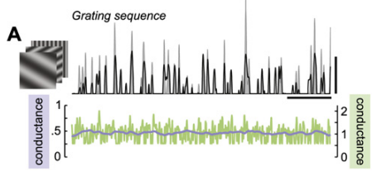
实验效果
The model explains 85% of the stimulus driven variance in the responses of the example cell and 78% (median, n = 45) over the entire population
The model explains 65% of the stimulus-driven variance in the measured responses for the example cell, and 59% (median) over the entire population
The model explained 61% of the stimulus related variance
Notes:
These stimuli are rapid sequences of flashed gratings of random spatial phase , spatial frequency, and orientation

Slide 5
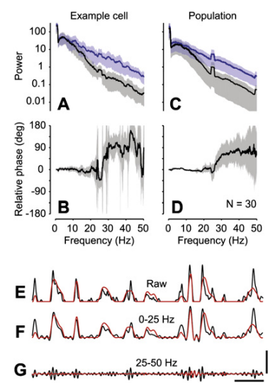
High temporal frequencies情况下，拟合效果较差
考虑加入burst generation机制
Notes:
自然序列下，神经元发放大约12%spike是burst

Slide 6
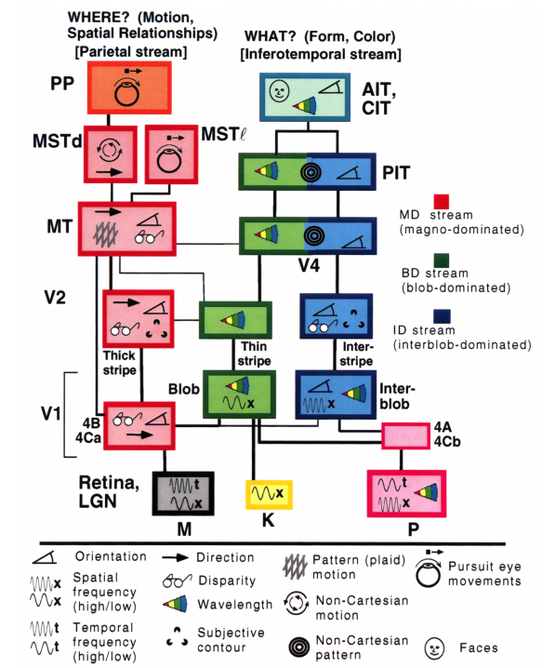
背侧通路
腹侧通路
平行通路是哺乳动物大脑感觉系统处理信息的特征，不同的受体与回路会从环境中提取不同的信息。大脑在通过整合从而产生感知与行为。
M pathway: no chromatic opponency, have rod input, lower spatial resolution, higher temporal resolution
P pathway: well-developed chromatic opponency, negligible rod input, higher spatial resolution, lower temporal resolution
K pathway: blue-yellow opponent pathway
①灵长类LGN较严格分离的平行通路相较于小鼠较混合的视觉通路，对于精细视觉影响有多大？
②M P K通路是否存在相互作用？如何相互作用？
③三条平行通路在V1首次整合，是如何整合的？
Essen, David C. Van and Jack L. Gallant. “Neural mechanisms of form and motion processing in the primate visual system.” Neuron 13 (1994): 1-10.

Slide 7
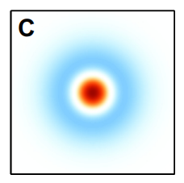
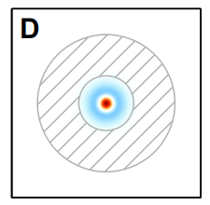


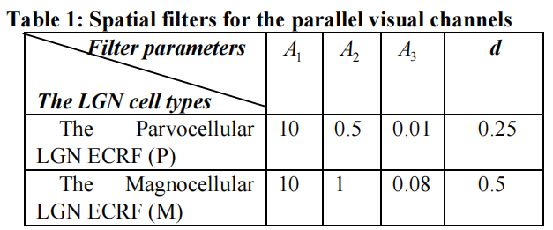
classical receptive field (CRF): 与RGC感受野近似，center-surround structure
Receptive Field
extra-classical receptive field (ECRF)：感受野更大，具有非线性结构(non-retinal source)
ECRF主要常发生在M layers(M layers ~15%interneuron，P layers ~4%interneuron) ，M cells respond faster than P cells
Jeffries, A.M., Killian, N.J., & Pezaris, J.S. (2014). Mapping the primate lateral geniculate nucleus: A review of experiments and methods. Journal of physiology, Paris, 108, 3 - 10.
A new excitatory-inhibitory neural network model for the extended classical receptive field (ECRF) of Parvo (P), and Magno (M) cells in the lateral geniculate nucleus
Classical Receptive Field( CRF )
Extended Classical Receptive Fields (ECRF)
Ghosh, K. (2016). A neural network based model of M and P LGN cells. 2016 International Conference on Bioinformatics and Systems Biology (BSB), 1-5.

Slide 8
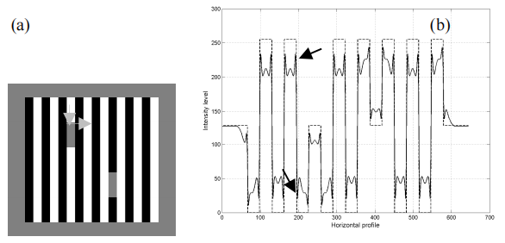
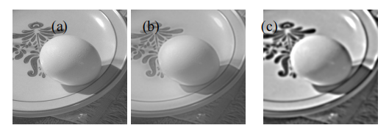
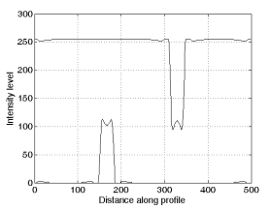
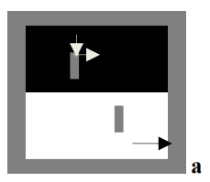
整体算法：
M pathway 产生初始信息，反馈给LGN做最终通道的选择
If M channel output identifies that the background around the test patches is UNIFORM*
P channel produces the brightness percept
Else
M channel itself produces the brightness percept.
UNIFORM
Either
the absence of sharp intensity changes in the background
OR
the direction of Weber contrast across the horizontal and vertical edges of the test patch
M channel
P channel
Ghosh, K. (2016). A neural network based model of M and P LGN cells. 2016 International Conference on Bioinformatics and Systems Biology (BSB), 1-5.

Slide 9
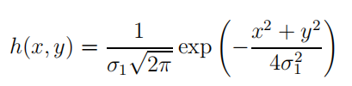
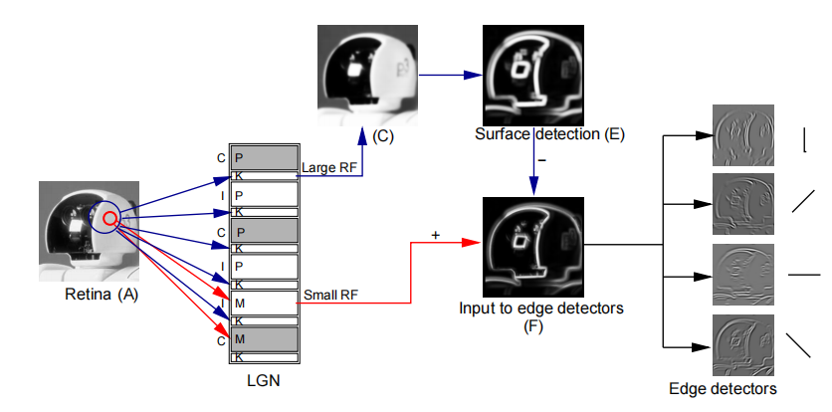

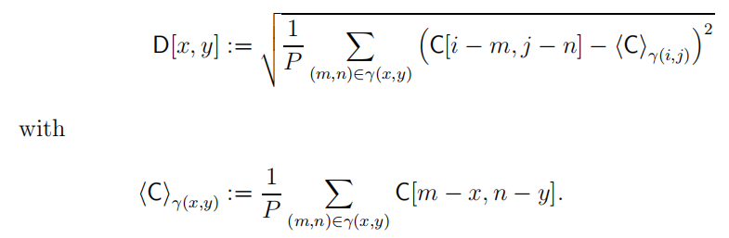
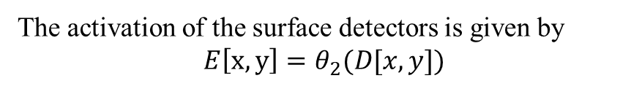
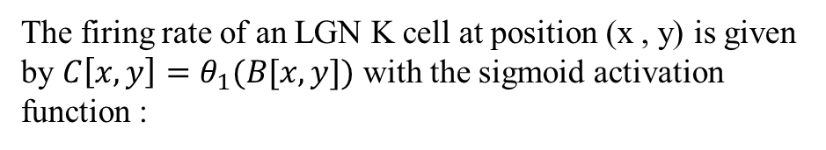
Model M and K pathway
We propose that surface information, provided by the k pathway supports orientation selectivity in layer II/III and, thus, may contribute to the improved tuning
K pathway感受野非常大，不能提供detail信息，但可以提供均匀的区域信息，在这里称为surface information
RF of k cells :
The firing rate of an LGN K cell at position (x , y) is given by $C\left[x,y\right]=θ_{1}(B[x,y])$ with the sigmoid activation function :
The activation of the surface detectors is given by
$$E\left[x,y\right]=θ_{2}(D[x,y])$$
如果surface detector感受野被均匀颜色覆盖，E响应最高,
且边缘与面相互排斥
F := A · E
Gewaltig, Marc-Oliver, Ursula Körner and Edgar Körner. “A model of surface detection and orientation tuning in primate visual cortex.” Neurocomputing 52-54 (2003): 519-524.

Slide 10
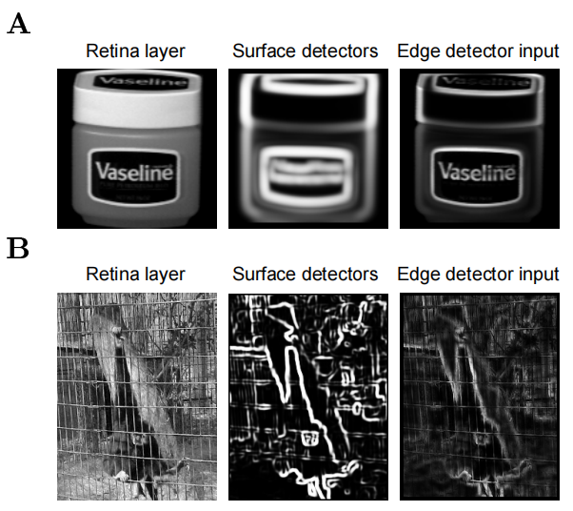
可以比较好的抑制笼子线条，检测到猴子的边缘轮廓

Slide 11
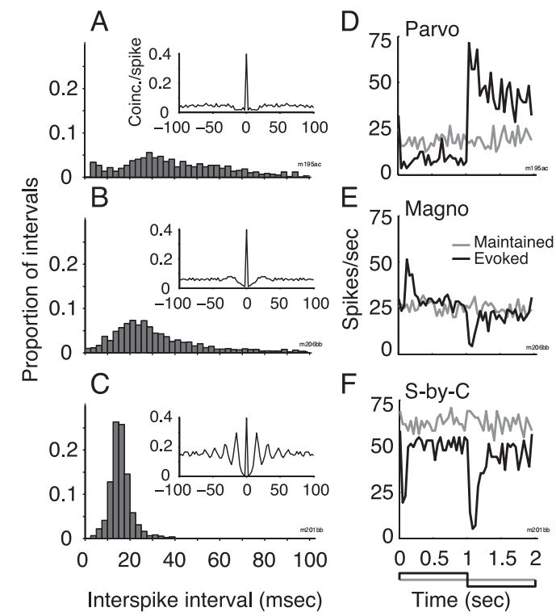
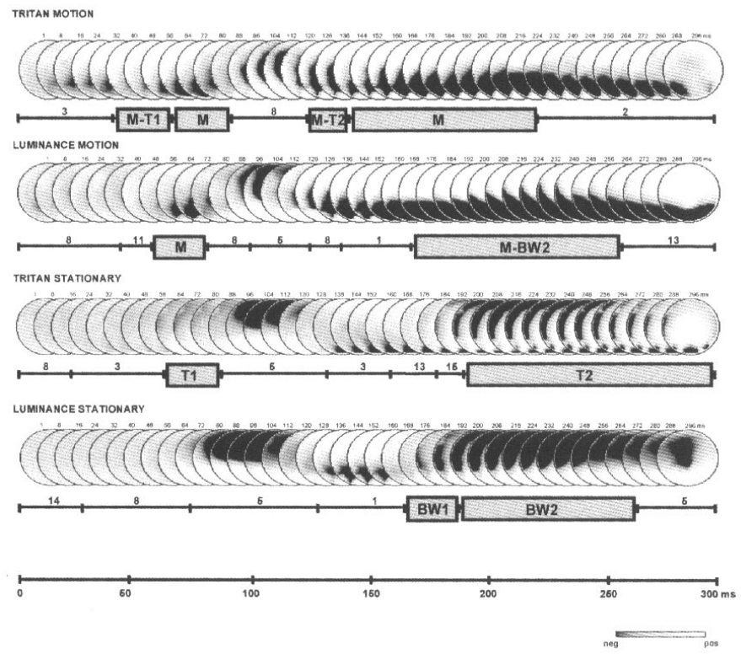
Suppressed-by-contrast cell
对侧眼
同侧眼
Suppressed-by-contrast cells 45.4 spikes/s
P-cells 15.9 spikes/s
Blue-yellow opponent cells 20.0spikes/s
M-cells 15.1spikes/s
Tailby, C., Solomon, S.G., Dhruv, N.T., Majaj, N.J., Sokol, S.H., & Lennie, P. (2007). A New Code for Contrast in the Primate Visual Pathway. The Journal of Neuroscience, 27, 3904 - 3909.
fast visual processing through the human koniocellular pathway
We found two time intervals where significant stimulus-specific electric fields were evoked: an early period between 40 and 75ms after stimulus onset, and a later period between 175 and 240ms
Morand, S., Thut, G., de Peralta, R.G., Clarke, S., Khateb, A., Landis, T., & Michel, C.M. (2000). Electrophysiological evidence for fast visual processing through the human koniocellular pathway when stimuli move. Cerebral cortex, 10 8, 817-25 .

Slide 12
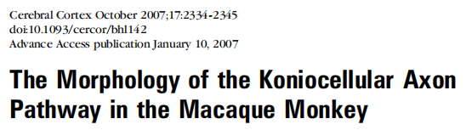
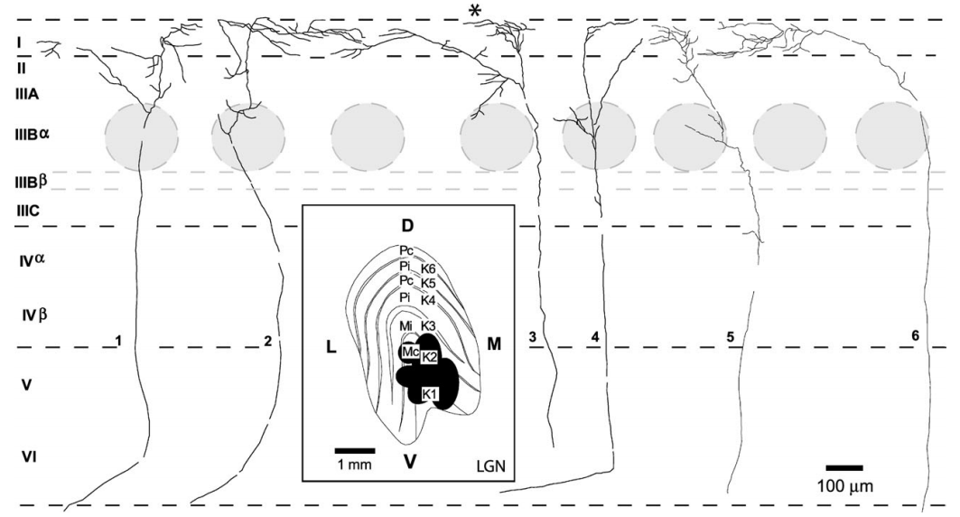
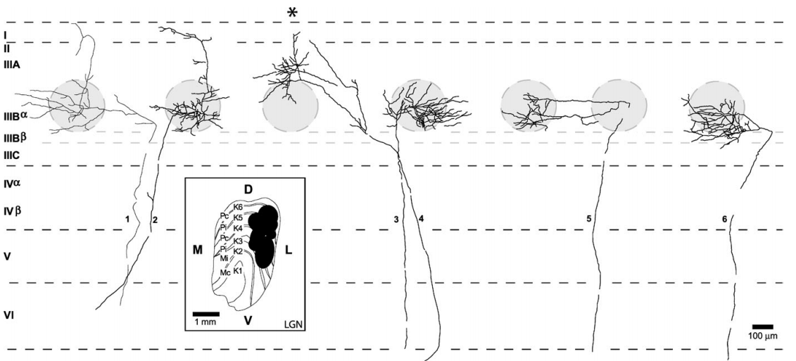
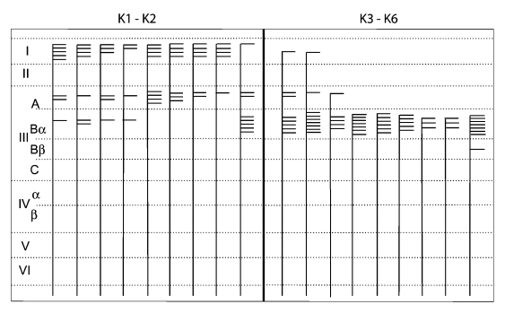
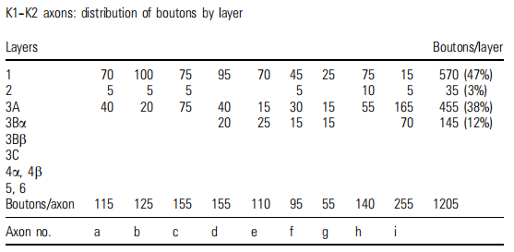
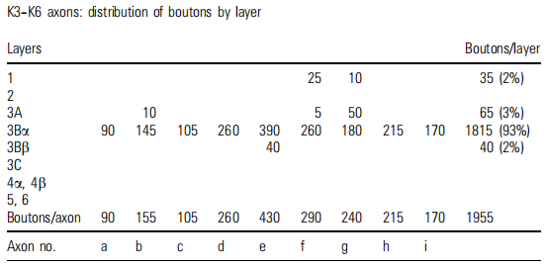
determine the distribution and morphology of koniocellular (K) lateral geniculate nucleus (LGN) axons in primary visual cortex (V1) of the macaque monkey
At least 2 main subpopulations of K axons in macaque V1 based on branching patterns and bouton distribution
morphologically simple and tend to branch in cortical layers 1 and 3A
more robust branching patterns that generally ended
in a single CO blob or blob column in cortical layer 3
Notes:
K cells是否存在不同的亚群，并且来自不同层
layers K1 and K2 are morphologically simple and tend to branch in cortical layers 1 and 3A，fewer boutons
layers K3--K6 terminate as complex, focused arbors in CO blobs in layer 3Ba, with only occasional simple projections to
the more superficial layers of cortex

Slide 13
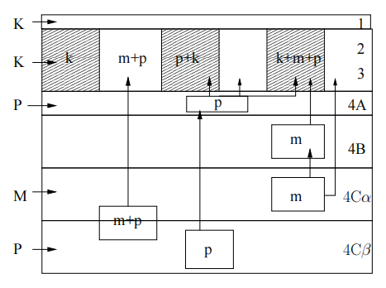
M pathway → dorsal visual areas (motion)
P pathway → ventral visual areas (identification)
M P and K通路信息混合产生新的平行通路
P pathway: 一些OFF midget ganglion cells接收S cone输入，携带blue-OFF/yellow-ON信号传输到4A
M + P pathway: axons穿过4A和4B投射到L3 blobs and interblobs
Blobs接收4Cα，4Cβ，4A以及4B输入
blue-ON/yellow-OFF
blue-OFF/yellow-ON
70% of these cells have a pyramidal morphology，接收4Cα与4Cβ输入，且M输入大约是P输入2倍
树突横跨上下两层，接收M和P pathway输入
red–green opponent
Callaway, E.M. (2005). Neural substrates within primary visual cortex for interactions between parallel visual pathways. Progress in brain research, 149, 59-64 .

Slide 15
Notes:
色度信息对运动检测意义，比如m cell在等亮度不同色度对比响应不同

