Slide 1
灵长类视觉组会——LGN
0523

Slide 2
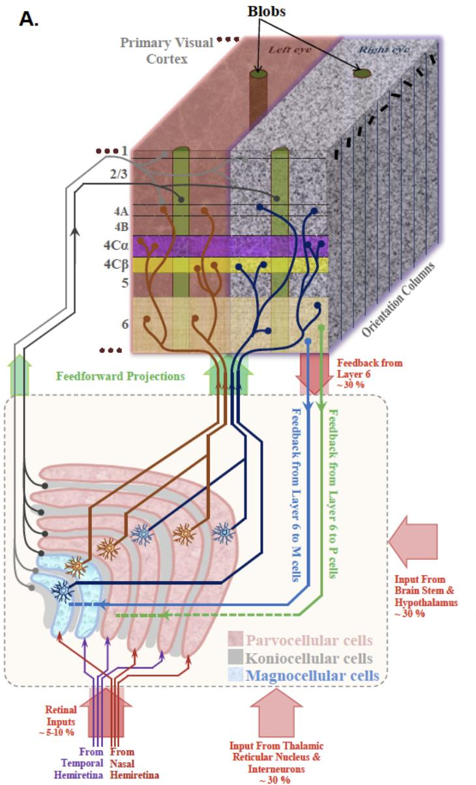
LGN输入
cortex
modulate
drive
modulate
retina
LGN
TRN
modulate
brainstem
③
产生这种功能差异的主要原因
① the location of synapses in the dendritic tree
视网膜输入的突触位于树突的底部靠近胞体，而其他输入位于树突的周边
② the type of neurotransmitter receptor in the postsynaptic membrane
视网膜输入的突触是离子受体，而其他输入的突触是离子受体与代谢型受体的混合
Ionotropic receptors: produce PSPs with a short latency(<1ms) and short response duration(tens of milliseconds)
Metabotropic receptors: produce PSPs with longer latencies(>10ms) and longer response durations(hundreds of milliseconds or more)
④
①
②
Notes:
使用离子受体是传递快节奏事件的有效策略，防止信息丢失，而代谢受体持续长时间的突触后点位，有效控制LGN神经元反应模式的长期变化

Slide 3
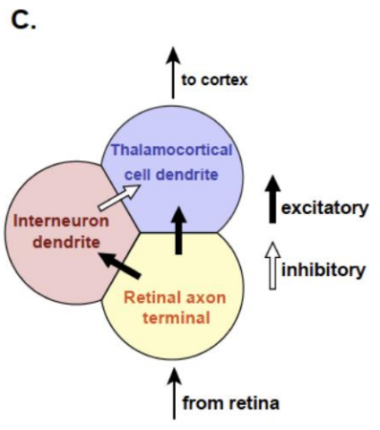
Interneuron与thalamocortical cell相互作用模式
Two modes of interaction exist between inhibitory interneurons and the thalamocortical:
Push-pull inhibition: thalamocortical cells are inhibited by interneurons having opposite contrast polarity
Same-sign inhibition: thalamocortical cells are inhibited by interneurons having same contrast polarity
Synaptic triads:
A distinctive feature of the synaptic organization of the thalamus
(M cells 比例更高)

Slide 4
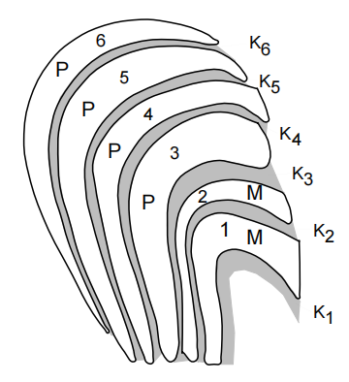
LGN皮层投射
① P cells、M cells
L4
L6
M cells
4Cα
P cells
4Cβ
② Thalamic cells
principal cells (spiny stellate cells)
stronger and faster
interneurons
③ On-center LGN cells
on-regions of striate cells
④ Off-center LGN cells
off-regions of striate cells
⑤ 10-30 LGN cells fire a cortical cell
⑥ L6 feedback is the largest single source of input to LGN in terms of the number of synapses
⑦ K1、K2
L1 and upper part of L3
K3-K6
blob areas in L2 and L3
K cells
V2、V3、V4、MT
(盲视现象)
Notes:
LGN和区域MT之间的直接连接对于将与运动相关的短潜伏期视觉信号传递到背视流可能具有功能意义

Slide 5
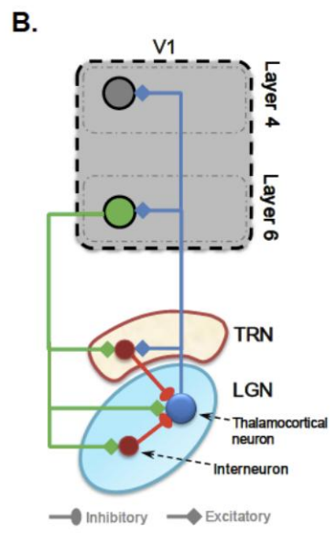
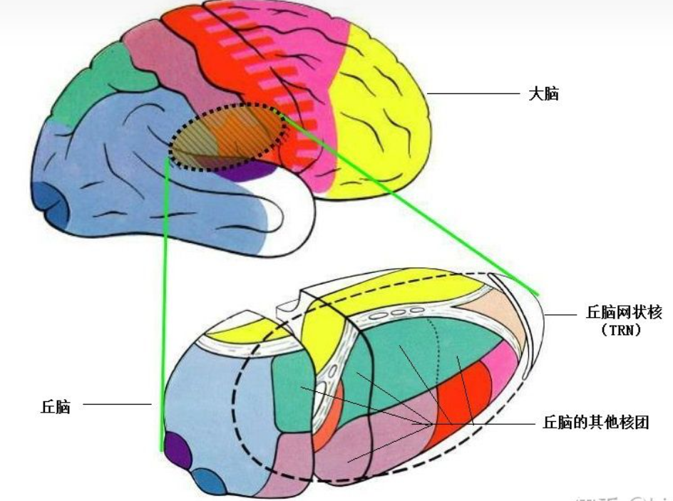
TRN输入
“If the thalamus is the gateway to the cortex, the reticular complex might be described as the guardian of the gateway.”
视觉部分位于TRN的尾部
TRN也有层次结构，靠近外侧的2/3与LGN和纹状皮层相关，靠近内侧的1/3与pulvinar和extrastriate cortex相关（夜猴和狨猴的发现，猕猴没有报道）
Notes:
覆盖在多个丘脑核与皮层之间，因此不同部分的LGN会与不同丘脑核皮层相关，

Slide 6
TRN输入
The TRN inhibitory field in LGN is bell-shaped, overlapping and aligned with the excitatory field of LGN thalamocortical cells but with a broader diameter.
TRN cells do not have a center/surround organization
Individual TRN cells project through multiple LGN layers, making synaptic contacts with many LGN cell types along the way
Notes:
覆盖在多个丘脑核与皮层之间，因此不同部分的LGN会与不同丘脑核皮层相关，

Slide 7
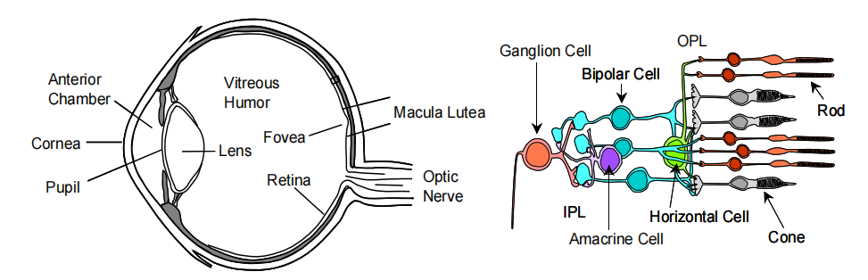
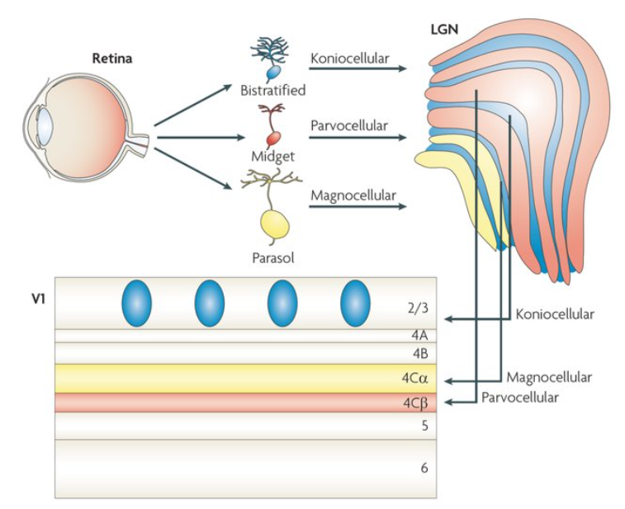
Retina输入
光通过眼介质和视网膜细胞被光感受器（视锥，视杆）吸收
Photoreceptors → bipolar cells → ganglion cells
（horizontal cells、amacrine cells横向调节）
Ganglion cells通过optic nerve离开眼睛

Slide 8
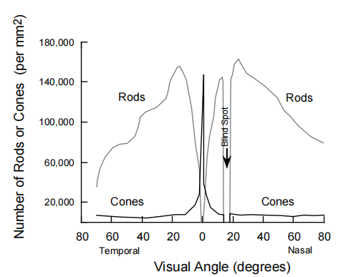
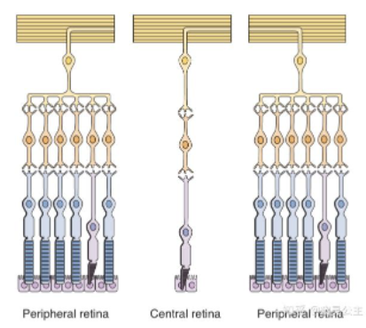
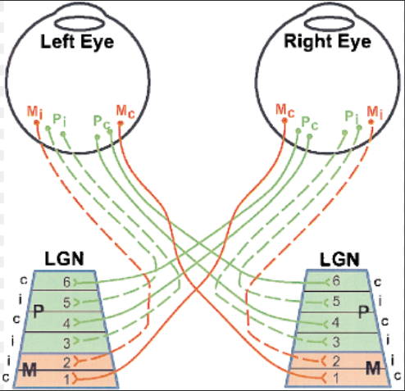
中央凹和视网膜周边结构
视锥细胞和视杆细胞在视网膜上的分布
不同区域的视神经节接受不同信号
视网膜到LGN传输

