Slide 1
A simpler primate brain: the visual system of the marmoset monkey
牟伦田
北京工业大学
2022.7.7

Slide 2
Outline
Why Marmoset?
The Marmoset Brain
The Marmoset Eye
Neurons in the Subcortical Visual System
Primary Visual Cortex (V1)
R&D Plan

Slide 3
U.S. labs clamor for marmosets (Science 2018)
Callithrix jacchus—the common marmoset—is in great demand in labs and yet almost nowhere to be found (Origin: Brazil)
Marmosets' small size, fast growth, and sophisticated social life were already enough to catch the eye of neuroscientists
Genetically engineered to make their brains easier to image and to serve as models for neurological disorders such as autism and Parkinson's
The National Institutes of Health plans to launch funding to expand marmoset research
Established marmoset researchers are working together to help new labs get animals

Slide 4

Marmoset
Small and social, marmosets offer advantages for researchers

Slide 5
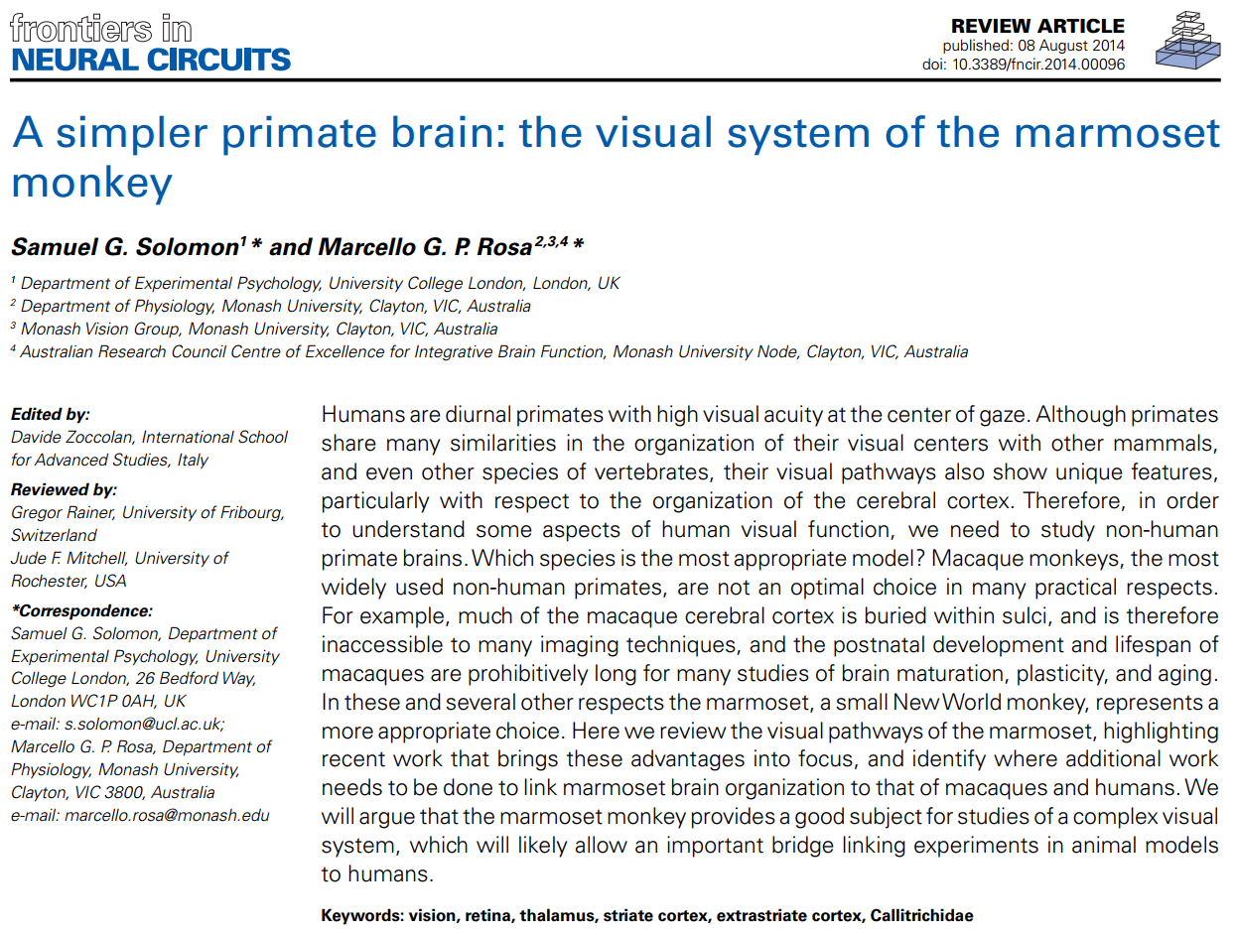
A simpler primate brain: the visual system of the marmoset monkey

Slide 6
Knowledge about marmoset
The most studied stages of visual processing are the retina, LGN, and cortical areas V1, V2, and MT
The simpler geometry of the thalamus and cortex in the marmoset allows sharper understanding of the relationship between structure and function in LGN and MT
Potential for genetic modification in developing models of normal vision and visual dysfunction

Slide 7
A sufficient model of primate vision
The precise functional organization of visual cortex
The availability of embryonic tissue
Rapid postnatal maturation
Potential for genetic manipulation
A tractable model for the study of the detailed molecular events that guide development of the primate cerebral cortex
In the case of most other extrastriate areas, as well as visual association areas of the parietal, temporal and frontal lobes, further comparative work is required to solidify knowledge regarding homologies between primate species

Slide 8
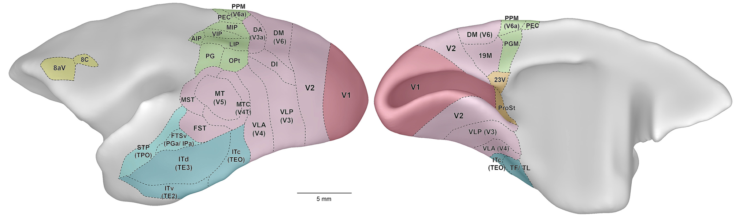
The Marmoset Brain
∼8 g, which is ∼12 times smaller in volume than that of the rhesus macaque, and 180 times smaller than the human brain
One key advantage of the marmoset : the relatively smooth topology of the cerebral cortex

Slide 9
The Marmoset Eye
Large compared to its body weight and brain size, with a diameter of about 11 mm
Near the fovea the retina samples the image with a resolution of about 128 μm/degree
Cone density reaches approximately 200,000 cones/mm² in the marmoset fovea
The spatial resolution of the photoreceptor mosaic in the marmoset is estimated to be close to 30 cycles/degree
Rod photoreceptors rise to a peak density of approximately 70,000 rods/mm², at about 15◦ from the fovea

Slide 10
The Marmoset Eye
Short gestation time of marmosets makes it easier to study the developing eye and retina
Hyperopic in early life and become myopic with age
The rapid postnatal maturation makes them useful in understanding the neural changes that accompany developmental disorders
Retrograde degeneration
Normal aging
Foveal detachment
Macular degeneration

Slide 11
Cone Photoreceptor Classes
The spectral sensitivity of a photoreceptor is defined by the type of opsin that it expresses
Primate cone photoreceptors can be divided into two classes
most sensitive to shorter (“blue”) wavelengths
most sensitive to longer (“red", "green”) wavelengths
Cones most sensitive to short wavelengths (S-cones, “blue”; 423 nm) are relatively rare (5–10%)
smaller than other cones
more irregularly distributed in the marmoset
present (at low density) at the center of the fovea

Slide 12
Cone Photoreceptor Classes
In primates the opsins associated with sensitivity to medium-long wavelengths are encoded on the X-chromosome
In macaques and humans, the genes for opsins most sensitive to long (L-cones; “red”) and medium (M-cones; “green”) wavelengths lie in sequence
Three alleles code opsins most sensitive to 543, 556, or 563 nm
Which opsin is expressed in females is dictated by inactivation of one of the X-chromosomes early in development
Male marmosets are dichromatic (“red–green color blind”), because the longer wavelength photoreceptors all have the same peak sensitivity
Those female marmosets carrying two distinct alleles are trichromatic

Slide 13
Other Retinal Neurons And Output Pathways
Parallel pathways emerge in the output of cone photoreceptors, which in primates distribute their signals to at least 9 different classes of bipolar cells ; These in turn provide input to at least 15 morphological classes of retinal ganglion cell
∼550,000 ganglion cells/mm², each foveal cone is sampled by at least two ganglion cells
These parallel pathways within the retina, and their subsequent targets in the brain, are remarkably similar in macaques and marmosets
Most ganglion cells in the marmoset retina can be classified as “ON-center” or “OFF-center”, A smaller number of ganglion cells respond well to both the onset and offset of light (“ON–OFF”)
Retinal ganglion cells generally show classical center-surround receptive field organization, with a smaller excitatory center surrounded by a larger inhibitory surround

Slide 14
Other Retinal Neurons And Output Pathways
Around 90% of the ganglion cells project to the lateral geniculate nucleus (LGN) of the thalamus
The LGN of the marmoset has a basic laminar organization, which emerges before birth
The size of the LGN increases rapidly after birth, without an increase in the number of neurons, and stabilizes at about 6 months of age
Retinal input arrives mainly at two dorsal parvocellular layers and two ventral magnocellular layers, each receiving dominant input from either the contralateral or the ipsilateral eye
Much of what we know about the koniocellular visual pathways in simian primates stems from work in marmoset

Slide 15
Other Retinal Neurons And Output Pathways
Most retinal ganglion cells are of the midget class, and project to the parvocellular layers of the LGN
Within about 10◦ of the fovea, ON and OFF-type midget ganglion cells appear to get input from a single midget bipolar cell, which in turn receive input from a single cone photoreceptor
The signals of individual cone photoreceptors located in and near the fovea can be passed largely independently to the LGN
While in macaque the midget bipolar cells contact single cones out to at least 8 mm (40◦), in marmosets the midget bipolar cells get convergent input from multiple cones at eccentricities above 1 mm (8◦)

Slide 16
Other Retinal Neurons And Output Pathways
The number of bipolar cells, and thus cone photoreceptors, converging onto a single midget or parasol ganglion cell increases with distance from the fovea
Neurons in the parvocellular and magnocellular layers project to V1 and there are about as many LGN neurons projecting to V1 as there are likely retinal afferents to the LGN
Intrinsically photosensitive retinal ganglion cells are morphologically similar in marmosets and macaques
Their central projections include the LGN, but other targets are possible

Slide 17
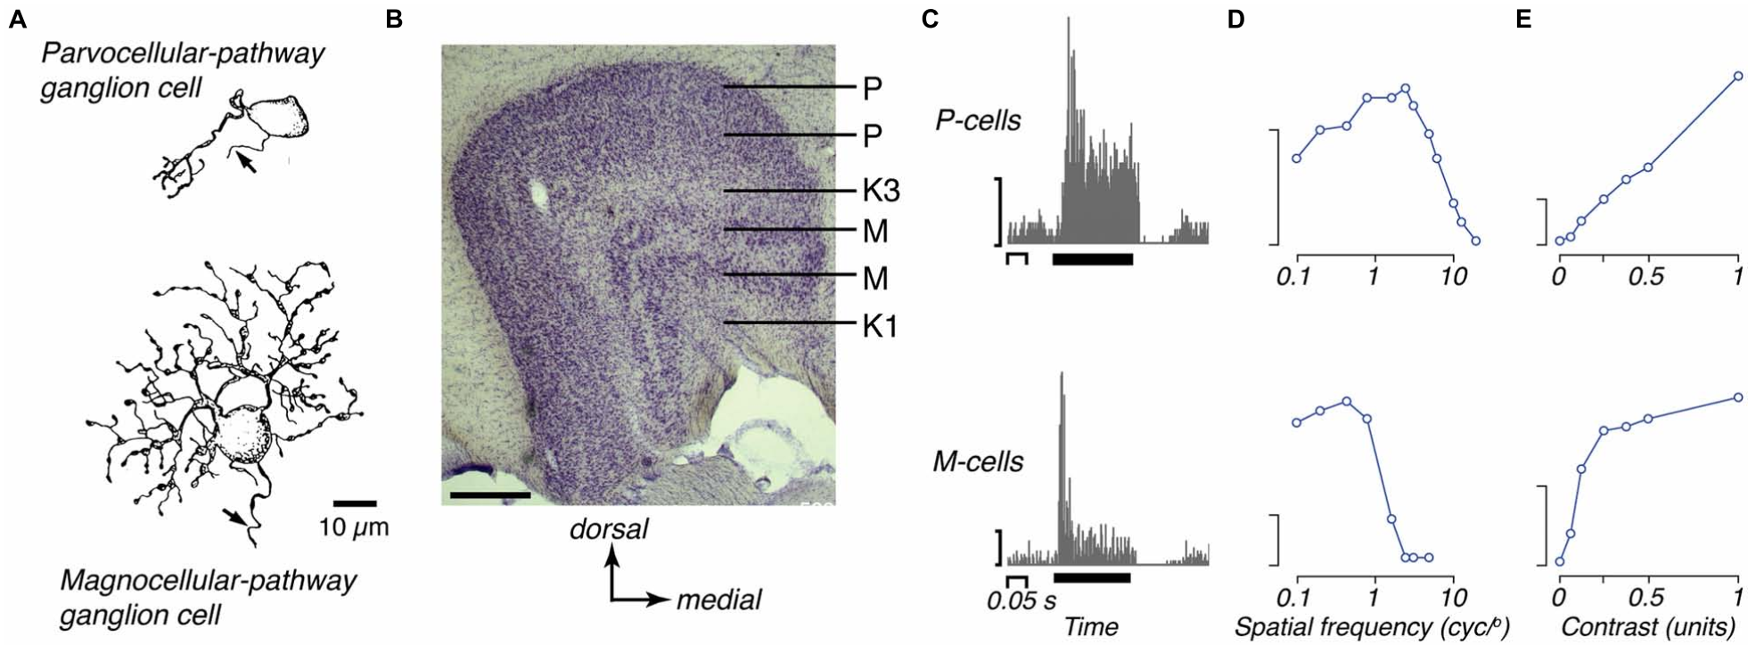
Other Retinal Neurons And Output Pathways
The two major retino-thalamic pathways in marmoset
The dorsal most P layer and ventral most M layer get input from the contralateral eye
The internal layers get input from the ipsilateral eye

Slide 18
Functional Properties Of Neurons in the Subcortical Visual System
Parvocellular, magnocellular, and koniocellular neurons are generally well segregated in the marmoset LGN
The functional properties of neurons in the parvocellular and magnocellular layers are each relatively homogenous, whereas neurons in the koniocellular zones form a more heterogeneous population
Neurons in the parvocellular layers have small receptive fields, low contrast sensitivity, a generally linear contrast–response function and a sustained response to an effective stimulus
Neurons in the magnocellular layers have larger receptive fields, higher contrast sensitivity, saturating contrast response function and a transient response to an effective high contrast stimulus

Slide 19
Functional Properties Of Neurons in the Subcortical Visual System
Among both parvocellular and magnocellular neurons, receptive field size increases with distance from the fovea and the response becomes more transient
At any given eccentricity, magnocellular neurons have larger receptive fields, shorter visual latencies, and more transient responses than parvocellular neurons
The presence of dichromatic and trichromatic individuals makes the marmoset a natural model to study normal red–green color vision, anomalous color vision and color-blindness

Slide 20
Functional Properties Of Neurons in the Subcortical Visual System
Neurons in koniocellular zones of the marmoset LGN show diverse response properties
Many respond well to achromatic stimuli, and their receptive fields are generally larger than those of parvocellular and magnocellular neurons at the same eccentricity from the fovea
Some are “ON–OFF” ，some are suppressed by the presence of any stimulus, and some are selective for orientation

Slide 21
Primary Visual Cortex (V1)
Structure And Topographic Organization
V1 is the largest single area：200 mm2 in each hemisphere
The retinotopic map found in V1 of the marmoset is very similar to that described for the macaque and other diurnal primates
The foveal representation is highly magnified, occupying ∼20% of the surface area, and about 60% of V1 is dedicated to the central 10◦ of the visual field
The peak magnification factor near the representation of the center of the fovea has been estimated to be 4–5 mm/degree, about 40% of the equivalent value in the macaque
The magnification factor follows the sampling density of ganglion cells, but representation of the foveal field in V1 greatly exceeds that expected likely due to greater divergence in the retino-geniculo-cortical pathways serving foveal vision, compared to those serving peripheral vision

Slide 22
Primary Visual Cortex (V1)
Structure And Topographic Organization
Relatively little is known about the distribution of cell types and interlaminar connections in marmoset V1
The few studies have concentrated primarily on dendritic architecture, with respect to columnar domains, projection patterns or postnatal development
Most, if not all layer IVb cells, which form the projection to the middle temporal area (MT), have an unambiguously pyramidal morphology , as opposed to spiny multipolar in the macaque

Slide 23
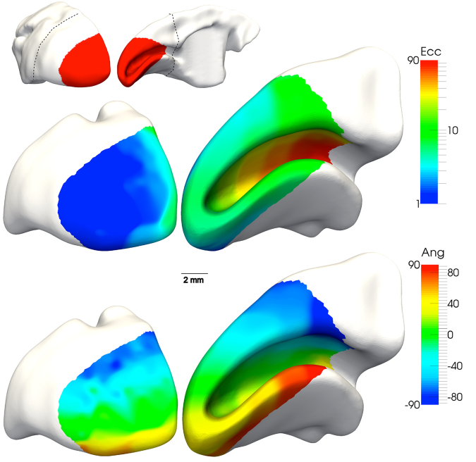
Primary Visual Cortex (V1)
Location and organization of marmoset primary visual cortex (V1)

Slide 24
Connections of V1
Our knowledge of the afferent connections of V1 in the marmoset still has many gaps
Anterograde tract tracing has shown strong projections from the LGN to layers IVcα and IVcβ, as well as a weaker projection to layer VI, and patchy projections to supragranular layers
Analysis of retrograde tracing shows that the projection to supragranular layers arises primarily from koniocellular LGN neurons, whereas parvocellular and magnocellular LGN neurons project primarily to layers IV and VI
A projection from the lateral pulvinar complex to V1 has been demonstrated, but its laminar targets have not been determined
Other subcortical projections to marmoset V1 have not yet been investigated in any detail

Slide 25
Connections of V1
Substantially more research is also needed on the issue of the intrinsic connectivity of V1 in the marmoset
We know only that periodic horizontal connections have been shown between neurons in supragranular layers
Interlaminar connections has remained virtually unexplored, with the exception of projections from layer VI to the superficial layers
Additional inputs to V1 arise in “feedback” connections from various other cortical areas
These connections originate primarily from infragranular layers in those areas, but their precise laminar targets in V1 have not been determined.

Slide 26
Connections of V1
Projection of V1 to extrastriate cortex in the marmoset from retrograde tracer injections in extrastriate areas
Projections to V2 arise throughout the upper layers of V1 (from layer II to layer IVb）
As in macaques, layer IVb contains the majority of neurons that project to thick cytochrome oxidase“stripes”in area V2
Layer IVb is also the primary source of V1 input to areas MT
Callosal fibers provide interhemispheric connections between left and right V1
Most callosal neurons are found along the border between V1 and V2

Slide 27
Connections of V1
Projection of V1 to extrastriate cortex in the marmoset from retrograde tracer injections in extrastriate areas
Projections to V2 arise throughout the upper layers of V1 (from layer II to layer IVb）
As in macaques, layer IVb contains the majority of neurons that project to thick cytochrome oxidase“stripes”in area V2
Layer IVb is also the primary source of V1 input to areas MT
Callosal fibers provide interhemispheric connections between left and right V1
Most callosal neurons are found along the border between V1 and V2

Slide 28
Columnar Organization of V1
The presence or absence of ocular dominance columns (ODCs) in marmosets remains a matter of interest
Transient or unstable expression of ODCs in marmosets is consistent with observations in some other New World monkeys, where the pattern and presence of ODCs varies from animal to animal
Strong evidence for functional ODCs, in electrophysiological or optical imaging experiments, has not been reported in any individual marmoset
Neurons in blobs are often thought to be important for color vision, but there is no difference in the distribution of blobs in dichromatic and trichromatic marmosets
No spatial organization of the blue–yellow chromatic response or the achromatic response across the cortical surface

Slide 29
Functional Properties of V1 Neurons
Spatial response properties of marmoset V1 neurons strongly resemble those described in the macaque
The degree of orientation selectivity varies between neurons, but throughout V1 the majority of neurons (∼80%) show clear orientation preference
The preferred spatial frequency among V1 neurons depends strongly on eccentricity from the fovea
Most neurons are generally sensitive to motion orthogonal to the preferred orientation
A broad distribution of contrast sensitivity – some are sensitive to very low contrasts and others only respond at high contrast

Slide 30
Functional Properties of V1 Neurons
No study has yet investigated the sensitivity of neurons in the marmoset visual cortex to binocular disparity
The range of depths that can be usefully discriminated from binocular disparity should be correspondingly smaller, but no behavioral or physiological evidence is currently available
Limited investigation of the chromatic response of neurons in marmoset V1
No study has characterized the response of V1 neurons to modulation along the red–green dimension of color space, which is present only in trichromatic animals

Slide 31
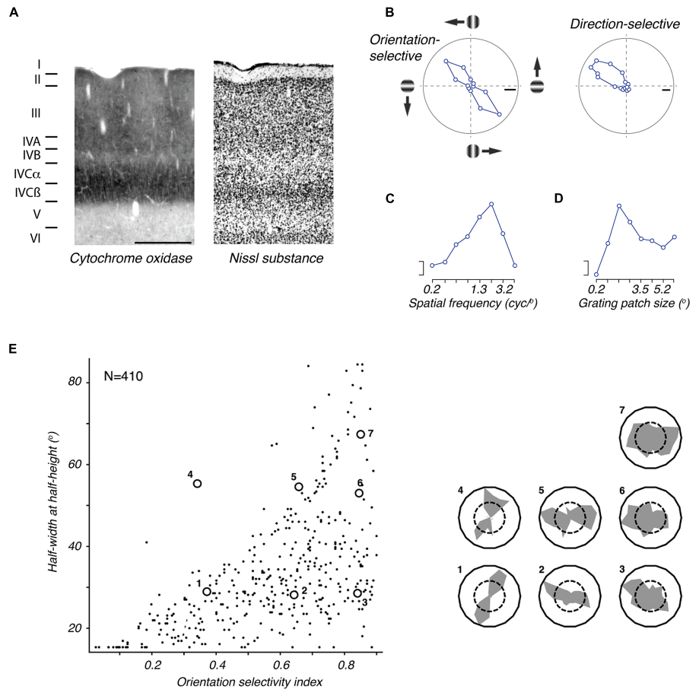
Primary Visual Cortex (V1)
The marmoset primary visual cortex (V1)

Slide 32
R&D Plan
Understanding Primate Brain and V1 (2022.7-2022.8)
Structure and functioning
Visual pathways from retina to V1 and beyond
Visual information processing mechanisms of V1
Modelling and Simulating Primate V1 (2022.9-2022.12)
Evaluating existing models and new models
Implementing a selected model
Experimental verification

Slide 33
Team
Supervisor: Prof. Tiejun Huang
Coordinator: Lei Ma
Team work with BAAI colleagues
Wenjie Chen , Jinying Gao, Kai Du
My team at BJUT
Master candidates: Yiyuan Zhao, Yihan Sun, Peize Li
Undergraduates: Zihao Li, Yunhan Tian, Jiawen Wu, Ruichen He, Ruiliang Dong, Yunfeng Wan

Slide 34
Thank you
Q&A
☺

