Slide 1
灵长类视觉——LGN
0711

Slide 2
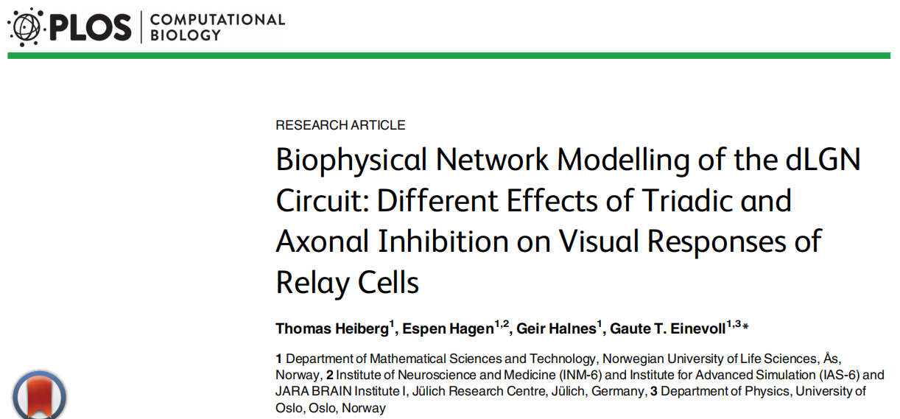
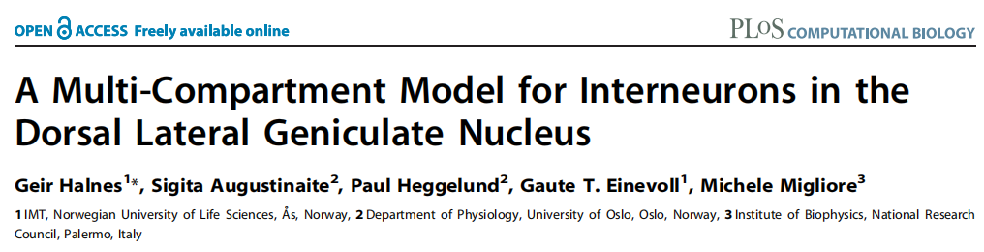
2016 研究interneuron与relay cell通过树突与轴突抑制性连接功能性差异
①triadic inhibition gain control, axonal inhibition regulation of spatial resolution
②瞬时响应和持续响应下不同抑制的影响
2011 构建了第一个interneuron多室模型

Slide 3
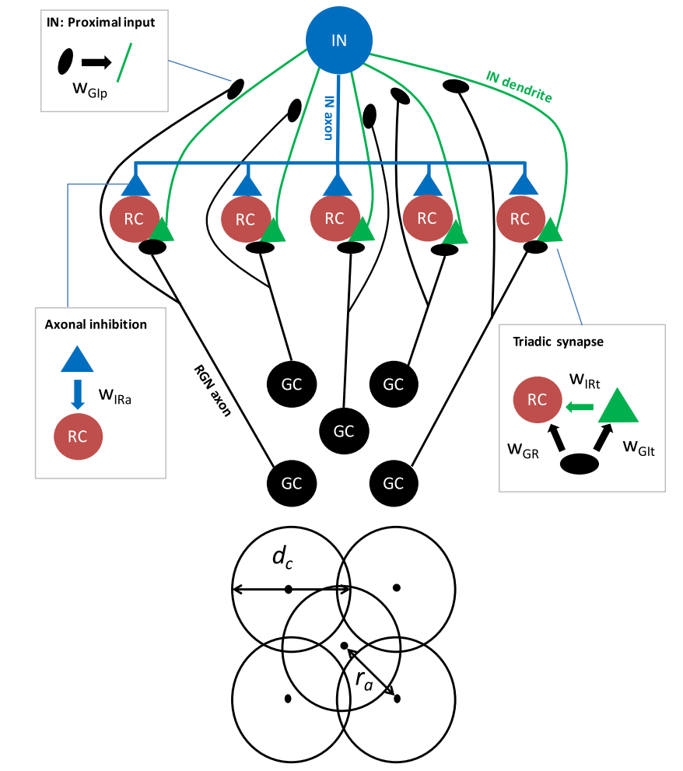
①Input
②Interneuron model
③Relay cell model
④Result analysis
A single retinal terminal contacts postsynaptic terminals on both an IN dendrite and an RC dendrite. The IN terminal is, at the same time, postsynaptic to the GC input and presynaptic to the RC
circular spot
Notes:
突触三联位置在RC近端树突与IN远端树突，IN由于GC输入，GABA释放，产生局部抑制，与soma无关，因此在功能上与soma解耦开

Slide 4
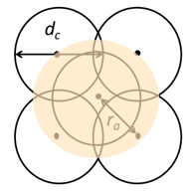



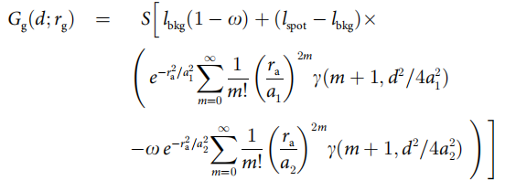
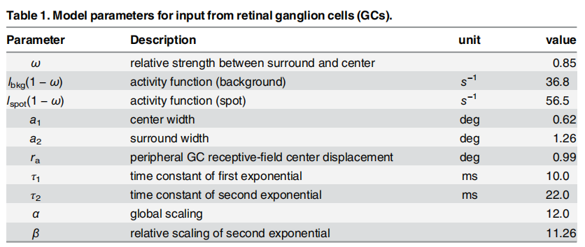

Input from retinal ganglion (GC) cells:
non-stationary Poisson processes with rates determined by a response function $R_{g}(t,d)$
空间部分：
对于一个亮度为$L_{spot}$, 背景亮度为$L_{bkg}$的圆形光斑，与光斑同心感受野响应为：
与光斑不同心且偏离距离为r的感受野响应为：
时间部分：

Slide 5
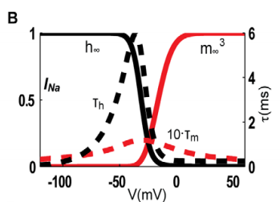
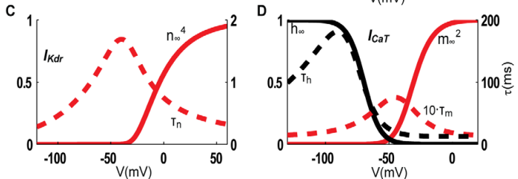
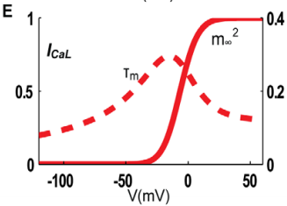
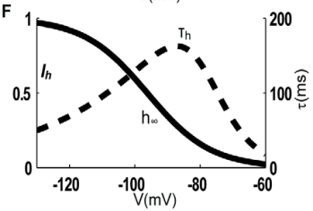
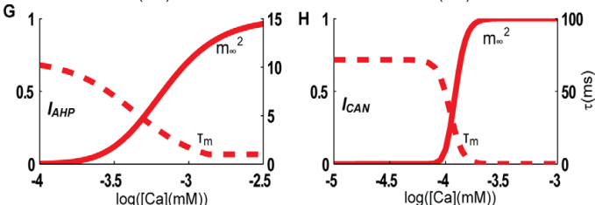
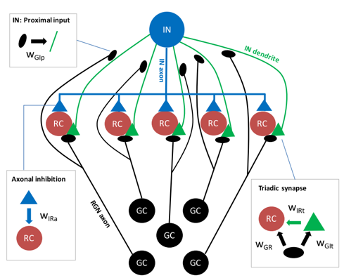


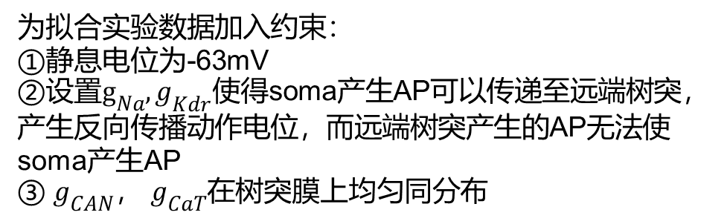
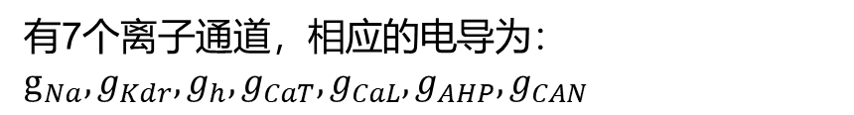

Interneuron model
有7个离子通道，相应的电导为：$g_{Na},g_{Kdr},g_{h},g_{CaT},g_{CaL},g_{AHP},g_{CAN}$
8.72μm
0.3μm
400μm
100μm
形态简化
15.3μm
4μm
Input
50 μm from the soma; wGIp
为拟合实验数据加入约束：
①静息电位为-63mV
②设置$g_{Na},g_{Kdr}$使得soma产生AP可以传递至远端树突，产生反向传播动作电位，而远端树突产生的AP无法使soma产生AP
③ $g_{CAN}$， $g_{CaT}$在树突膜上均匀同分布
450 μm from the soma; wGIp
The intracellular ${Ca}^{2+}$-concentration was modeled
soma
Output：
Direct triadic inhibition：局部电压超过-10mV局部释放GABA
Soma-driven triadic inhibition：
Axonal inhibition：
Conductance-based synapses：

Slide 6
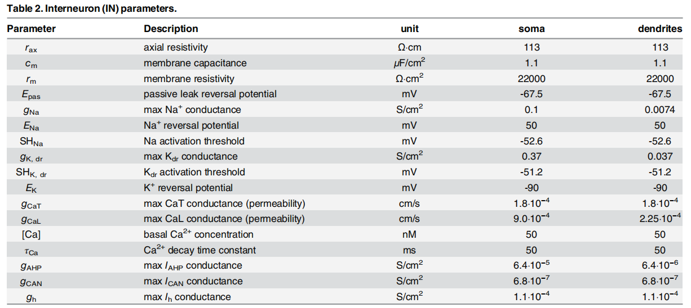

Slide 7
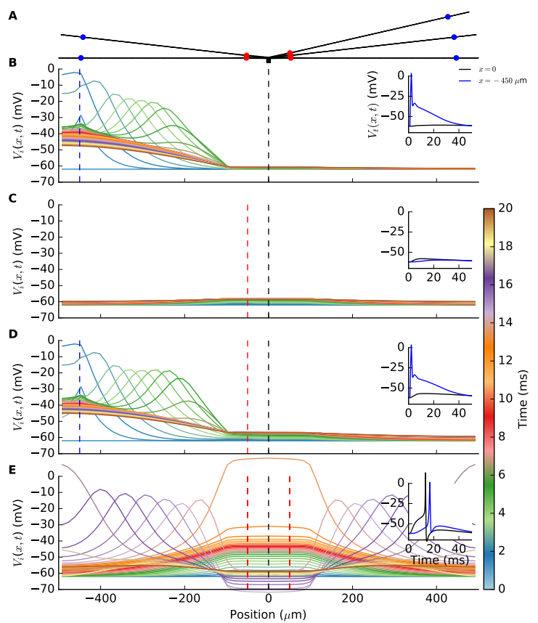
Synaptic integration properties of interneuron model
A single GC spike arrives at a distal IN synapse
局部钠通道激活，产生快速去极化，钾通道激活，逐渐衰减，远端树突依旧保持相对去极化在-50mV以上，持续20ms，该持续反应是由于局部T-type钙通道激活。
但向soma传播过程逐渐衰减，soma无法产生AP
A single spike arriving at a proximal IN synapse
仅产生微弱的去极化，无法产生三联抑制和soma产生AP
A single distal and a single proximal synapse positioned on the same branch are activated at the same time
依旧无法使soma产生AP
All five proximal synapses are activated by simultaneous spikes
Soma产生AP，产生axonal inhibition以及soma-driven triadic inhibition

Slide 8
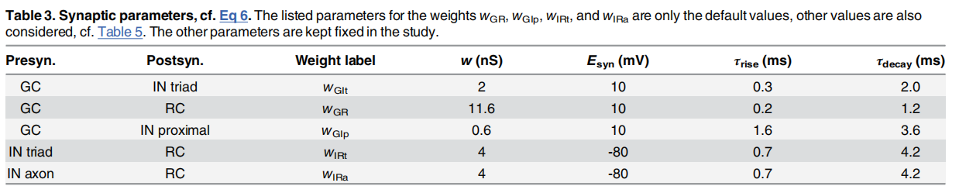
Relay cell model
In contrast to INs, relay cells (RCs) appear to be electrotonically compact , and we thus use a single-compartment model
有三个离子通道，相应的电导为： $g_{Na},g_{K},g_{CaT}$
Input：
①excitatory input from GCs in triadic synapses
②inhibitory input from INs via dendritic GABA release in triadic synapses
③inhibitory input from INs via axonal GABA release

Slide 9
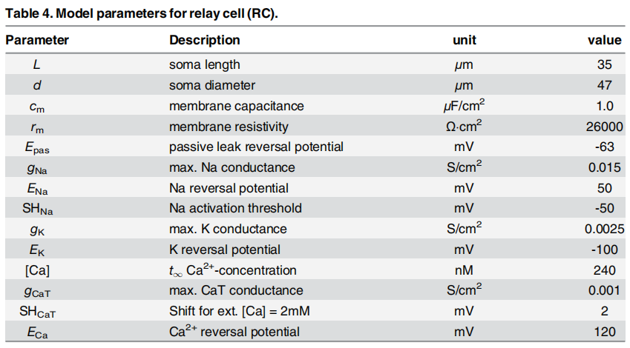

Slide 10
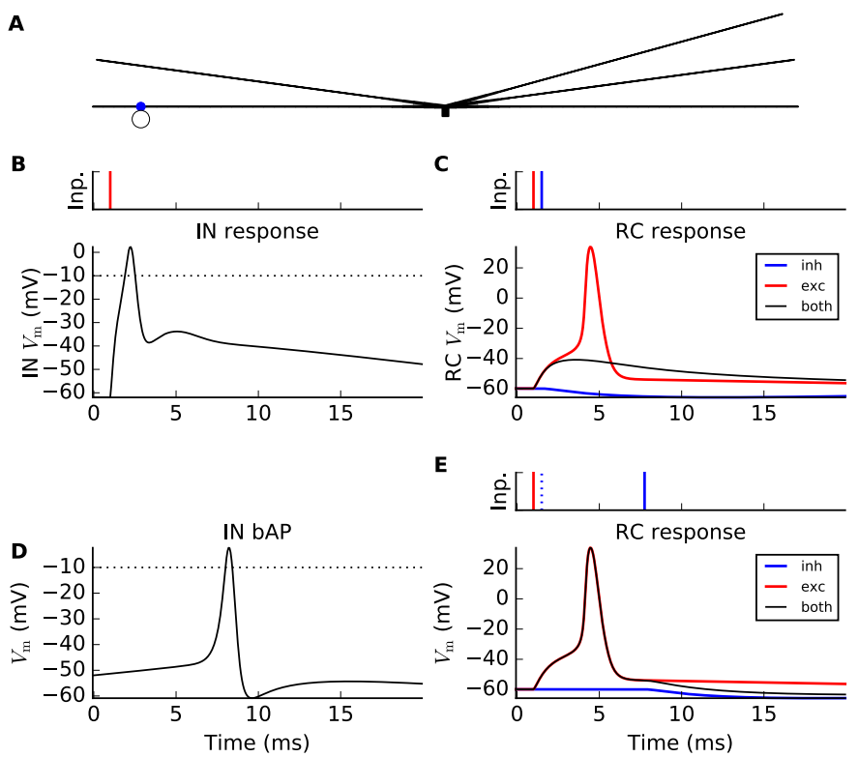
Direct triadic inhibition & soma-driven triadic inhibition
A single GC spike input to a distal synapse
Back-propagating action potential in IN dendrite
Soma-driven triadic inhibition是由soma动作电位反向传播产生，会延迟几毫秒，因此无法抑制RC产生AP

Slide 11
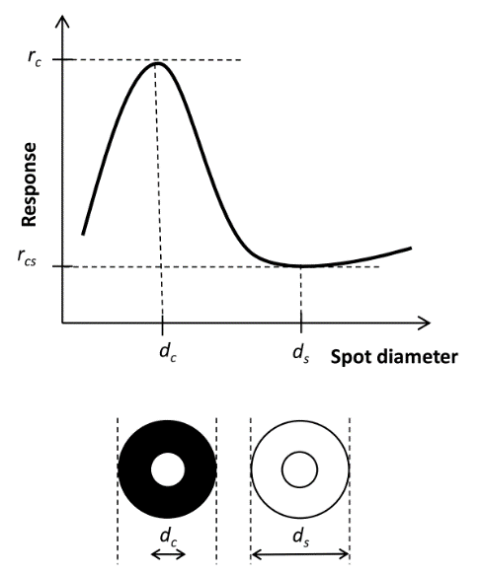
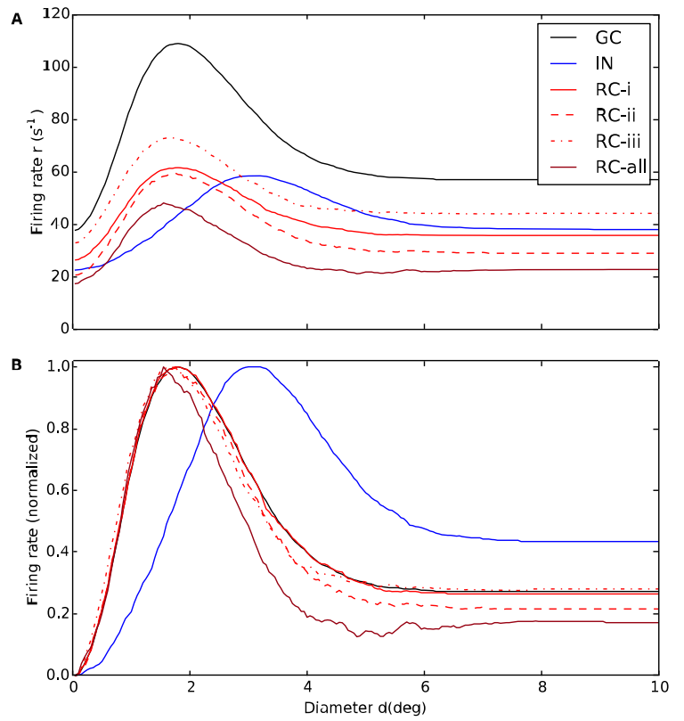
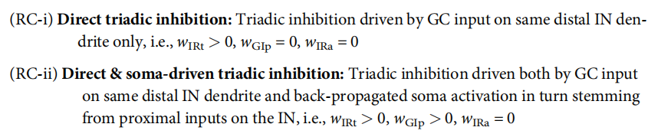
effects of various types of inhibition on relay-cell (RC) response
①RC center diameter ~2° IN center diameter ~3°
②direct triadic inhibition仅降低了firing rate，没有改变tuning curve形状，gain control作用
③soma-driven and axonal inhibition减少了中心感受野的大小，调节空间分辨率

Slide 12
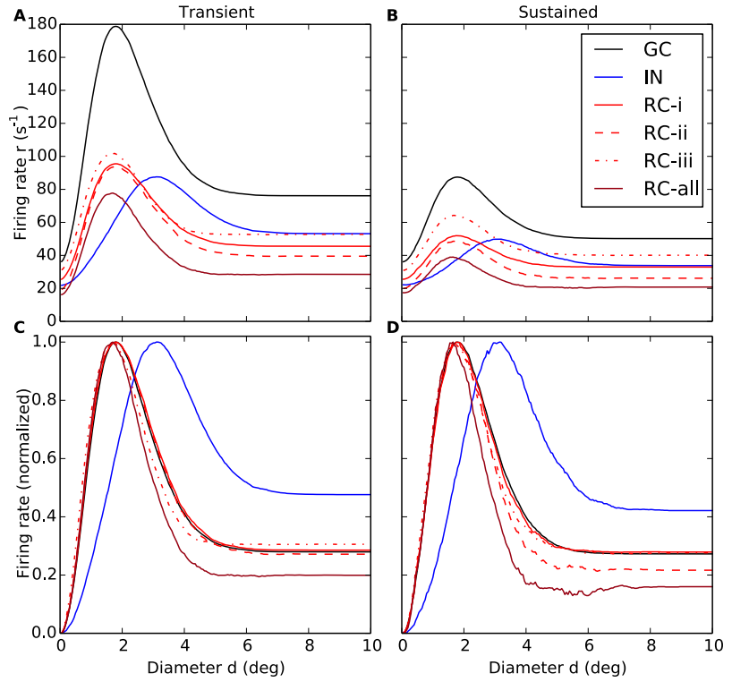
triadic and axonal inhibition have differential effects on the transient and sustained responses of the RC
①对于sustained response，triadic inhibition比axonal inhibition抑制性更强
②soma-driven triadic inhibition产生更强的center surround拮抗特性
0–100ms after stimulus onset
400–500ms after stimulus onset

Slide 13
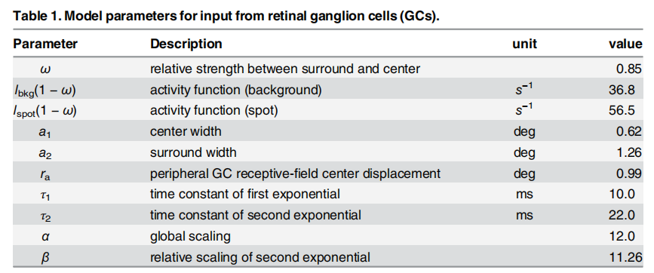

Slide 14
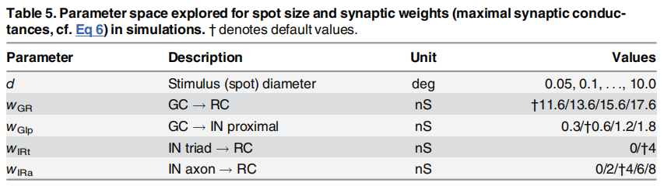

Slide 15




Slide 16
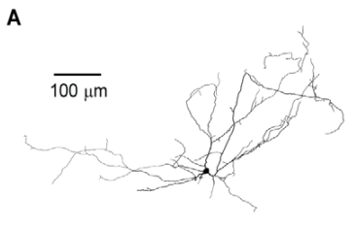
The total surface area was 9864 mm2 , the total length of dendrites was 5771 mm, the longest dendrite was 673 mm, and the mean somatodendritic diameter was about 0.5 mm.
Morphology：

