Slide 1
灵长类视觉——LGN
0620

Slide 2
本周主要内容
①LGN中是否存在方向选择性和朝向选择性以及性能
②视网膜到LGN的具体投射及偏心率对投射位置影响

Slide 3
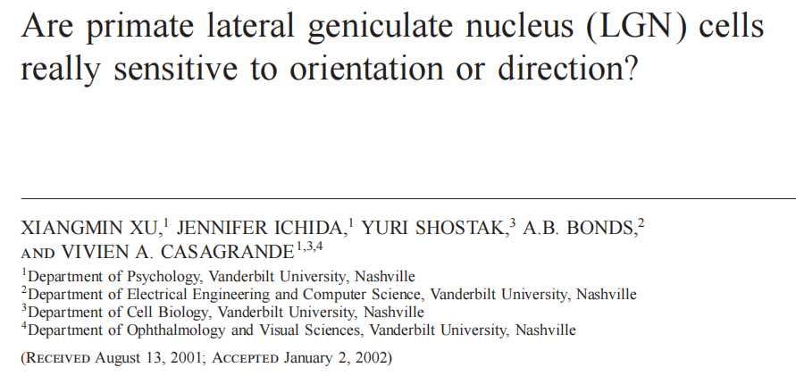
主要解决三个问题：
（1）LGN细胞对direction和orientation的敏感性如何？
（2）偏心率和空间频率如何影响LGN神经元的direction and orientation tuning？
（3）与初级视觉皮层(V1)中的细胞相比，LGN细胞direction和orientation敏感性如何？

Slide 4
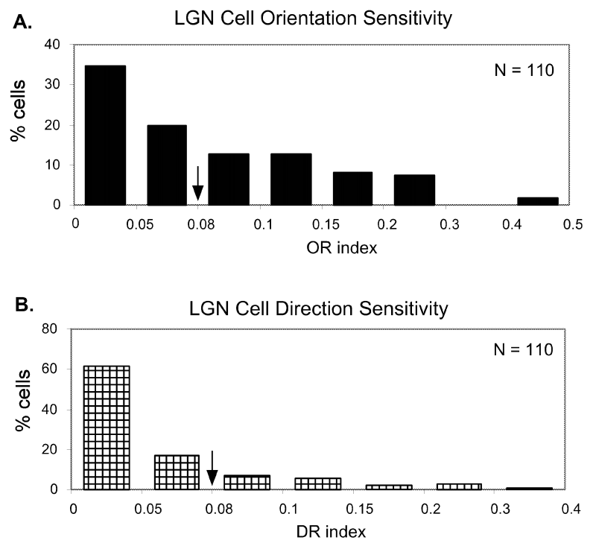
（1）LGN细胞对direction和orientation的敏感性如何？
owl monkey 110 LGN cells(32 k cells, 34 m cells, and 44 p cells) were recorded
41.8% of the LGN cells are sensitive to orientation
19.1% of the LGN cells are sensitive to direction
Xu, X., Ichida, J.M., Shostak, Y., Bonds, A.B., & Casagrande, V.A. (2002). Are primate lateral geniculate nucleus (LGN) cells really sensitive to orientation or direction? Visual Neuroscience, 19, 97 - 108.

Slide 5
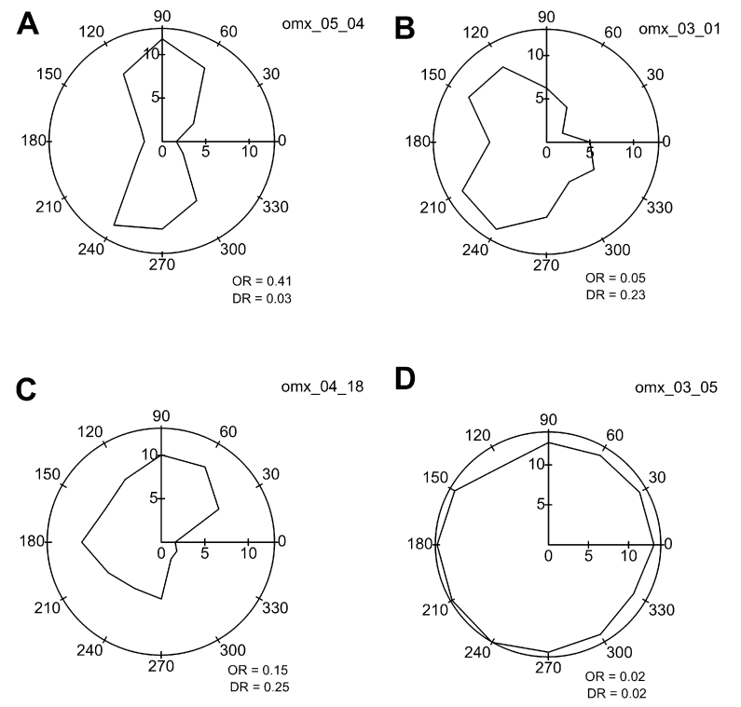
①
orientation sensitivity √ direction sensitivity ×
②
orientation sensitivity √ direction sensitivity ×
on-center P cell
on-center P cell
③
orientation sensitivity √ direction sensitivity ×
④
orientation sensitivity √ direction sensitivity ×
34/110①类神经元，且29/34神经元prefer orientation在水平或垂直20°范围内
9/110②类神经元，且7/9神经元对水平方向敏感
12/110③类神经元，且10/12神经元对水平or垂直朝向敏感，9/12神经元prefer direction与prefer orientation正交
55/110④类神经元
off-center M cell
off-center K cell

Slide 6
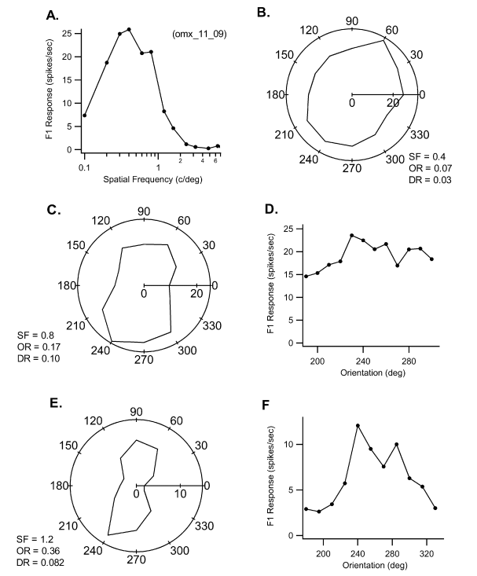
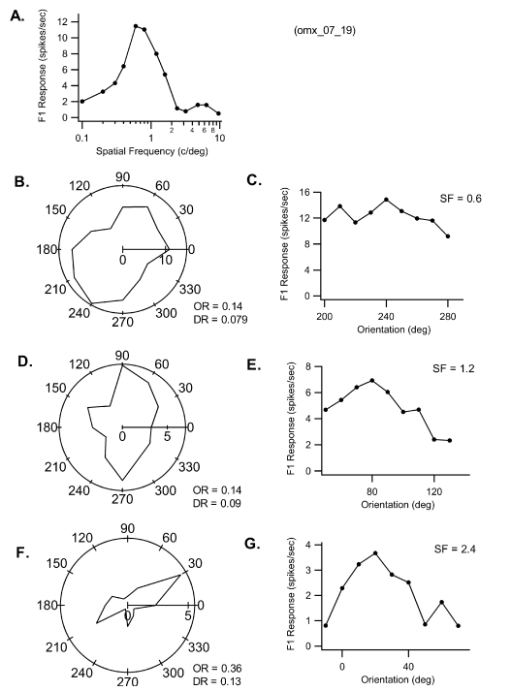
（2）偏心率和空间频率如何影响LGN神经元的direction and orientation tuning？
8/25神经元随着空间频率的加强，prefer orientation发生偏移，偏移范围在40°内
The receptive-field eccentricities of the cells studied ranged from 2.6 deg to 27.5 deg，the orientation and direction biases of LGN cells did not vary with the eccentricity of the receptive field

Slide 7
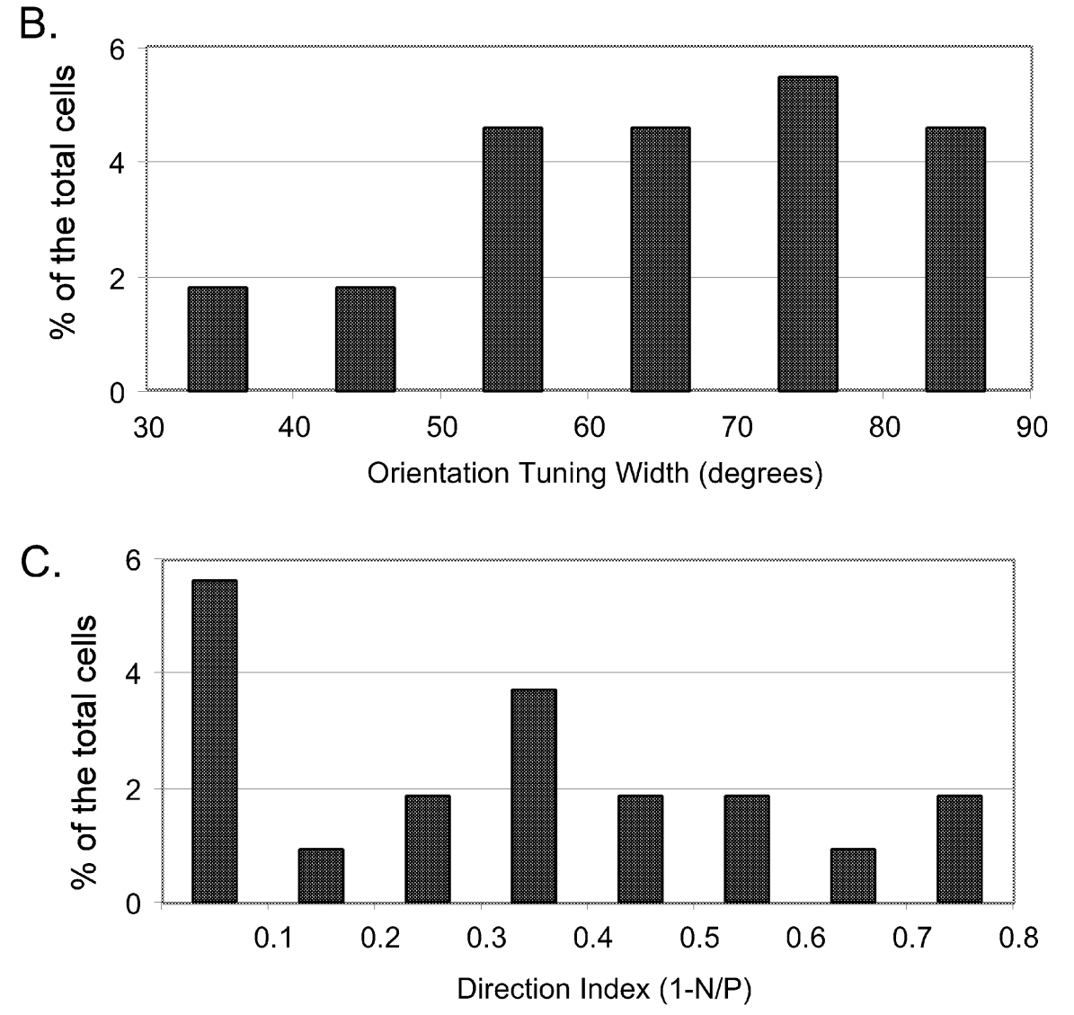
（3）与初级视觉皮层(V1)中的细胞相比，LGN细胞direction和orientation敏感性如何？
Compared to cortical cell orientation tuning, LGN cell orientation sensitivity in owl monkey is weak.
If its bandwidth≤90 deg，they defined a cell had an orientation tuning
25/110 LGN cells have orientation tuning
21/110 LGN cells have broad tuning
The tuning bandwidth of our 25 best tuned LGN cells was about 2.5 times broader (median 67.5 deg) than that of V1 cortical cells(27.4 deg)
If a cell had a DI≥0.67, they defined it as direction selective
34% of the V1 cells are direction selective
3% of the LGN cells are direction selective
Notes:
与98年相近实验测试皮层tuning curve比较

Slide 8
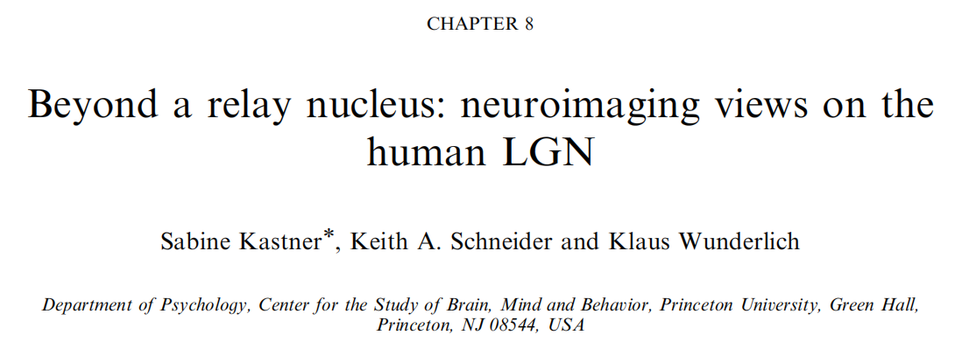
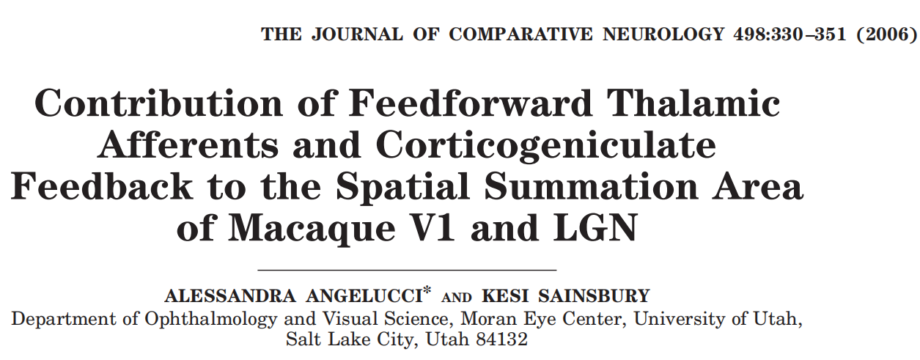
retinotopic organization

Slide 9
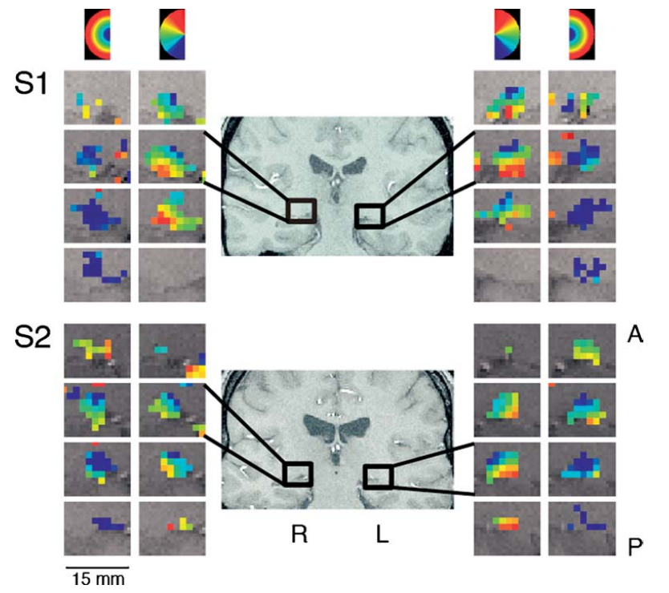
polar-angle maps and eccentricity maps
0°-5° 深蓝→浅蓝
5°-10° 青→绿→黄
10°-15° 橙→红
红色 upper field
绿色 horizontal field
蓝色 lower field
lower field → medial-superior portion
upper field → lateral-inferior portion
fovea → posterior and superior portion，with increasing eccentricities resented more anteriorly

Slide 10
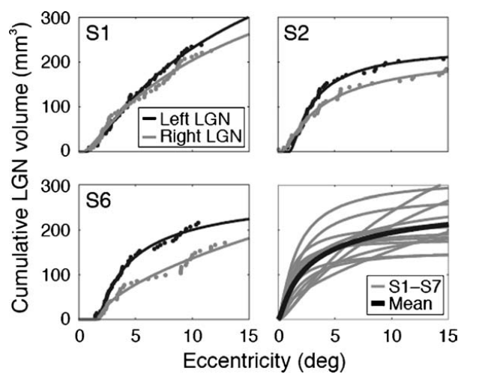
eccentricity magnification factor
会有更多的神经元致力于中央凹的表征，因此可以用离心放大因子来参数化表征。
在中央凹内可以看做是恒定数量表征

Slide 11

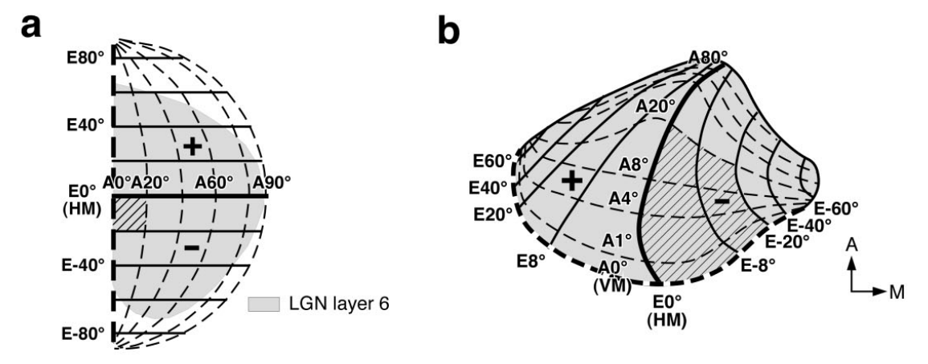
对侧 On-center P
同侧 On-center P
对侧 Off-center P
同侧 Off-center P
同侧 M
对侧 M
Angelucci, A., & Sainsbury, K. (2006). Contribution of feedforward thalamic afferents and corticogeniculate feedback to the spatial summation area of macaque V1 and LGN. Journal of Comparative Neurology, 498.

Slide 12
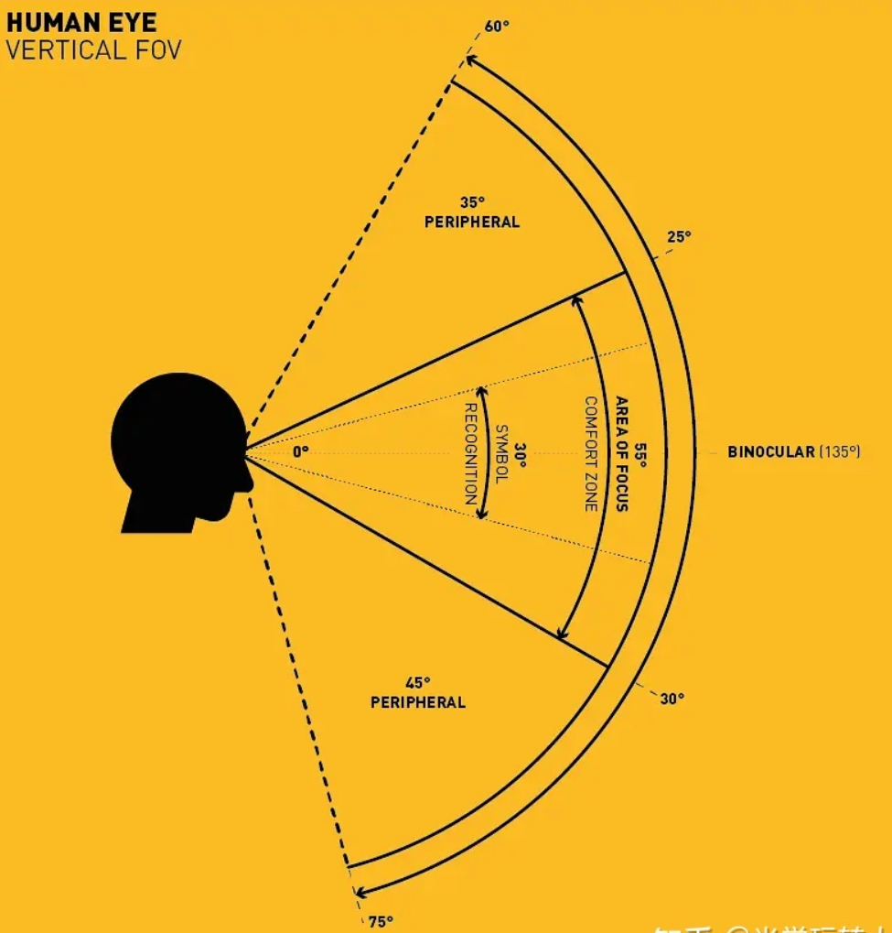
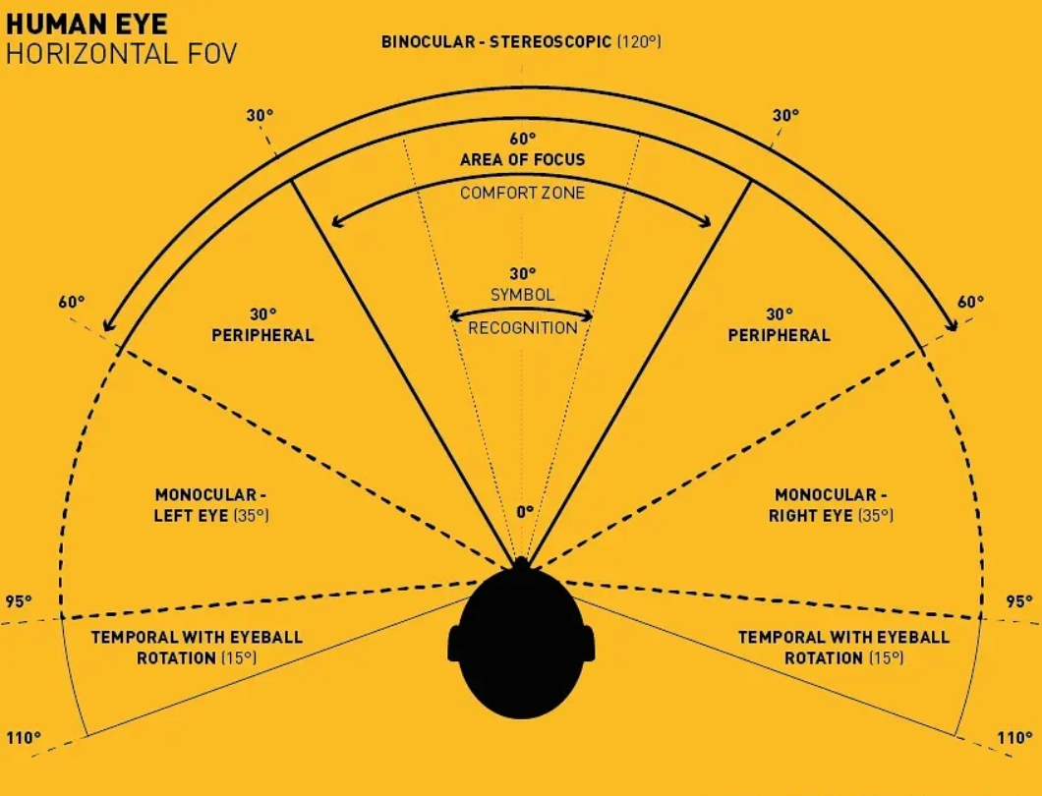
人眼的视野范围
垂直视野：
人的垂直方向视野角度大约为向上60°，向下75°，共135° 舒适角度为55°
纵深视野：
（1）0.2-11m之间，我们能获得一个“真实”3D的视野，这也是我们的舒适景深；
（2）11-20m间，我们依然能够通过双眼在视网膜上成像的差别，获得一个“边缘”的3D视野；
（3）＞20m，我们只能得到一个“扁平”的2D视野，因为景象通过双眼的成像差别太小，无法分辨；
水平视野：
（1）单眼的视野（不转动眼球、脖颈）大约是左右各95°，共190°
（2）单眼视野，转动眼球，脖颈不动，能获得更大的视野，左右各增加约15°
（3）两眼重合的视野角度为120°，但是舒适角为60°

