Slide 1
National Parks Service Biodiversity
By
Ben Cole
(Future Data Scientist)

Slide 2
Introduction
The data in species_info.csv includes the following columns:
category: The category of the species (e.g. Mammal, Bird etc.)
scientific_name: The scientific name of the species.
common_names: Common names for the species.
conservation_status: The conservation status of the species.
Observations:
Majority of species are under ‘No Intervention’.
Significant number of species are classified as ‘Species of Concern’.

Slide 3
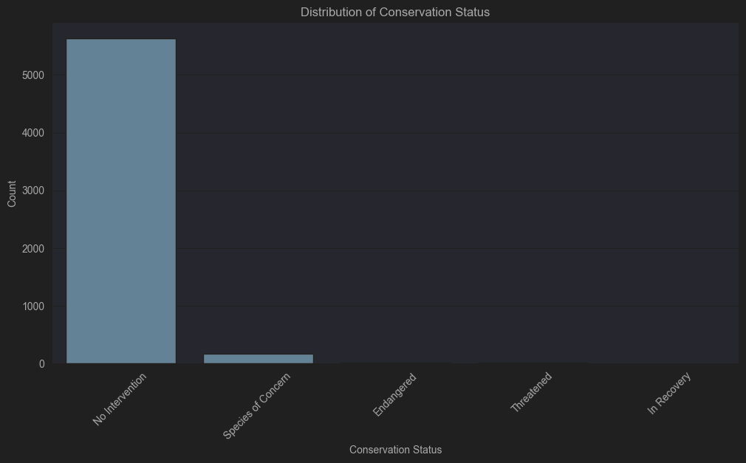

Slide 4
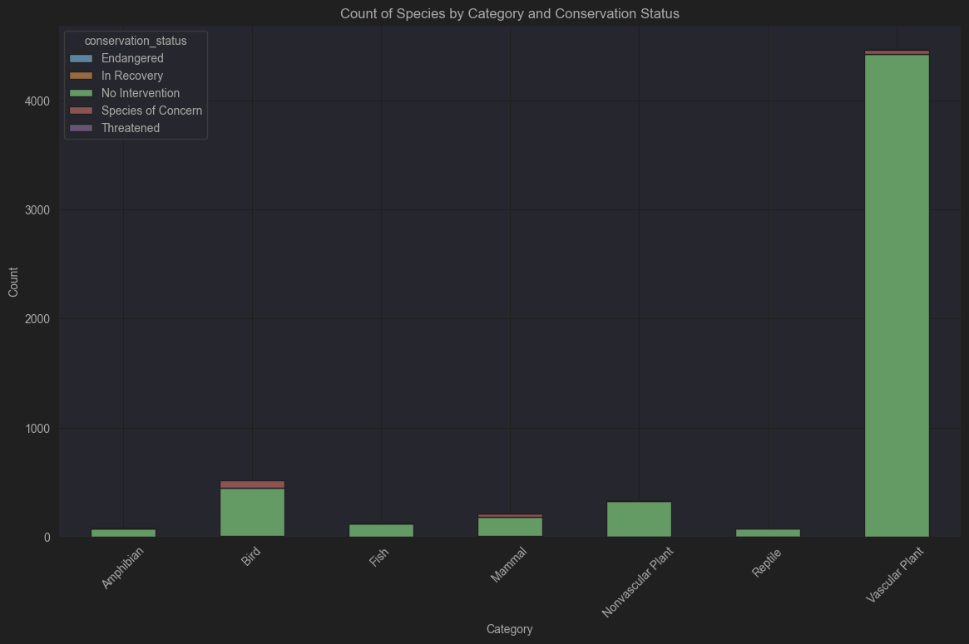

Slide 5
Significance Calculations
Significance calculations were performed to determine if there are significant differences between species and their conservation status.
Chi – squared test results:
Chi-squared test static: 628.58
P-value: 2.45e-117
The extremely low p-value indicates a highly significant relationship between species categories and their conservation status.

Slide 6
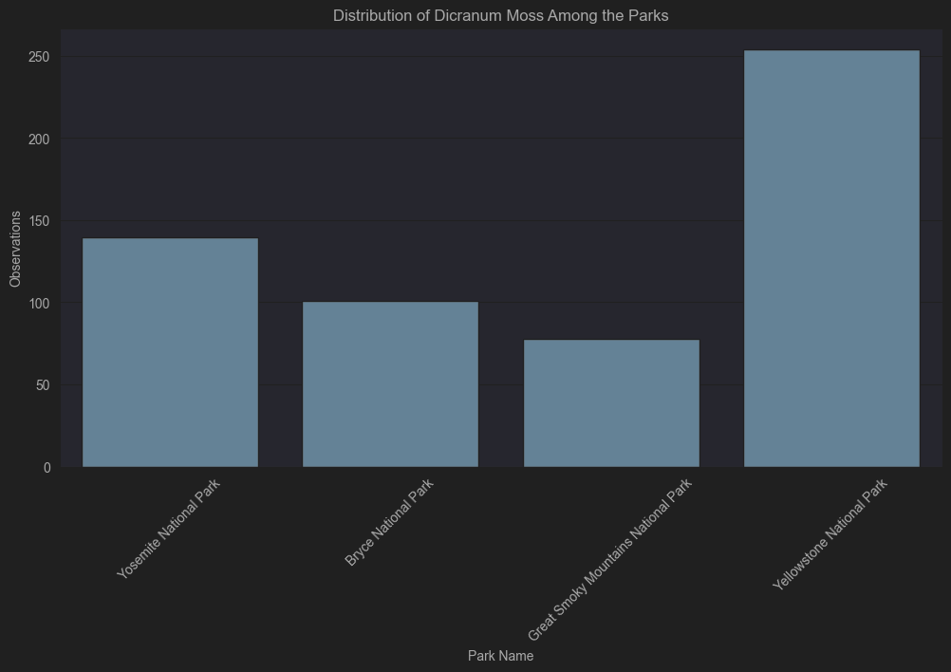

Slide 7
Recommendations for Conservationists
Based on the significance calculations, it is recommended that conversationists focus on the following:
Prioritize categories with higher numbers of endangered species.
Implement targeted conservation strategies for ‘Bird’ and ‘Mammal’ categories, which show higher numbers of species with various conservation statuses.
Continually monitor species under ‘No Intervention’ to ensure their populations remain stable.

