Slide 1
It’s My First Animation Video.
Name: Atiqa Khan
Roll Number: 211370150
Class: BSCS_ SECTION_C
Submitted to: Miss Sadaf.

Slide 2
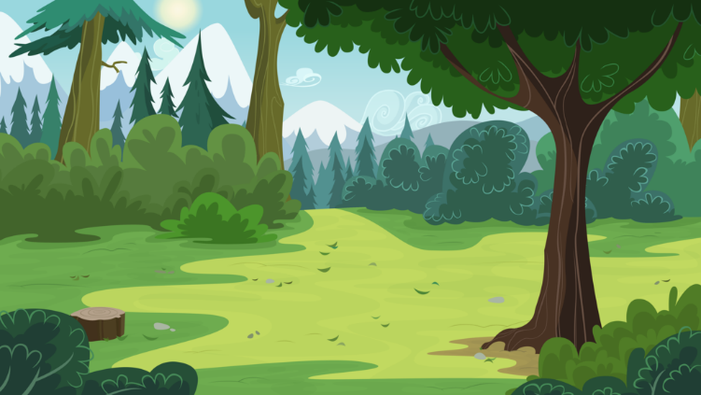

A friend in Need is
a friend Indeed

Slide 3
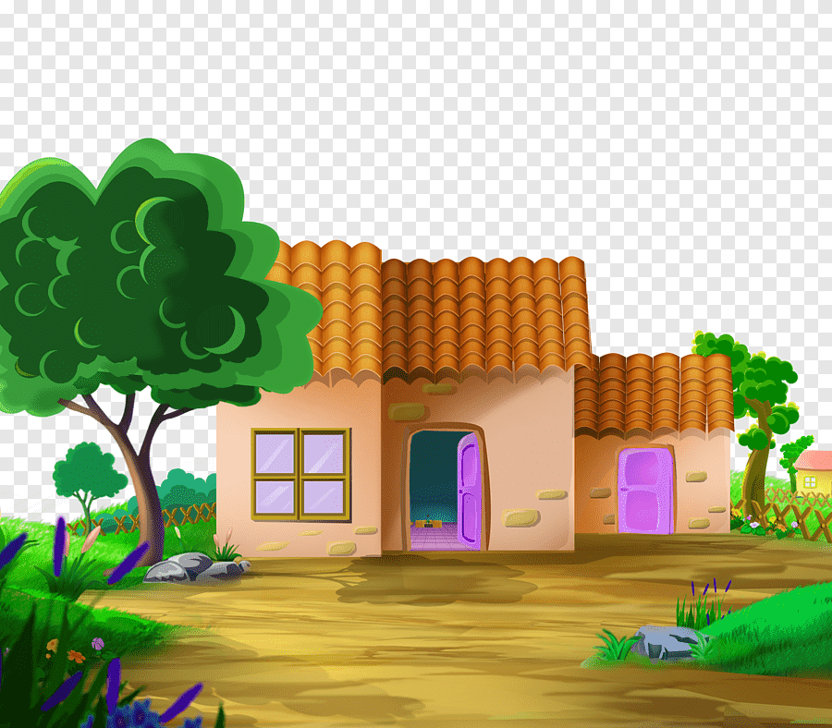
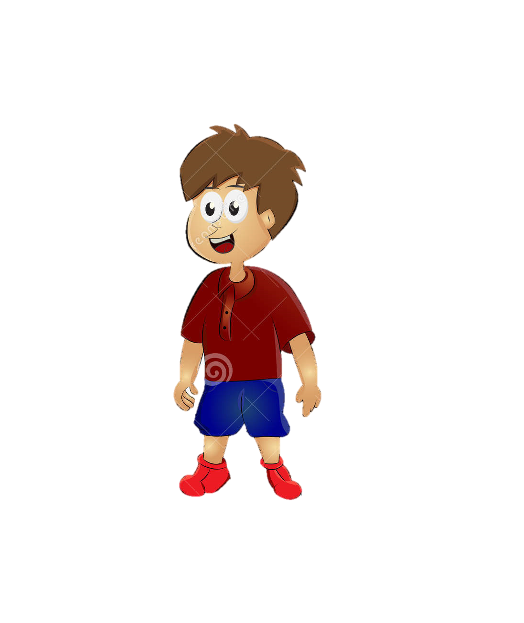
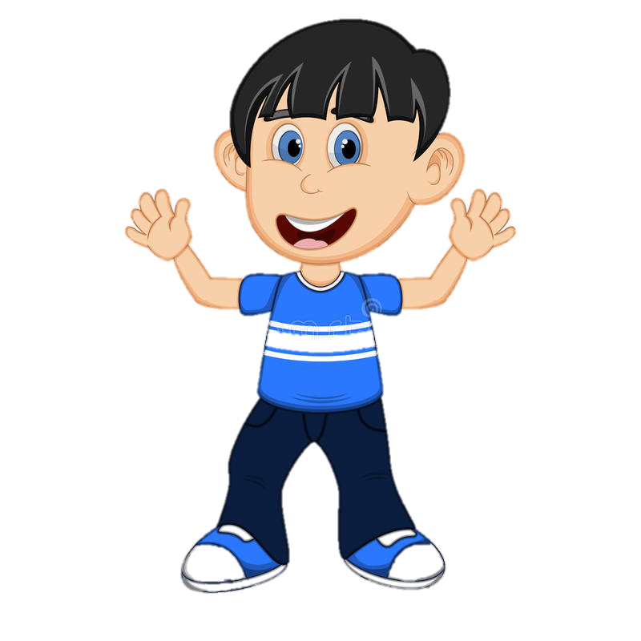
Come peter lets go outside.
Hey! Peter
Yes, Jack
What happen

Slide 4
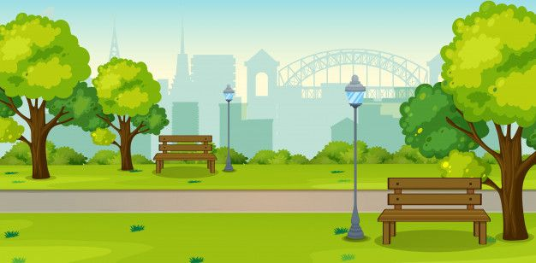
Peter I want to go to forest
Ok let’s go.

Slide 5

I am your best friend I will not leave u in any situation
What u can do for me peter?

Slide 6

Yeah! Hurry! Jack we finally came to forest.
Yes we finally come let’s play here.

Slide 7

Oooh No! We have to find a place to save ourselves.
OMG! A Bear.

Slide 8
Come with me.
Peter!!!! Why are u leaving me Alone.??

Slide 9
Bear Smells jack…..

Slide 10
Jack,What the bear said in your ear.??
The Bear said never trust a selfish friend.

Slide 11
THE END
The moral of this story is.
A FRIEND IN NEED IS A FRIEND INDEED.

