Slide 1
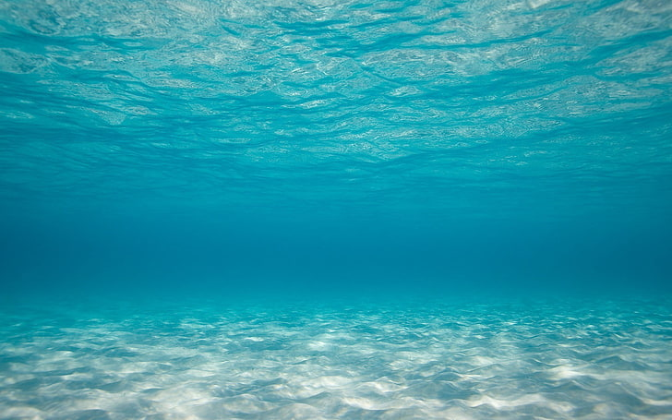
Quiz
Game
Start

Slide 2

Find sum 37+49 =
86
85
82
88

Slide 3

Next Question

Slide 4
The capital city of Pakistan is:
Lahore
Islamabad
Karachi
Gujranwala

Slide 5
Next Question

Slide 6
The currency of Pakistan is:
Rupees
Dollars
Pounds
Euros

Slide 7
Next Question

Slide 8
The Prime Minister of Pakistan is:
NAWAZ SHARIF
BADAR RASHEED
IMRAN KHAN
MARYAM NAWAZ

Slide 9
Next Question

Slide 10
25% of 60 is:
17
15
14
16

Slide 11
Next Question

Slide 12


Slide 13
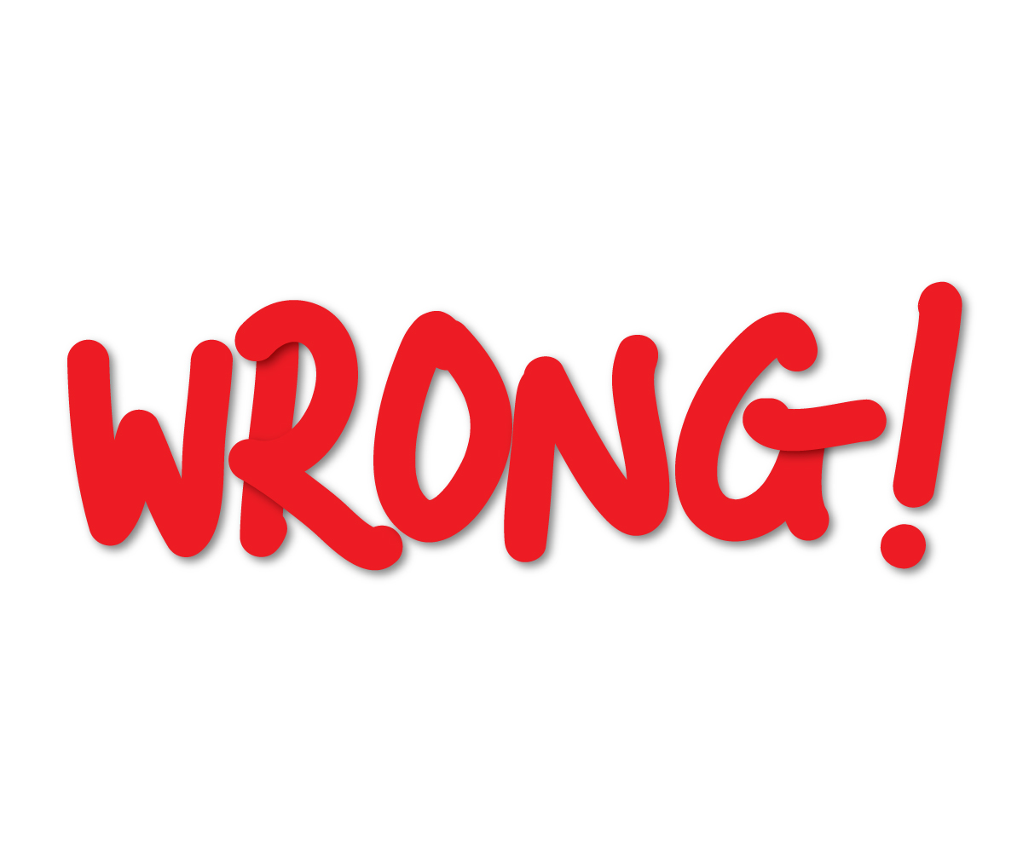
Retry

Slide 14


