Slide 1

211370113
BADAR RASHEED
Quiz_Game

Slide 2
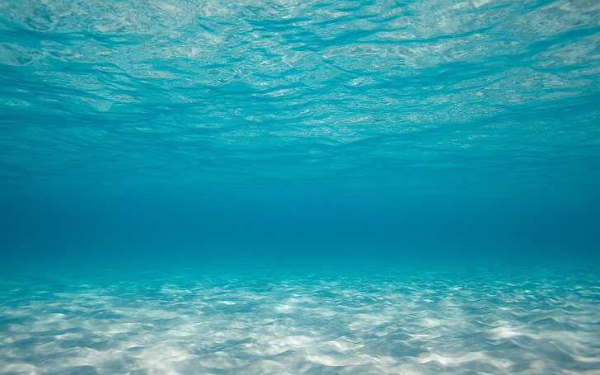
Quiz
Game
Start

Slide 3
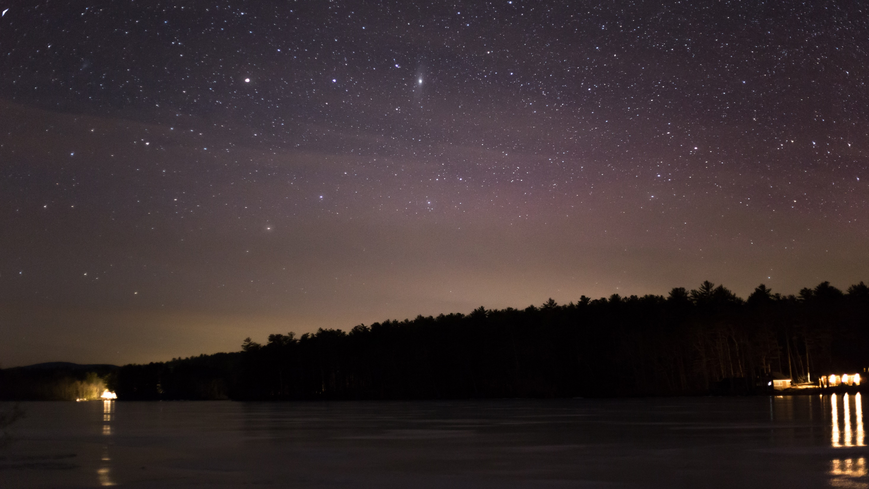
Find sum 37+49 =
86
85
82
88

Slide 4


Next Question

Slide 5
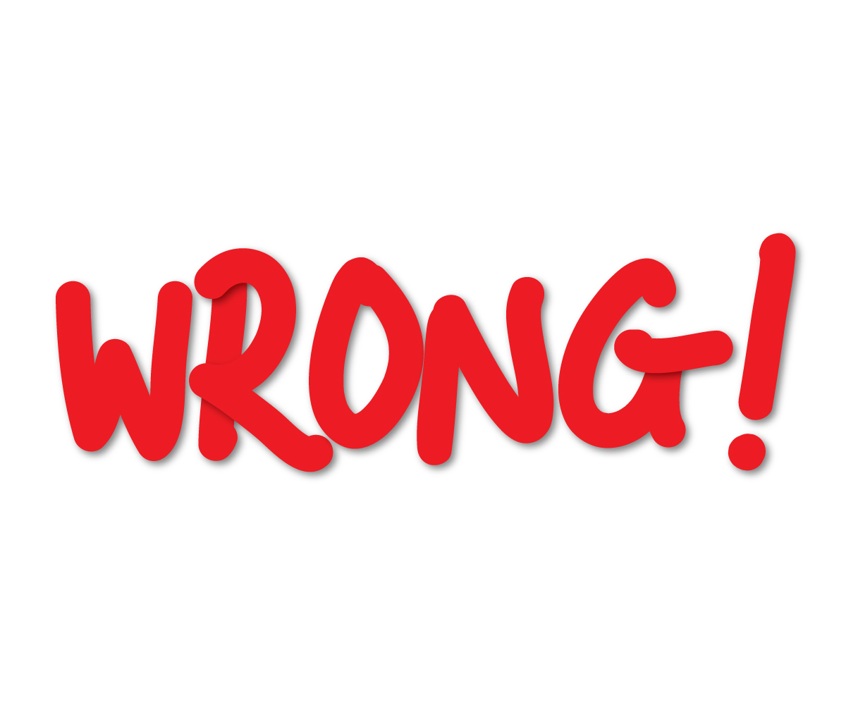
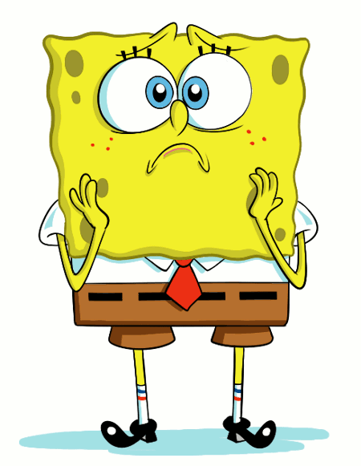
Retry

Slide 6
The capital city of Pakistan is:
Lahore
Islamabad
Karachi
Gujranwala

Slide 7
Next Question

Slide 8
Retry

Slide 9
The currency of Pakistan is:
Rupees
Dollars
Pounds
Euros

Slide 10
Next Question

Slide 11
Retry

Slide 12
The Prime Minister of Pakistan is:
NAWAZ SHARIF
BADAR RASHEED
IMRAN KHAN
MARYAM NAWAZ

Slide 13
Next Question

Slide 14
Retry

Slide 15
25% of 60 is:
17
15
14
16

Slide 16
Next Question

Slide 17
Retry

Slide 18


Slide 19


