Slide 1
ANTI-GRAVITY

Slide 2
Submitted to:
Dr.Nameeqa Firdous
Presented By:
BADAR RASHEED
211370113

Slide 3
Content:
What Is antigravity?
Theories
Applications
What if we could create anti-gravity?
Conclusion

Slide 4
What is Anti-Gravity?
“Anti-gravity is an idea of creating a place or object that is free from the force of gravity.”

Slide 5
Explanation:
Antigravity is not something where you do not feel the force of gravity but to balancing the force of gravity with some other force such as electromagnetism or aerodynamic lift.

Slide 6
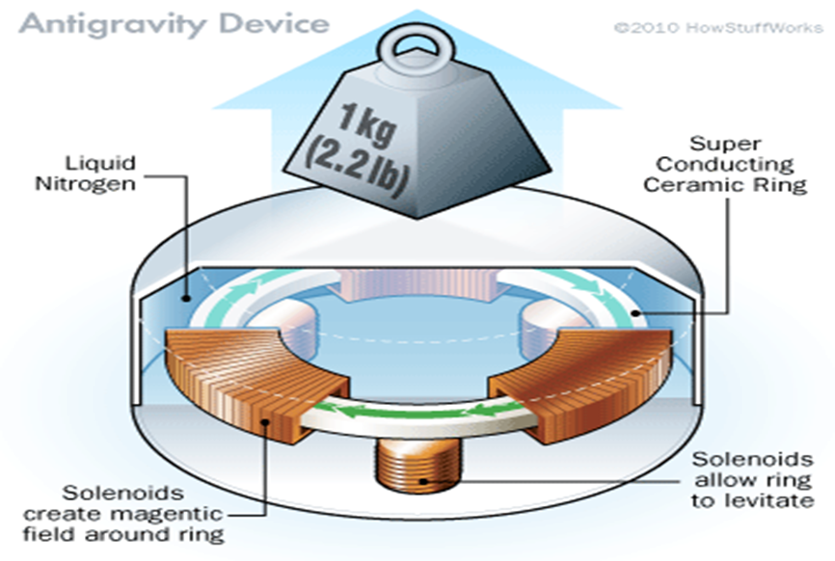
Anti-gravity device

Slide 7
NASA antigravity machine:
Quantum Levitation is another way to succeed in Anti-Gravity.
Quantum levitation as it is called is a process where scientists use the properties of quantum physics to levitate an object (specifically, a superconductor) over a magnetic source.
The reason this works is something called the Meissner Effect and Magnetic flux pinning.

Slide 8
NASA researchers hope to conduct an experiment that could determine if the force of gravity might someday be adjusted, like the volume of a radio.
In 1992, Dr. Eugene published the results of his experiment with high temperature ceramic superconductors.
He devised an experiment in which a disc of superconducting material was magnetically levitated and rotated at high speed, up to several thousand rpm, in the presence of an external magnetic field.

Slide 9
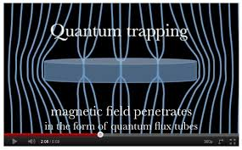
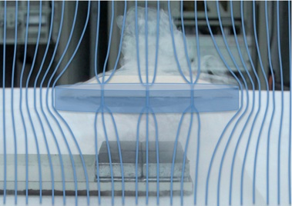

Slide 10
Applications:
Cheap energy can be produced without burning any fossil fuels.
Antigravity is a very powerful weapon. It can destroy the missiles or remove them from their trajectory. So the interest for military people will be definitely big.
Moving heavy objects will be made simple, any heavy object can easily be moved with antigravity technology applied to it.
Antigravity technology would revolutionize space exploration and energy production.

Slide 11
What if we could create Anti-Gravity?
It could lead us to a scientific or technological revolution.
We could make a lot of stuff float in air.
We could built floating cities to accommodate our ever expanding population. Massive structures could be suspended over bodies of water which we wouldn’t otherwise be able to built.

Slide 12


Slide 13
Conclusion:
With the help of anti-gravity we can easily explore the solar system.
Antigravity will be an addition of a very decent luxury in Human life.

Slide 14


