Slide 1
Lottery Drawings Billie Adkins

Slide 2
Audience I’m wanting to reach lottery enthusiasts that are looking for the best game to play and when to play it. They will be familiar with lottery number drawings and the use of multipliers to enhance the jackpot winnings. Plan The purpose of this is to generate excitement with lottery players to show that they can win and that there are patterns that can be found in the seemingly randomness of winnings.
Medium/Design Choices
PowerPoint is used to show the graphs created with Tableau. Most color choices were chosen from the Tableau 20 color palette since it seemed less harsh of contrasts between colors while also providing enough contrast that colors are distinguishable between each other for those with color blindness. I chose to use size, color, and mark labels on several charts to highlight areas that are more prominent in influencing our story.

Slide 3
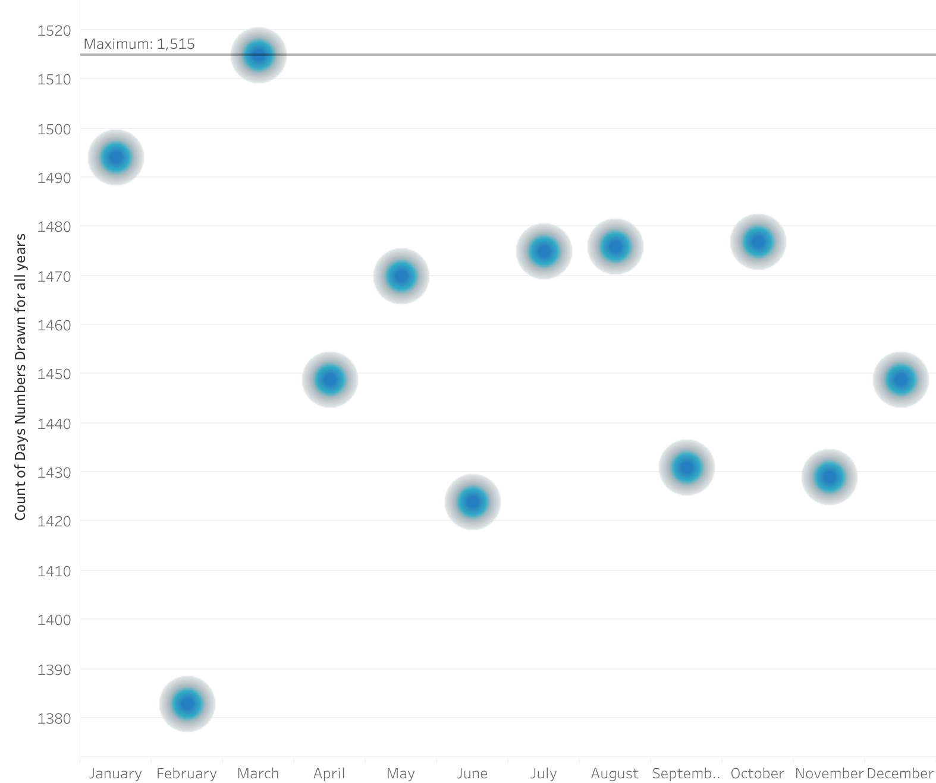
March has the highest total drawings across all years for all games combined

Slide 4
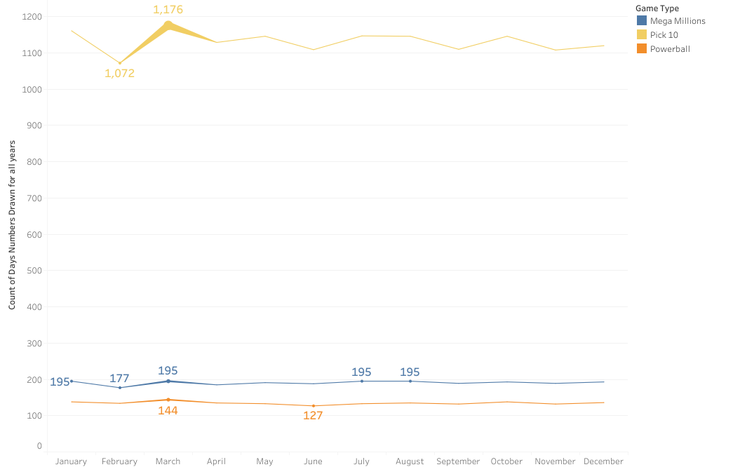
By showing the minimum and maximum counts, we see that March is still the month with the most drawings for each of the games

Slide 5
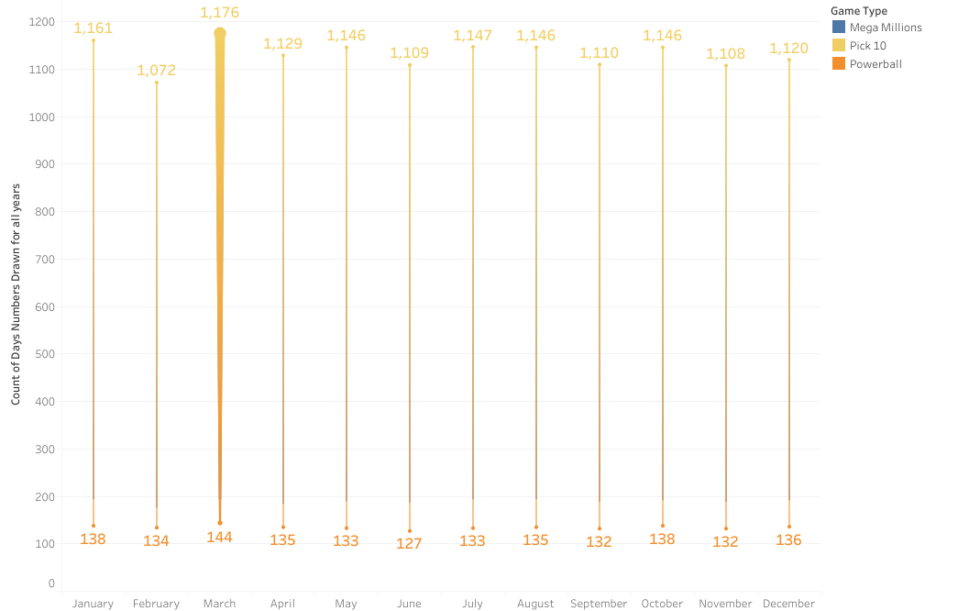
The total number of days that had a lottery drawing in March throughout the years range from 144 to 1,176

Slide 6
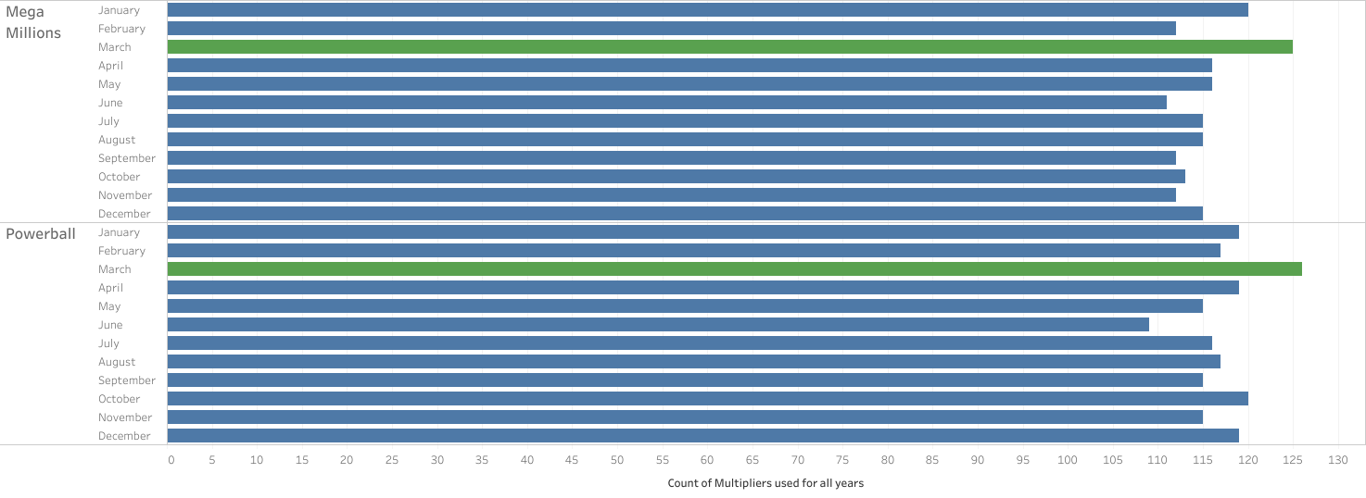
The number of multipliers drawn are highest in March across games only with multipliers

Slide 7
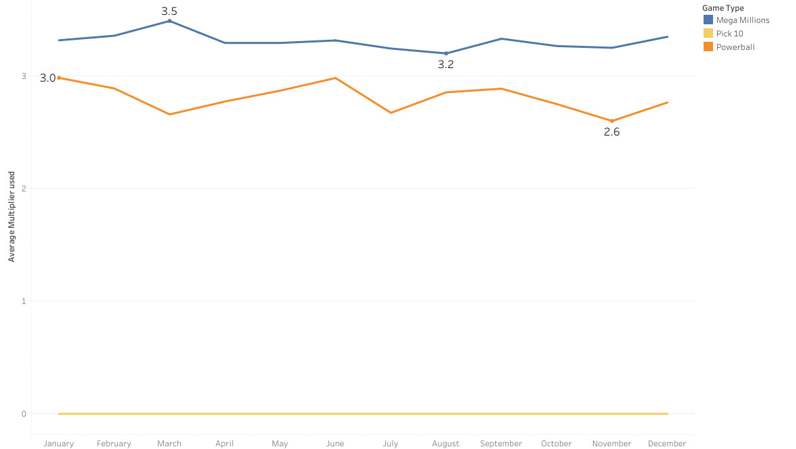
Mega Millions consistently has the highest average multiplier out of the games, and it peaks in March at 3.5

Slide 8
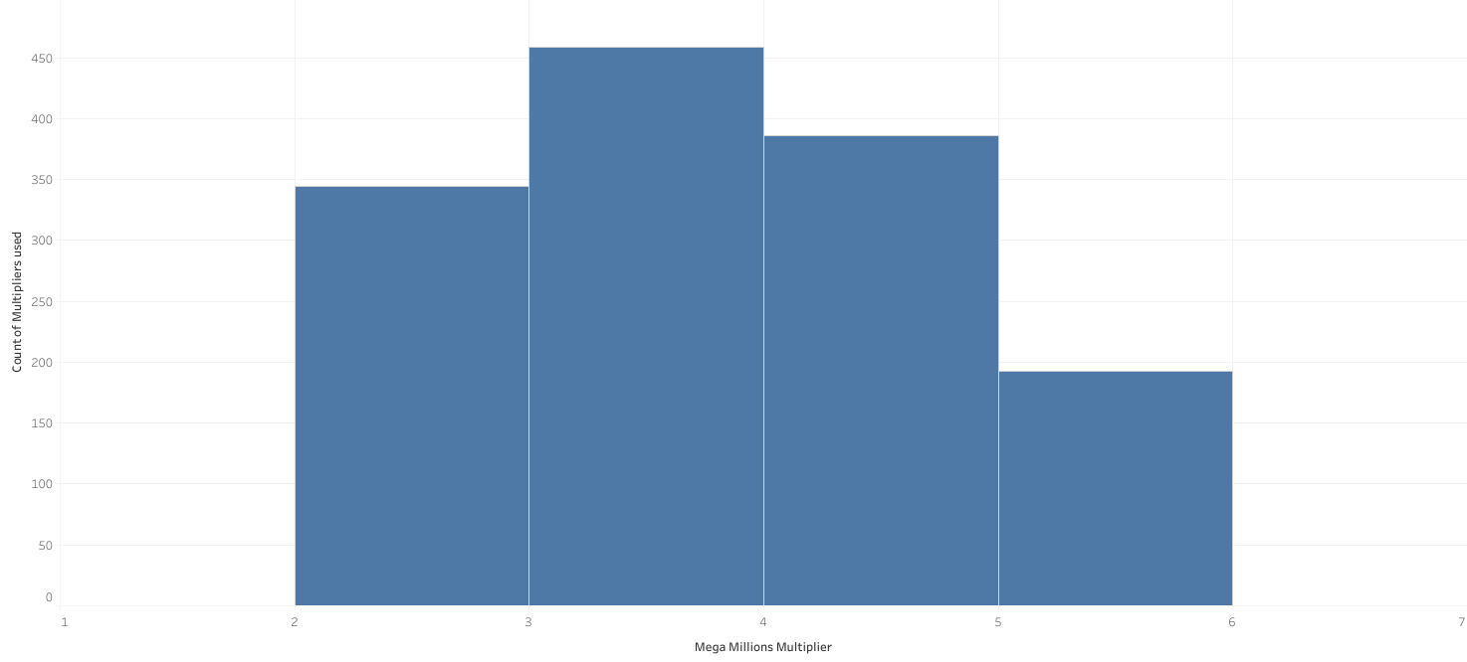
Mega Millions multipliers can range from 2x to 5x

Slide 9
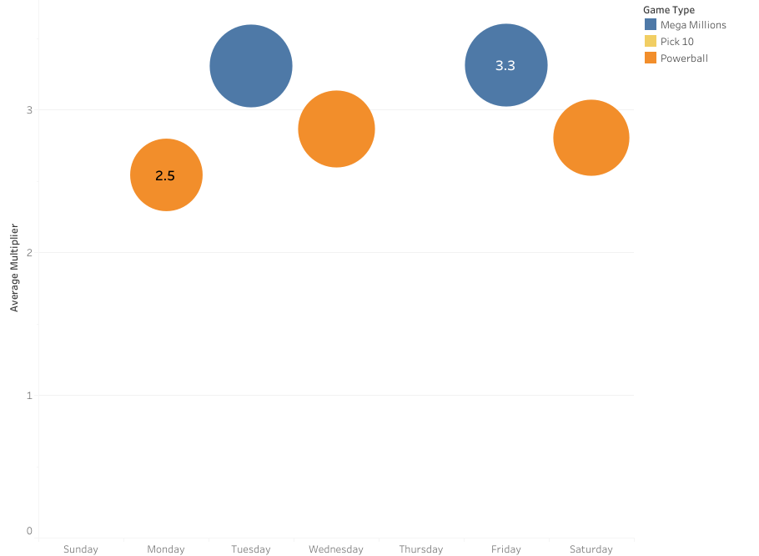
Mega Millions on Friday has the highest average multiplier at 3.3

