Slide 1
Call Escalation Detection
Call Centers
Notes:
Contact centers are designed to handle customer inquiries and issues in an efficient manner. Time is money so every second on a call may be a cost to the company. Of course, servicing customers in a positive way can impact business and produce benefits also.

Slide 2
Project Overview
Downloaded JSON files from Hugging face
Retrieved data
Selected valid records from JSON files
Preprocessed/Transformed data
Labeled records with binary escalation indicator
Pretrained model to transform sentences into vectors
Oversampled from minority class (potential escalation)
Neural Net Classification Model
Multi-Layer Perceptron with dropout rate of 30%
Hypertuned to maximize recall
Results
Notes:
The goal of this project is to detect if calls are starting to show signs of needing to be transferred to another agent more skilled to handle escalated situations or highly complicated issues. Routing calls with real potential for escalation is critical to maintain customer service quality and mediate issues before they advance.

Slide 3
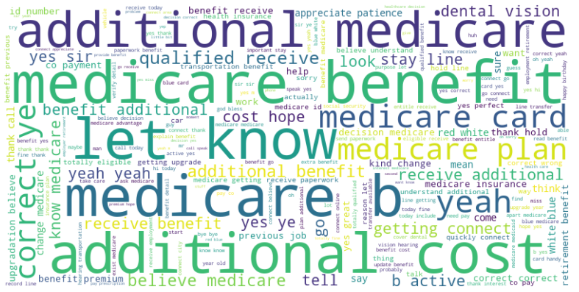
Notes:
What if we could predict when a call has potential for escalating? Imagine as a customer that may need extra attention or has an atypical issue but are routed through varying general agents. Their satisfaction with your customer service and therefore product decreases and their mood begins to shift negatively. We can see by these common phrases associated with escalated calls that we can identify the calls in need of higher skilled agents.

Slide 4
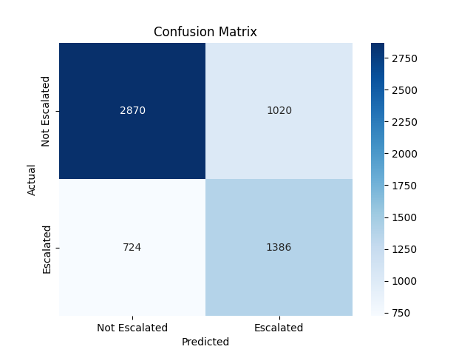
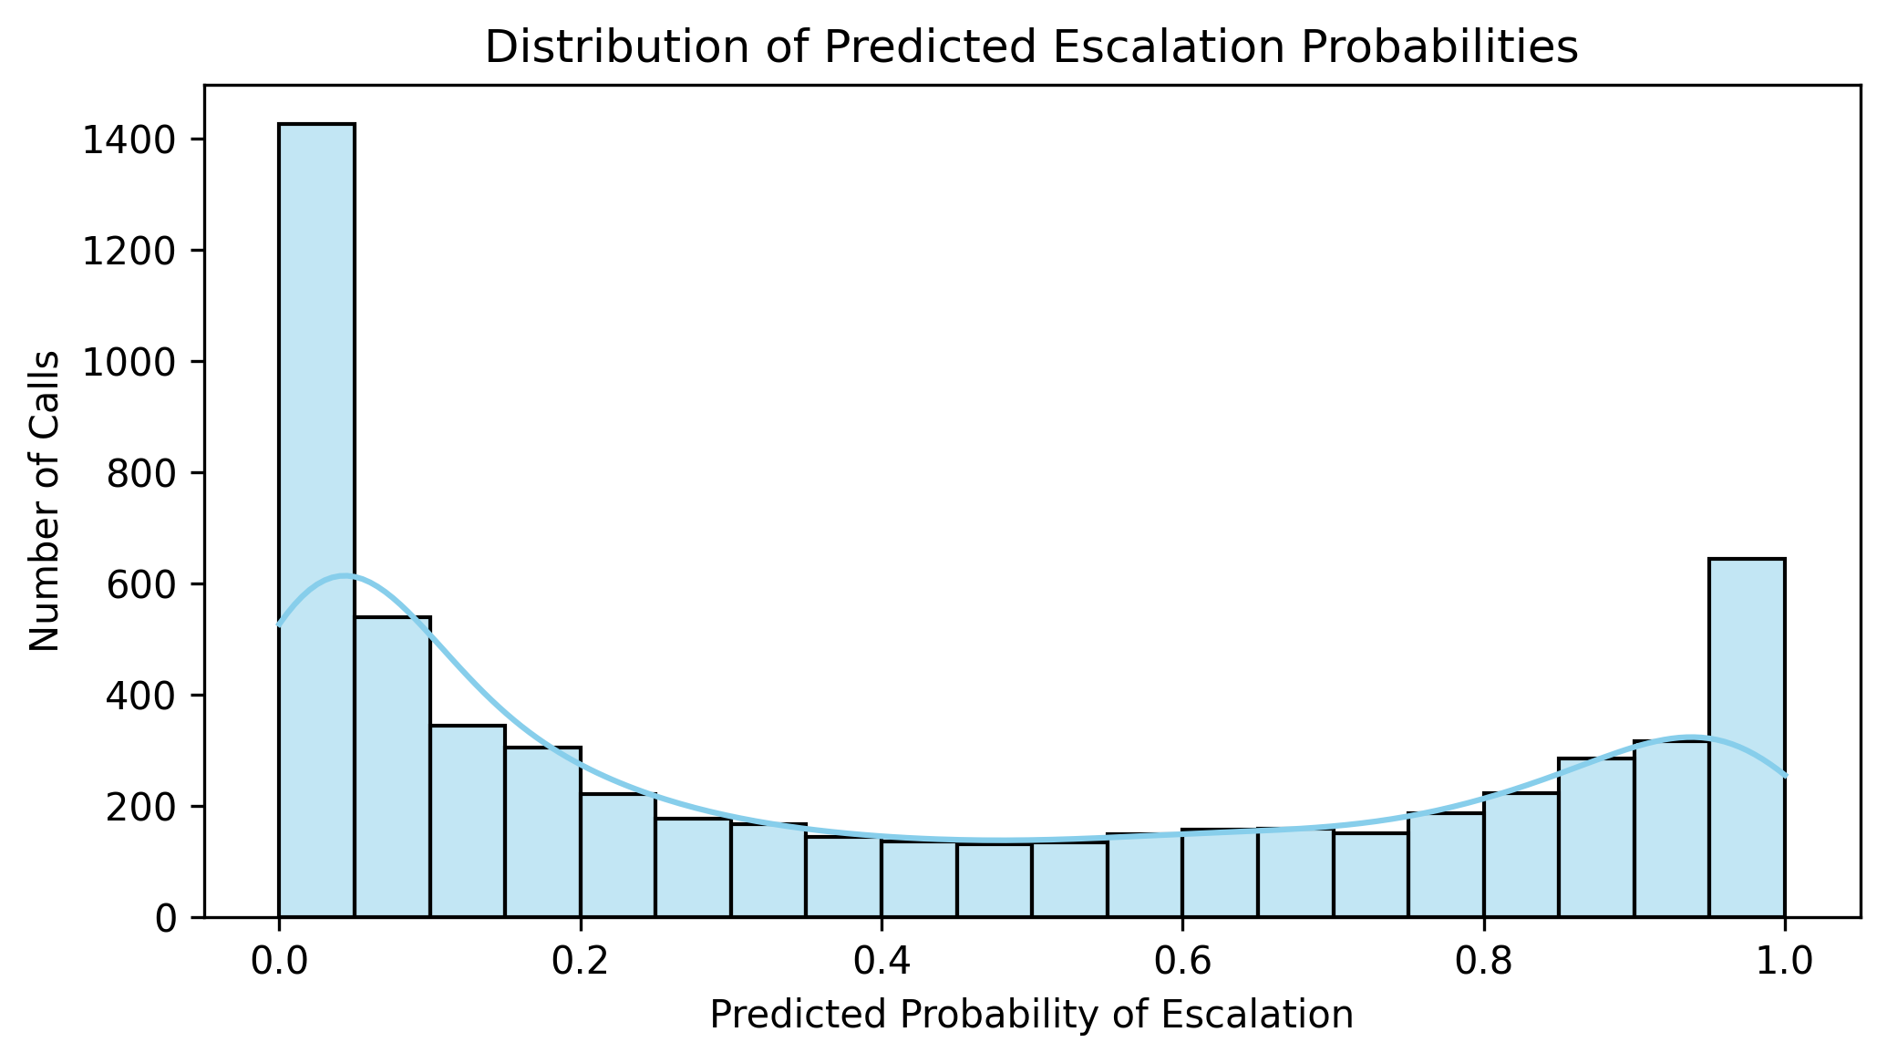
Notes:
The natural language processing of the data transforms the call transcripts based on the sentences meaning rather than just looking for keywords. We used a pretrained model on the 14,000 call transcript records. It used those records to learn the linguistic patterns behind the labeled escalation records so that it could use that knowledge when running a model on real data to predict potential escalation.

Slide 5
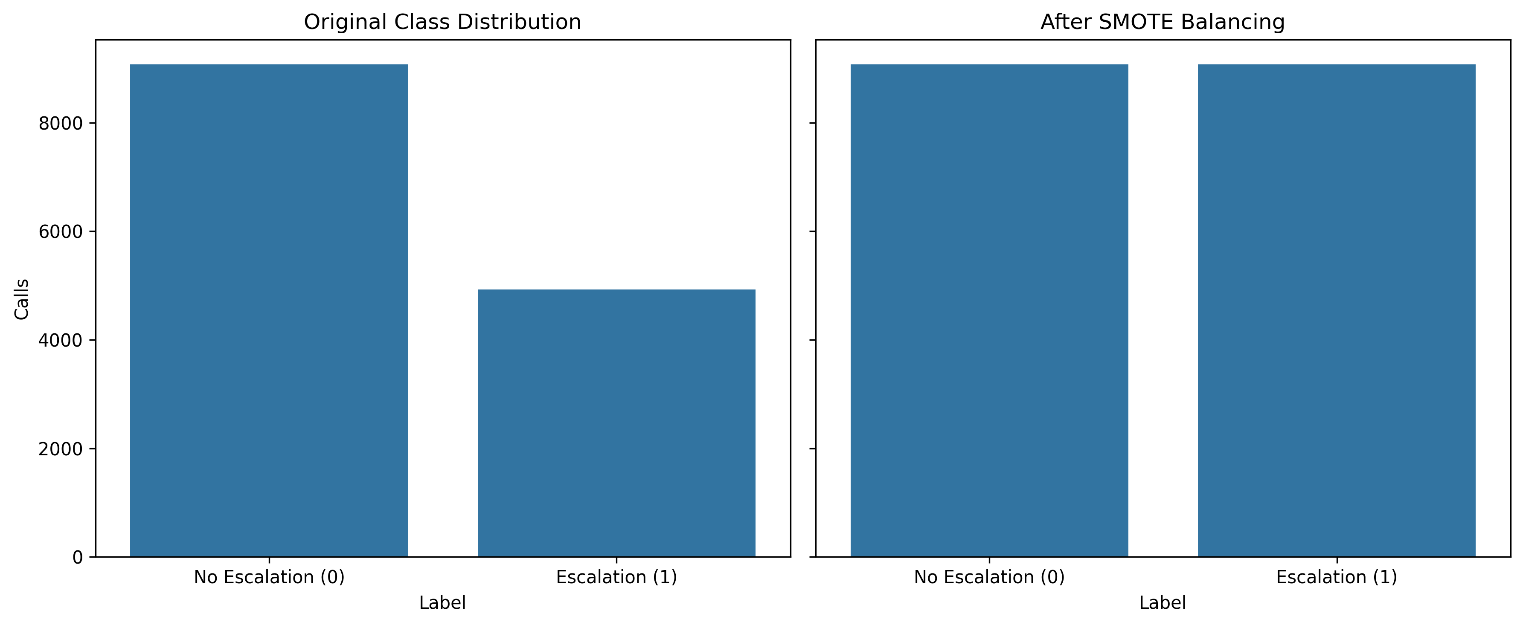
Notes:
Since there was a class imbalance between typical calls and escalation potential calls, I oversampled from the escalation calls using SMOTE (which stands for the Synthetic Minority Oversampling Technique) to bring the data in balance. Balanced data allows for the training and modeling process to be better able to predict patterns rather than leaving it without many escalated calls to learn from.

Slide 6
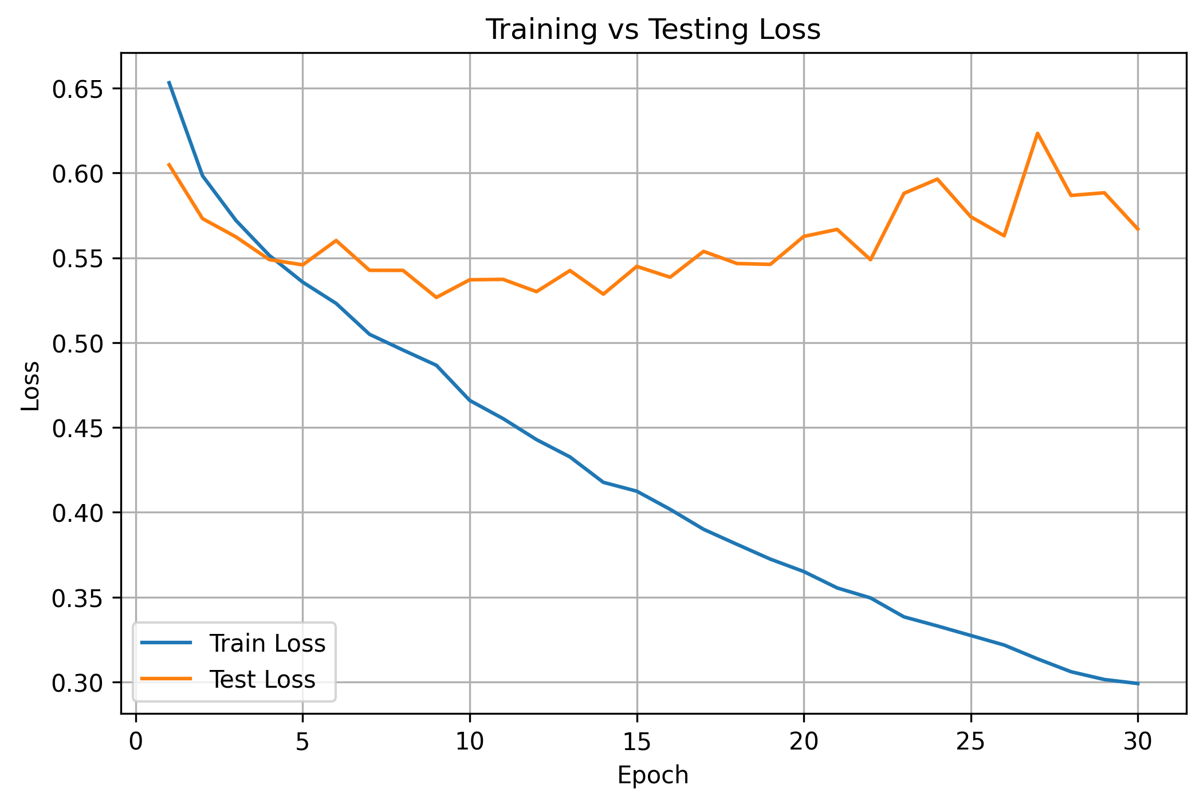
Notes:
We used 30 epochs to train the neural network classifier to capture the true training behavior and expose any propensity to overfitting. This allows us to know that even though the testing loss appears to even out around 5-6 epochs (meaning that it is performing well but also not overfitting), we can see that if more training is needed, the model will continue to learn without overfitting. More training will happen if this is implemented and real call records are used to train the model.

Slide 7
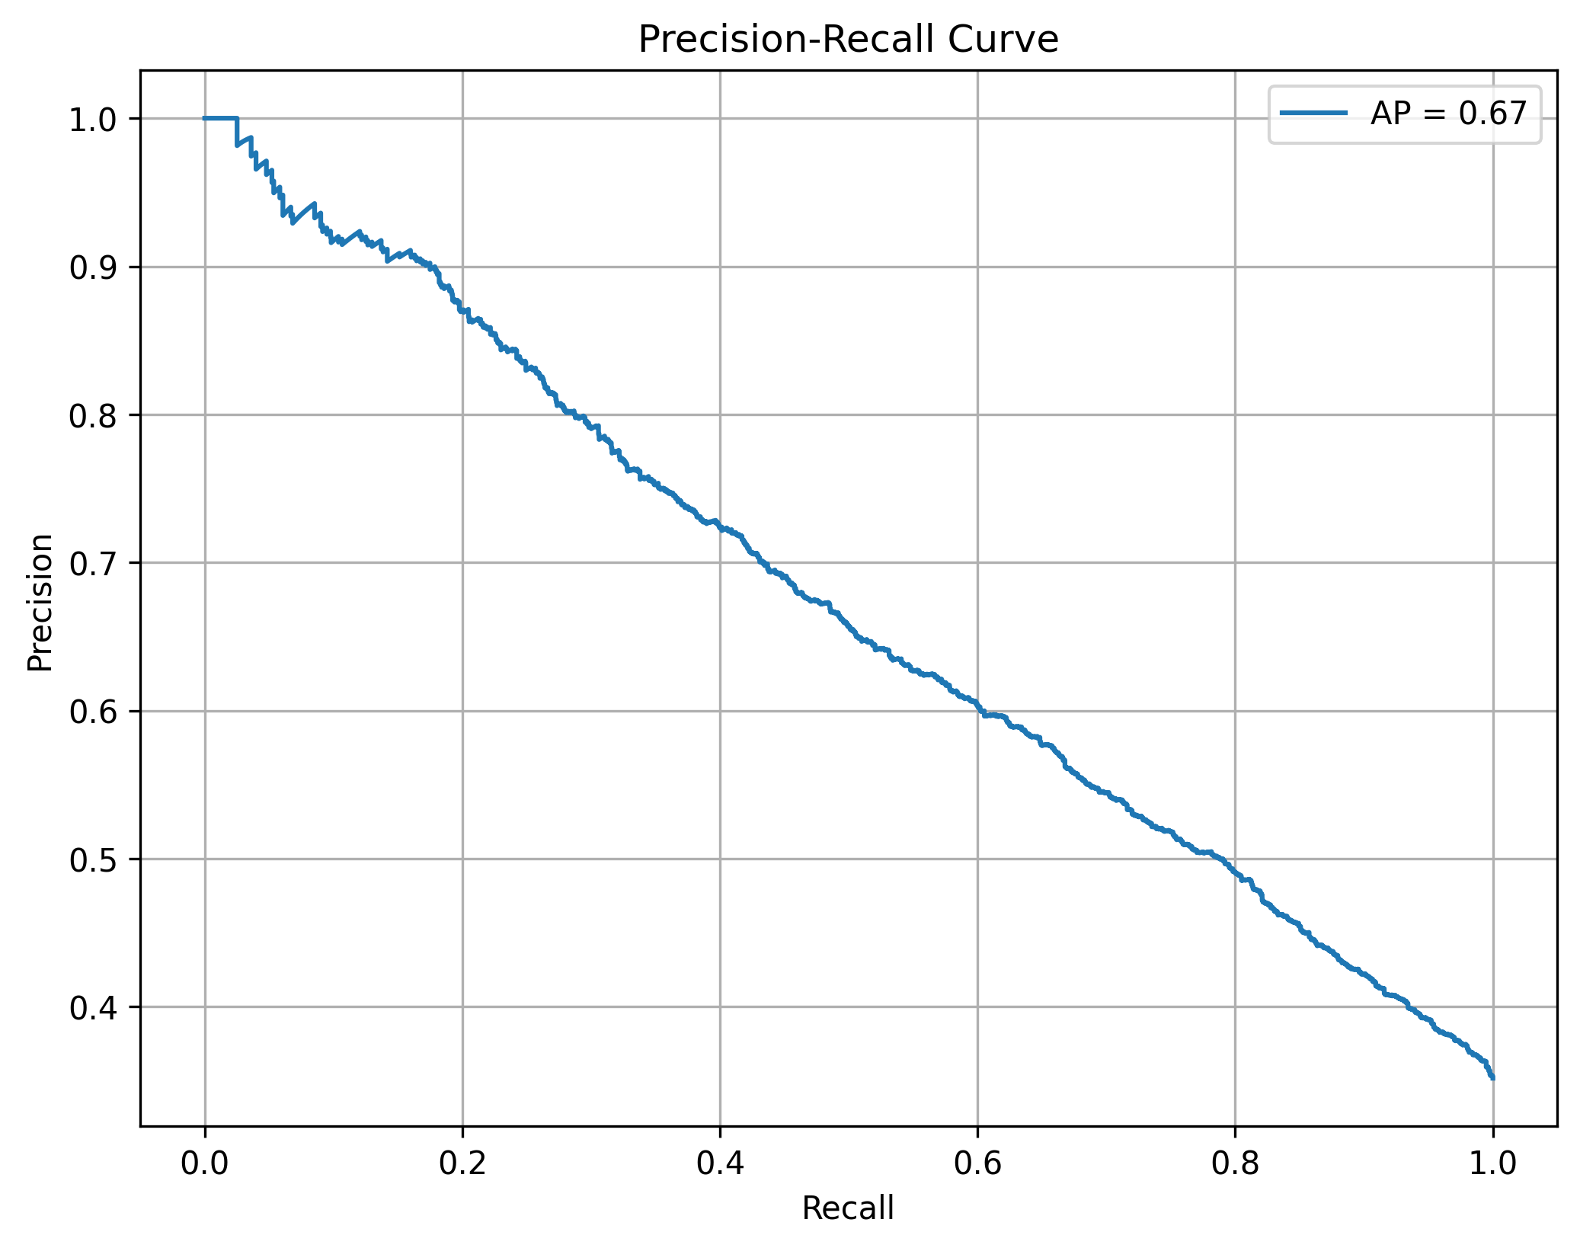
Notes:
The model is tuned to prioritizing capturing escalations at the cost of false positives to try to prevent customer dissatisfaction by getting to the appropriately skilled agents to handle their inquiries. This model is performing well with balancing recall with precision. It shows that as recall increases which is the identification of escalations), the precision or accuracy decreases. This is an expected trade-off when trying to ensure all calls with potential for escalation are flagged to be routed outside of the general agents.

Slide 8
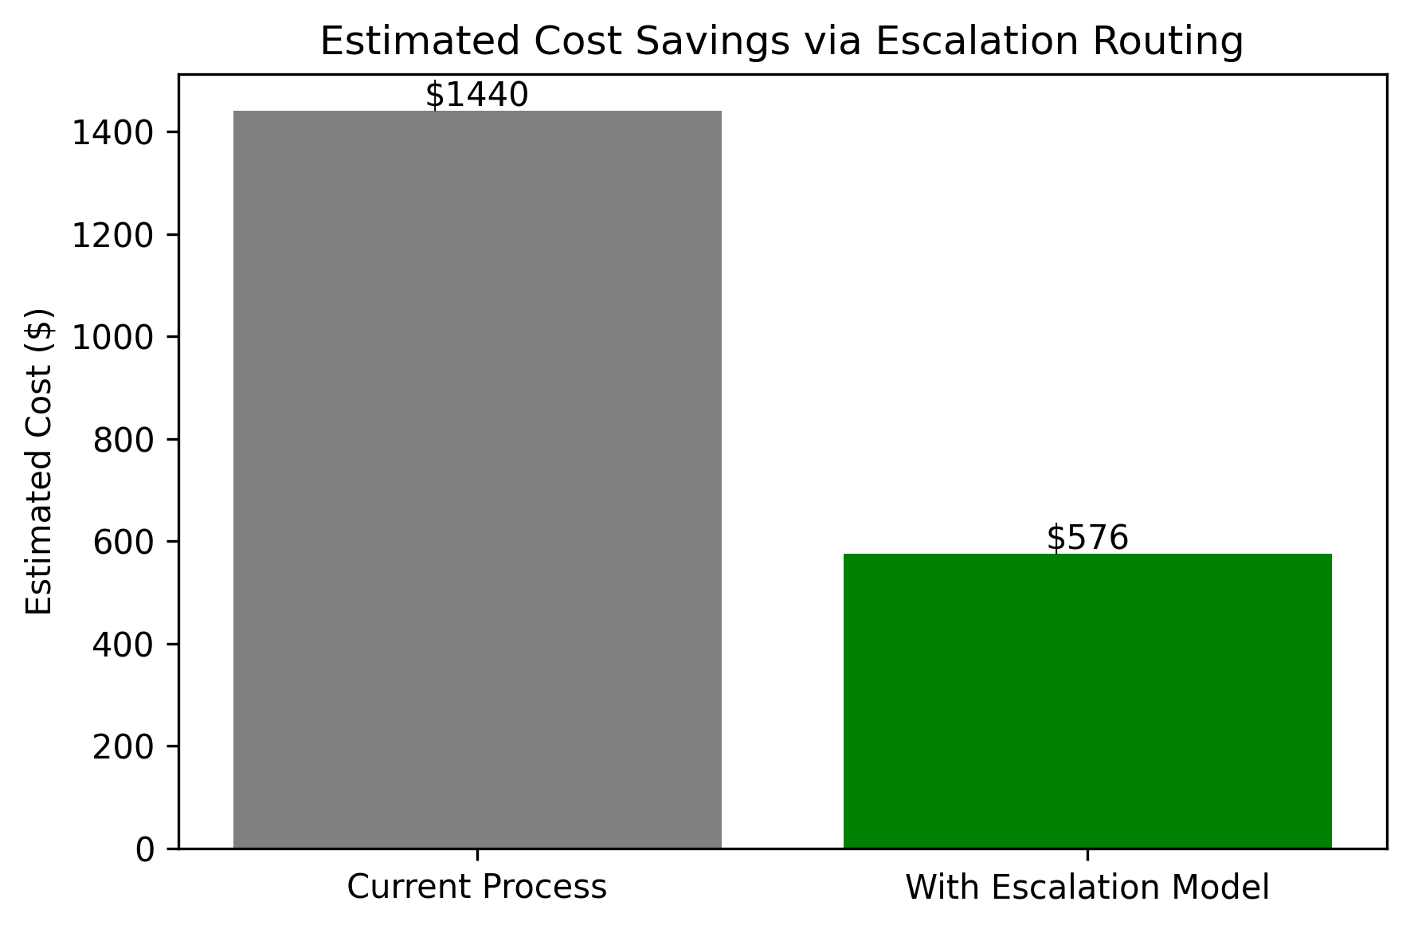
Notes:
We estimated the cost saving by taking the cost associated with each call in the current process. We then estimated the cost reduced by routing the call to an escalation area early. For example, if a call that gets escalated costs $20 but identifying it as a potential escalation and routing it to the escalation area early costs $8, then you have a $12 savings per call since it was correctly identified as escalation by the model. The chart is based on the data we used to test the model. These costs can be changed as defined by the finance department of business.

Slide 9
Anticipated Outcomes
Implement into call routing system
Proactively identify when calls are escalating
Trigger a signal to agents to prepare for assistance
Maintain customer satisfaction and brand reputation
Reduce risk by reduction in complaints received
Improve model results based on agent feedback
Notes:
This model could be used as part of your current call routing logic to enable it to identify escalation based on learned language patterns and trigger to the agent that a supervisor is available to assist. By addressing potential issues early in the conversation, it can help to keep the customer from reflecting negatively toward the brand and reduce the complaints received. The agents can then provide feedback on the signals received to improve the training of the model and prediction abilities.

Slide 10
Appendix
Anticipated Questions / Answers
How accurate is the model at identifying escalated calls? The model achieves a high recall for the escalated calls, meaning that it is correctly identifying most of them. This is critical for routing the sensitive calls to the higher skilled agents.
How does the model know if the call is a potential for escalation? It uses patterns in the data to predict potential escalation. The patterns are learned from thousands of transcripts and can be refined based on feedback, if implemented.
What’s the benefit to this system compared to our current call routing process? Proactive instead of reactive identification of escalating calls. Reduced resolution times, customer satisfaction improvements, and reduced risk from complaints.
Can this model reduce costs? This model can help reduce call handling times which increases operational efficiency and staffing expenses.
What happens if the model makes a wrong prediction? We are proposing to set up a feedback loop from agents where their feedback can go into training the model to further refine the process and reduce false positives.

Slide 11
Appendix continued
Anticipated Questions / Answers Continued
How does the system handle that escalated calls are not common? I used SMOTE to oversample from the escalated calls population of the training data to have a more balanced dataset to train the model.
Does this model understand tone or strictly input keywords/patterns? Yes, the use of a natural language model can recognize context and meaning to identify escalation even if expressed with different keywords.
Can this be adapted to different call types or functions? Definitely. This model was created using transcripts from varying call center domains.
What kind of support will this system require? Periodic monitoring of model performance and possible hyper tuning as new call records and feedback is added to training model.
When are you available to discuss implementing this model for our call center? Immediately. Thank you for your interest. Let's discuss.

Slide 12
Appendix continued
Escalated Call Prediction Code in Github Repository
Click paper to review White Paper for Project

