Slide 1

Kia Thefts
Billie Adkins

Slide 2
Narrative Audience Community, as a whole, to promote awareness about rise in car thefts, and more specifically Kia and Hyundai owners or potential owners. Audience is already aware of social media trend and news regarding Kia thefts. Plan To show that although Kia and Hyundai thefts are a small portion of the overall car thefts, they are drastically on the rise. This presentation to the community is to also encourage owners to get anti-theft devices that are offered by the manufacturers and to allow for potential buyers to have full picture about where the thefts are most prominently occurring.
Medium
Powerpoint is used to show the graphs created with R in Rstudio.

Slide 3

Watch out for car thefts!!!

Slide 4
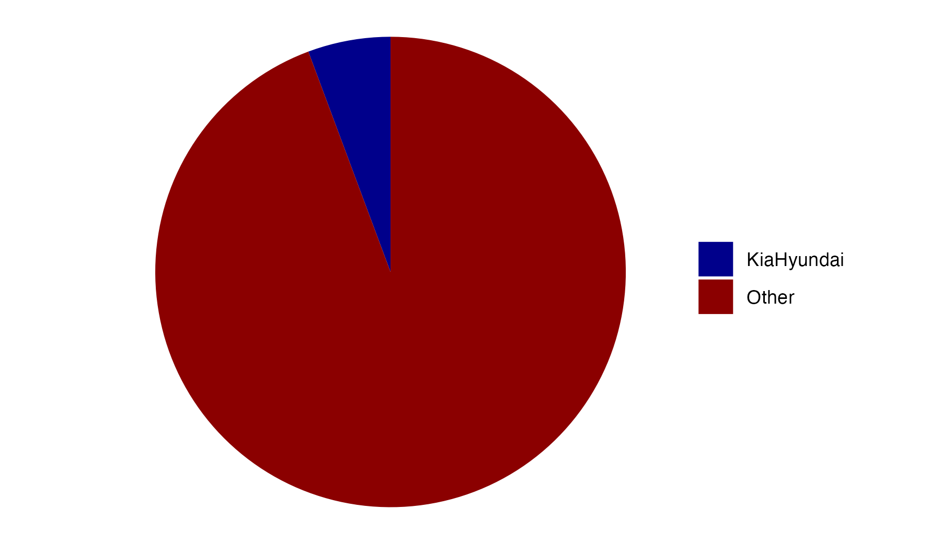

Slide 5
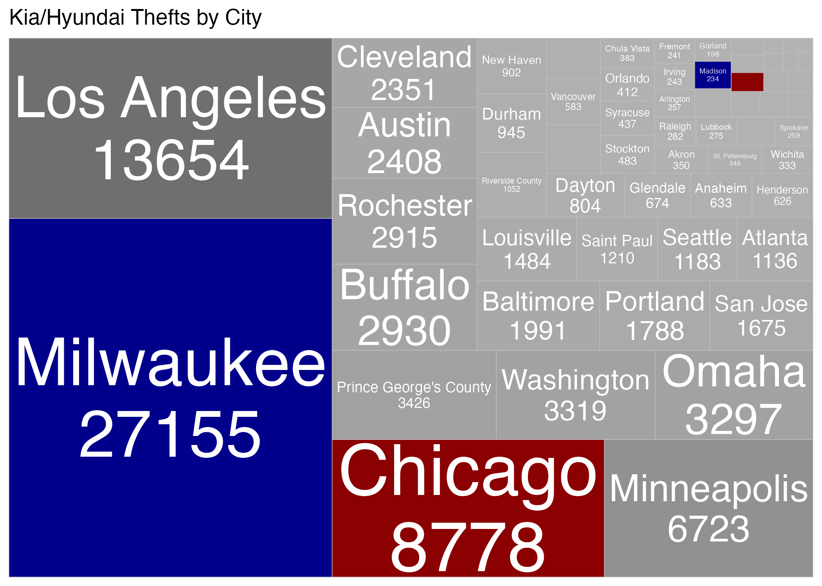

Slide 6
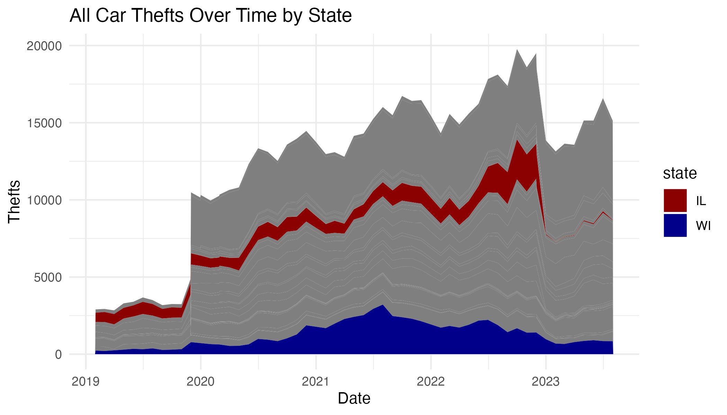

Slide 7
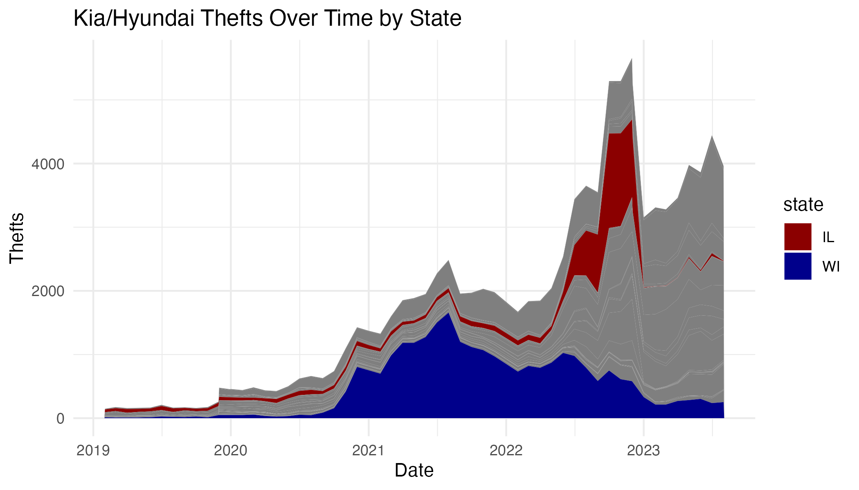

Slide 8
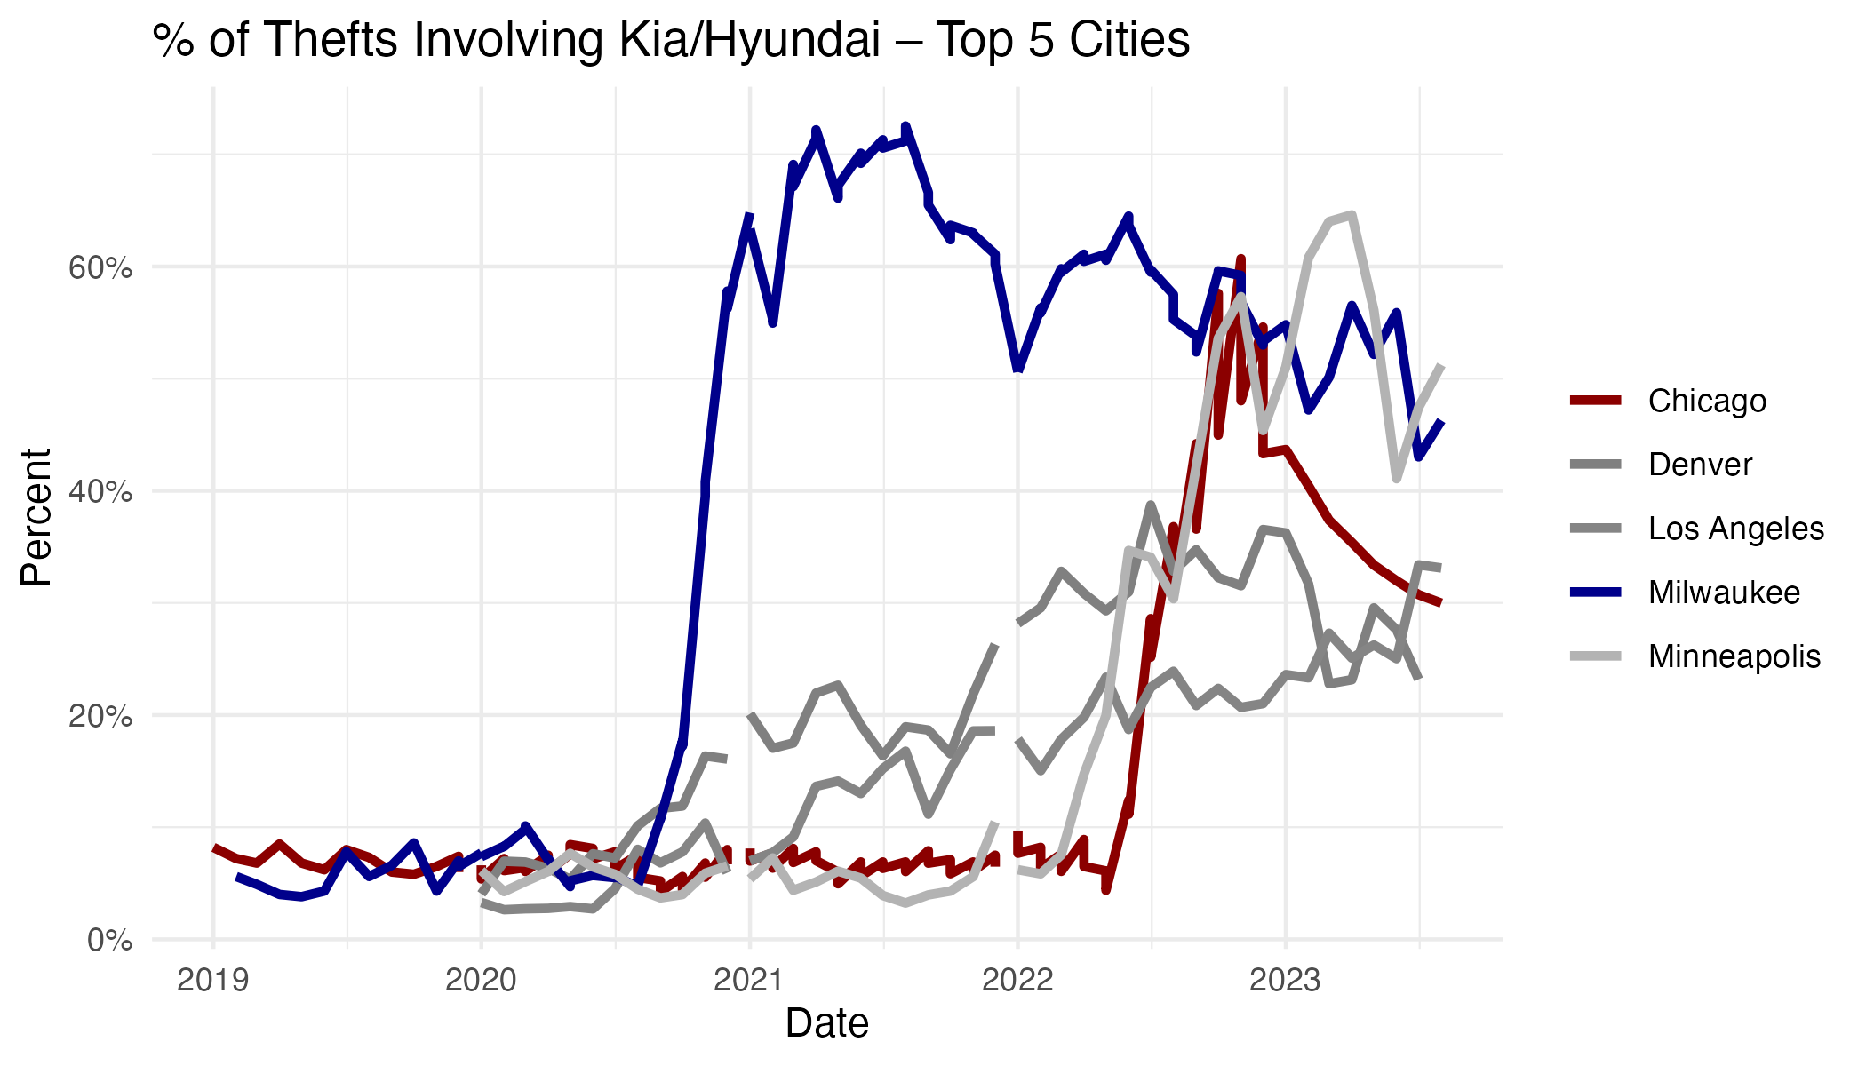

Slide 9
