Slide 1
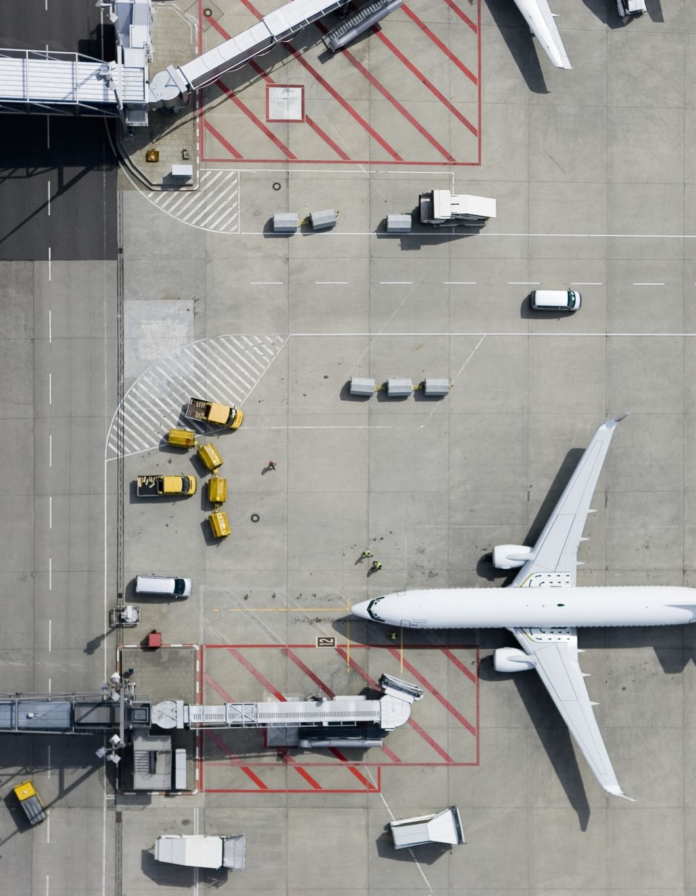
TSA Complaints
Billie Adkins

Slide 2
Audience
The audience will be TSA leadership. They will be familiar with the complaint process and tracking and understand the costs and risks associated with customer complaints. Since complaints can range from customer service to safety issues, the associated costs of not addressing the underlying causes can become substantial. Plan
The purpose of this data analysis was to identify where complaints are prevalent so that attention can be diverted to those airports or regions. Further analysis would need to be completed to dive in deeper to determine the type of changes that could help improve customer service, safety, or the indicated issues. Changes may include different training resources, staffing increases, varying employee motivation techniques, or other options. This presentation is to engage the audience to take note of the airports in need as based on the current complaints analysis and agree to engaging our company for further analysis.
Medium/Design Choices
PowerPoint is used to show the graphs created with Python. I used a Viridis theme, when possible, to allow for ease of use for color-blind users and because colors show enough of a contrast to make a distinguishing impact to the visual. I chose a blue theme when pairing the heatmap with the image of traveler’s items which included denim. I chose to put an image of an airplane soaring off in the chart showing the drastic difference in the highest complaint categories. I used the box plot to highlight the differences between the monthly complaints in the top 3 airports in each of the top 3 complaint categories. The radar chart was chosen since our audience is leadership with the airlines. I thought this was a good chart to show that we can delve into even the subcategories of complaints to make further and more refined recommendations.

Slide 3
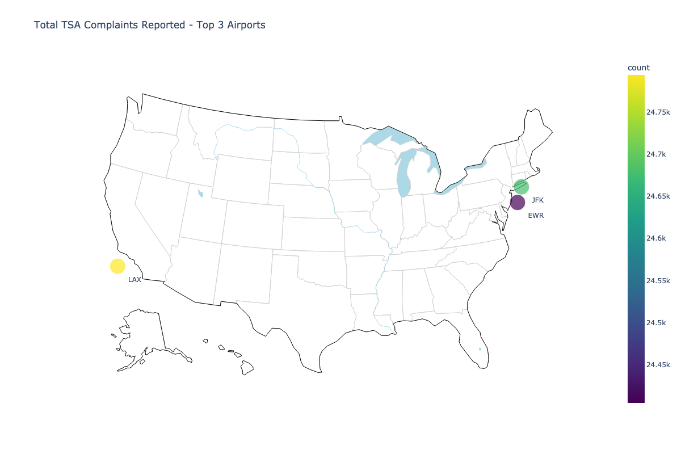
TSA Complaint data has been tracked since 2015 LAX has the highest complaints received followed by JFK and then Newark International

Slide 4

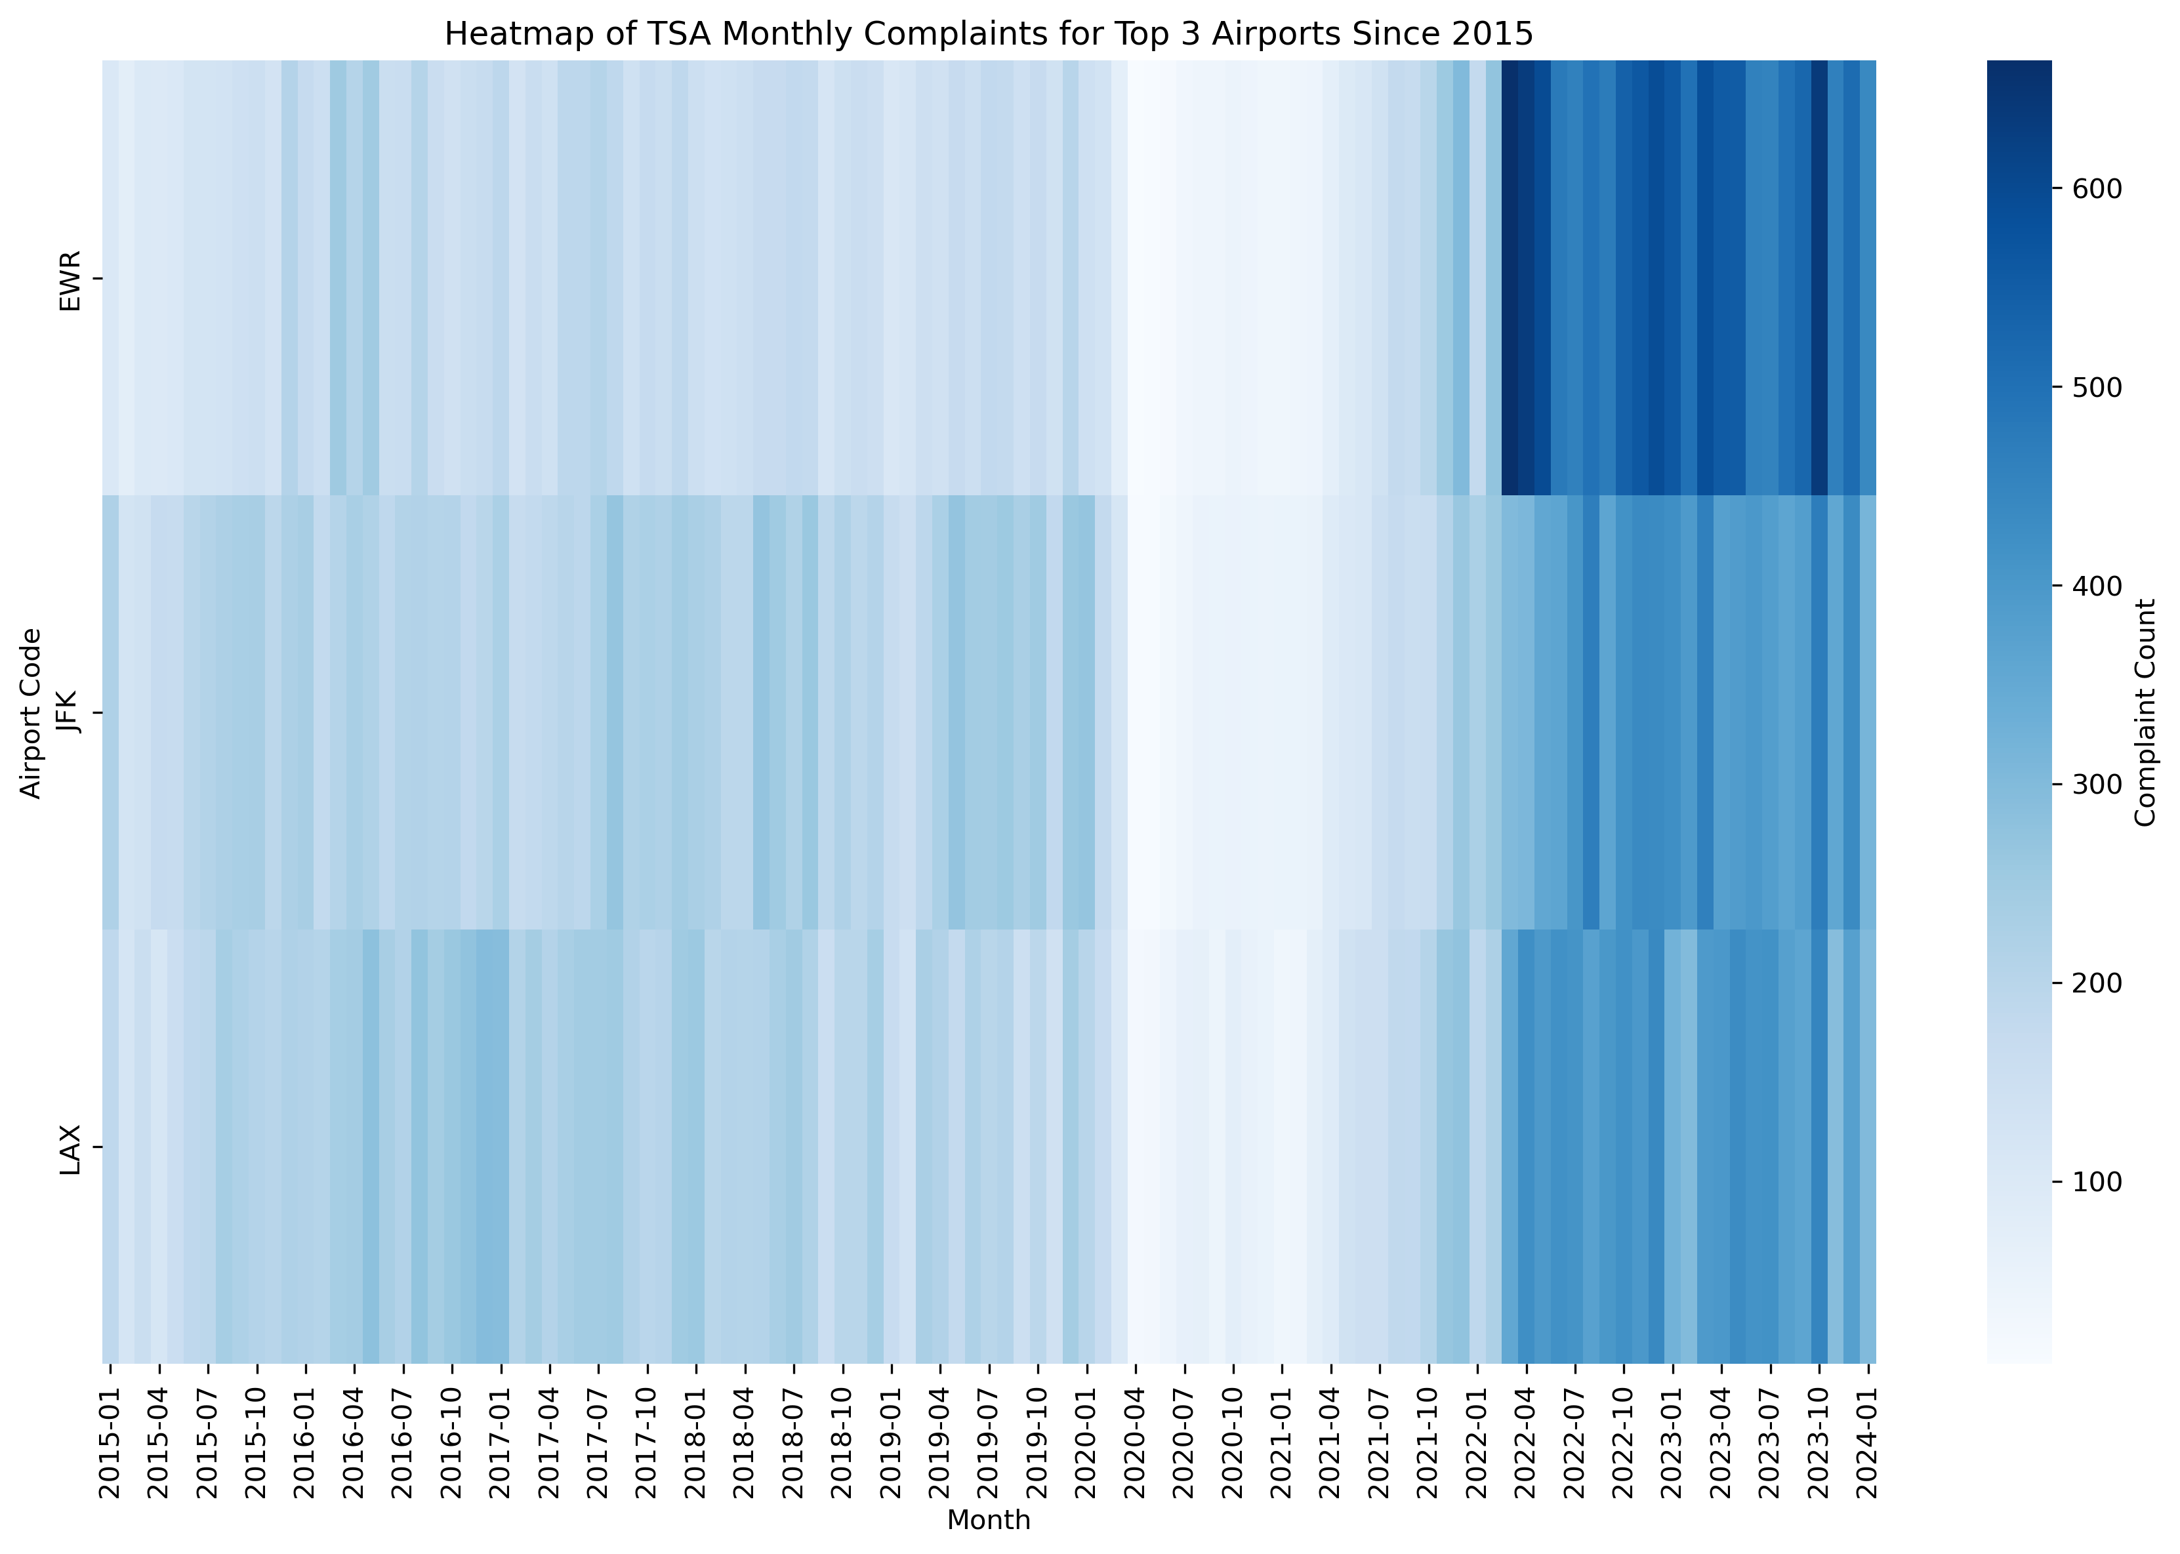
The heatmap shows the top 3 airports based on complaints over time We can see that most complaints are concentrated since 2022 and do not appear to be tracked throughout the covid pandemic period

Slide 5
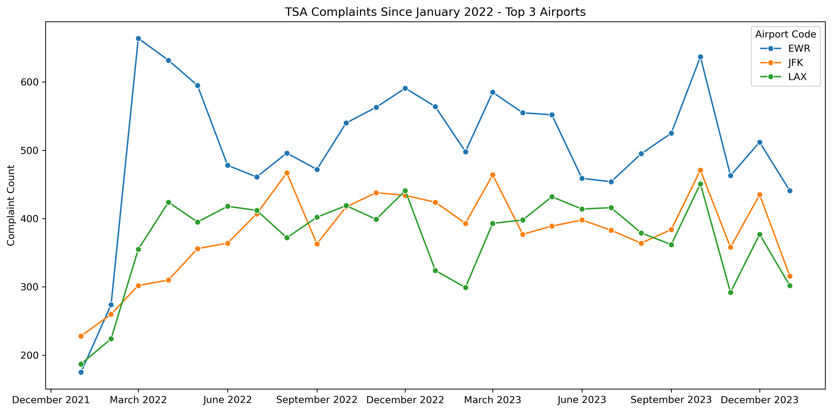
We can see that Newark International airport leads in complaints since 2022 You may also notice that complaints seem to be trending consistently since September 2023 across top 3 airports receiving most complaints which may indicate similar techniques being used across airports for that period

Slide 6
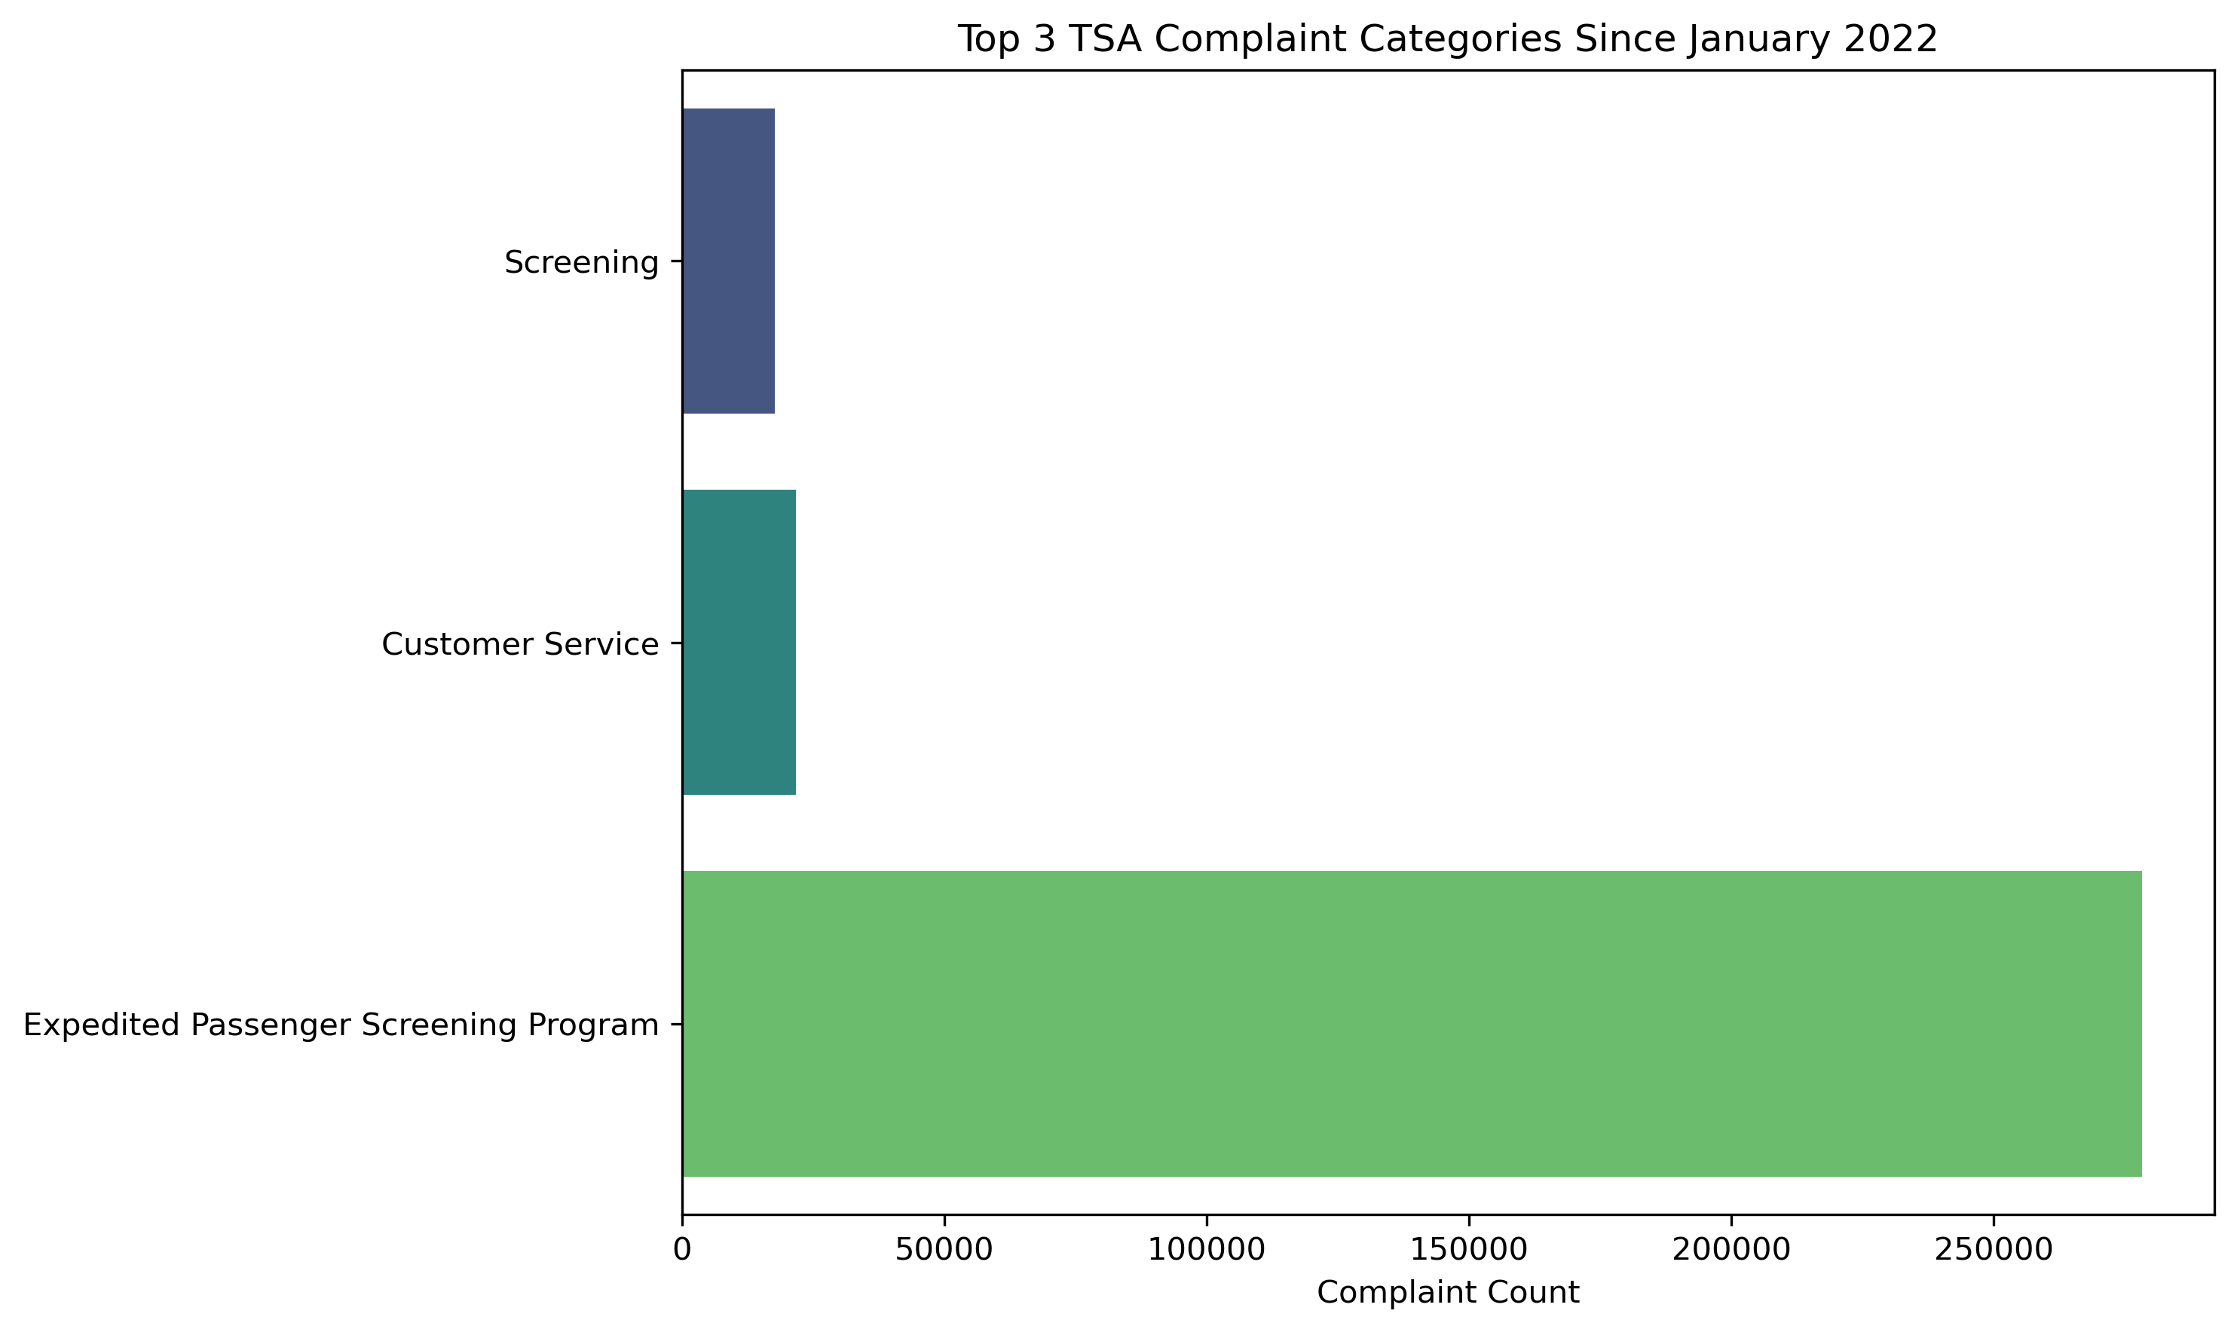
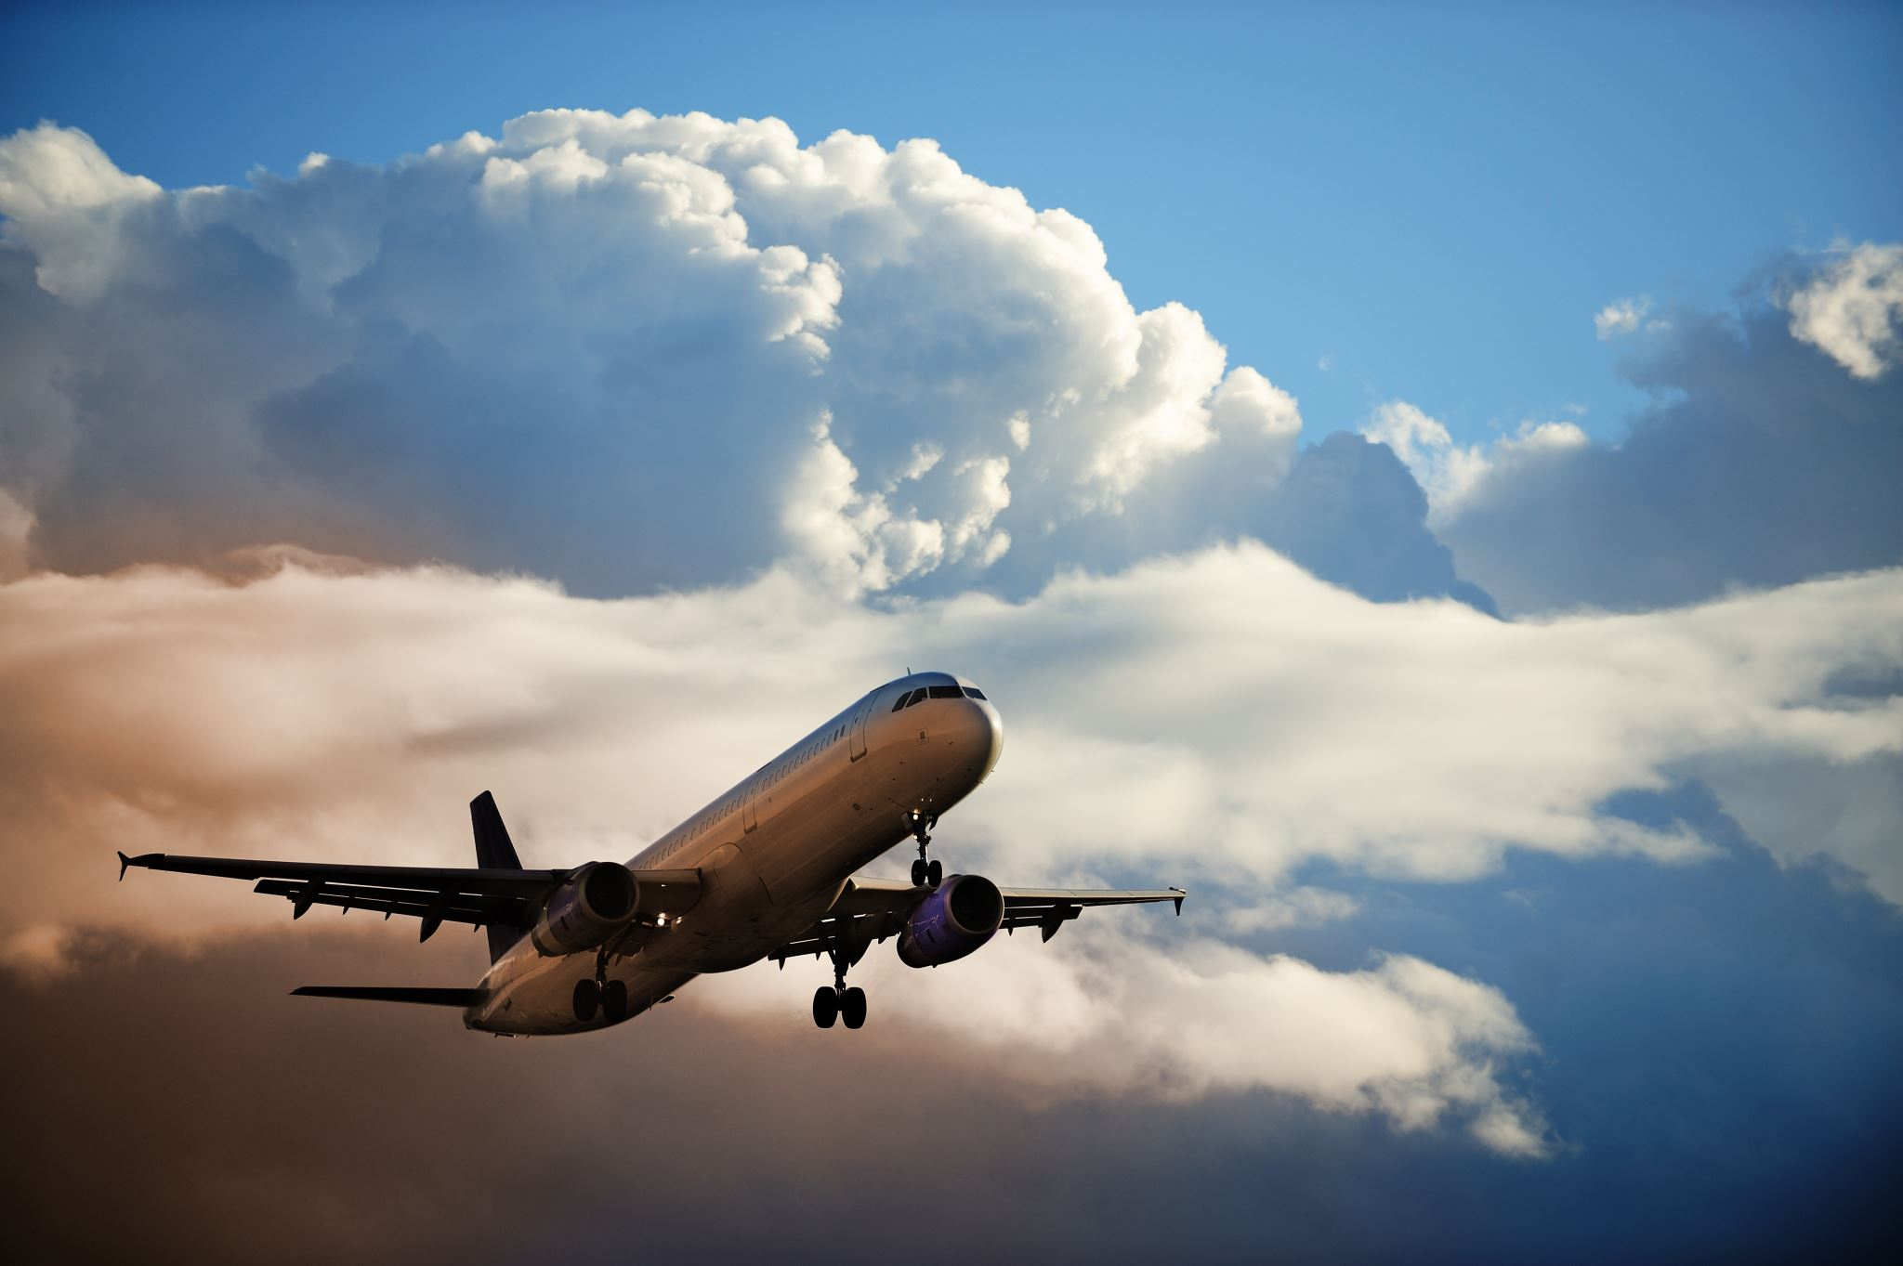
Complaints are exponentially larger in the Expedited Passenger Screening Program Customer Service and Screening are the next top categories where complaints are received

Slide 7
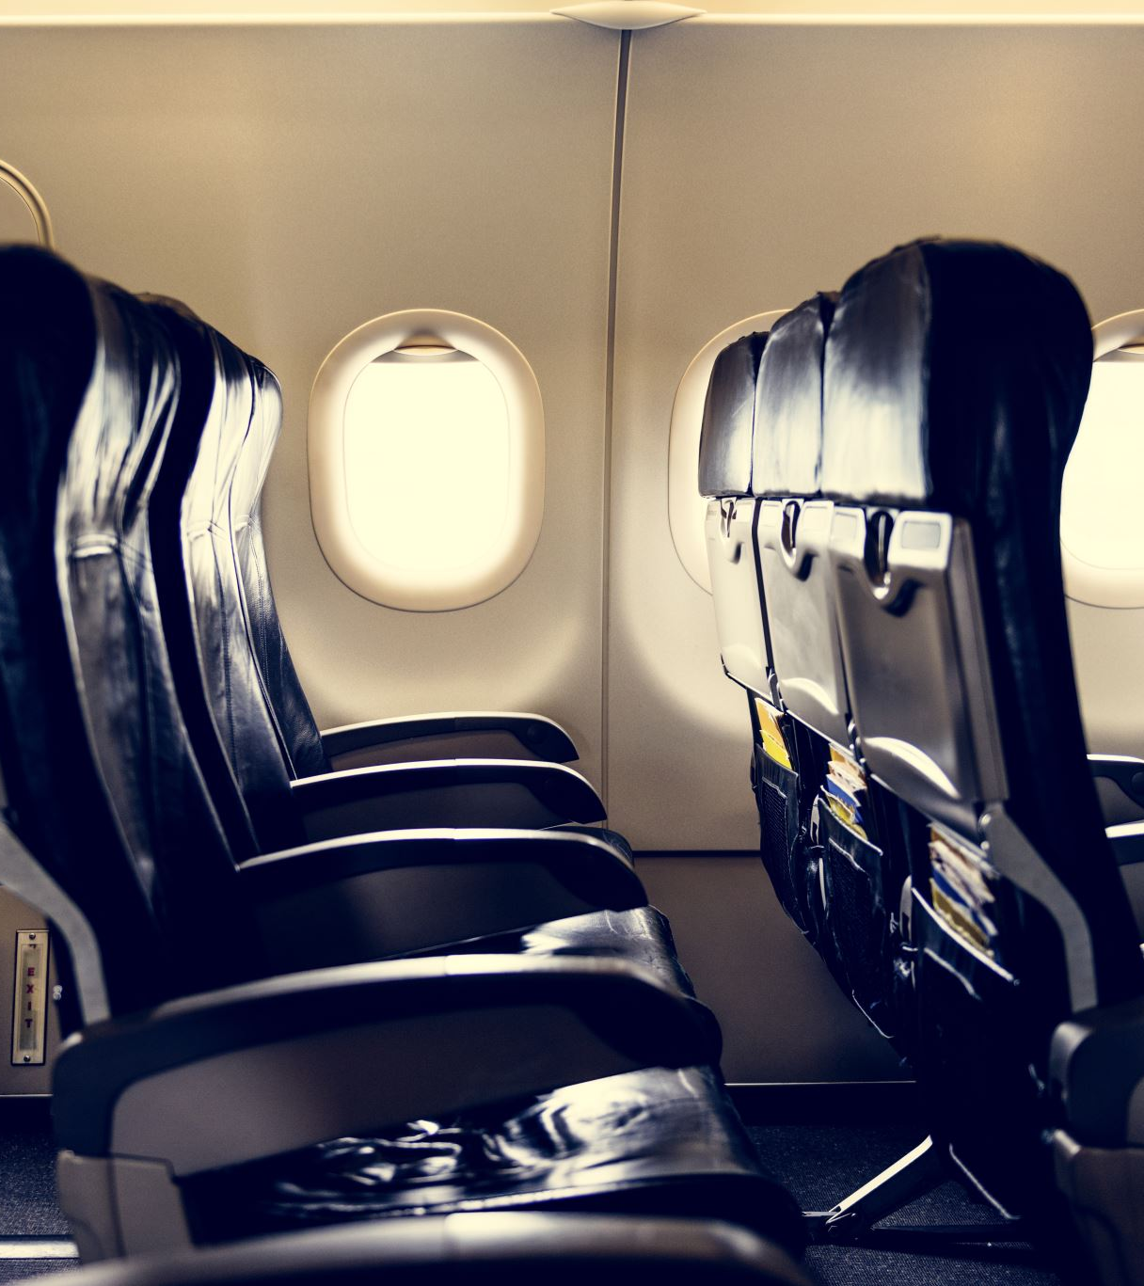
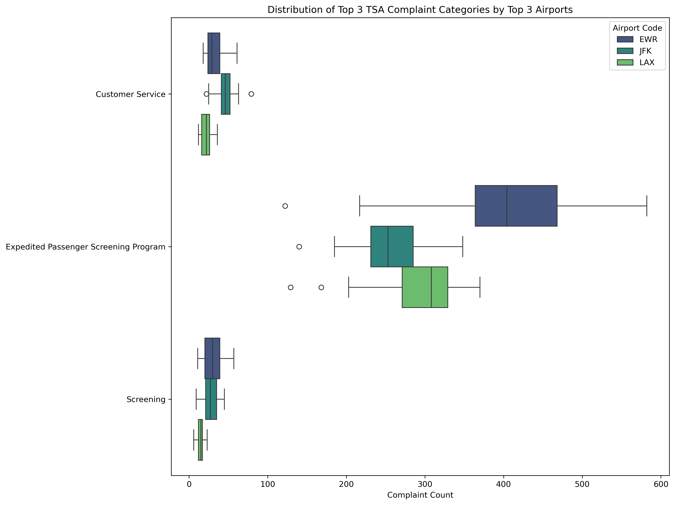
We can see that the Expedited Passenger Screening is top on the list of complaints with the Newark International (EWR) airport being the one in most need of improvement

Slide 8

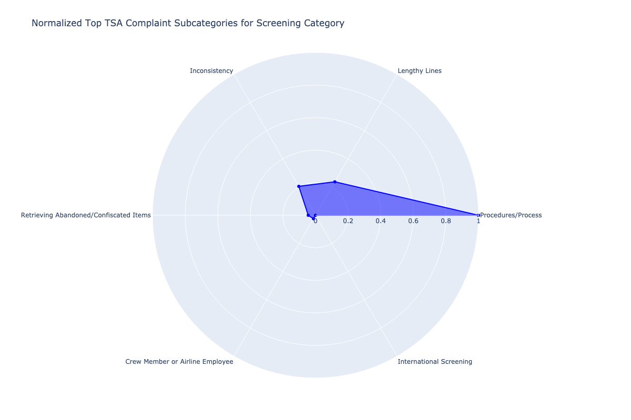
Procedures/Process received 5 times the complaints in the Screening category followed by lengthy lines and inconsistency

Slide 9

We need you to devote resources to Newark International airport’s Expedited Screening Process as well as the Process/Procedures in the Screening area of the airport.
After we see improvement at this airport, we encourage you to expand the same type of trainings and procedures to JFK and LAX airports for phase 2 of this project and then the rest of the airports as needed.

