Slide 1
Risky Vehicles
Chicago Area
Notes:
Laws should be able to keep up with society’s everchanging inventions. However, the legislative process is often long and drawn out. This presentation is asking for a call to action in the form of a proactive approach to reviewing safety standards for certain vehicles. While waiting on vehicle safety laws to catch up to current risks, I have reviewed data currently available in Chicago’s Data Portal. This data is reported by the Chicago Police Department and contains data from September 2017 to present. For purposes of this presentation, I used datasets containing only data from this past year.

Slide 2
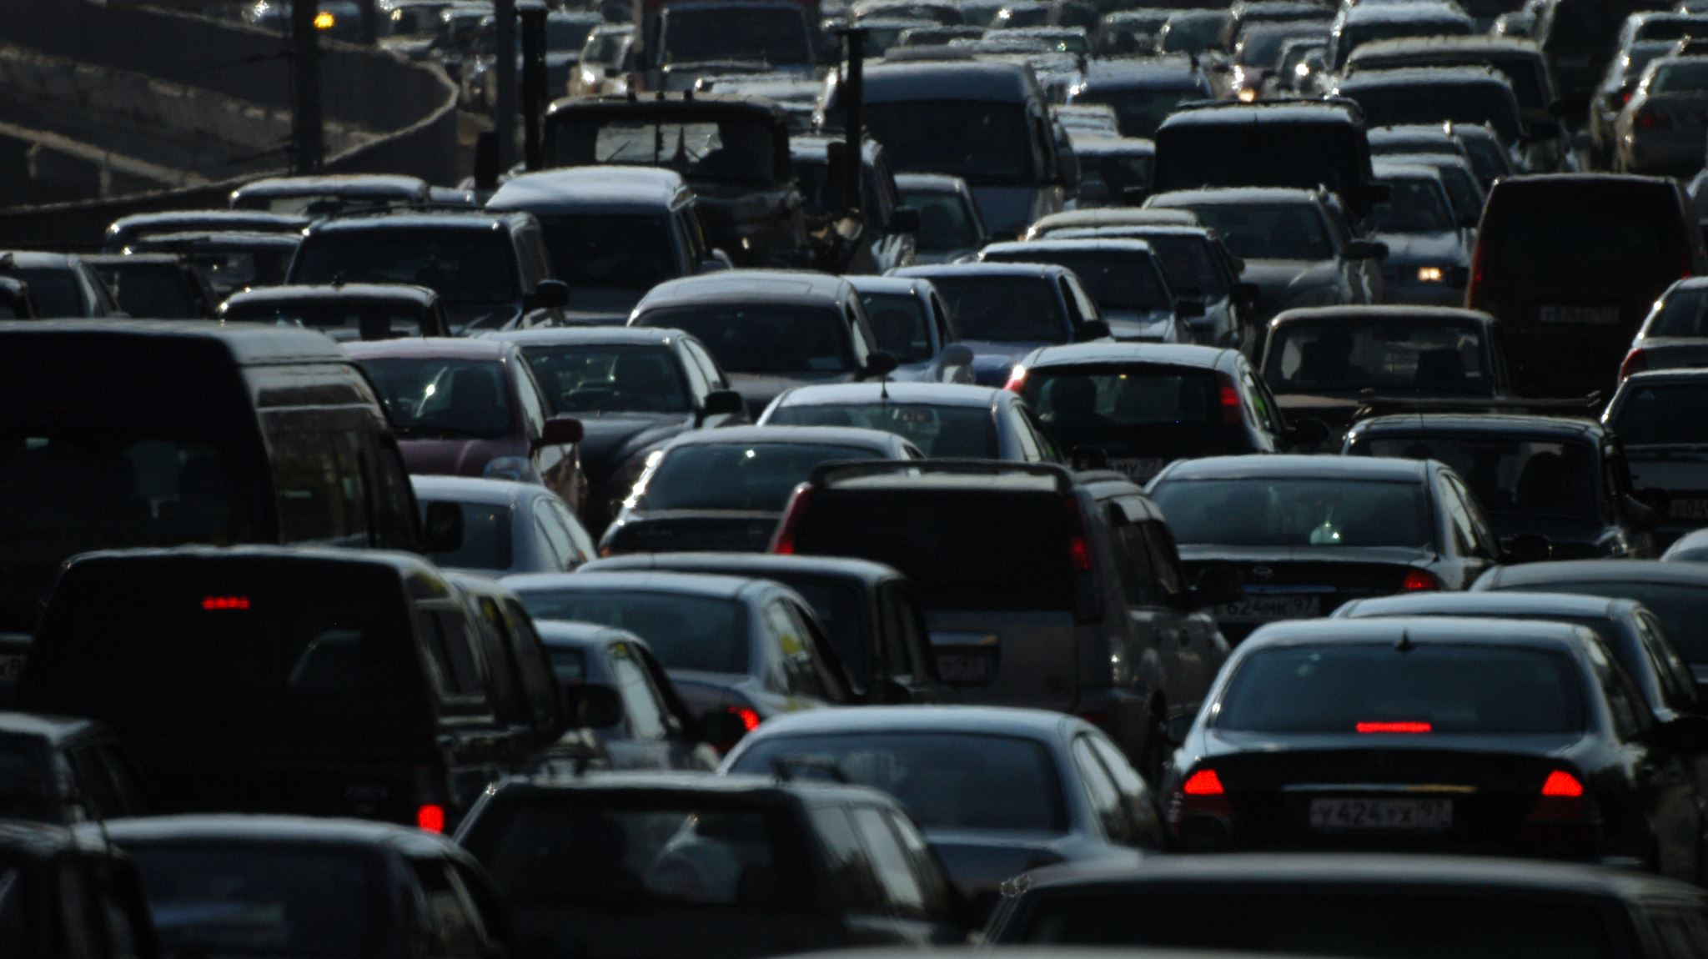
Project Overview
Merged Datasets
Cleaned data
Removed records with missing values
Transformed data
Data format consistency
Z-Scores for age bin and sex
Oversampled from minority class (injury present)
Scaled Data
Gradient Boost Classification Model
Hypertuned with best parameters
Post model processing rules and reassignments
Results
Notes:
The datasets would allow me to evaluate the risk of a vehicle based on the probability of injury when involved in an accident. To start on this data science journey into risky vehicles, I cleaned the data by only using records where all necessary variables were available (such as make, model, vehicle defect, maneuver, age, sex, and whether an injury was present). I grouped the records into age groups and created z-scores for those age groups and sex to help standardize the data to be able to use it for statistical modeling. A z-score is just a fancy way of saying how far away from the mean a record happens to be and in this case will help to compare vehicle risk across these groups.

Slide 3
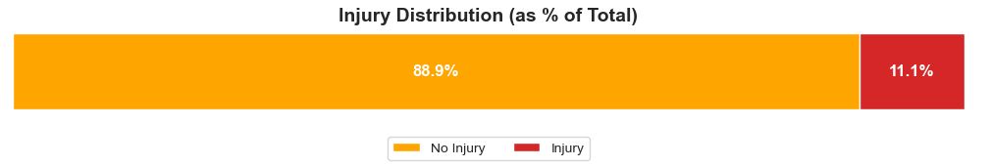
Notes:
I reviewed the records to see how many records indicated an injury compared to those that did not. We can see by the chart that we have approximately 90% of records without an injury reported. When creating data models, they work more effectively when there is a balance in data that needs to be predicted. There is a huge class imbalance in the injury data so I needed to mitigate the impacts of the imbalance through methods such as oversampling from the reported injury population so the model could be trained properly to predict a potential risk of injury. Although, the oversampling from the injury class of records did help, there were still many records that were predicted to be an injury when they were not.

Slide 4
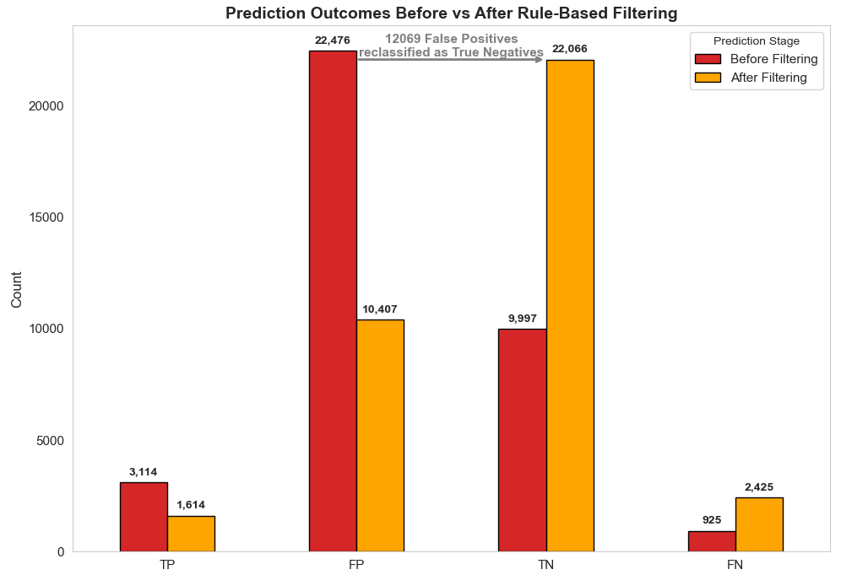
Notes:
The Extreme Gradient Boosting classifier, which is an ensemble of decision trees, was used to predict whether an accident would result in an injury. I used the RandomizedSearchCV technique to find the best hyperparameters to use for the classification model. The red colored bars on the chart show the predictions from the XGBoost classifier. As mentioned before, there were a large number of records that were incorrectly predicted as an injury risk when they were not (False Positives). I used rules to filter out records that should not have been classified as injury because the vehicles were either not moving or had no damage. The orange colored bars show how those records are now assigned as non-injury records (True Negatives) after applying the rules after the model was executed.

Slide 5
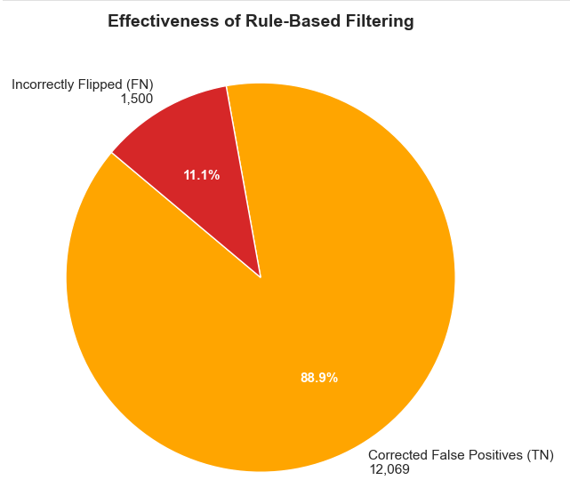
Notes:
The post processing rules applied after the model classifier has ran is not flawless and without cost. This chart shows the effectiveness of the applied rules. We can see that close to 90% of our changes were beneficial since they did place the records in the correct classification group, but we did incorrectly move approximately 11% of the injury reported records to show as non-injury.

Slide 6
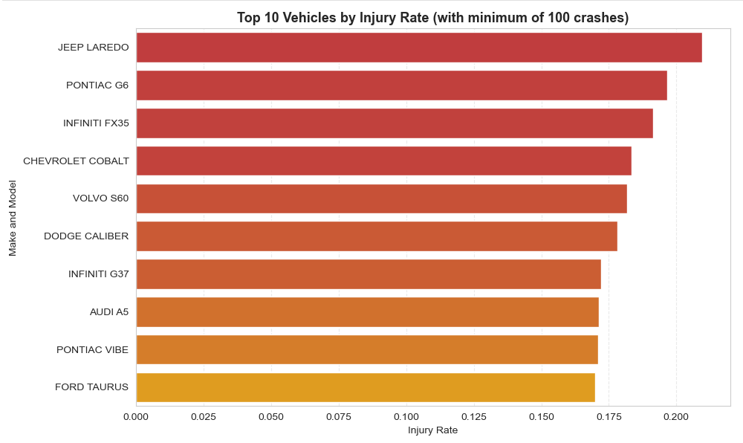
Notes:
This chart shows the top 10 riskiest vehicles based on the calculated injury rate based on this project’s analysis. The Jeep Laredo and Pontiac G6 are showing to be the riskiest vehicles in the Chicago area in the past year.

Slide 7
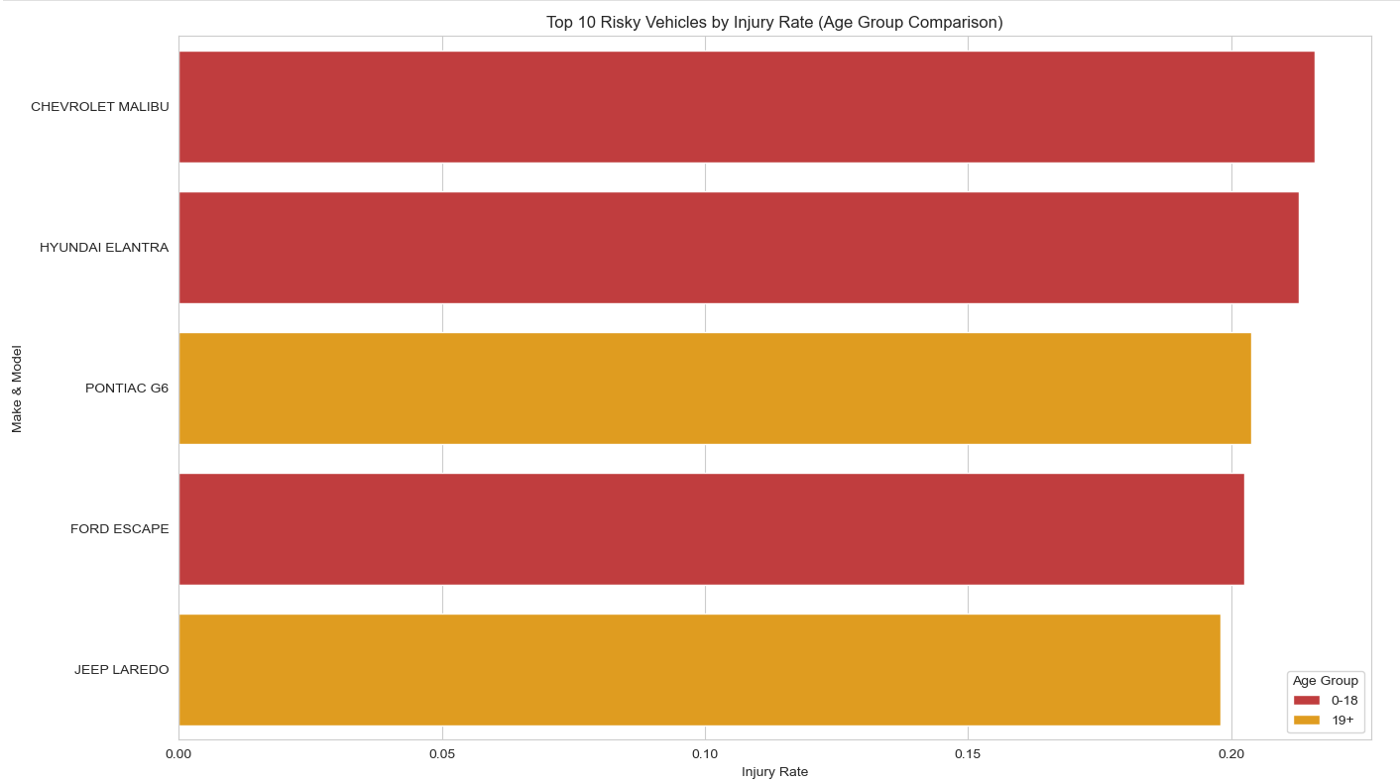
Notes:
When comparing the riskiest vehicles of those in the 0-18 age group with those of other age groups, the Jeep Laredo and Pontiac G6 are still highly ranked as risky, but some other vehicles appear to be riskier when driven by younger and inherently less experienced drivers, such as the Chevrolet Malibu and Hyundai Elantra.
As the committee that is overseeing vehicle safety standards, I am recommending to you that these top 5 vehicles be reviewed for safety violations and complaints. These vehicle reviews may be approached in different ways since the vehicles appearing as riskiest to age group 0-18 may be vehicle related but could also be from underlying contributing factors such as vehicles being operated by a certain age group due to affordability or being driven by someone more likely to take risks or make mistakes due to lack of driving experience.

Slide 8
Anticipated Outcomes
Quarterly Review
Expanded area of analysis
Proactive recalls
Revised safety standards on new vehicles
Direct emergency services to those in need
Reduction of injury and suffering from vehicular collisions
Notes:
I would like to propose that this analysis be completed and presented quarterly. I also propose that we expand the scope of the data being reviewed to other cities/states and possibly nationwide. This will be dependent on the amount of data being reported and accessible.
By proactively reviewing vehicles for possible defects that may be causing risk of injury, car manufacturers can initiate recalls and fix the concerns before they become another negative record of injury. Eliminating vehicle collisions reduce not only costs needed for city emergency services but also the emotional and financial stressors on the people involved. The reduction of accidents and better vehicle safety allows for the smooth flow of traffic without incident and the waves of negativity and inconveniences caused by collisions to be small.

Slide 9
Appendix
Anticipated Questions / Answers
Do more common makes and models of vehicles appear more often as higher risk? No, because risk is determined by the predicted injury rate of each make and model not the frequency of the crashes
Could the crashes be caused by something other than the vehicle make and model? Yes, we are not assuming the vehicles are causing the crashes, just that there may be more safety standards that could decrease the risk of injury while in the vehicles.
Since data is input by police staff and is prone to error, how did you mitigate for that? I used fuzzy matching on the make and model of cars to account for differences in text input such as Toyota and toyta. I used a threshold of 75% to determine matches.
Could certain demographics be more likely to drive riskier vehicles? Yes, to reduce the impact on our analysis, I used z-score of age bins and sex to normalize the demographic data, but this does not eliminate all influence, it just mitigates it.
Does this data justify a recall? Not necessarily, we want to bring it to the attention so that safety considerations can be made when dealing with the manufacturing of the vehicle or safety tests performed on vehicles. It does not mean the vehicle is defective or causing crashes.

Slide 10
Appendix continued
Anticipated Questions / Answers Continued
Can this be combined with other data? Yes, future uses may involve incorporating driver health, weather conditions, vehicle condition, and other factors into determining risk of vehicles.
Can this be used on a larger level, such as nationwide rather than just based on Chicago city data? It can be expanded if that data is being tracked elsewhere, and we have the similar features and targets and measured the same to perform the analysis.
How did you validate that the rule-cased filters did not hurt model performance? Filters confirmed that the injury predictions were mostly incorrect when vehicles were marked as parked or no injury. (See Fig 2)
Can you tell which feature was driving model predictions? We could investigate to pull out the feature importance scores from the XGBoost classifier to see which feature (make, model, z-score) contributed most to the predictions.
How can this project help inform vehicle safety requirements? It can represent a need to proactively study collisions to mitigate injuries and increase safety standards, while bringing attention to the riskiest vehicles and aiding in their prioritization for review.

Slide 11
Appendix continued
Risky Vehicles Code in Github Repository

