Slide 1
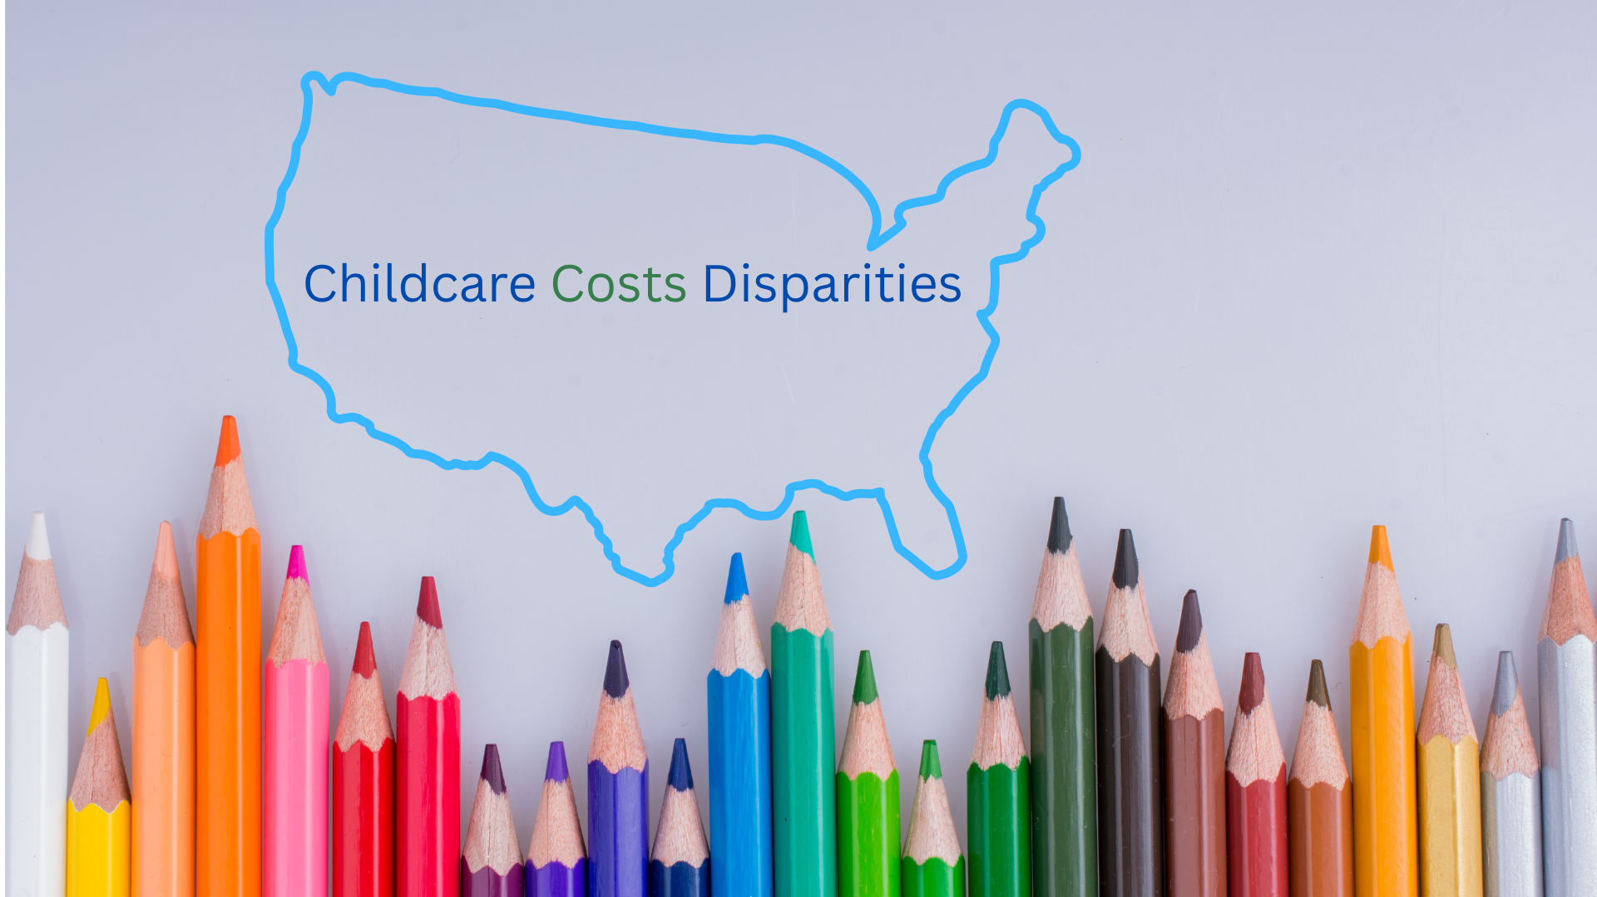
Created By: Billie Adkins

Slide 2
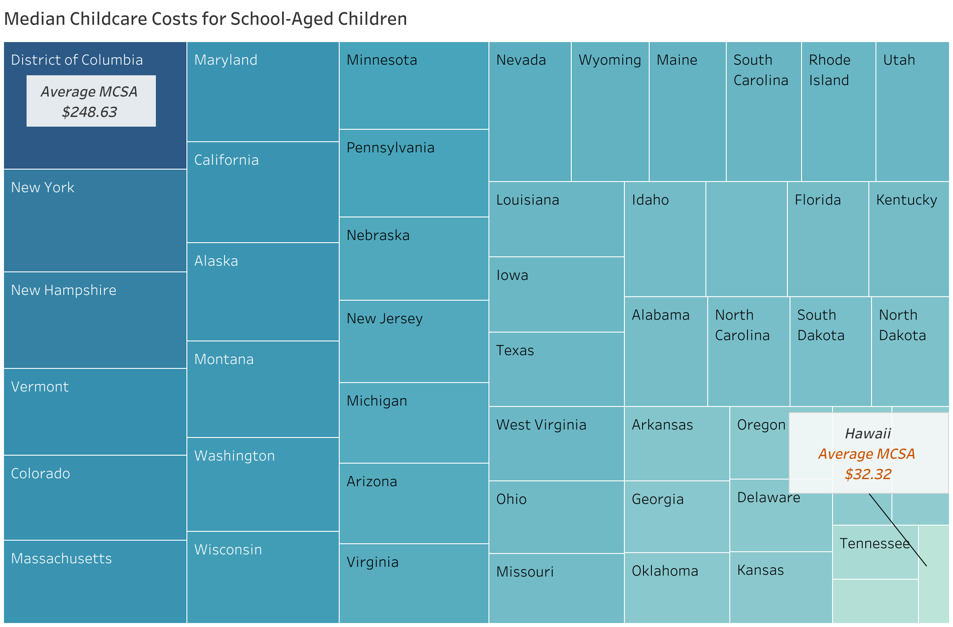
Washington, D.C has the highest in childcare costs and Hawaii has the lowest

Slide 3


Slide 4
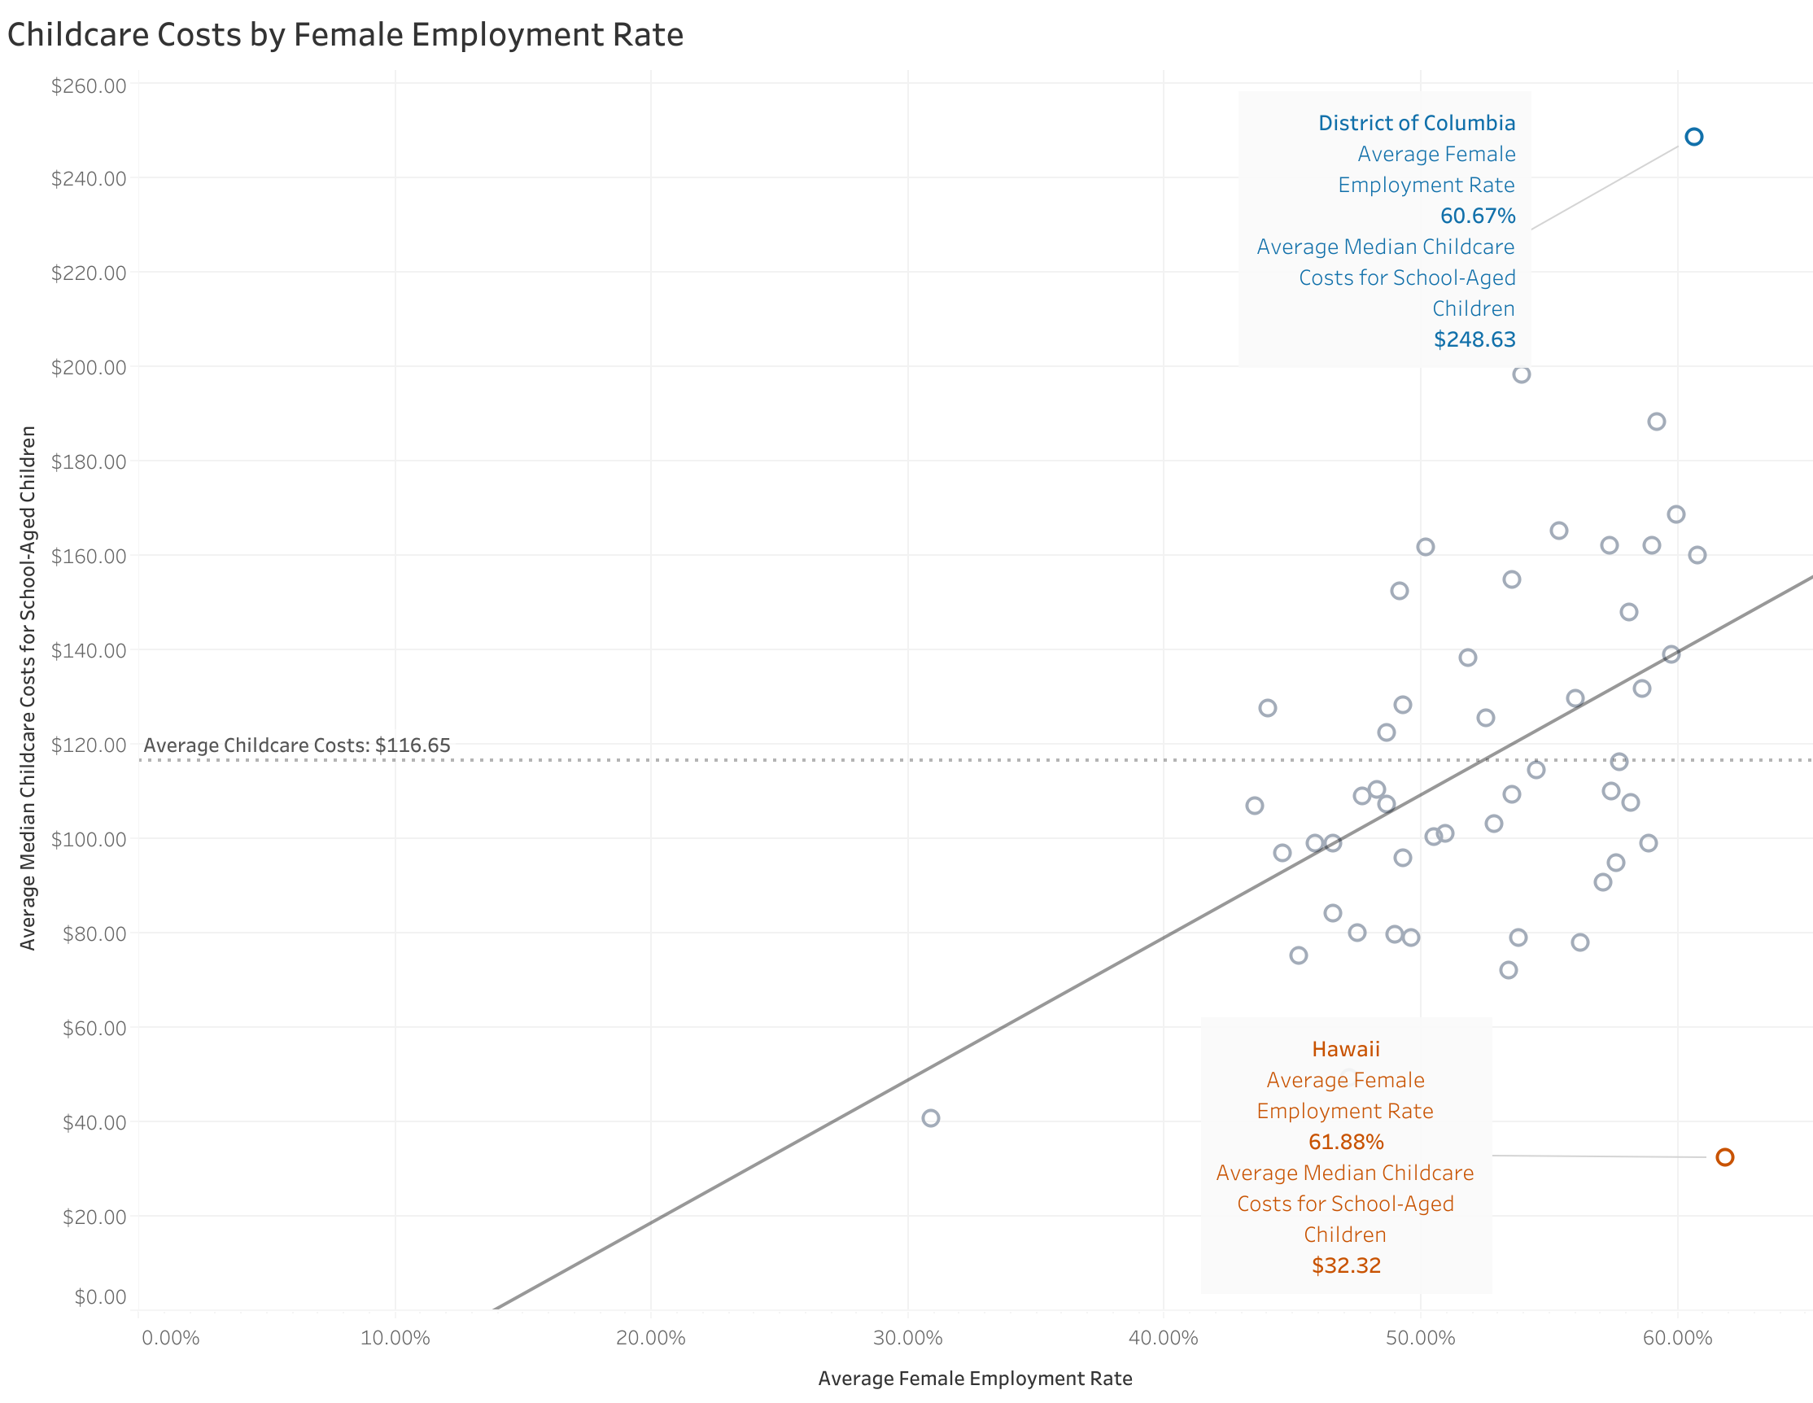
As average Female Employment Rate increases, so does childcare costs.
This could indicate underlying systemic issues that can make opportunities for females to be employed less lucrative.

Slide 5
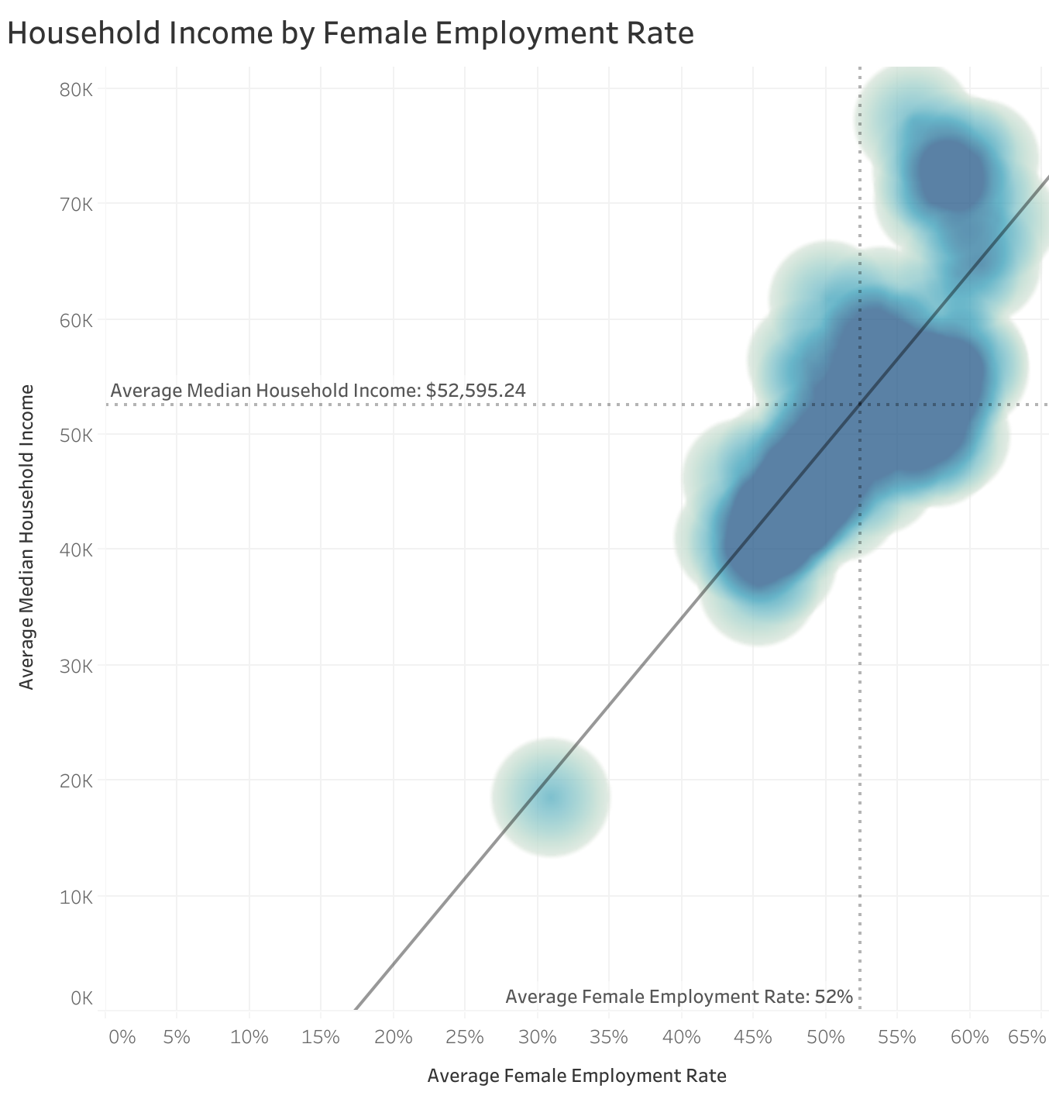
This shows that as average female employment rates increase so does median household income
The outlier of Hawaii has the lowest childcare costs and highest female employment. In comparison, we are proposing the need to subsidize childcare costs in places such as Washington, D.C.
We believe this will help drive up female employment rates and ultimately strengthen the economy through shared societal growth and reduce poverty by lifting everyone to an equitable plane.

Slide 7
References https://create.piktochart.com Created infographics on April 13, 2025
https://www.canva.com Created infographic on May 23, 2025

