Slide 1

SIGNATURE VERIFICATION
A WEB APPLICATION TO AUTHENTICATE SIGNATURES OF CUSTOMERS
Team Members
Daksh Pokar, Saurabh Bora, Atharva Dharmadhikari, Aniket Gokhale, Manas Shende

Slide 2
HARDWARE AND SOFTWARE REQUIREMENTS
NVIDIA GeForce GTX 1070 GPU for model training
Windows 10 Home
Spyder
PyCharm
16 GB Ram & 1 TB HDD + 128 GB SSD
Intel Core i7 6700HQ Processor

Slide 3





ALGORITHMS AND APIs USED
Algorithms :-
Convolutional Neural Networks (CNNs)
Backpropagation
Siamese Neural Network for one-shot learning
APIs & Libraries:-
Keras - Neural Network API
TensorFlow – Machine learning framework
Django - Python web framework
OpenCV - image processing in Django
Python (3.0+)
Bootstrap

Slide 4
PROBLEM STATEMENT
Design a system to accept a genuine signature of the customer and store it in the database against the customer ID at the time of registration of the customer. This signature can be used to compare with the input signature received to check whether the input signature is real or forged by returning a Confidence Match Score.

Slide 5
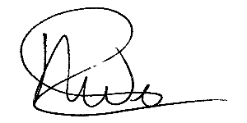
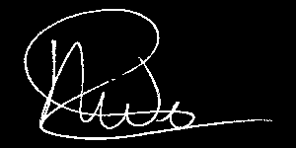
How we did it?
1. Preprocessing
A image of signature might be written on different coloured papers or it might be written with different pen. For that we preprocessed the signature image by making it grayscale and then using Image Thresholding technique we obtained the following signature.

Slide 6
How we did it?
2. Model Creation
In signature verification we need to compare the image with real image from the database and return the confidence rating. For that we used Siamese Convolutional Network. This consist of 2 identical networks with exact same weights.
To this network we pass an image of preprocessed signatures of size 300x150. This network is a 24 layers deep convolutional neural network which outputs a 128 dimensional vector.

Slide 7
3. Working
System - Django based web app.
Registration - The user has to register a form with a unique ID, Customer Name and upload real images of signature with minimum and maximum limit as (1,5) respectively - bulk uploading.
Vector Generation - Model processes both the inputs and generates corresponding vectors.
Verification - Initially the user is asked to enter the number of signatures that he wants to verify - bulk verification. Then the user needs to enter his unique ID and upload the image for classifying it as real or forged.

Slide 8
3. Working
Calculation of distances - Distance is calculated between the real image vectors and the vector of the image uploaded for verification.
Loss Function - Binary cross - entropy loss to minimize the loss and predict the final answer.
Threshold Value - This value is determined as a decision point to classify whether the uploaded image is real or forged.
Result - The results of the system are listed on a new page called prediction.

Slide 9
ARCHITECTURE DIAGRAM
Name
Register
Customer ID
Upload to Database
Real Signature
Bank Customer
Real
Forged
ID
Database
Real Signature
D > threshold
D < threshold
Real Vector
Compare Distance(D) with threshold
Verify
Input Signature
Model
Distance
Input Vector

Slide 10
ARCHITECTURE DIAGRAM – MODEL A (Inference Model)
MODEL A
Convolutional Layer
16 - (3,3)
Batch
Normalization
Max. Pooling
(2,2)
Batch
Normalization
Convolutional Layer
64 - (3,3)
Max. Pooling
(2,2)
Batch
Normalization
Convolutional Layer
32 - (3,3)
Max. Pooling
(2,2)
Convolutional Layer
128 - (3,3)
Batch
Normalization
Max. Pooling
(2,2)
A

Slide 11
ARCHITECTURE DIAGRAM – MODEL A (Inference Model)
A
Convolutional Layer
256 - (3,3)
Batch
Normalization
Max. Pooling
(2,2)
Flattening
Dense - 128

Slide 12
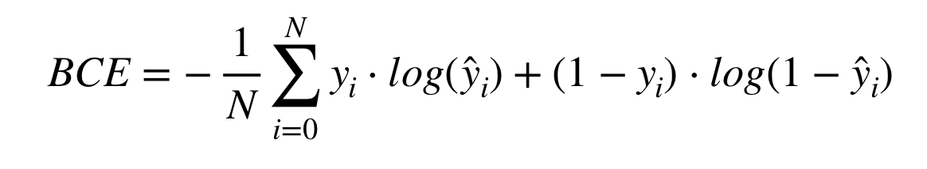
Binary-Cross Entropy Loss

Slide 13
MODEL DESCRIPTION
Convolutional Layer
This layer creates a convolution kernel that is convolved with the layer input to produce a tensor of outputs. If use_bias is True , a bias vector is created and added to the outputs.
Max Pooling Layer
Like the name suggests, it will take out only the maximum from a pool. This is done with the help of filters sliding through the input and at every stride , the maximum parameter is taken out and rest is dropped.
Batch Normalization
We normalize the input layer by adjusting and scaling the activations. Batch Normalization reduces the amount by what the hidden unit values shift around i.e covariance shift
Flattening
It flattens the input i.e. it converts the input matrix into a vector.

Slide 14
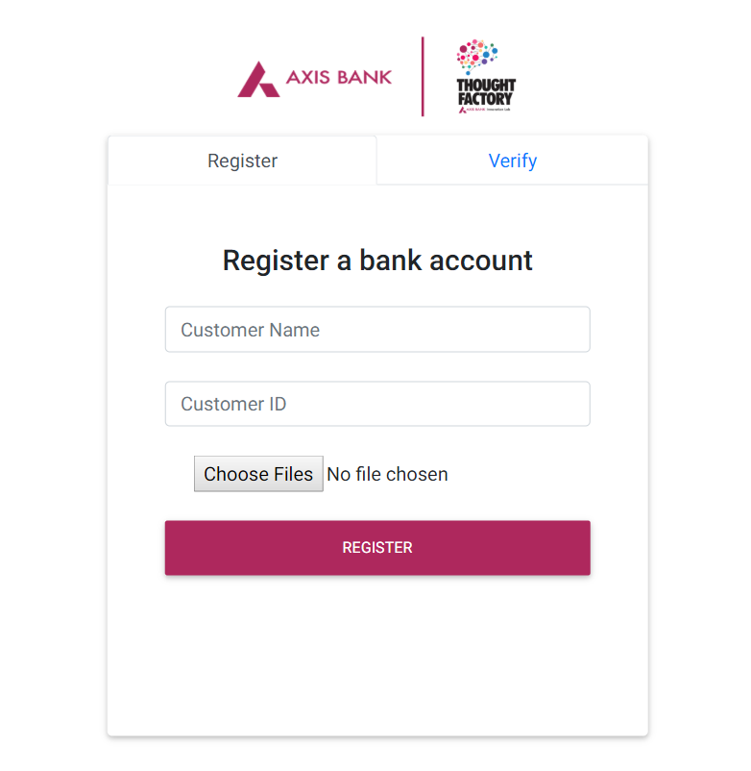
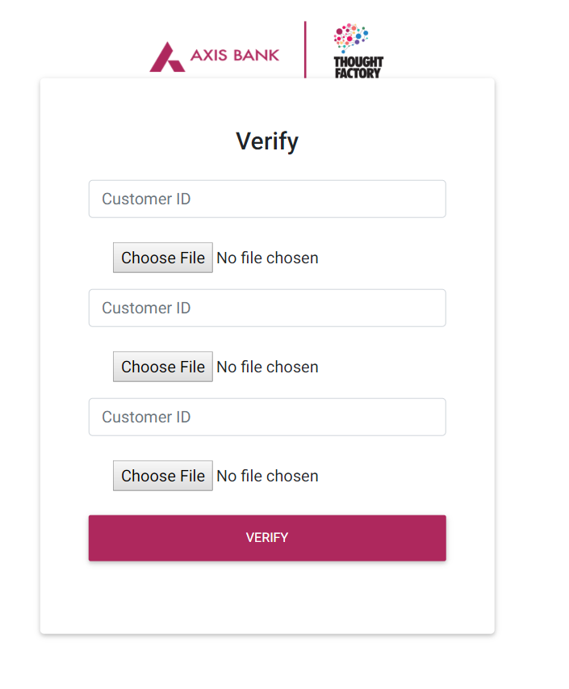
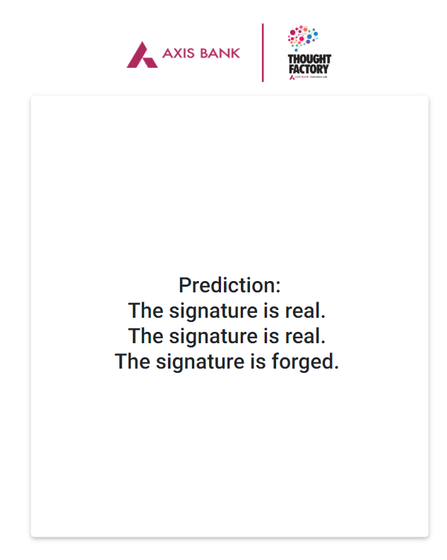
Screenshots

Slide 15
Challenges Foreseen
We had thought of using Bounding Box Algorithm at early stage of the Hackathon but we discarded the above idea after referring to the datasets given to us.
We had also discussed to use foreign language signatures for training and testing purposes but, since the dataset provided was very specific and limited, we decided not to use any other dataset than provided.
For verification of many signatures at a time, it will take a significant amount of time to predict the answer but we cannot help as we do not have the required computational power to minimize the computational time.

Slide 16
FUTURE SCOPE
Capturing signature , account number and other related information from cheque using Optical Character Recognition (OCR) i.e. a Bounding Box Algorithm and creating an embedded system.
We intend to increase accuracy -
By increasing the number of layers used in the customized model.
By training model with images having noise and making the white space around the signature redundant.
By increasing the size of the dataset.
Training and Testing the model on signatures of various languages.

Slide 17
CONCLUSION
Thus , we have developed an efficient and easy to use signature verification web application with bulk uploading and bulk verification facility to detect signature forgeries.

Slide 18
REFERENCES
YouTube - https://www.youtube.com/
Django - https://docs.djangoproject.com/en/2.1/
Keras - https://keras.io/
TensorFlow - https://www.tensorflow.org/api_docs/
SigNet : Convolutional Siamese Network for Writer Independent Offline Signature Verification - https://arxiv.org/abs/1707.02131

